Slide 1
Modified genetic algorithm for training of deep CNN architectures
Milan M. Čugurović, Faculty of Mathematics, UB
Nikola Dimitrijević, Microsoft Development Center Serbia
doc dr Stefan Mišković, Faculty of Mathematics, UB

Slide 2
Focus on
Merge:
Deep Learning
Genetic Algorithms
Handwriting recognition
Todays section: Mathematics and its applications today
Gradient, Partial Derivate, Function composition, etc.
A kind of homage:
Petrović, Pejović, Dajović, Mateljević

Slide 3
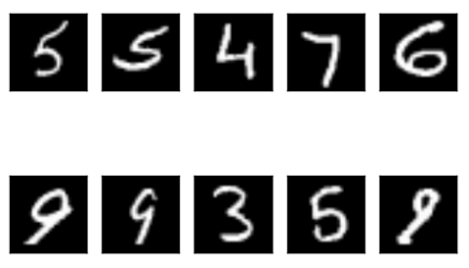

$${\text{MNIST} \text{dataset}}^{\text{[}\text{LeCun} \text{et} \text{al}\text{., 1998]}}$$
The most famous set of handwritten characters (digits)
60k+10k, 28x28x1
Yann et. all, 1997
Example:

Slide 4
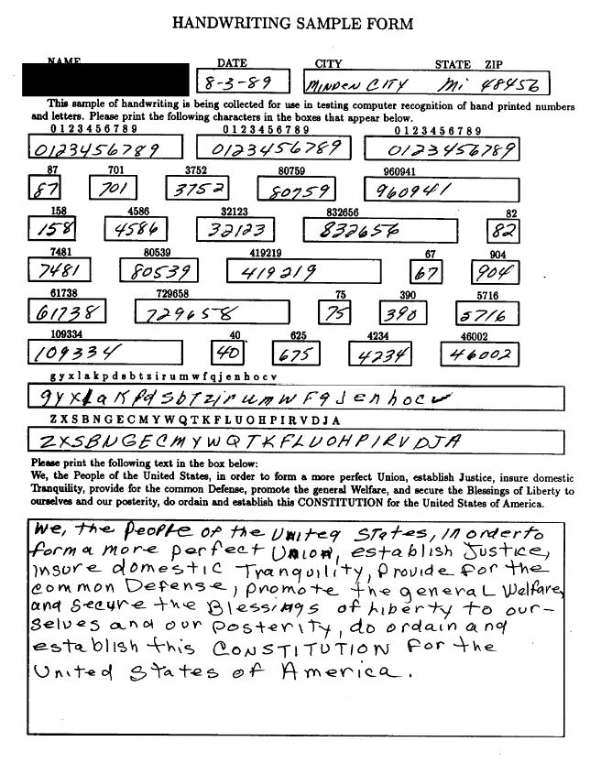


$${NIST Special Database 19}^{\text{[}\text{Grother}\text{, 1995] }}$$
American National Institute of Standards and Technology
>800k images, >3600 writers
128x128x1, 62 labels
${EMNIST}^{\text{[}\text{Cohen} \text{et} \text{al}\text{., 2017] }}$

Slide 5
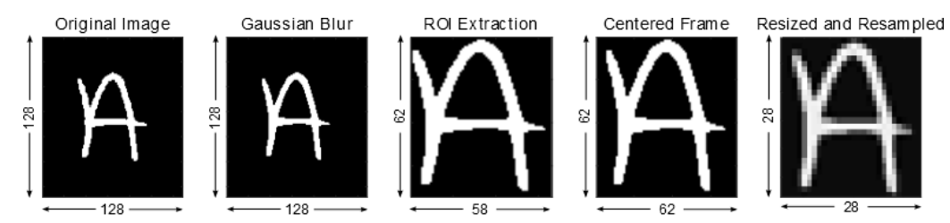


$${Doubled MNIST}^{[Čugurović et al., 2020]}$$
Doubled in relation to MNIST in number of samples and in each sample resolution
120k+20k, 56x56x1
62 labels, ‘0’-’9’, ‘A’-’Z’, ‘a’-’z’
$\text{[}\text{Cohen} \text{et} \text{al}\text{., 2017}$]:

Slide 6

$${Doubled MNIST}^{[Čugurović et al., 2020]}$$
Conversion process inspired by $\text{[}\text{Cohen} \text{et} \text{al}\text{., 2017]}$
128x128 pixel NIST binary images -> 56x56 pixel images with 8-bit grayscale resolution
Each image loaded individually
Fitting bounding box to character
Extracting character (2 pixel padding)
Apply Gaussian filter with standard deviation set to 2
Centering into a square frame (preserving aspect ratio)
Resizing image using bi-cubic interpolation
Scaling pixels to 8-bit range

Slide 7
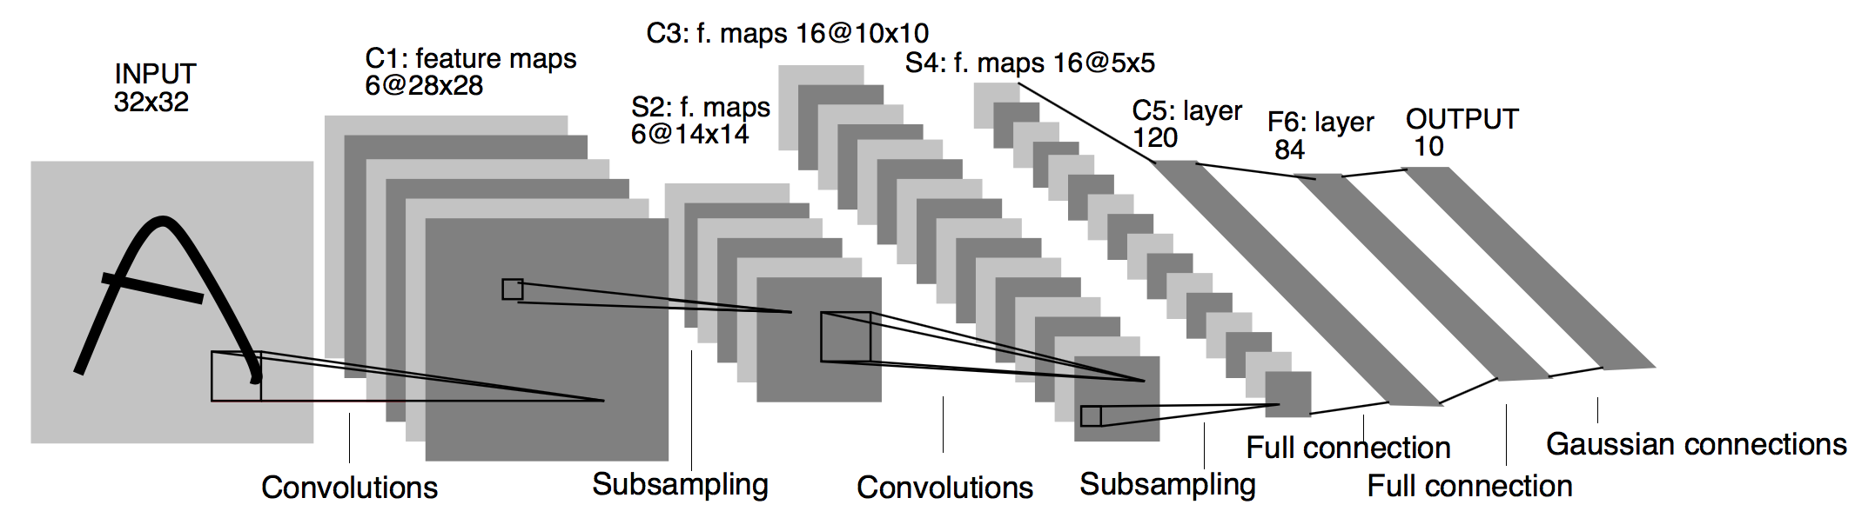

Genetic algorithm
Inspired by paper Genetic CNN [Xie et al., 2017]
How to design the best deep CNN architecture?
Le-Net-5 $\text{[}\text{LeCun} \text{et} \text{al}\text{., 1998}$]

Slide 8
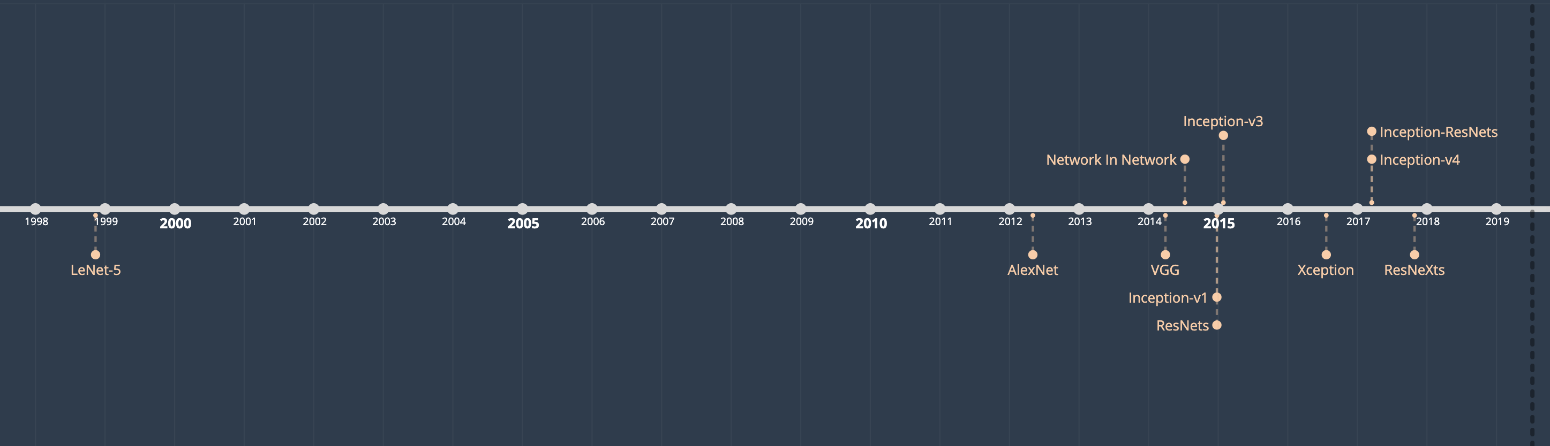
Genetic algorithm

Slide 9
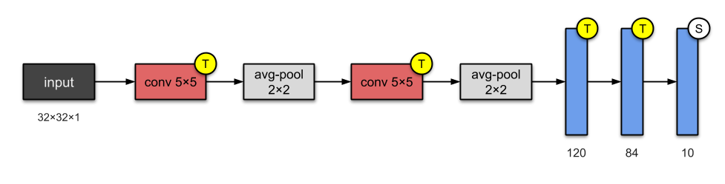
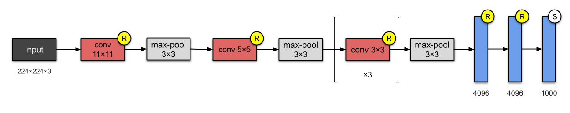
Architectures
Lenet5 (1998, 60k params)
AlexNet (2012, 60M params)
VGG 16/19 (2014, 138M params)
Notes:
AlexNet - Relu

Slide 10
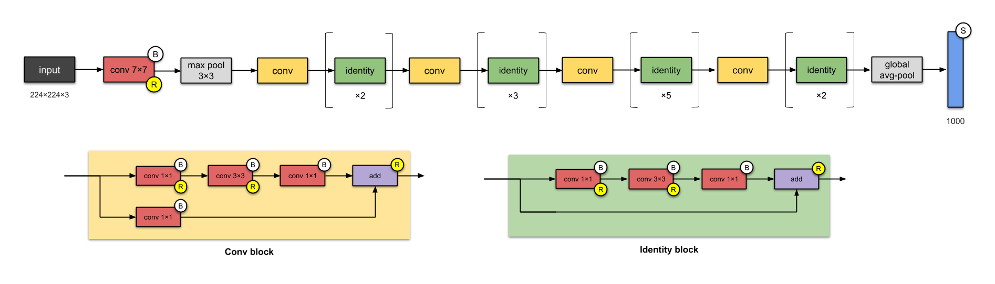
Architectures
ResNet (2015)
Skip connections
Very Deep CNN, up to 152 layers
Notes:
From the past few CNNs, we have seen nothing but an increasing number of layers in the design, and achieving better performance. But “with the network depth increasing, accuracy gets saturated (which might be unsurprising) and then degrades rapidly.” The folks from Microsoft Research addressed this problem with ResNet — using skip connections (a.k.a. shortcut connections, residuals), while building deeper models.

Slide 11
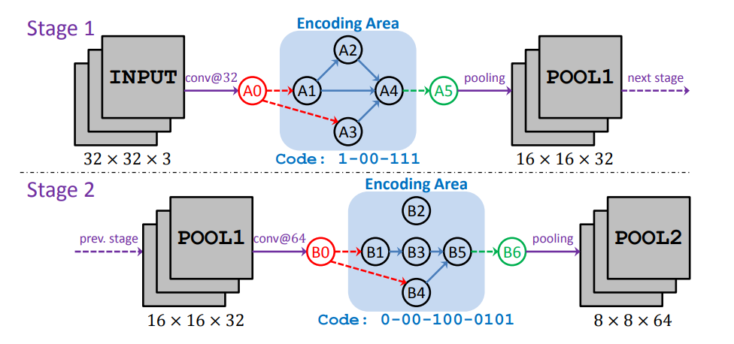

$${Learn architecture}^{\text{[}\text{Xie} \text{et} \text{al}\text{., 2017] }}$$

Slide 12
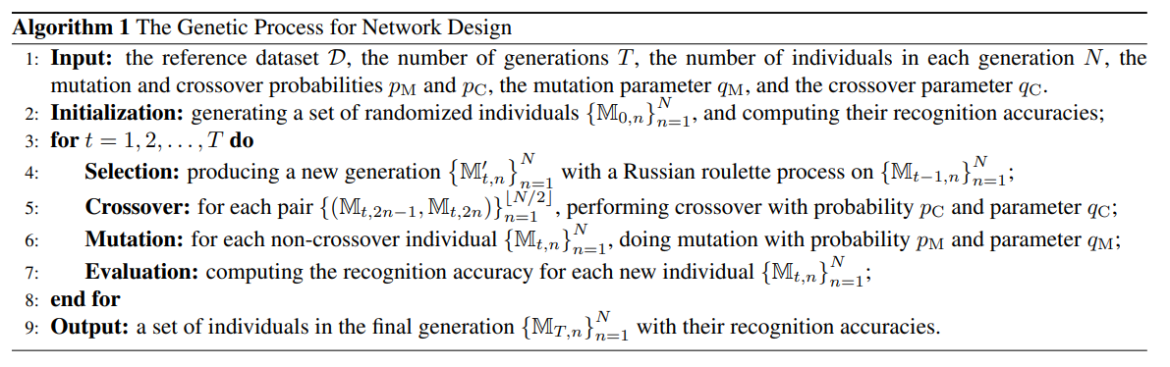
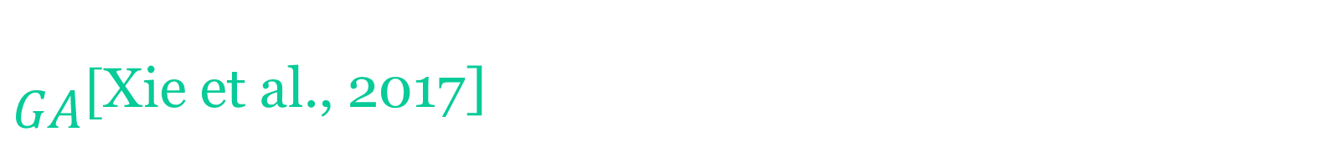
$${GA}^{\text{[}\text{Xie} \text{et} \text{al}\text{., 2017]}}$$
time-consuming?
Notes:
Crossover
Mutation

Slide 13
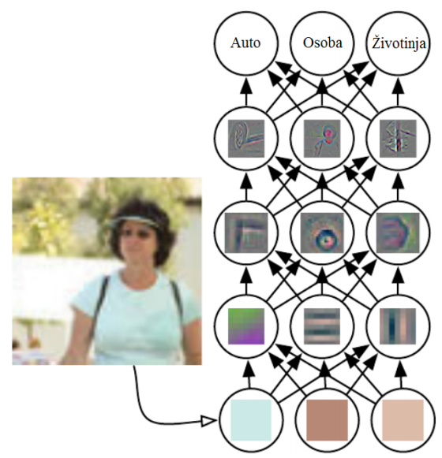
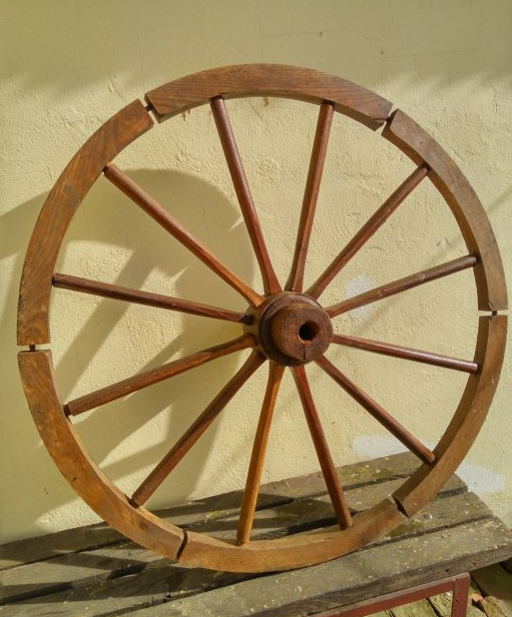
Our Contribution
Reuse of learned weights (block level)
Interpretability of CNN
Fast adaptation to new attributes
First 1, 2, 3?

Slide 14
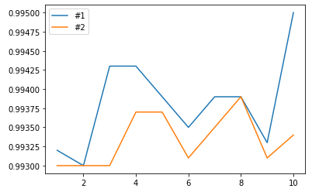
Our Results
Example 10x10x10
Top2:
In only 10 epochs, from 99.32 to 99.52 + Same as Biologicaly

Slide 15
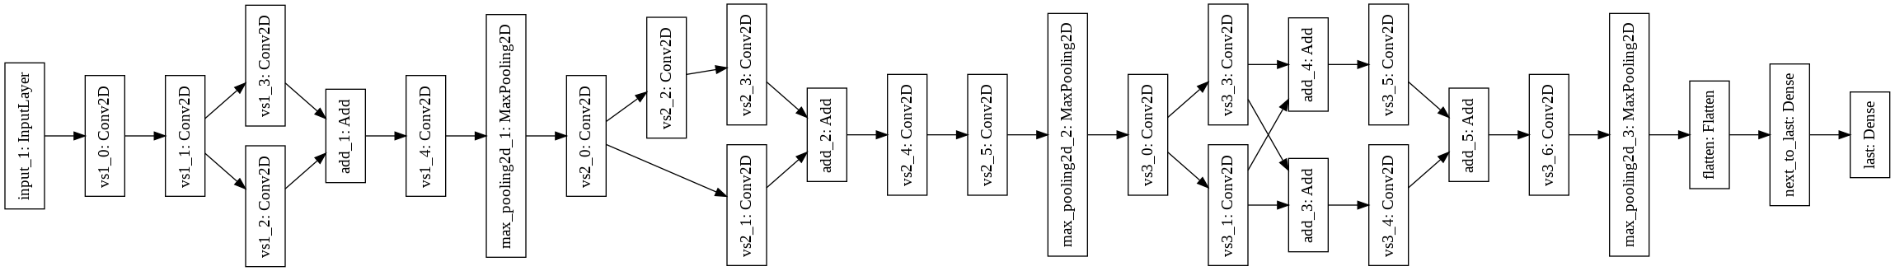
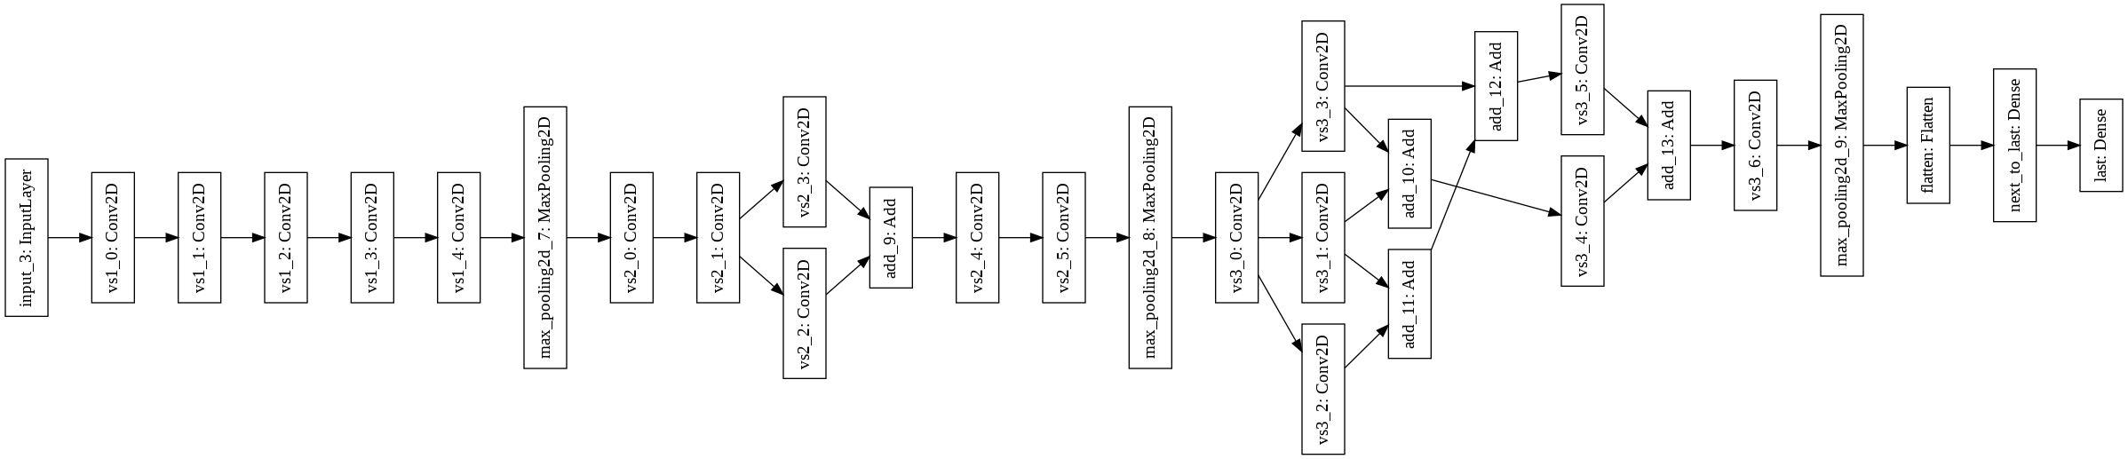
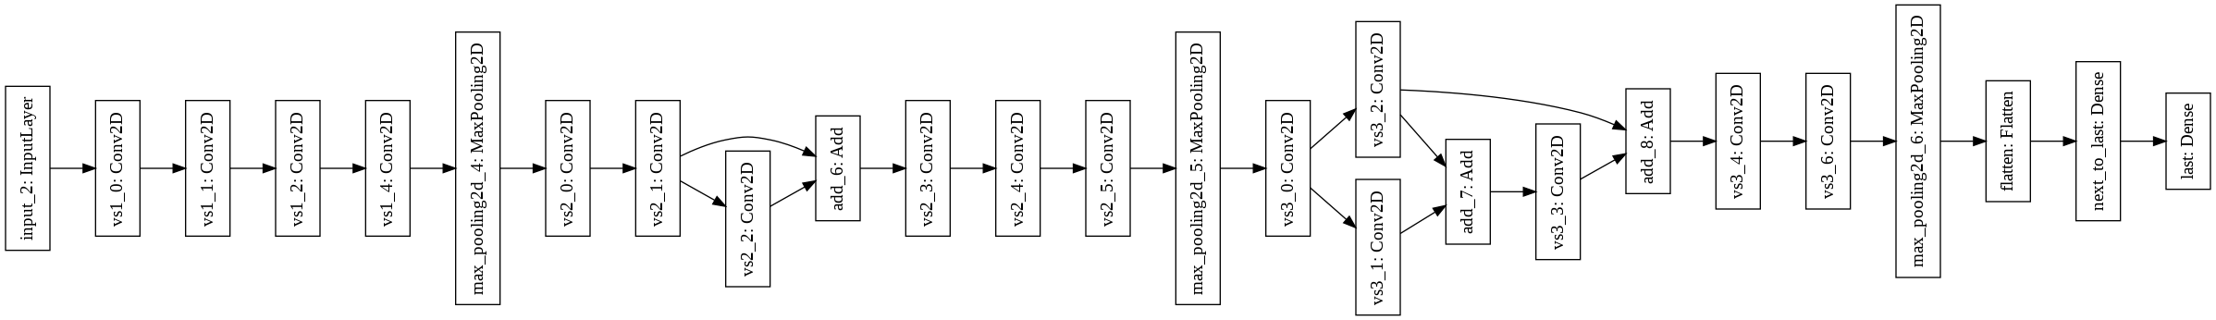

Slide 16
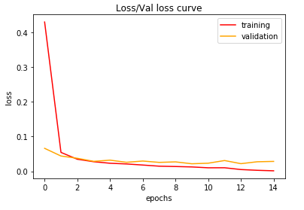
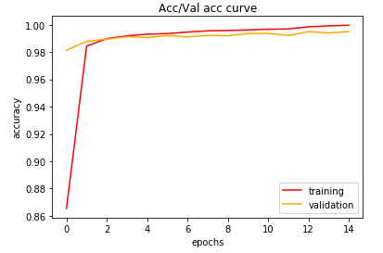
Time results
MNIST:
4x4 basic: 32min 44s, 4x4 modification: 18min 1s
20x2 basic: 1h 22min 22s, 20x2 modification: 46min 55s
2x20 basic: 25min 25s, 2x20 modification: 18min 18s
20x20 basic: 2h 33min 54s, 20x20 modification: 1h 6min 25s [restricted /6]
Doubled MNIST:
29min 31s
Early stopping
14 epochs:
99.97/99.51/99.495

Slide 17
Thank you
{milan_cugurovic, stefan}@matf.bg.ac.rs
nikoladim@gmail.com

Slide 18
References
[LeCun et al., 1998]
Y. LeCun, L. Bottou, Y. Bengio, and P. Haffner. "Gradient-based learning applied to document recognition." Proceedings of the IEEE, 86(11):2278-2324, November 1998
[Grother, 1995]
Grother, P. J. “NIST special database 19.”, Handprinted forms and characters database, National Institute of Standards and Technology, 1995
[Cohen et al., 2017]
Cohen, G., Afshar, S., Tapson, J., & van Schaik, A. (2017). “EMNIST: an extension of MNIST to handwritten letters.” arXiv preprint arXiv:1702.05373.
[Čugurović et al., 2020]
Milan Čugurović, Nikola Dimitrijević, Stefan Mišković, “Modified genetic algorithm for training of deep CNN architectures”, Annaunced for 2020

Slide 19
References
[Xie et al, 2017]
Xie, L., Yuille, A. Genetic cnn. In Proceedings of the IEEE International Conference on Computer Vision (pp. 1379-1388), 2017.
[Towards Data Science, towardsdatascience.com]
https://towardsdatascience.com/illustrated-10-cnn-architectures-95d78ace614d#e4b1

