Slide 1
Deep Adaptive Learning for Writer Identication based on Single Handwritten Word Images
Pattern Recognition Elsevier, vol.88, pp.64-74
November 2018
6th on Google Schoolar Computer Vision and Pattern Recognition
IF 5.898

Slide 2
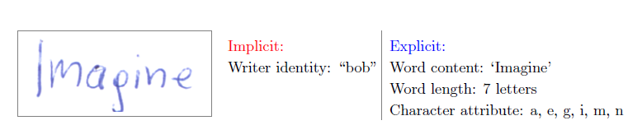
Main idea
Explicit/Implicit information (use as much information as you can)
Main/Auxiliary task (multi-task learning)
Regularization?

Slide 3
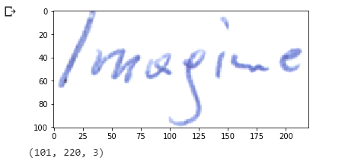
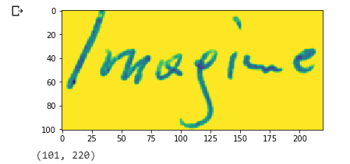
CVL Dataset
310 Writers x 5 pages (English/German)
Document, Line, Word level (two students manually)
filter(min 20 instances, length>0) : 99,513 -> 28,735/70,788 (70,853/28,660)
Image Preprocessing?

Slide 4
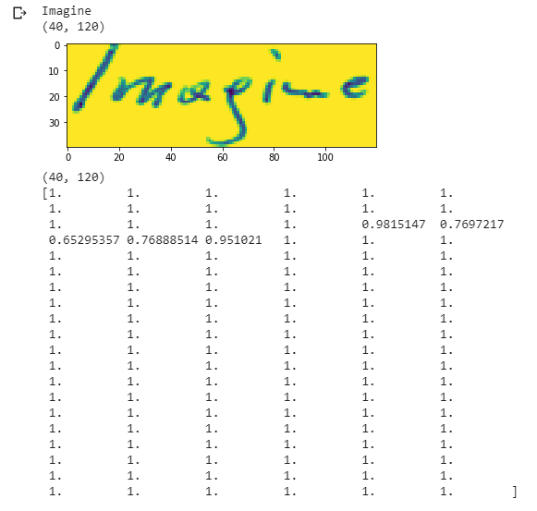
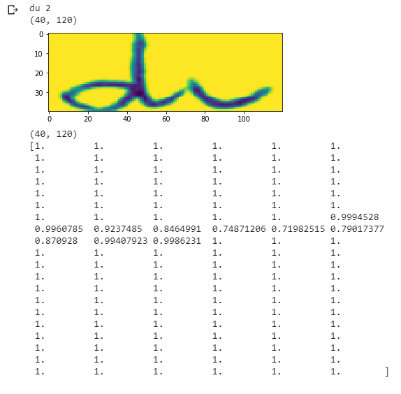

Slide 5
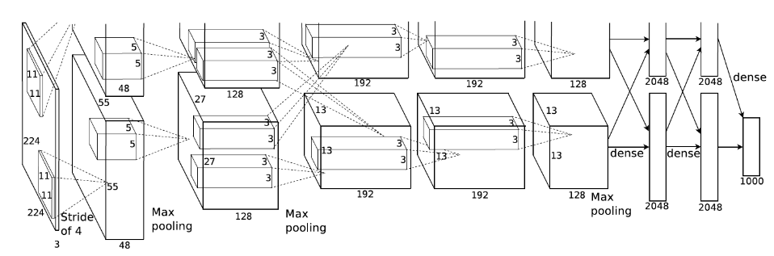
Proposed Method
Single word images
CNN for multi task learning (writer identification main task, auxiliary task?)
Two pathways
~AlexNet, NIPS, 2012

Slide 6
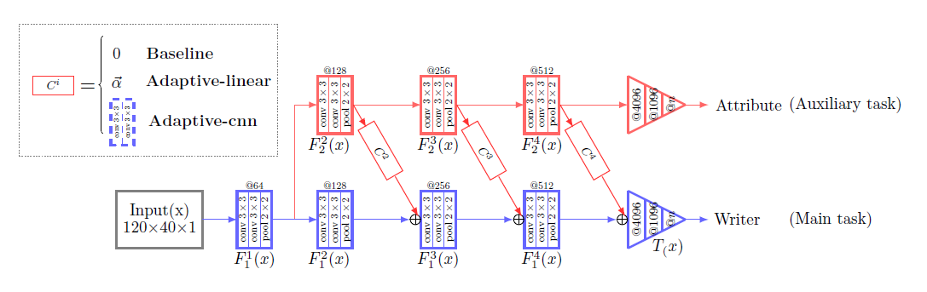
Architecture

Slide 7
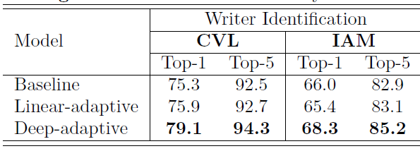
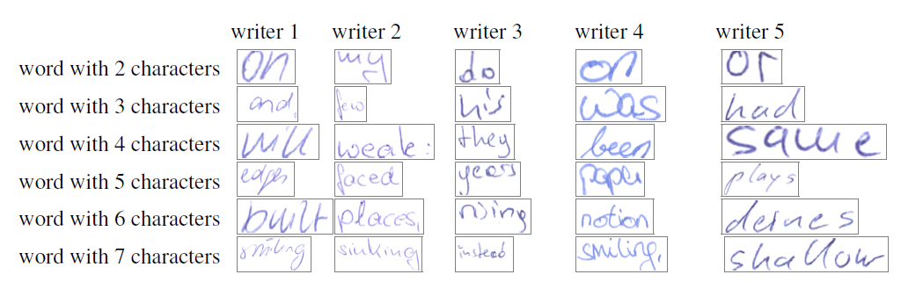
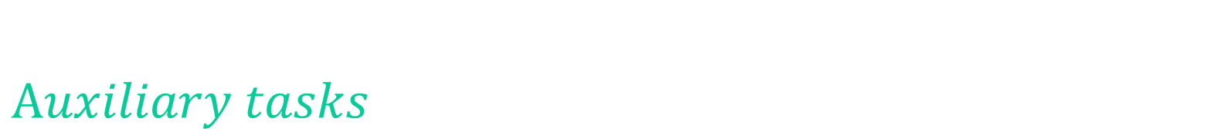
$$Auxiliary tasks$$
Word recognition
Character atribute recognition
Word length estimation (1-13)

Slide 8




Model?
Main formula
Baseline
Linear
Deep Adaptive

Slide 9
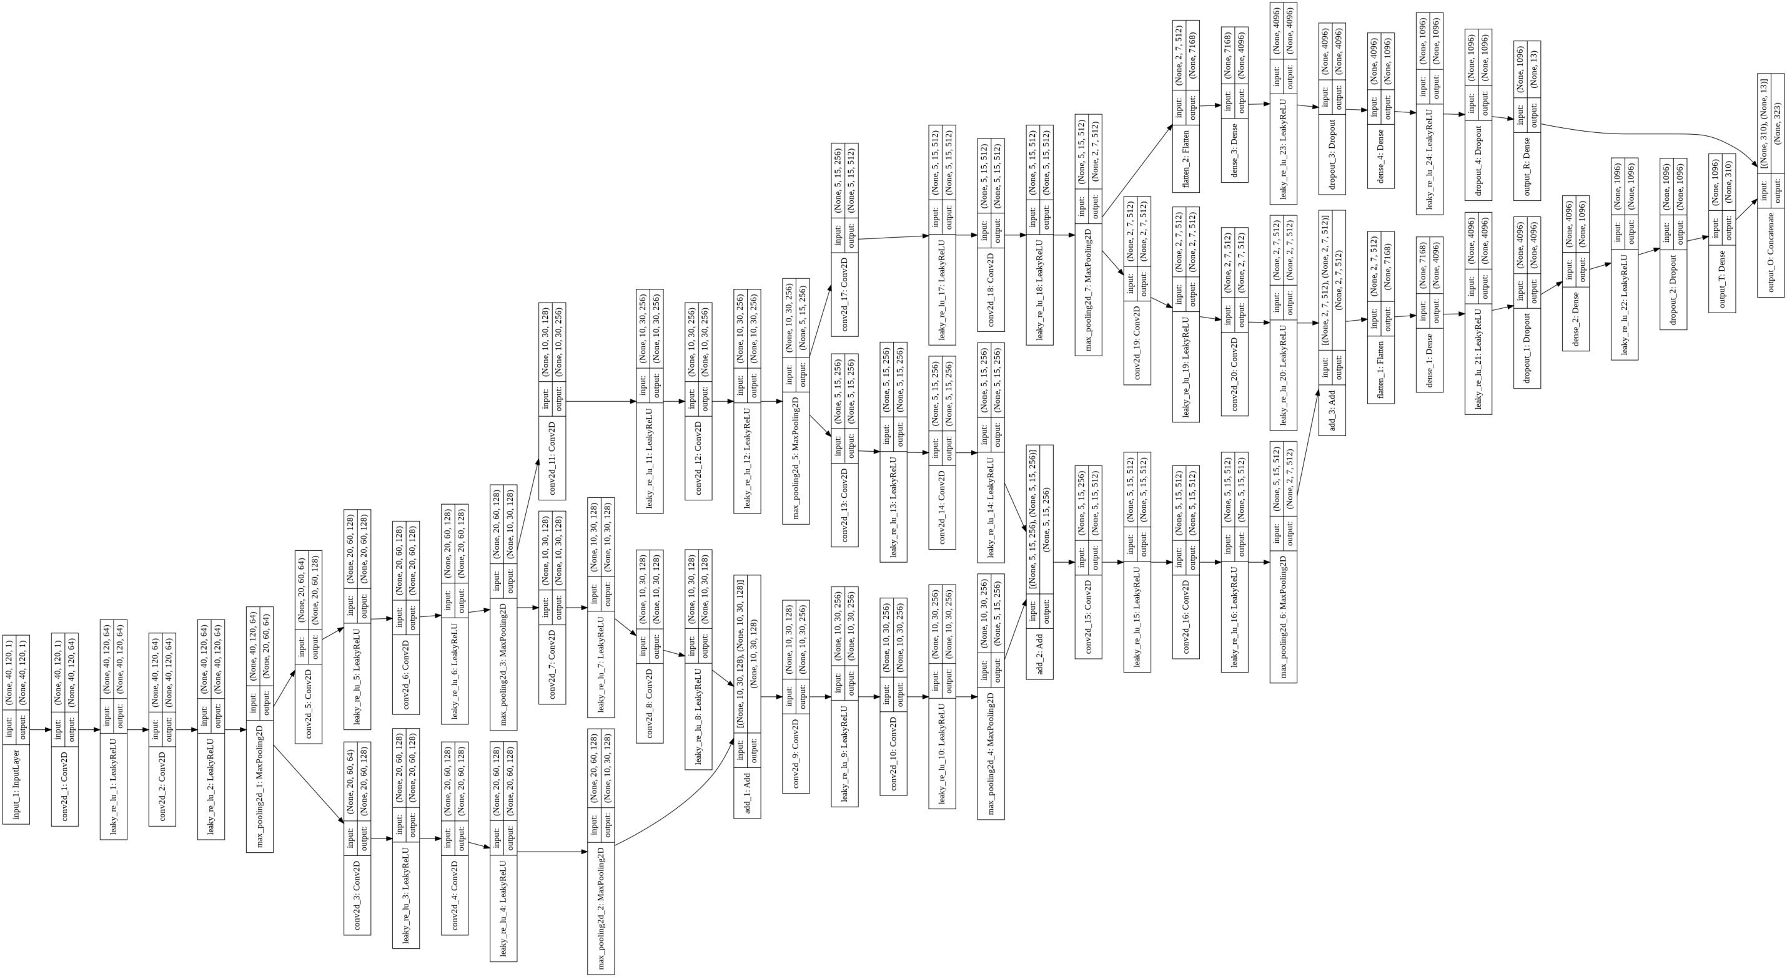

Slide 10

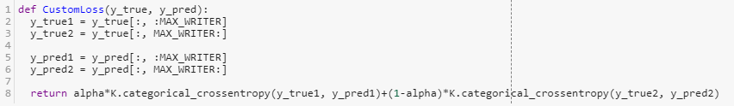
This is still seminary work

Slide 11
Implementation details
Conv2D: kernel_size = (3, 3)
MaxPool2D: pool_size = (2, 2)
LeakyRelu(0.1)
Dropout(0.5)
cross-entropy loss (softmax activation/sigmoid activation?)
Xavier initialization
Adam(0.001)
batch_size=100, n_iter=40 000 ~ 40 epoch! (My problem?)
83,589,227 params

Slide 12


Training
Combine two losses (O -> T, R)
$λ=0.5$ (10 epoch) + 0.066 (5 epoch) - increasing lambda effect?
0.896
$λ=0.5$ (0 epoch) + 0.01 (every epoch) - better one
0.9
Weird lambda?

Slide 13
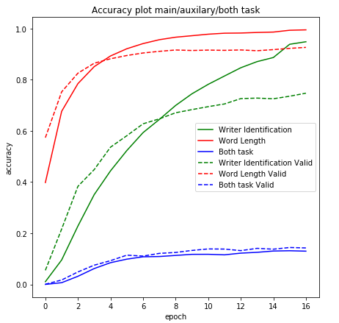
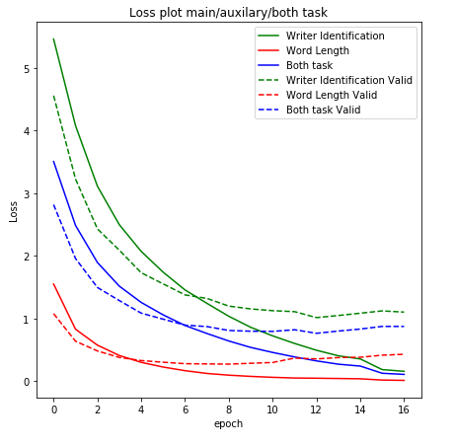
Early stopping? Overfitting? 15/40? Split?

Slide 14
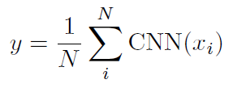
Top1/Top5?
Weird evaluation?
Identifcation based on N word images from the same writer
Randomly selected N word images for each writer
Put them into CNN
Use average response of the last CNN layer to recognize writer (x20 times, avg)

Slide 15
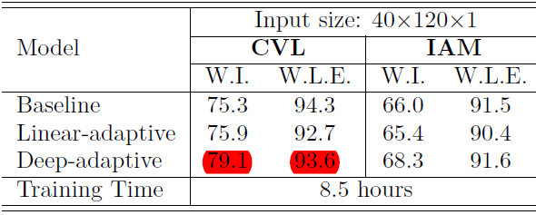
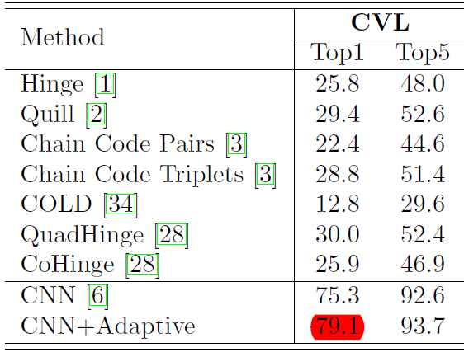
Results (Paper)
Baseline: 68.62%
Deep-adaptive: 72.37%/92.02% (T/R)
???

Slide 16
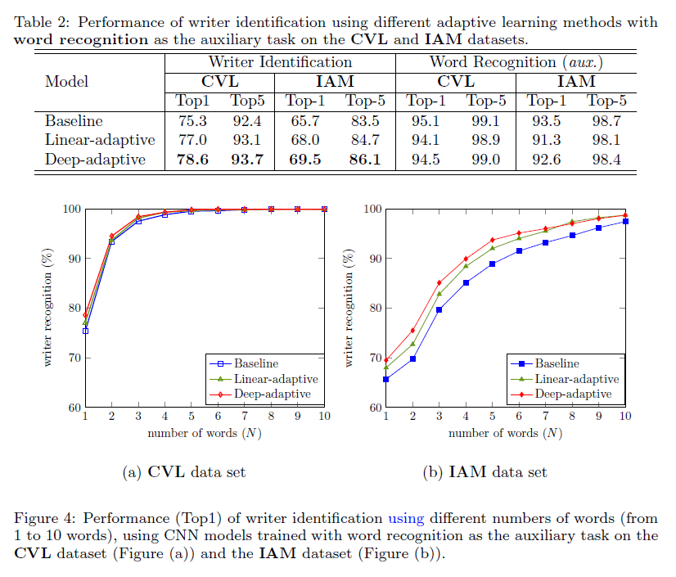

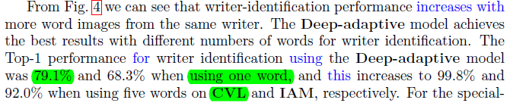
Misunderstanding?

Slide 17
My improvements
Next-To-Last layer
Baseline:
Last: Top1/Top5/Top10: 67.90%/95.03%/98.87%
Next-To-Last: Top1/Top5/Top10: 66.99%/98.75%/99.73% (on Top1 is the small sample)
+3.72%
Deep:
Last: Top1/Top5/Top10: 72.11%/97.20%/99.50% VS 79.10%/99.80%??
Next-To-Last: Top1/Top5/Top10: 70.53%/99.29%/99.98%
+2.09%

Slide 18
More ideas?
Babysitting the learning process
(O? Better guidance through loss surface?)
Preprocessing?
(Why n is the best auxiliary?)
One word cropping?
(Augmentation some kind? Histogram with respect to n? ~Top3/5)
Baseline (Hinton) to 75.3% and Next-To-Last = Top5 Improvements publication!

Slide 19
Questions?
Milan M. Čugurović
milan_cugurovic@matf.bg.ac.rs

