Slide 1
TCP
Congestion Control
Lecture material taken from
“Computer Networks A Systems Approach”, Third Ed.,Peterson and Davie,
Morgan Kaufmann, 2003.

Slide 2
TCP Congestion Control
Essential strategy :: The TCP host sends packets into the network without a reservation and then the host reacts to observable events.
Originally TCP assumed FIFO queuing.
Basic idea :: each source determines how much capacity is available to a given flow in the network.
ACKs are used to ‘pace’ the transmission of packets such that TCP is “self-clocking”.

Slide 3
AIMD
(Additive Increase / Multiplicative Decrease)
CongestionWindow (cwnd) is a variable held by the TCP source for each connection.
cwnd is set based on the perceived level of congestion. The Host receives implicit (packet drop) or explicit (packet mark) indications of internal congestion.
MaxWindow :: min (CongestionWindow , AdvertisedWindow)
EffectiveWindow = MaxWindow – (LastByteSent -LastByteAcked)

Slide 4
Additive Increase
Additive Increase is a reaction to perceived available capacity.
Linear Increase basic idea:: For each “cwnd’s worth” of packets sent, increase cwnd by 1 packet.
In practice, cwnd is incremented fractionally for each arriving ACK.
increment = MSS x (MSS /cwnd)
cwnd = cwnd + increment

Slide 5
Figure 6.8 Additive Increase
Source
Destination
Add one packet
each RTT

Slide 6
Multiplicative Decrease
The key assumption is that a dropped packet and the resultant timeout are due to congestion at a router or a switch.
Multiplicate Decrease:: TCP reacts to a timeout by halving cwnd.
Although cwnd is defined in bytes, the literature often discusses congestion control in terms of packets (or more formally in MSS == Maximum Segment Size).
cwnd is not allowed below the size of a single packet.

Slide 7
AIMD
(Additive Increase / Multiplicative Decrease)
It has been shown that AIMD is a necessary condition for TCP congestion control to be stable.
Because the simple CC mechanism involves timeouts that cause retransmissions, it is important that hosts have an accurate timeout mechanism.
Timeouts set as a function of average RTT and standard deviation of RTT.
However, TCP hosts only sample round-trip time once per RTT using coarse-grained clock.

Slide 8
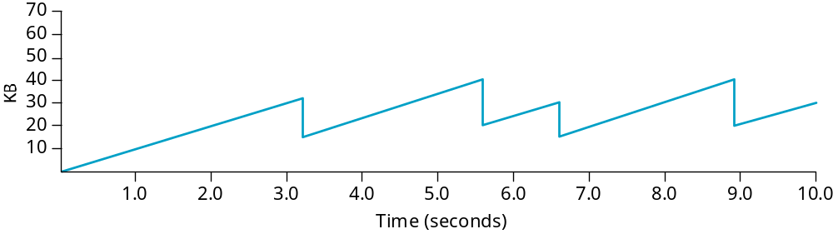
Figure 6.9 Typical TCP
Sawtooth Pattern

Slide 9
Slow Start
Linear additive increase takes too long to ramp up a new TCP connection from cold start.
Beginning with TCP Tahoe, the slow start mechanism was added to provide an initial exponential increase in the size of cwnd.
Remember mechanism by: slow start prevents a slow start. Moreover, slow start is slower than sending a full advertised window’s worth of packets all at once.

Slide 10
Slow Start
The source starts with cwnd = 1.
Every time an ACK arrives, cwnd is incremented.
cwnd is effectively doubled per RTT “epoch”.
Two slow start situations:
  At the very beginning of a connection {cold start}.
  When the connection goes dead waiting for a timeout to occur (i.e, the advertized window goes to zero!)

Slide 11
Figure 6.10 Slow Start
Source
Destination
Slow Start
Add one packet
per ACK

Slide 12
Slow Start
However, in the second case the source has more information. The current value of cwnd can be saved as a congestion threshold.
This is also known as the “slow start threshold” ssthresh.

Slide 13
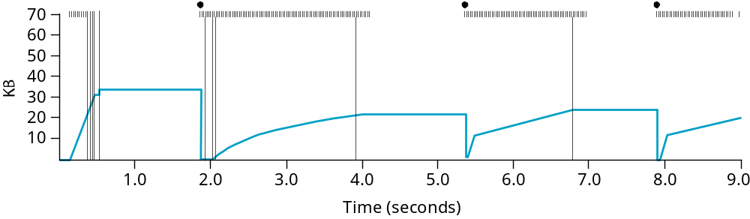
Figure 6.11 Behavior of TCP
Congestion Control

Slide 14
Fast Retransmit
Coarse timeouts remained a problem, and Fast retransmit was added with TCP Tahoe.
Since the receiver responds every time a packet arrives, this implies the sender will see duplicate ACKs.
Basic Idea:: use duplicate ACKs to signal lost packet.
Fast Retransmit
Upon receipt of three duplicate ACKs, the TCP Sender
retransmits the lost packet.

Slide 15
Fast Retransmit
Generally, fast retransmit eliminates about half the coarse-grain timeouts.
This yields roughly a 20% improvement in throughput.
Note – fast retransmit does not eliminate all the timeouts due to small window sizes at the source.

Slide 16
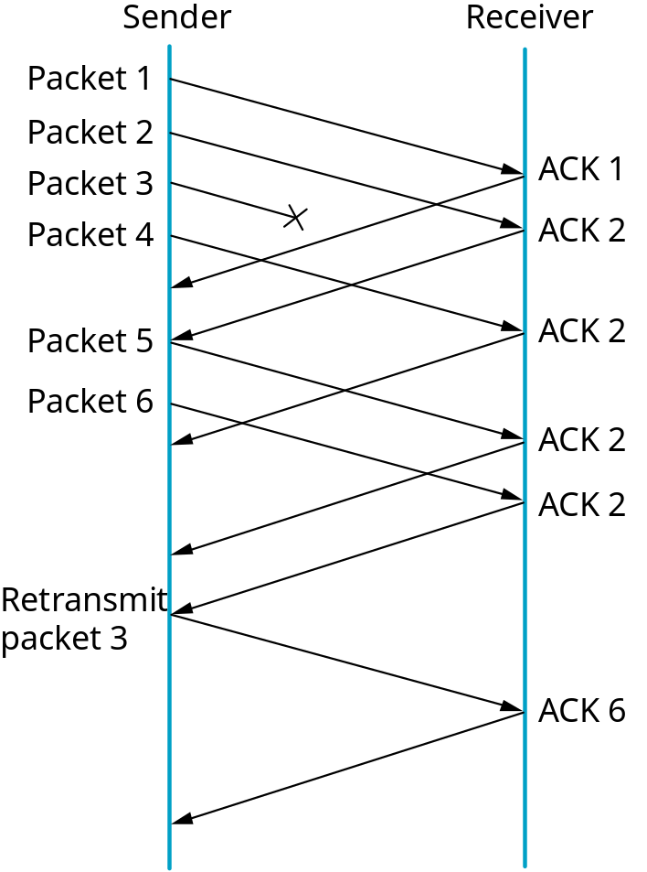
Figure 6.12 Fast Retransmit
Fast Retransmit
Based on three
duplicate ACKs

Slide 17
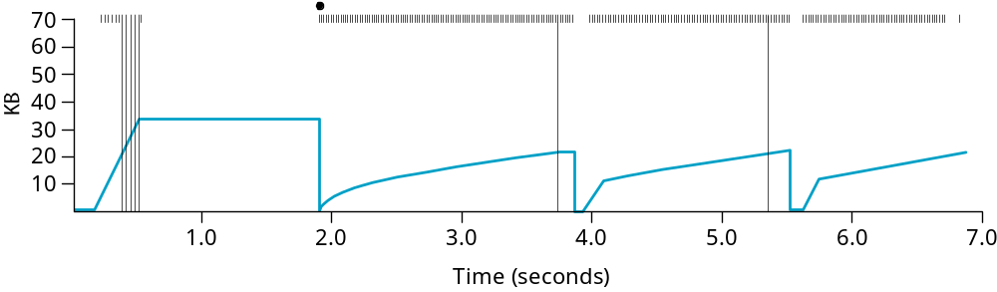
Figure 6.13 TCP Fast Retransmit Trace

Slide 18
TCP Congestion Control
Congestion
Congestion occurs
20
avoidance
15
Congestion
window
Threshold
10
Slow
start
5
0
Copyright ©2000 The McGraw Hill Companies
Round-trip times
Leon-Garcia & Widjaja: Communication Networks
Figure 7.63

Slide 19
Fast Recovery
Fast recovery was added with TCP Reno.
Basic idea:: When fast retransmit detects three duplicate ACKs, start the recovery process from congestion avoidance region and use ACKs in the pipe to pace the sending of packets.
Fast Recovery
After Fast Retransmit, half cwnd and commence
recovery from this point using linear additive increase
‘primed’ by left over ACKs in pipe.

Slide 20
Modified Slow Start
With fast recovery, slow start only occurs:
  At cold start
  After a coarse-grain timeout
This is the difference between TCP Tahoe and TCP Reno!!

Slide 21
TCP Congestion Control
Congestion
Congestion occurs
20
avoidance
Fast recovery
would cause a
change here.
15
Congestion
window
Threshold
10
Slow
start
5
0
Copyright ©2000 The McGraw Hill Companies
Round-trip times
Leon-Garcia & Widjaja: Communication Networks
Figure 7.63

Slide 22
Adaptive Retransmissions
RTT:: Round Trip Time between a pair of hosts on the Internet.
How to set the TimeOut value?
  The timeout value is set as a function of the expected RTT.
  Consequences of a bad choice?

Slide 23
Original Algorithm
Keep a running average of RTT and compute TimeOut as a function of this RTT.
  Send packet and keep timestamp t_{s} .
  When ACK arrives, record timestamp t_{a} .
  SampleRTT = t_{a} - t_{s}

Slide 24
Original Algorithm
Compute a weighted average:
EstimatedRTT = α x EstimatedRTT + (1- α) x SampleRTT
Original TCP spec: α in range (0.8,0.9)
TimeOut = 2 x EstimatedRTT

Slide 25
Karn/Partidge Algorithm
An obvious flaw in the original algorithm:
Whenever there is a retransmission it is impossible to know whether to associate the ACK with the original packet or the retransmitted packet.

Slide 26
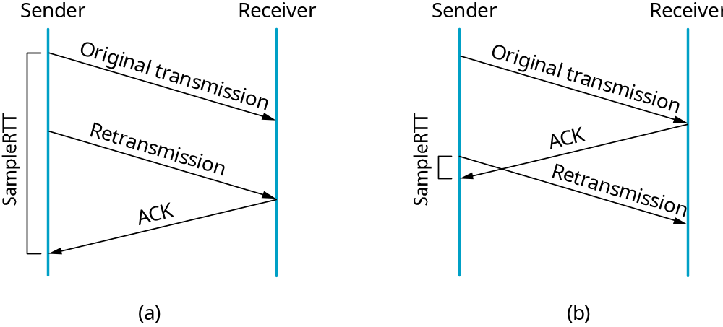
Figure 5.10
Associating the ACK?

Slide 27
Karn/Partidge Algorithm
Do not measure SampleRTT when sending packet more than once.
For each retransmission, set TimeOut to double the last TimeOut.
{ Note – this is a form of exponential backoff based on the believe that the lost packet is due to congestion.}

Slide 28
Jaconson/Karels Algorithm
The problem with the original algorithm is that it did not take into account the variance of SampleRTT.
Difference = SampleRTT – EstimatedRTT
EstimatedRTT = EstimatedRTT +
(δ x Difference)
Deviation = δ (|Difference| - Deviation)
where δ is a fraction between 0 and 1.

Slide 29
Jaconson/Karels Algorithm
TCP computes timeout using both the mean and variance of RTT
TimeOut = µ x EstimatedRTT
+ Φ x Deviation
where based on experience µ = 1 and Φ = 4.

