Slide 1
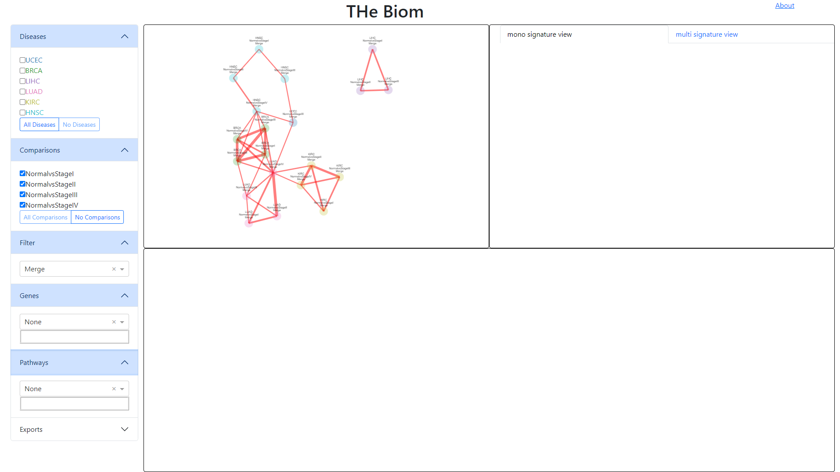
Filter menu
Signature view
Overview graph
Boxplots expression

Slide 2
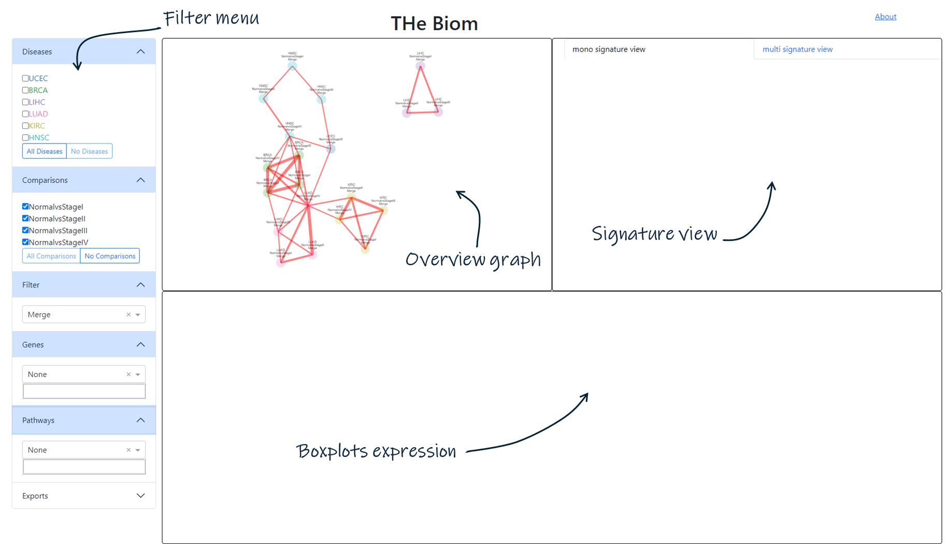

Slide 3
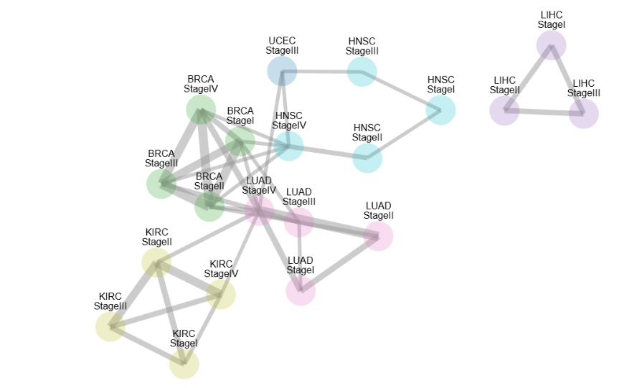
Cancers are color-coded
A signature (Cancer/stage)
Biomarkers in common

Slide 4
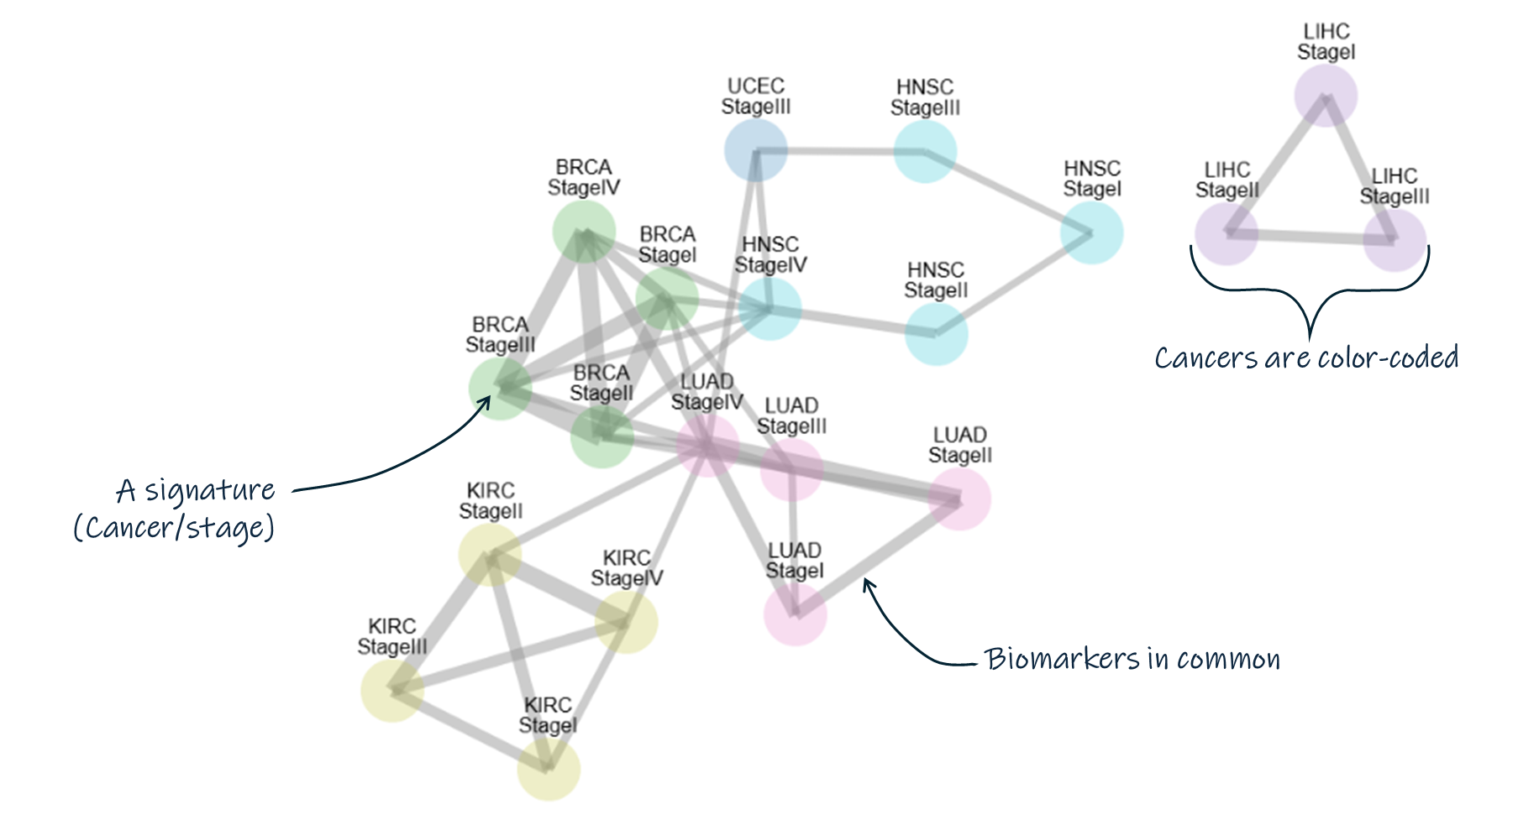

Slide 5
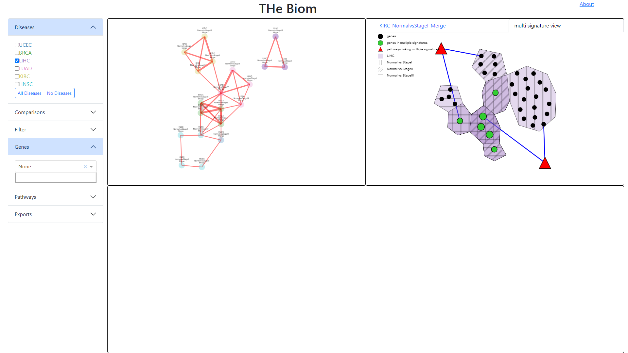
Cancer stages
Clickable legend
Biological pathways

Slide 6
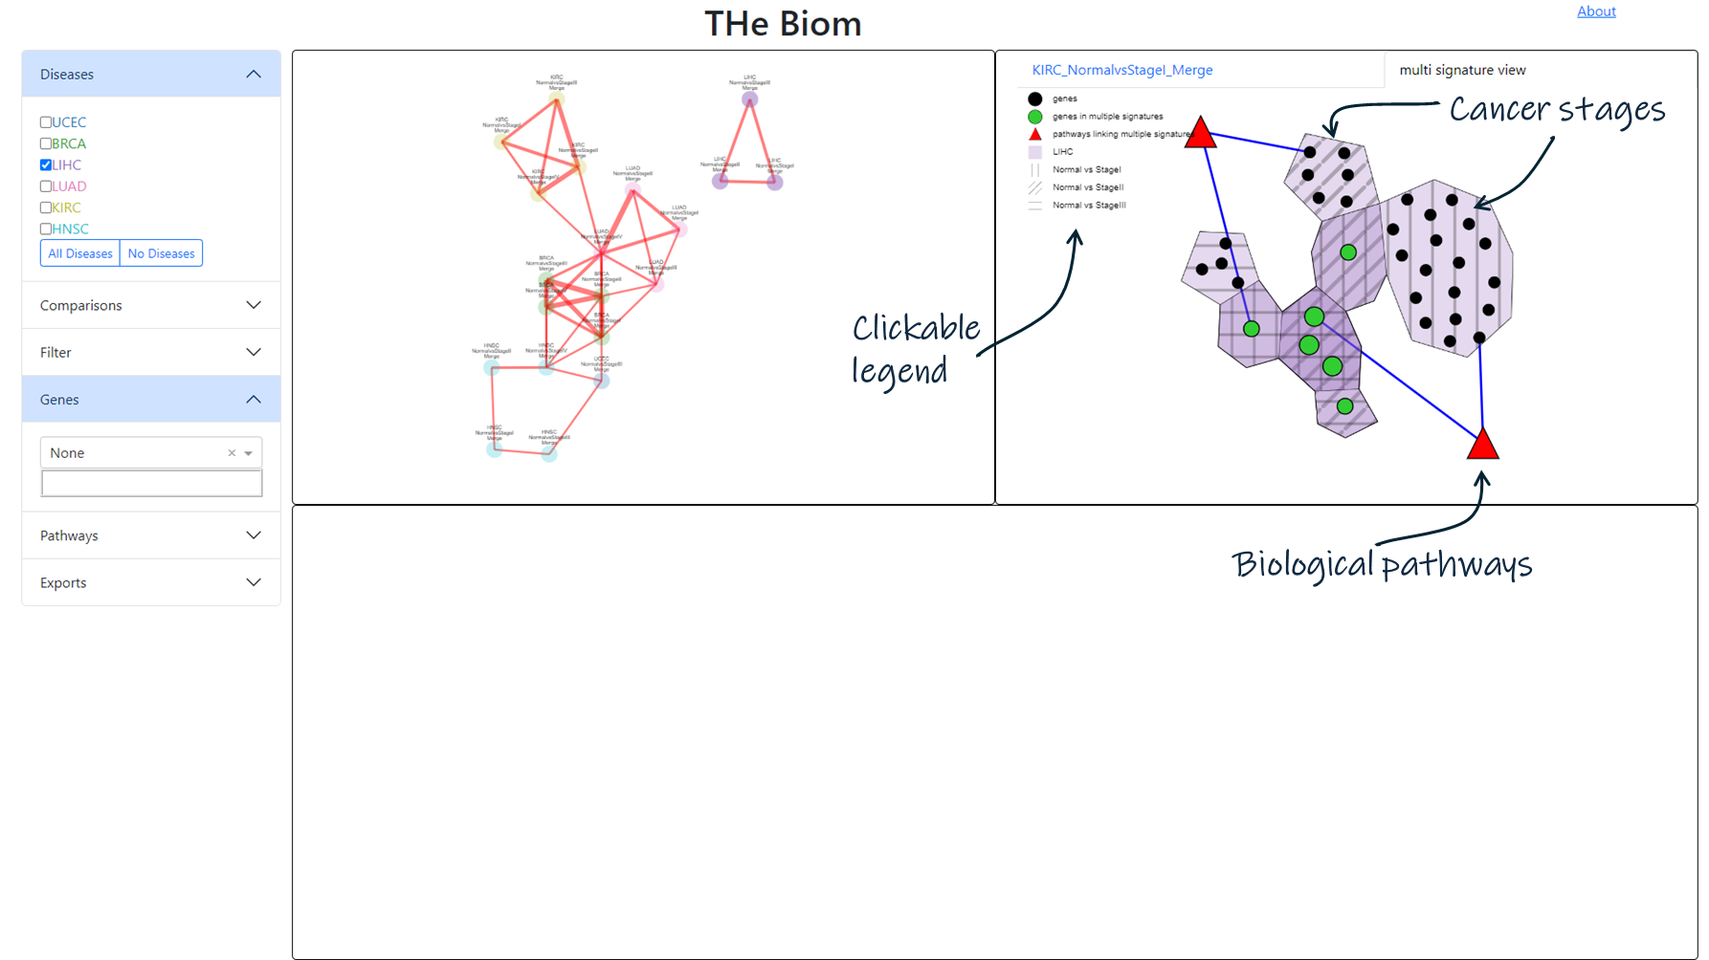

Slide 7
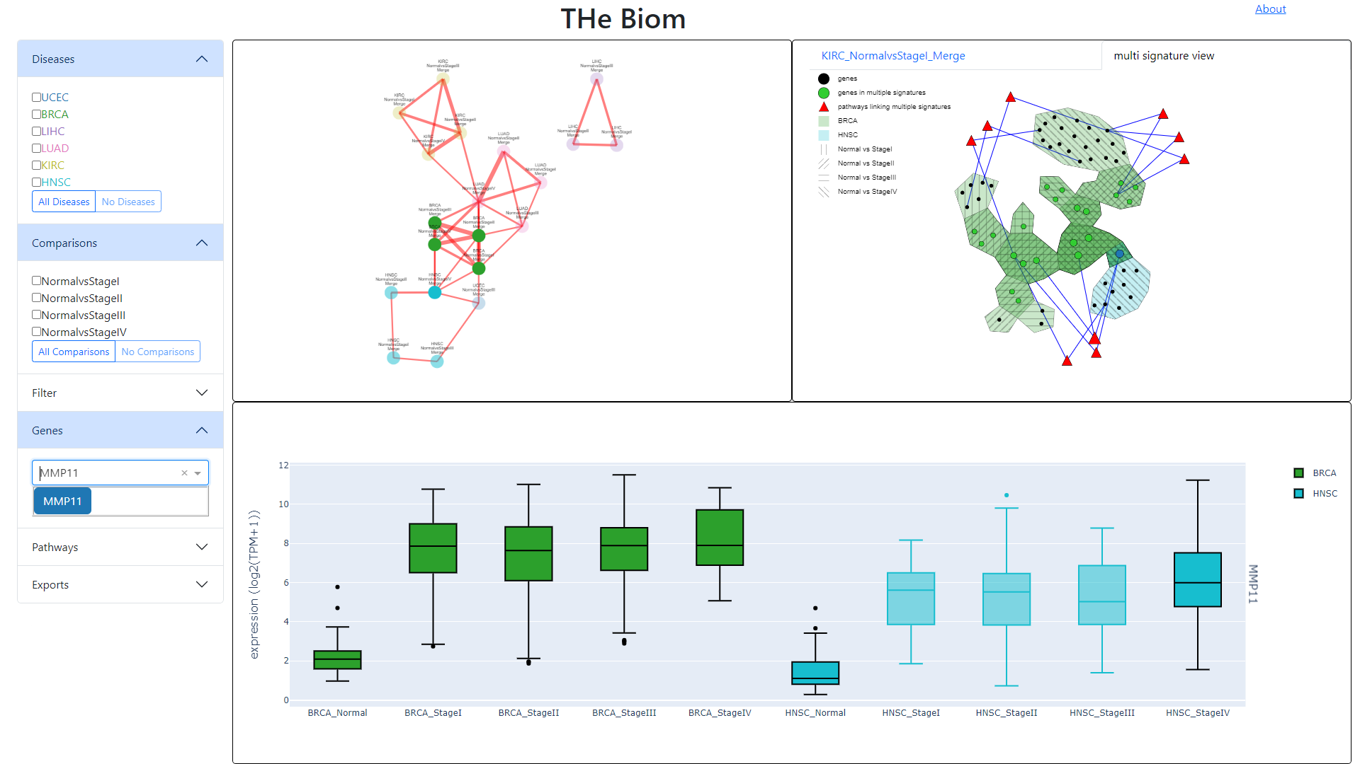
Clicking on a gene here
Expression in the different tissues
Or selecting a gene there

Slide 8
