Slide 1
Puzzle 8

Slide 2
Data structure and algorithms used-
Stack
Array list
Priority queue

Slide 3
Data Structure Used-
Array List- It behaves like a normal array. Java Array List allows us to randomly access the list. It is re-sizable collection of data. Java Array List is especially used for managing a large number of objects.
Stack- It is a container of objects that are inserted and removed according to the last-in first-out (LIFO) principle. In the pushdown stacks only two operations are allowed: push the item into the stack, and pop the item out of the stack. A stack is a limited access data structure - elements can be added and removed from the stack only at the top.
Priority Queue-A priority queue is different from a "normal" queue, because instead of being a "first-in-first-out" data structure, values come out in order by priority. Lower the priority number more is the priority,

Slide 4
Algorithms-
In shuffle method, id number of every tile is saved in a array list. And randomly a id number is selected and pushed in stack until stack is full and then by popping out the id numbers tile images are set.
In solve method, priority queue is used. Queue is implemented according to priority. Tile id number is treated here as priority number, then in this way, correct order is displayed of images in tiles.

Slide 5
What our do??
The Puzzle-8 is a sliding puzzle that consists of a frame of numbered square tiles in random order with one tile missing.
If the size is 3×3 tiles, the puzzle is called the 8-puzzle.
The object of the puzzle is to place the tiles in order by making sliding moves that use the empty space.
Choose a picture (8-puzzle) from the dropdown above and start the mixing of the puzzle pieces with the "Restart"-Button.
If the puzzle module has finished the shuffling of the pieces, you can start with the solving of the puzzle.
If you want to shuffle tiles, then just click on the “Shuffle"-Button.

Slide 6
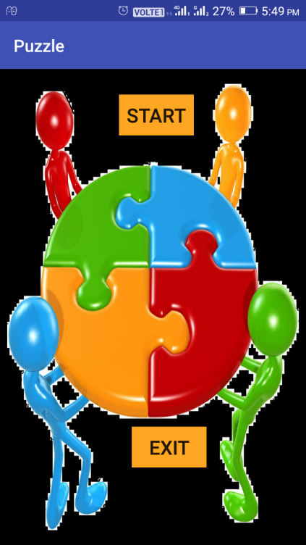
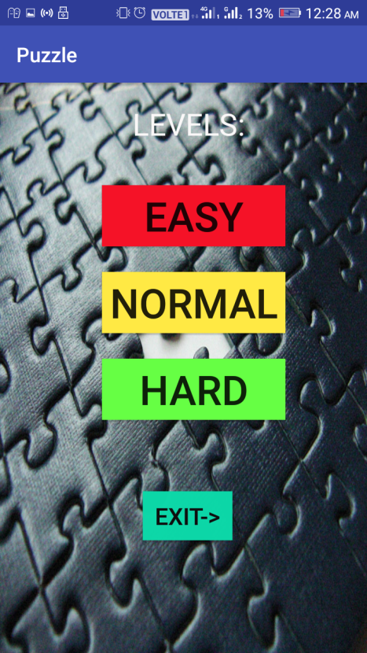
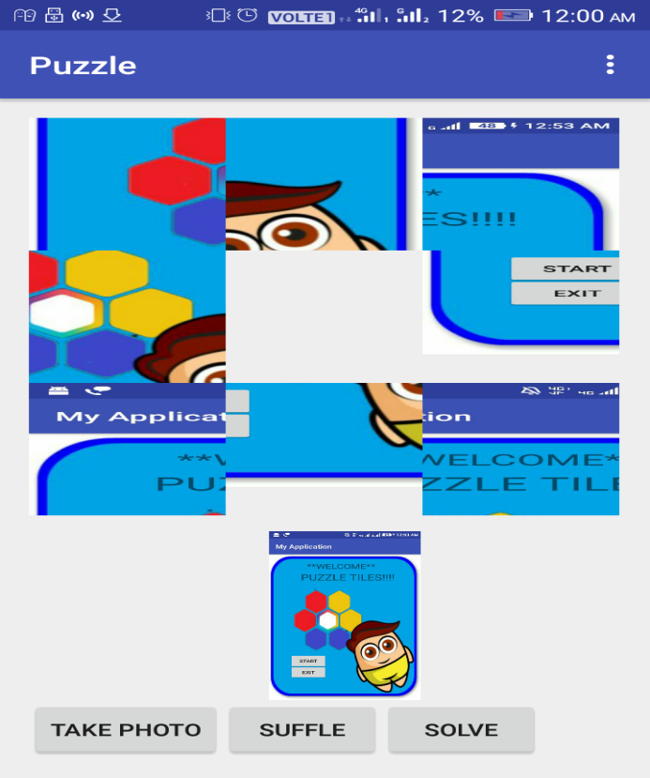

screenshots-
Icon
START PAGE

Slide 7
Team feedback about workshop-
It was very great experience.
The best part was the group work and opportunity to apply learned knowledge straightaway.
Thank you very much for an engaging and motivating few days.

Slide 8
Submitted by-
Gaurav Jain
Manali Gorwani
Jaya Jain

