Slide 1
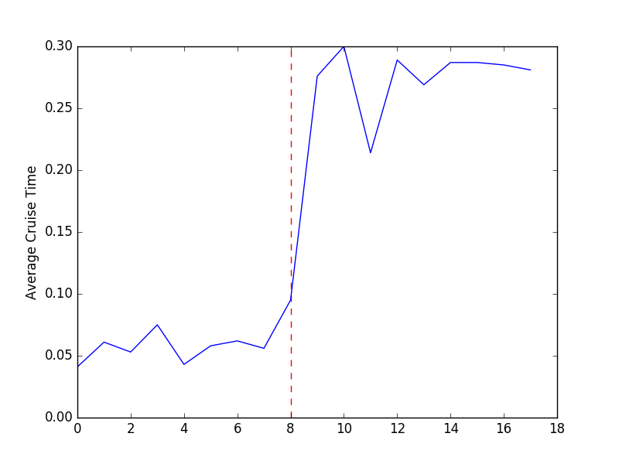
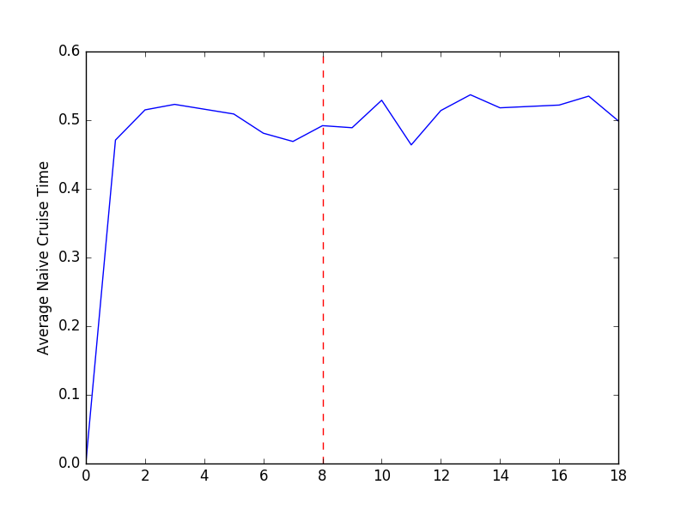
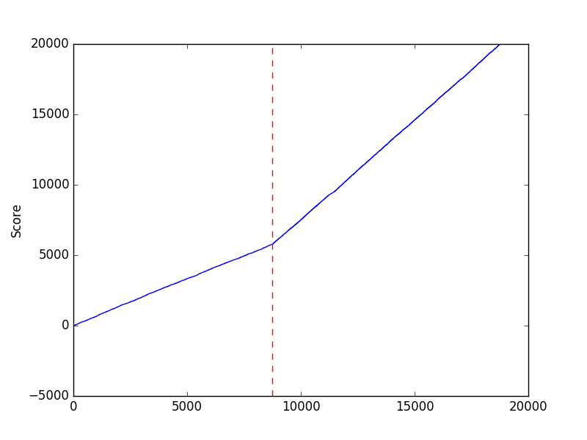
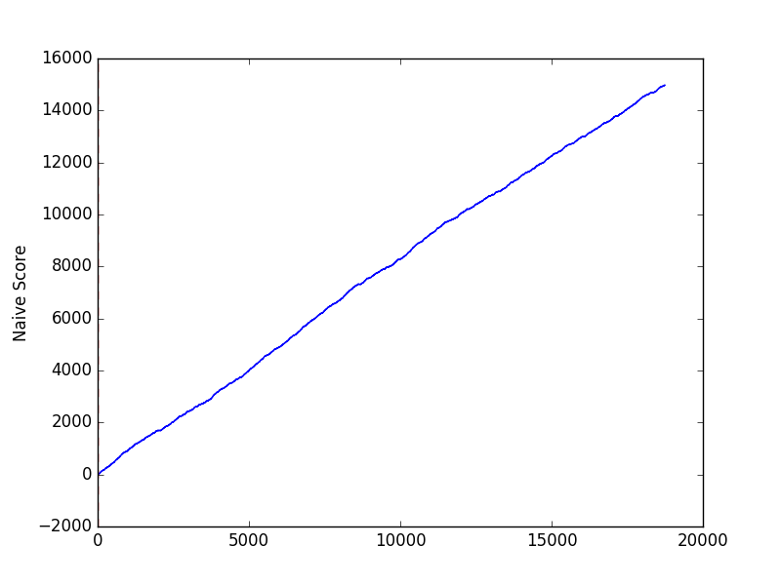
Model-Free Reinforcement Learning application to the Taxicab (Uber) Problem
Results
Below are results for a learning agent and a random agent on a 3x3 grid.
Mandela Patrick
mandelapatrick@college.harvard.edu
Milan Ravenell
mravenell@college.harvard.edu
CS 182
Fall 2016
Data
In order to measure the efficiency of our algorithm, we use the following metrics:
Cruise Time: The average amount of time that the driver spends without a passenger per 1000 time steps.
Move to higher proportion: The average number of times the driver moves to a state with a higher customer proportion per 1000 time steps
Overall profits (score) for the driver
Each experiment consists of a training phase and a calculated phase. In the training phase, the agent performs random actions with a bias towards states that it has not seen before, learning the q-values of each state/action pair. In the calculated phase, the agent takes the action with the best q-value at each state, and it is still learning from its experience.
Introduction
Our project addresses the question of where should drivers go to pick up a passenger when idle in order to maximize the efficiency of their work time. Throughout a city, there are going to be certain locations that offer a greater chance of being matched with a passenger than other parts. As the self-driving car becomes more prevalent, we decided to use reinforcement learning in order to find the best policy for where a driver should travel while he/she doesn’t have a passenger.
Figures 1 and 2. Figure 1 is the cruise time of our learning agent, and the red line is the point where we exit training mode. Figure 2 is the cruise time of a random agent
Approach
Our solution uses Q-learning, a model-free approach to solve the problem. Our world is a NxN grid, with each square having a certain probability of containing a passenger when a taxi reaches that location. The state of our world is as follows:
Location of the driver
Destination of the current passenger (None if there is no passenger)
Whether or not there exists a passemger at the location to be picked up
The actions available to the driver are as follows:
NORTH, EAST, SOUTH, WEST, PICK, DROP, STAY
The rewards to the driver are as follows:
If the driver takes an action and has no passenger: -1
If the driver has a passenger: Inversely proportional to driver’s distance from passenger’s destination
If driver drops off: 3
Conclusion
Consistently, when we look at the policy of a passenger-less driver, we see the driver chooses the action that will give it the best possible chance to find a passenger. We observe that, as we switch the agent from random mode to calculated mode, we notice that the cruise time increases and stabilizes to about 30%. We believe that cruise time increases because as it learns, it spends less time carrying passengers because it is better able to drive a passenger straight to the destination. When we compare the cruise time of our learning agent to that of the naive agent, we notice that of the learning agent is approximately 10% less than that of the naive agent. We also notice that when we switch from random to calculated, our agent is more likely to move to a location with a higher chance of containing a passenger.
Figures 3 and 4. Figure 1 is the cumulative score for our learning agent and Figure 2 is that for the random agent. We see the rate of our profits increase as we switch to a learned agent in figure 1
| 0.49, 'South' || 0.3, 'East' | 0.95, 'Stay' |
______________________
| 0.4, 'South' || 0.78, 'North' | 0.05, 'South' |
______________________
| 0.37, 'East' | 0.96, 'Stay' | 0.53, 'West' |
______________________
Figure 5. The above picture represents the optimal action of the driver from each location when it is not carrying a passenger. Double lines between locations imply a wall
Citations
http://cs229.stanford.edu/proj2012/Tang-RLTaxiDriverPassengerSeekingStrategy.pdf

