Slide 1
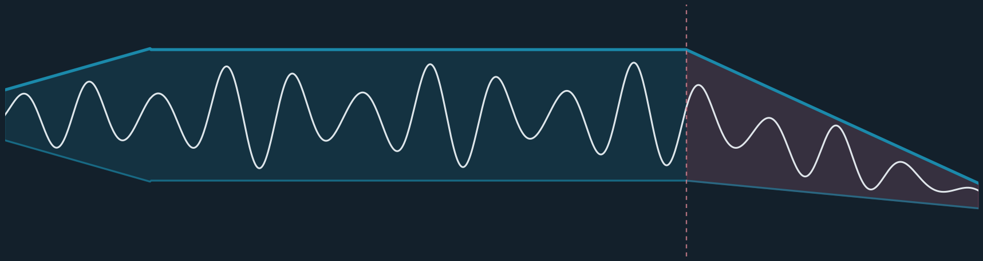
QUANTITATIVE RISK METHODOLOGY · RESEARCH MODEL
The Systemic & TAM Risk Model
Read the macro envelope first. Then ask two separate questions of every name:
how deep can it fall — and does it come back.
45 names — stocks · ETFs · leveraged 150,000-path regime-switching Monte Carlo 102/102 tests · 7/7 backtest
Notes:
The model in one breath: macro envelope first; depth and recovery are different questions; the growth premium is real and measurable. Everything on the following slides is from the 2026-06-05 run, independently audited 2026-06-10.

Slide 2
THE MODEL IN ONE SLIDE
Three commitments, one engine
Macro first
The premium is real
Depth ≠ recovery
The macro economy is the envelope every market lives inside. It is computed before any company — it sets crisis odds, correlation, and the freeze.
Large, durable TAM earns a higher multiple — like the ocean view in real estate. Only the unsupported float above it is fragility.
Beta and crisis correlation set how far a name falls. TAM, growth, cycle, and balance sheet set whether it climbs back. Never crossed.
150k
102/102
7/7
simulated 7-year futures per run
invariant tests · zero violations
historical crashes inside the band
Research model — not investment advice · 2026-06-05 snapshot · engine audited 2026-06-10
Notes:
Three commitments: macro-first ordering, a respected growth premium, and the strict separation of depth from recovery. The stats row: scale, verification, validation.

Slide 3
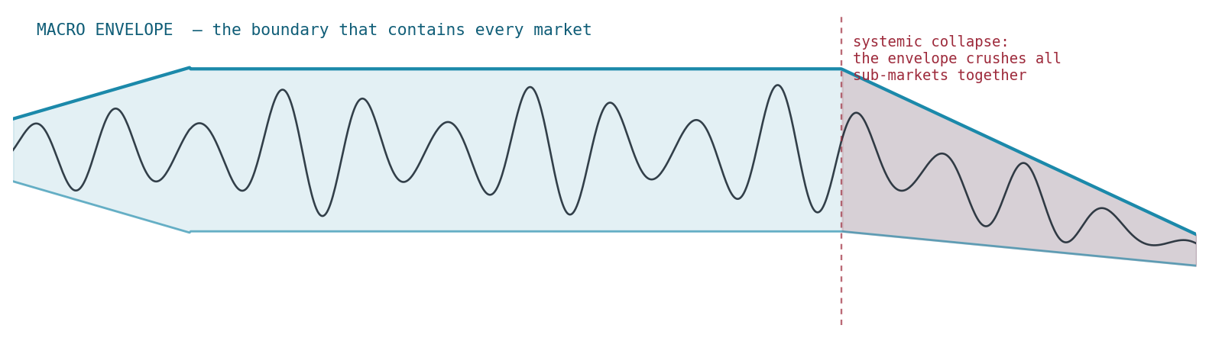
WHY MACRO FIRST
The envelope contains every market
Sub-markets are the signal; the macro economy is the boundary curve. Growth, rates, liquidity, credit, and leverage set the ceiling and floor that contain all individual motion.
When the envelope itself collapses, it presses all markets down together — no individual quality protects a name from a broken envelope. So the first question is never “is this stock good?” It is “what is the envelope doing?”
Wide envelope: names move on their own stories. Crushed envelope: everything falls together.
Research model — not investment advice · 2026-06-05 snapshot · engine audited 2026-06-10
Notes:
The organizing idea. The engineer's framing: signal inside an envelope. The model computes the envelope before looking at a single company.

Slide 4
THE ENVELOPE, MEASURED
Macro stress today: dry powder, no lit match
48 / 100
composite stress — watch zone
Structural 58 — elevated: valuation, leverage, real rates widen the tail. Acute 25 — dormant: credit and vol are calm. Crisis odds scale ×0.99 today.
■ structural (slow-burn) ■ acute (trigger)
Research model — not investment advice · 2026-06-05 snapshot · engine audited 2026-06-10
Notes:
Each input is scored 0-1 against documented bands; group means give structural 0.583 and acute 0.246; composite 0.50s+0.30a+0.20max = 0.482. The fragility is structural, not acute — powder dry, no match lit.

Slide 5
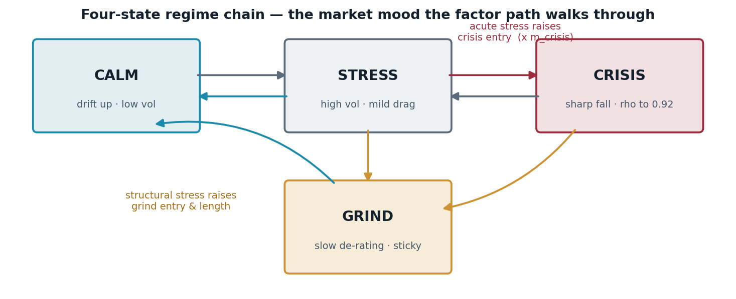
TRANSMISSION
Stress tilts the odds — not the outcome
Acute stress raises crisis entry; structural stress raises grind entry. Correlations rise toward 0.92 in crisis — diversification fades exactly when the envelope breaks.
Columns sum to 100%. The systemic tail (3→6→9%) is derived from “5 episodes in 97 years” via a hazard transform, scaled by live stress.
Research model — not investment advice · 2026-06-05 snapshot · engine audited 2026-06-10
Notes:
Four-state chain. The stacked column is the actual current regime distribution; each column verified to sum to 1. The systemic row is derived, not hand-set.

Slide 6
THE DOMINANT RISK
A systemic collapse freezes all layers — unevenly
Past a ~55% broad-market collapse, the plumbing seizes: recovery is suspended market-wide, scaled by each layer’s dependence on the frozen keystone (AI-infra).
~62 mo
model keystone recovery
vs the S&P’s real ~66 months to reclaim its 2007 peak — the freeze layer reproduces history’s shape, and is dormant today (severity 0.02).
months to recover on a 2008-state path
Research model — not investment advice · 2026-06-05 snapshot · engine audited 2026-06-10
Notes:
'All layers, but unevenly' — the literal meaning of systemic. Dependency multiplies the freeze window: infra 1.00 down to defensive 0.35. Calibration check: ~62 vs ~66 realized.

Slide 7
2008 VS 2020
Panic doesn’t freeze a system — the liquidity response decides
2008: sev 0.71 → ~25-month freeze 2020: sev 0.12 → ~14 months — averted Same panic, opposite outcome: the gate falls as Fed liquidity floods.
severity = panic × liquidity gate; duration = 30 mo × (0.40 + 0.60·sev) × dependency
Research model — not investment advice · 2026-06-05 snapshot · engine audited 2026-06-10
Notes:
The historical lesson encoded as a formula. 30×(0.40+0.60×0.714)=24.9 months — the model's 2008. The same arithmetic gives 2020 ~14 months: the flood breaks the freeze.

Slide 8
THE AGGREGATE FALLACY
Why we reject the Buffett indicator
One line over the whole market ignores:
What the model does instead:
Composition — today’s index is high-margin, capital-light growth, not 1970s heavy industry
Rates — valuation is rate-dependent; the ratio has no rates term at all
Globalization — global earnings divided by domestic GDP, a widening mismatch
Its record — “overvalued” for a decade while the market compounded
Decompose each name: rates-aware base + justified premium + unsupported float
Only the float is fragility — the earned premium is value, not sin
The fair multiple moves with real rates: 15.8× today, 18× at 1.5%, ~24.6× in 2020
Falsifiable: every band and constant is documented and recomputes
Research model — not investment advice · 2026-06-05 snapshot · engine audited 2026-06-10
Notes:
Cap/GDP treats the market as one undifferentiated asset against one frozen line. We replace the aggregate question with a per-name decomposition on a rates-aware baseline.

Slide 9
SUPPLY AND DEMAND FOR GROWTH — THE OCEAN VIEW
The growth premium is real
No one prices every house at the city average and calls the waterfront “overpriced.” Scarce, durable growth earns its premium the same way — and the model decomposes it instead of punishing it.
Same headline “expensive,” opposite fragility: the secular leader is mostly earned premium with a thin float; the speculative name is mostly float. They cannot be modeled the same way.
Research model — not investment advice · 2026-06-05 snapshot · engine audited 2026-06-10
Notes:
The real-estate analogy is the heart of the TAM pillar. The stacked bars are the decomposition: only the red float deflates as fragility; the amber earned slice is the ocean view.

Slide 10
THE PREMIUM, TESTED THROUGH TIME
The earn-back clock
∞
CoreWeave · IonQ
cannot grow into the multiple on crash-surviving growth — the quantitative content of “broken / watch.”
T = ln( PE / PE_fair ) / ln( 1 + g·κ )
κ — what growth survives a crash: secular ×1.05 · cyclical ×0.78 · broken ×0.50
Research model — not investment advice · 2026-06-05 snapshot · engine audited 2026-06-10
Notes:
T_earn = ln(PE/PE_fair)/ln(1+g·kappa). NVIDIA's multiple is already supported at crash growth. IonQ has the highest growth in the universe and still earns back never — that is the model refusing to reward an unproven thesis.

Slide 11
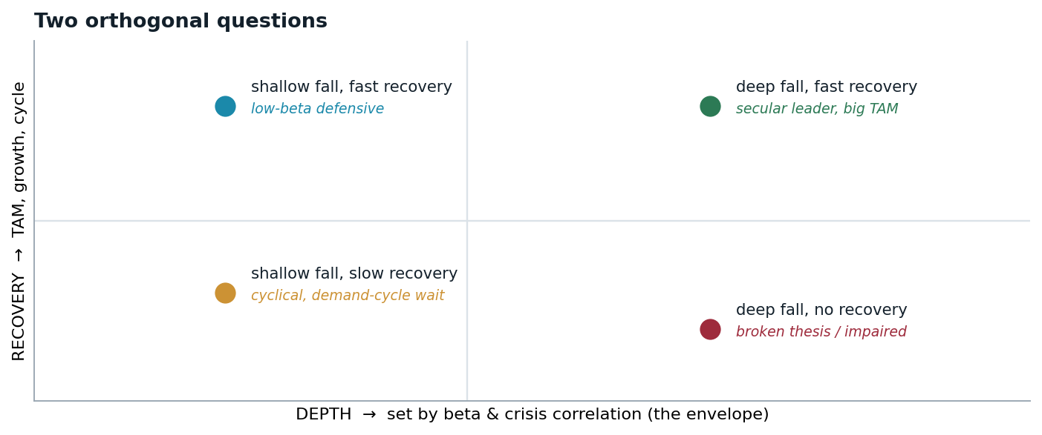
THE SPINE
Depth and recovery are different questions
Depth is market-driven. Beta and crisis correlation — the envelope — set how far a name falls. Recovery is fundamental. TAM, growth, cycle, and balance sheet set whether it climbs back. Two names can fall identically and have opposite futures.
Research model — not investment advice · 2026-06-05 snapshot · engine audited 2026-06-10
Notes:
The orthogonality principle that holds the model together — and the axis assignment is never crossed: nothing about quality appears in the depth equation, nothing about beta in the recovery channel.

Slide 12
SAME FALL, THREE FUTURES
Conditional recovery, given a >25% fall
Secular climbs from month one. Cyclical is pinned at 0% for a year — an explicit demand trough (memory: 9 mo down + 6 mo stabilizing) — then catches up steeply. Broken has a low ceiling: most paths never reclaim the peak.
Research model — not investment advice · 2026-06-05 snapshot · engine audited 2026-06-10
Notes:
P(reclaimed prior peak) vs months since the fall. Micron's flat-then-steep shape is the demand-rebound picture, not a slow version of NVIDIA's curve — different mechanism, modeled explicitly.

Slide 13
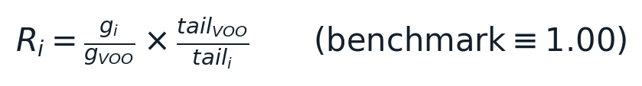
READING THE BUCKETS
“Best” is ranked differently inside each archetype
SECULAR — by reward-to-risk
CYCLICAL — two axes
BROKEN — least-bad only
Growth per unit of long-drawdown risk, S&P ≡ 1.00: Astera 5.15 · NVIDIA 4.54 · Palantir 4.15 · Broadcom 3.64 …down to VOO 1.00, Apple 0.50 — safest, lowest-reward end of the same good bucket.
Reward AND survivability (>3y tail): Top: Micron 3.82/22% · DRAM 3.72/20% · AMD 3.54/21% Watch: CoreWeave 2.18 but 45% tail — a cyclical that can’t fund the trough never sees the rebound.
No buy ranking exists here: QTUM → ARKK → IonQ (worst) IonQ carries the universe’s highest growth (80%) and still ranks last — the model refuses to reward an unproven thesis.
the reward metric — verified exact, all names
Research model — not investment advice · 2026-06-05 snapshot · engine audited 2026-06-10
Notes:
One-line rule: secular — rank by reward and take the top; cyclical — high reward WITH a survivable tail, fat tail = demotion toward broken; broken — don't rank, avoid.

Slide 14
VALIDATION — DEPTH INSIDE THE BAND
Seven crises, seven captures
Macro dial set to each crisis eve; nothing else touched. Every realized fall (ink) lands inside the simulated tail (rose). Validates stress→depth; recovery timing is calibrated separately (freeze: ~62 vs ~66 mo for 2008).
Research model — not investment advice · 2026-06-05 snapshot · engine audited 2026-06-10
Notes:
Drawdown magnitudes shown as positive %. The honest framing: documented historical inputs test the machinery — this is mechanism validation, not foresight. 2008 sits deepest in the band, exactly where a true tail should.

Slide 15
VERIFICATION · 2026-06-10 INDEPENDENT AUDIT
The engine computes what it claims
102/102
0
bit-identical
|z| ≤ 2.27
invariant tests pass on fresh artifacts
violations — bounds, monotonicity, complements, 47 names
two identical runs hash the same
seed change = pure sampling noise
Every formula re-derived and reproduced: stress 0.482 · fair multiple 15.8× · freeze 0.71/0.12/0.02 · reward exact to machine precision. Sampling error ≤0.13 pt at 150k paths.
What it is: a probability engine — how likely a fall is, and how likely a recovery given a fall, with the envelope read first and every premium earned or exposed. What it isn’t: a price target, a timing signal, or a promise.
RESEARCH MODEL — NOT INVESTMENT ADVICE. Probabilities are frequencies over simulated futures; judgment inputs (growth, TAM, archetypes) are documented opinions the simulation sweeps.
Notes:
Close on trust: verification (the engine is right) plus validation (it behaves against history) plus honesty (what it cannot promise). Findings disclosed in the full report: unify the two tail definitions; never quote light-mode runs.

