Slide 1

BulletSOP 2.0
Milan Suk
CG Research & Development
MilanSuk86@gmail.com
Linkedin.com/in/milan-suk

Slide 2
BulletSOP 2.0

Slide 3
BulletSOP 2.0
Rigid Body tool set for SideFX Houdini 12
Using the latest Bullet Physics library
Free & Without limitation

Slide 4
BulletSOP 2.0
Inside SOPs(surface) network
Only 6 nodes, but very powerful

Slide 5
BulletSOP 2.0
Immediate interruption(ESC key)
% info feedback

Slide 6
BulletSOP 2.0
Windows®, Linux®
  64bit only
Houdini Production builds
  Optional Daily builds

Slide 7
Why SOPs network?

Slide 8
BulletSOP 2.0
Why SOPs network?
  Something different!
  Why compete with Houdini manufacture
  Everybody know SOPs

Slide 9
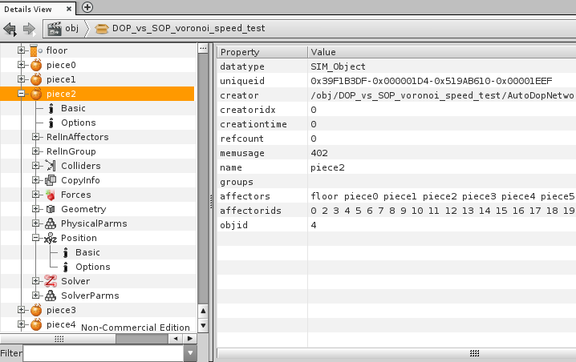
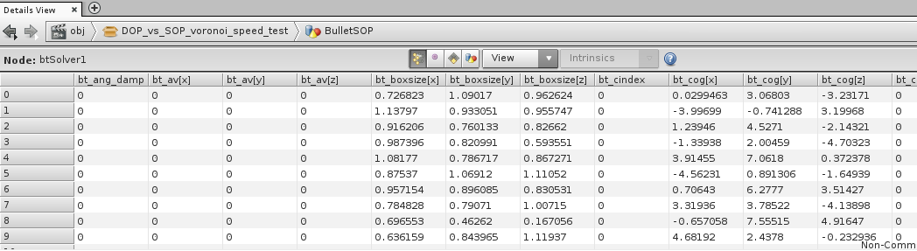
BulletSOP 2.0
Why SOPs network?
  DOPs vs. SOPs => Object vs. Relational database

Slide 10
BulletSOP 2.0
Demos:
  500K boxes
  Chains
  Object activation
  Snow ball
  Auto-breaking

Slide 11
Speed test

Slide 12
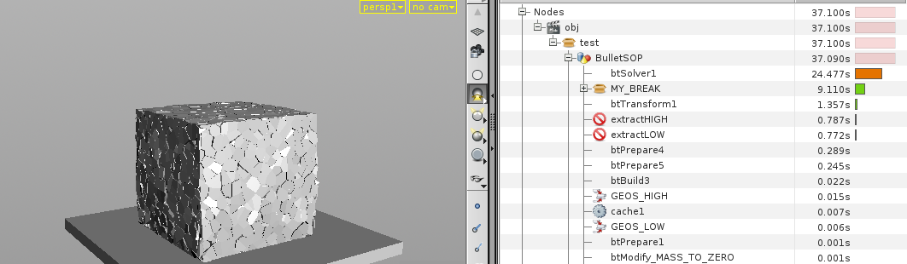
BulletSOP 2.0
Speed test
  Core i7–3820(3.6GHz), 16GB RAM, GTS450, Win7
  ~4000 convex pieces + static floor

Slide 13
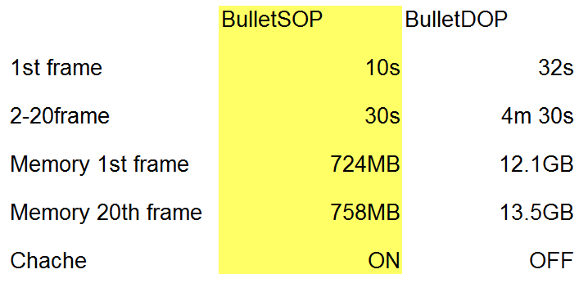
BulletSOP 2.0
Speed test
  Core i7–3820(3.6GHz), 16GB RAM, GTS450, Win7
  ~4000 convex pieces + static box floor

Slide 14
Source Code

Slide 15
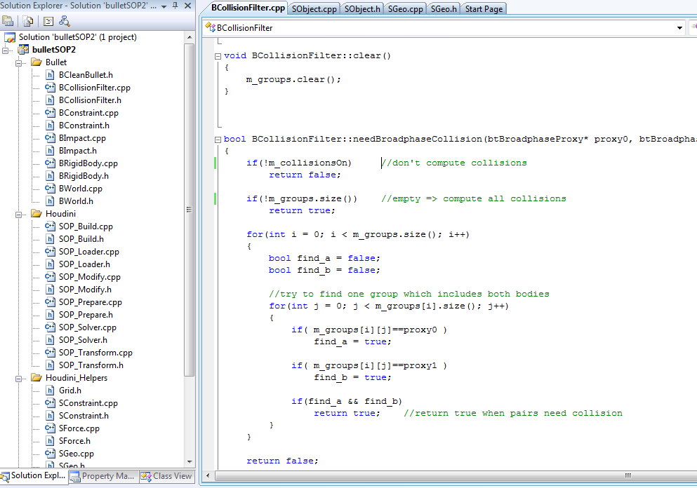
BulletSOP 2.0
Source code:
  C++
  43 files(*.cpp, *.h)

Slide 16
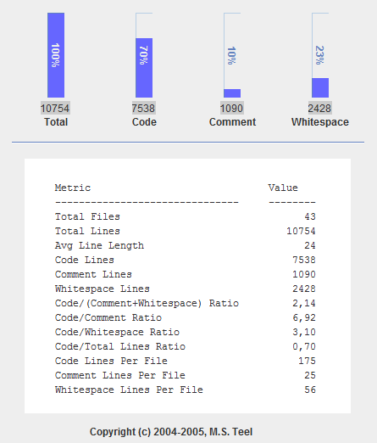
BulletSOP 2.0
Source code:
  ~7500 lines of code
  ~1100 lines of comments

Slide 17
BulletSOP 2.0
Source code:
  Highly Object-oriented
  Commented

Slide 18
BulletSOP 2.0
Source code:
  Houdini development kit(HDK)
  Standart libs(std::vector, ...)

Slide 19
BulletSOP 2.0
Source code:
  Visual studio® 2008 project for Windows®
  Makefile for Linux®
  OS X® implementation in progress

Slide 20
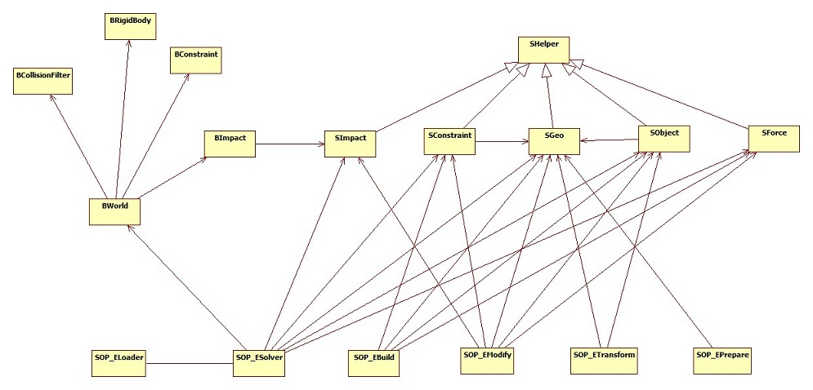
BulletSOP 2.0
Class Diagram:

Slide 21
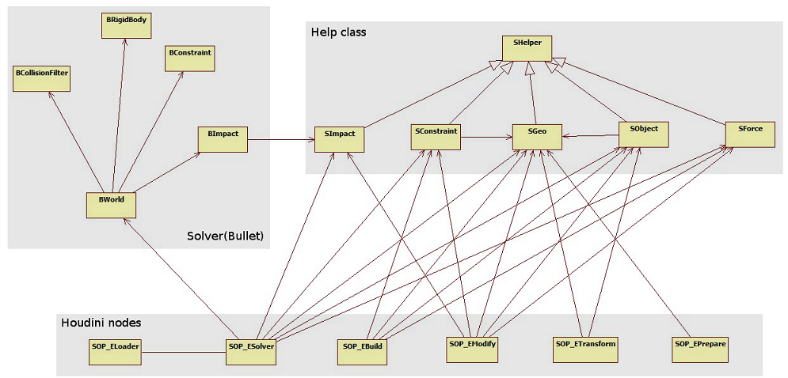
BulletSOP 2.0
Class Diagram:

Slide 22
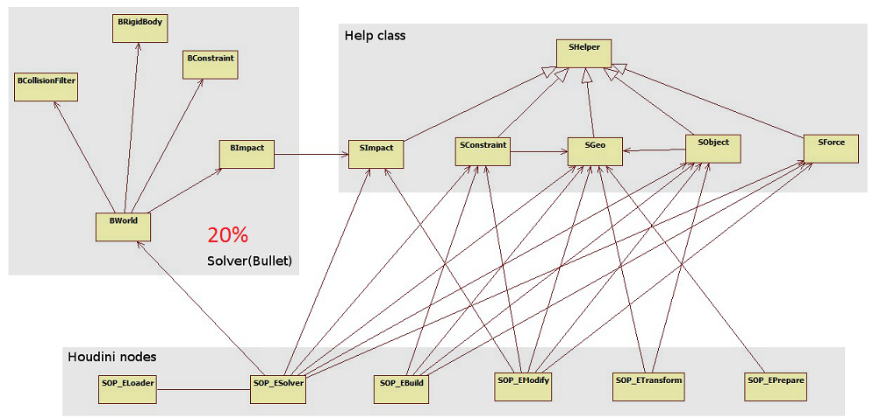
BulletSOP 2.0
Class Diagram:

Slide 23
Price

Slide 24
BulletSOP 2.0
Price?
  Binary is free without any limits!!!

Slide 25
BulletSOP 2.0
Price?
  Source code with comments
  UML graphs
  Example scenes
  Easy to extend(Newton, PhysBAM, PhysXTM, Algoryx, …)
    ~80% of code doesn't depend on solver

Slide 26
BulletSOP 2.0
Price?
  Compiles for Houdini Daily Builds
  Works with Houdini(Non-FX)

Slide 27
BulletSOP 2.0
Price?
  All future updates are Free!
    Houdini 13
    Bullet on GPU
    Bugs, Speed improvements, ...
    Extension(advance decomposition, ….)

Slide 28
BulletSOP 2.0
Price?
  $4999

Slide 29
BulletSOP 2.0
Price?
  $4999
  How much time will your programmer(s) spent on it?
  Competitors are more expensive!

Slide 30
Summary

Slide 31
BulletSOP 2.0
Free & Without limits
Very fast / Low memory
Easy to extend
Future updates included

Slide 32
BulletSOP 2.0
Links:
Forum: http://forums.odforce.net/index.php?/forum/69-bullet/
LinkedIn: www.linkedin.com/groups/BulletSOP-Houdini-4796605

Slide 33
BulletSOP 2.0
Thank you for watching!
And remember:
  “Details View is your the best friend!”

Slide 34
BulletSOP 2.0
Windows® is a registered trademark of Microsoft Corporation
Visual Studio® is a registered trademark of Microsoft Corporation
Linux® is a registered trademark of Linux Mark Institute
OS X® is a registered trademark of Apple Inc.
PhysXTM is a registered trademark of NVIDIA Corporation
Autodesk® is a registered trademark of Autodesk Inc.

