Slide 1


Slide 2

STELLAR OBJECT
CLASSIFICATION
“A stellar object refers to any naturally occurring astronomical object that exists within a star system, typically in space. These objects include a variety of celestial bodies such as: Stars, Planets, Moons, Asteroids, Comets, Nebulae, Black Holes, Neuron stars, white Dwarfs, Galaxies.”

Slide 3

INTRODUCTION
02
DATA GATHERING/
DATA REFINING
01
categorize stars and other celestial
objects based on their physical properties
Models and early detection bring essential benefits
Comprehensive Dataset Overview
Refinement and Data Preparation Steps
EXPLORATORY DATA ANALYSIS
FEATURE EXTRACTION
03
04
Find patterns and identify trends
Gain valuable insights from the dataset
Divide Features into X and Y
Machine Learning / Deep learning
METHODOLOGY
Experimental results
05
06
Algorithms or Models Used
Compare each Evaluate Algorithm
Visuals of Compared models
Accuracy, confusion matrix of models
CONCLUSION
APPENDICES AND REFERENCES
07
08
Importance of the used approach
Suggestion for future
Links and codes used in the project

Slide 4
INTRODUCTION
OBJECTIVE:
The objective of this project is to develop a sophisticated machine learning model for accurately classifying stellar objects. The project focuses on identifying distinguishing patterns, addressing data challenges, and improving classification precision, ultimately contributing valuable insights to the field of astrophysics.
Dataset:
The dataset includes 100,000 entries with features such as celestial coordinates, photometric magnitudes, redshift, and other observational identifiers
Importance:
The importance of this project lies in advancing the precision of stellar object classification, a critical task in astrophysics. By improving classification accuracy, the project enhances our understanding of the universe, aids in the discovery of new celestial bodies, and supports further research in astronomical studies and cosmology.

Slide 5


Monitor and Update
STEP
Continuously monitor the model's performance in the real-world scenario
07
Model Evaluation
STEP
06
Assessing the performance of a machine learning model using metrics
Model Selection and
Model Training
STEP
Choosing a suitable machine learning algorithm and optimizing its parameters
05
Split Train And Test Data
WORK FLOW
STEP
WORK FLOW
04
Dividing the dataset into training and testing sets to evaluate
PREPROCESSING
STEP
Preparing and cleaning data to enhance its quality and suitability
03
Exploratory Data Analysis
STEP
02
Analyzing and visualizing data patterns to understand its characteristics
Data Collection
STEP
Gathering and organizing data to train machine learning models.
01

Slide 6
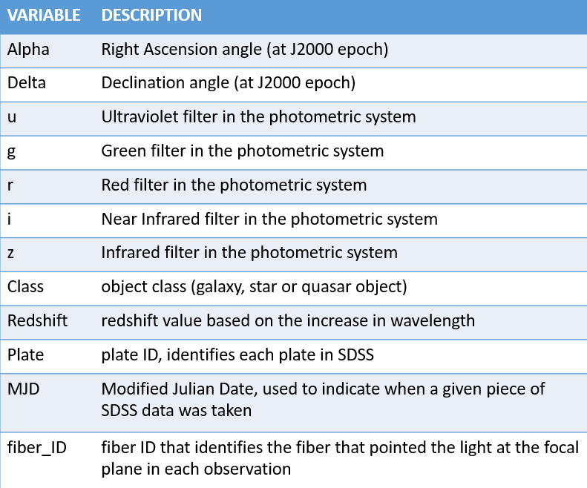
DATA COLLECTION & REFINEMENT
100000
18
DATASET DESCRIPTION
ROWS
STELLAR OBJECT
CLASSIFICATION
COLUMNS
Features
(Columns)
Alpha
X
Celestial Co-ordinates
Delta
Delta
Photometric Magnitudes
u, g, r, i, z
0: Galaxy
Y
Outcome Variable
Class :
1: Quasar
2: Star

Slide 7
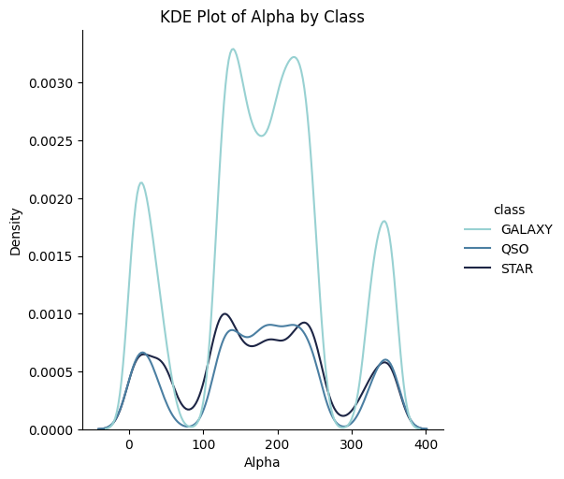
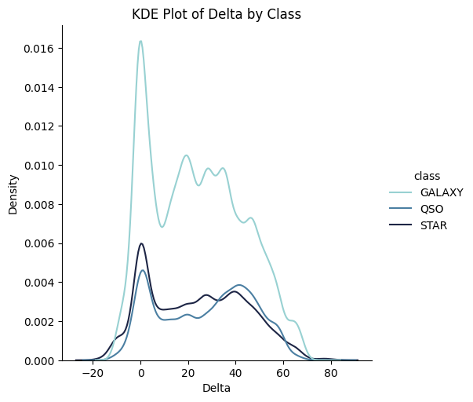
UNIVARIATE ANALYSIS
These KDE plots provide insights into the spatial distribution of different stellar classes (GALAXY, QSO, STAR) across the Alpha (right ascension) and Delta (declination) coordinates. The differences in the density patterns suggest that galaxies, stars, and quasars are concentrated in different regions of the sky, with galaxies showing more pronounced clustering in specific ranges of both Alpha and Delta, while stars and QSOs have more spread-out distributions.
KDE Plot of Alpha by Class:
X-axis (Alpha): Represents the Alpha coordinate (right ascension) in degrees.
Y-axis (Density): Represents the estimated density of observations.
Observation:
The STAR class shows a relatively smooth distribution with smaller peaks across the Alpha range.
The GALAXY class exhibits more pronounced peaks, suggesting specific Alpha ranges where galaxies are more densely clustered.
QSOs have a less smooth distribution, with several distinct peaks, indicating regions of higher concentration.
KDE Plot of Delta by Class:
X-axis (Delta): Represents the Delta coordinate (declination) in degrees.
Y-axis (Density): Represents the estimated density of observations.
Observation:
Similar to the Alpha plot, the STAR class has a relatively consistent density, though with a notable peak around 0-20 degrees in Delta.
The GALAXY class has a sharp peak at lower Delta values, indicating a high concentration of galaxies within a specific declination range.
QSOs display several peaks across the Delta range, highlighting areas of higher density.

Slide 8
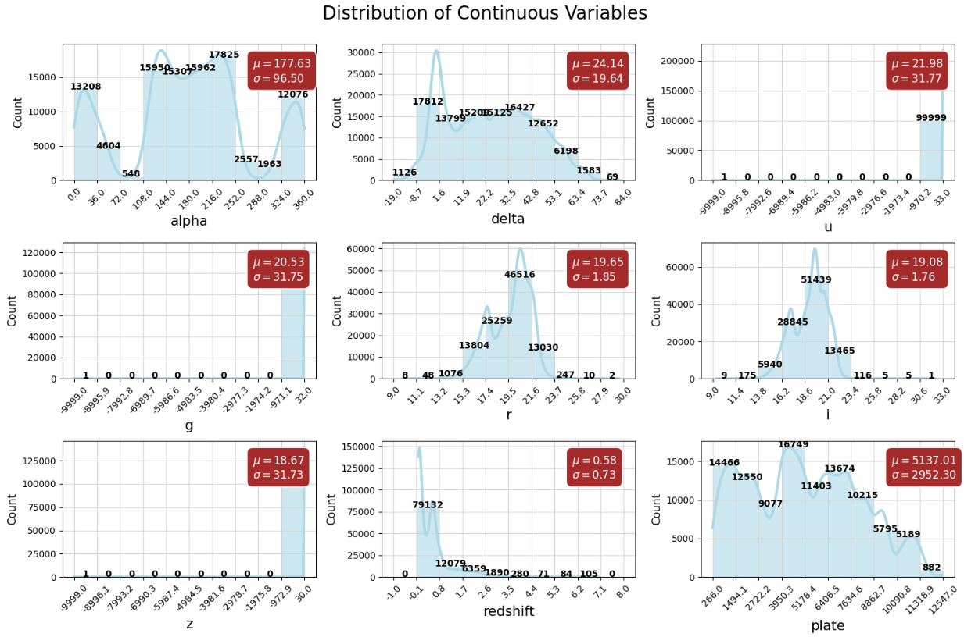
DISTRIBUTION OF CONTINUOUS VARIABLE
Alpha (α): Represents the right ascension in degrees. The distribution shows multiple peaks, indicating certain preferred right ascension angles where observations are more concentrated. The mean (`µ`) is 177.63, with a standard deviation(`σ`) of 96.50.
Delta(δ): Represents the declination in degrees. The distribution is skewed towards lower values, with a significant peak around 0-10 degrees.The mean (`µ`) is 177.63, with a standard deviation(`σ`) of 96.50.
U: This is the ultraviolet magnitude of the stellar objects. The data appears to have a major peak at the highest magnitude value, with many objects around `µ = 32.0`. The mean (`µ`) is 21.98, with a standard deviation (`σ`) of 31.77.
G: This magnitude represents the green part of the spectrum. The distribution is highly skewed, with a majority of the data at a high magnitude value. The mean (`µ`) is 20.53, with a standard deviation (`σ`) of 31.75.
R: The red magnitude of the stellar objects, showing a distribution with two peaks around `r = 14.0` and ` r = 17.0`. The mean (`µ`) is 19.65, with a standard deviation (`σ`) of 1.85.

Slide 9
I: Represents the near-infrared magnitude. The data shows a distribution similar to the `r` magnitude, with peaks around similar values. The mean (`µ`) is 19.08, with a standard deviation (`σ`) of 1.76.
Z: The distribution of the z-band (near-infrared) magnitude is similar to that of `g` magnitude, with a major peak at high magnitude values. The mean (`µ`) is 18.67, with a standard deviation (`σ`) of 31.73.
Redshift: The redshift distribution shows a strong peak around `0.0`, indicating that most observed objects have very low redshift values. The mean (`µ`) is 0.58, with a standard deviation (`σ`) of 0.73.
Plate: This represents the spectroscopic plate number. The distribution indicates that certain plates were used more frequently in observations, with several prominent peaks. The mean (`µ`) is 5137.01, with a standard deviation (`σ`) of 2952.30.

Slide 10
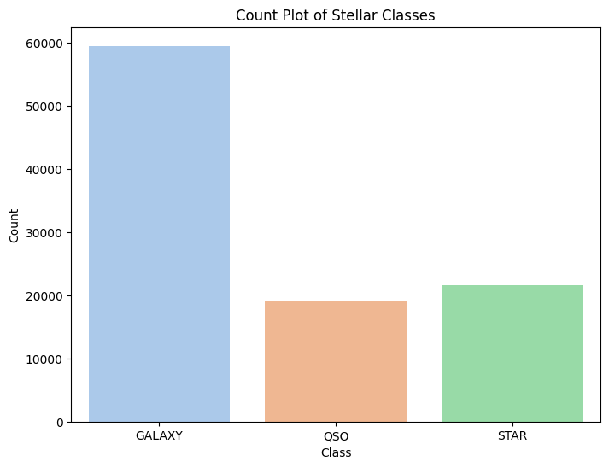
COUNT PLOT OF STELLAR CLASS
The bar chart highlights the distribution of stellar objects in the dataset, showing a clear dominance of the GALAXY class over the other two classes (QSO and STAR). This imbalance in the data could be important when training machine learning models, as it might affect the model's performance and bias towards the most frequent class (GALAXY). Understanding the class distribution is crucial for implementing strategies such as resampling or adjusting class weights during model training to ensure balanced and accurate classification.
Detailed Breakdown:
Classes Represented:
GALAXY: Represented by the blue bar.
QSO (Quasi-Stellar Object): Represented by the orange bar.
STAR: Represented by the green bar.
Counts:
GALAXY: This class has the highest count, with nearly 59445 instances, indicating that galaxies dominate the dataset.
QSO: This class has around 18961 instances, representing quasi-stellar objects.
STAR: This class also has approximately 21594 instances.

Slide 11
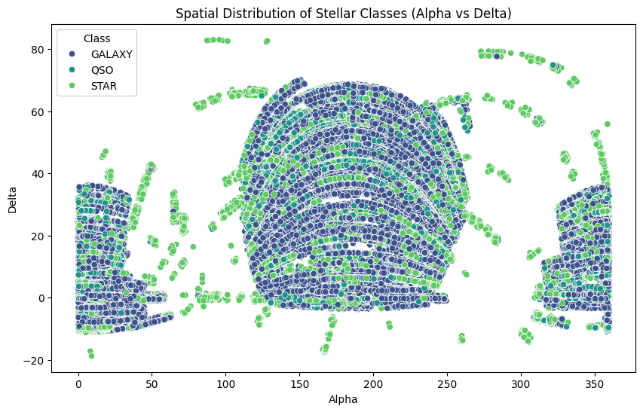
SPATIAL DISTRIBUTION OF
STELLAR CLASSES(ALPHA VS DELTA)
This scatter plot provides a clear visual representation of how different types of stellar objects are distributed across the sky. The GALAXY class is the most prevalent and forms dense structures, while the QSO and STAR classes are less concentrated but still cover a broad area. This visualization is valuable for understanding the observational coverage and the spatial relationships between different classes of celestial objects in the dataset.
Detailed Breakdown:
Axes:
X-axis (Alpha): Represents the right ascension (`α`) in degrees, ranging from 0 to 360. This is essentially the celestial equivalent of longitude.
Y-axis (Delta): Represents the declination (`δ`) in degrees, ranging from -20 to 80. This is the celestial equivalent of latitude.
Classes Represented:
GALAXY: Depicted with blue dots.
QSO: Depicted with orange dots.
STAR: Depicted with green dots.
Spatial Distribution:
GALAXY: The blue dots dominate the central region of the plot, forming dense bands and clusters. This suggests that galaxies are the most widely observed objects in this dataset and are spread across a wide range of right ascension and declination.
QSO: The orange dots are more sparsely distributed and tend to appear interspersed with galaxies, indicating that QSOs are less frequent but still spread across the sky.
STAR: The green dots, representing stars, are distributed throughout the plot but are not as densely clustered as galaxies. They are more evenly spread out across the celestial sphere.

Slide 12
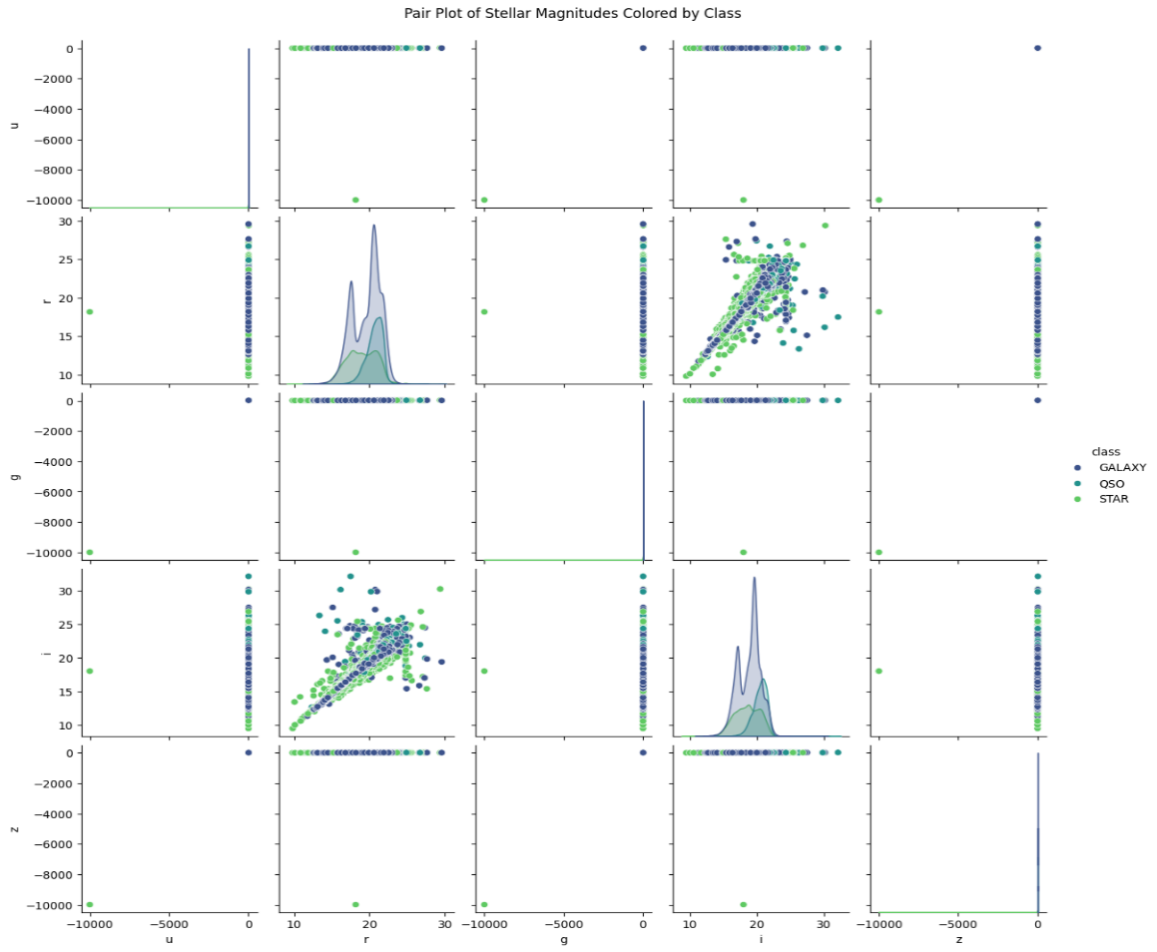
PAIR PLOT OF STELLAR MAGNITUDES COLORED BY CLASS
This pair plot provides a comprehensive view of the relationships between different photometric magnitudes for stellar objects. By color-coding based on class (GALAXY, QSO, STAR), it becomes easier to observe patterns and differences between these classes. The strong correlations between certain magnitudes and the presence of outliers are key insights that could inform further analysis, such as feature selection or the identification of distinct subgroups within the dataset.
Detailed Breakdown:
Pairwise Relationship:
Scatter Plots (Off-diagonal): The scatter plots show pairwise relationships between the different magnitudes. For example, the plot at the intersection of row `r` and column `g` shows the relationship between `r` and `g` magnitudes.
Distribution Plots (Diagonal): The diagonal plots show the distribution of each magnitude. For example, the plot in the `r` row and column shows the distribution of the `r` magnitude for each class.
Observations:
The scatter plots often show a strong correlation between certain magnitudes (e.g., `r` vs `i`), where the points form a diagonal line. This indicates that as one magnitude increases, the other tends to increase as well.
The distributions along the diagonal reveal the spread and density of the magnitude values for each class. For example, the `r` magnitude shows distinct peaks in its distribution, which might correspond to different types of objects or observational biases.
There are outliers visible in the scatter plots, particularly for the `u`, `g`, and `z` magnitudes, where some points lie far from the main clusters. These outliers could represent rare or unique observations.

Slide 13
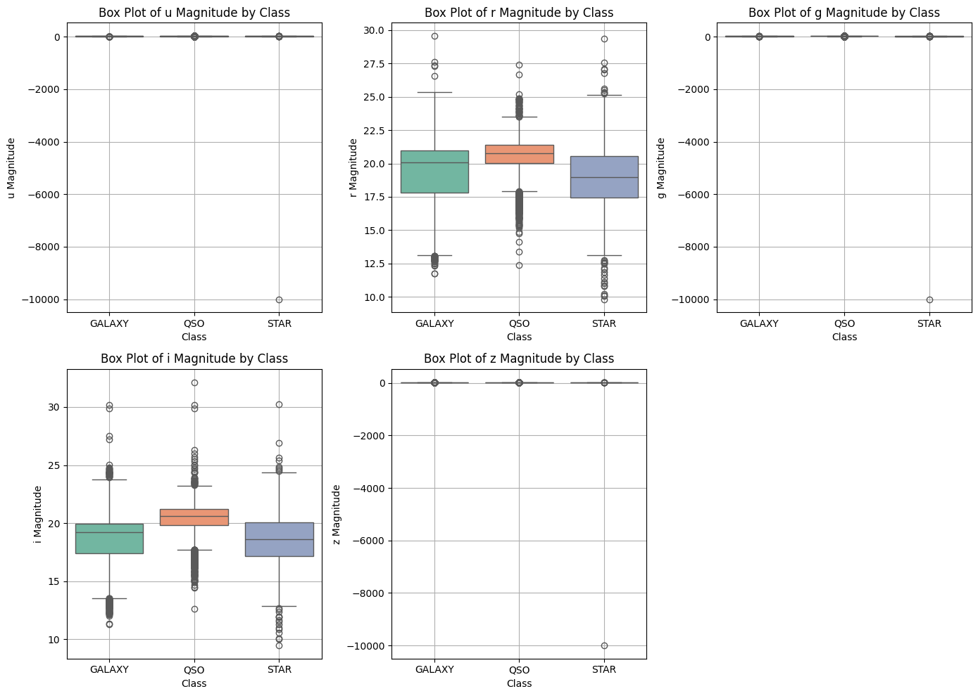
BOXPLOT OF MAGNITUDES
These box plots provide a comparative view of how the different photometric magnitudes vary across the GALAXY, QSO, and STAR classes. While some magnitudes show clear distinctions and distributions that can aid in classification, others (especially `u`, `g` and `z`) may require further investigation due to the presence of extreme outliers and limited variation within the classes.
Detailed Breakdown:
Axes:
The x-axis for each plot represents the different stellar classes: GALAXY, QSO, and STAR.
The y-axis represents the magnitude values for the respective photometric filter (`u`, `g`, `r`, `i`, `z`).
Box-plot Interpretation:
Each box plot shows the distribution of magnitude values for each class.
The central line in each box represents the median value.
The edges of the box represent the interquartile range (IQR), which includes the middle 50% of the data
The "whiskers" extend to the smallest and largest values within 1.5 times the IQR from the first and third quartiles.
Data points outside the whiskers are considered outliers and are plotted as individual points.

Slide 14
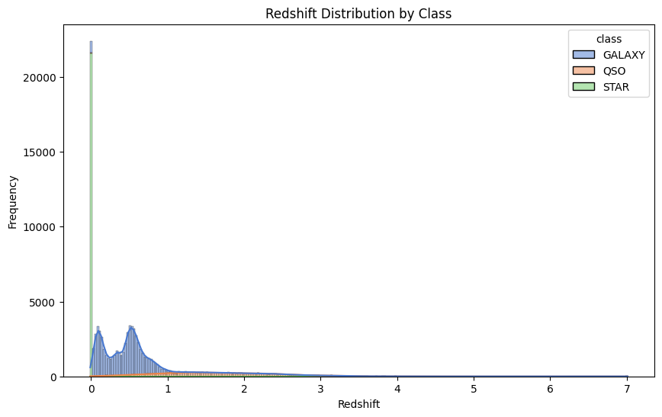
REDSHIFT DISTRIBUTION BY CLASS
This histogram effectively visualizes how redshift varies across different stellar classes. The STAR class shows a sharp peak at 0 redshift, reflecting their proximity. The GALAXY class shows a broader distribution, with a significant portion at low redshifts. The QSO class, associated with distant quasars, shows a wider distribution, with peaks at higher redshifts. This visualization is useful for understanding the spatial distribution of these objects in the universe based on their redshift.
Detailed Breakdown:
Axes:
The x-axis represents the redshift values.
The y-axis represents the frequency or count of observations for each redshift value.
Class-wise Observation:
GALAXY: The distribution is wider and extends across a range of redshift values, peaking around 0.2 and gradually tapering off.
QSO: The distribution for QSOs is more spread out, with a notable presence in the higher redshift range, especially between 0.5 and 2, reflecting the nature of QSOs as very distant objects.
STAR: The STAR class has an overwhelming concentration at a redshift of 0, indicating that the stars observed are relatively close and exhibit little to no redshift.

Slide 15
PREPROCESSING
Irrelevant Feature Removal: All features in the dataset appears to be relevant based on EDA. We will retain all the columns, ensuring no valuable information is lost, especially given the dataset’s small size.
Missing Value Treatment: No missing value found in the dataset.
Outliers Treatment: Checked outliers using IQR method for the continuous features and upon identifying outliers, nature of algorithm, and given small dataset size direct removal of outliers might not be best approach. Instead, we will apply Box-Cox transformation to stabilize variance and make the data more normal-distribution.
Categorical Feature Encoding: Applied one hot encoding to the columns like ”class” since these variables are nominal variables.
Feature Scaling: Are imp. for the algorithms that are sensitive to the magnitude and scale of feature, but not all algorithms requires scaling like Decision Tree are scale-invariant and given our intent to use mix-model we’ve chosen to handle scaling later using pipelines.

Slide 16
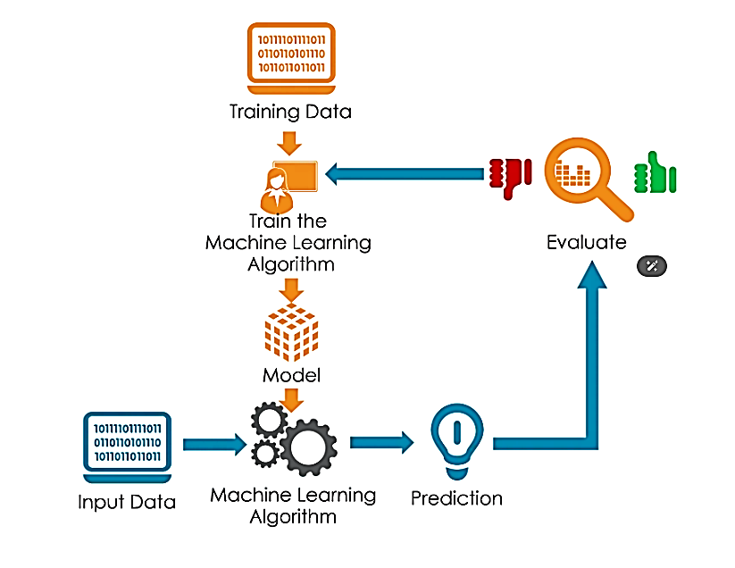
TRAIN TEST SPLIT
We divided the data into training (70%) and testing (30%) sets.
Setting a random state ensures consistent results and using stratify=y maintains a proportional distribution of the target variable in both sets.
SPLITING THE DATA INTO X & Y
We divided the dataset into two parts: X and y.
"X" typically represents the independent Variables, and "y" represents the Dependent (Class variable) that we want to predict or understand.

Slide 17
MODEL SELECTION
Models used:
Logistic Regression: logistic Regression is commonly used for binary classification problems. it's preferred because it provides a simple an efficient way to model the relationship between the independent variables and the probability of a certain outcome.
Decision Tree: Decision Tree algorithms are used for classification because they are simple, computationally efficient, and effective in handling high-dimensional data.
Works best for categorical independent columns.
Support Vector Machine: SVM is a powerful supervised algorithm that works best on smaller datasets but on complex ones. Support Vector Machine(SVM)can be used for both regression and classification tasks, but generally, they work best in classification problems.
Random Forest Algorithm: Random Forest is a robust supervised algorithm suitable for both regression and classification tasks.
XGBoost: XGBoost is a powerful, efficient gradient boosting algorithm used in machine learning. It excels in handling large datasets, reducing overfitting, and delivering high accuracy in predictive modeling tasks.

Slide 18
CLASSIFICATION REPORT
 | precision_0 | precision_1 | precision_2 | recall_0 | recall_1 | recall_2 | f1_0 | f1_1 | f1_2 | macro_avg_precision | macro_avg_recall | macro_avg_f1 | Accuracy
XG | 0.98 | 0.96 | 0.99 | 0.98 | 0.93 | 1.0 | 0.98 | 0.95 | 0.99 | 0.97 | 0.97 | 0.97 | 0.98
SVM | 0.97 | 0.93 | 0.96 | 0.96 | 0.91 | 1.0 | 0.97 | 0.92 | 0.98 | 0.95 | 0.96 | 0.95 | 0.96
RF | 0.95 | 0.90 | 0.98 | 0.96 | 0.83 | 1.0 | 0.95 | 0.86 | 0.99 | 0.94 | 0.93 | 0.93 | 0.94
LR | 0.95 | 0.80 | 0.97 | 0.92 | 0.85 | 1.0 | 0.94 | 0.83 | 0.99 | 0.91 | 0.92 | 0.92 | 0.93
DT | 0.88 | 0.86 | 1.00 | 0.97 | 0.58 | 1.0 | 0.92 | 0.69 | 1.00 | 0.91 | 0.85 | 0.87 | 0.90

Slide 19
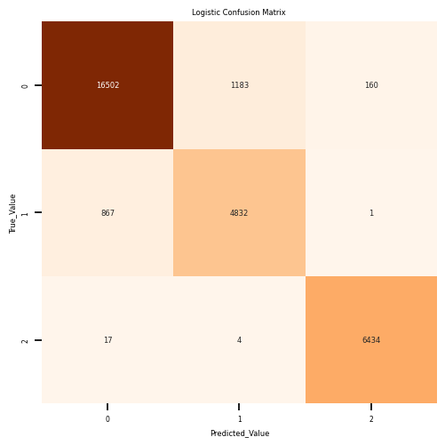
CONFUSION MATRIX
This image shows the confusion matrix generated by a Logistic Regression model, which is used to evaluate its performance across three classes: 0, 1, and 2. The rows represent the actual values (True Value), and the columns represent the predicted values (Predicted Value).
Breakdown:
Class 0 (True Value 0): 1. Correctly predicted as 0: 16,502 times. 2. Misclassified as class 1: 1183 times. 3. Misclassified as class 2: 160 times.
Class 1 (True Value 1): 1. Misclassified as class 0: 867 times. 2. Correctly predicted as class 1: 4832 times. 3. Misclassified as class 2: 1 times.
Class 2 (True Value 2): 1. Misclassified as class 0: 17 times. 2. Misclassified as class 1: 4 times.
3. Correctly predicted as class 2: 6,434 times.

Slide 20
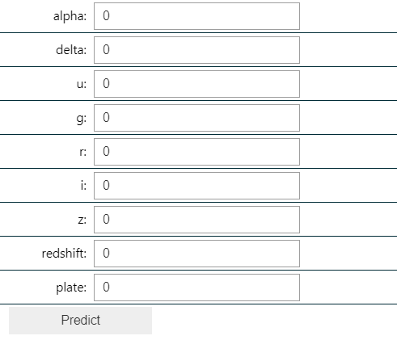
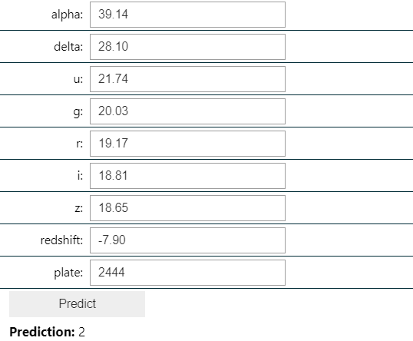
PREDICTION LAYOUT
BEFORE PREDICTION
AFTER PREDICTION

Slide 21



CONCLUSION
Key Findings
The results indicated that the XGBOOST model had the highest accuracy of 98%
The study utilized the Kaggle Stellar Object Classification dataset with 100000 instances, and all algorithms were implemented on Jupyter Notebook
The accuracies of all algorithms were above 85% with the lowest accuracy of 90% given by Decision Tree and the highest accuracy given XGBOOST as previously mentioned.
Limitations
Certainly! The project faces limitations such as potential data imbalance, which could lead to bias towards the majority class.
Feature engineering may be complex and time-consuming, and data quality issues could arise from missing or noisy data.
Future research
Future research must ensure robustness, generalizability, and interpretability for informed decision-making based on study findings. It's important to check how duplicate data and unusual values affect the model's accuracy. Creating strategies to deal with these issues is valuable for improving model performance.

Slide 22
APPENDICES & REFERENCES
BIA:
https://lms.bostoninstituteofanalytics.org/courses/data-science-business-analytics/
KAGGLE:
https://www.kaggle.com/
Streamlit:
https://stellerobjectclassification-milan-virash.streamlit.app/

Slide 23


