Slide 1

My Internship Experience
Francesco Milani
5AI
a.s. 2019/2020

Slide 2
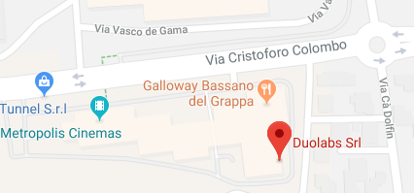
Introduction
- Name: Duolabs Srl
- Location: Via Baggi 28 – Bassano Del Grappa (Legal Office)
-Description: Small company, 4 employees
- Tutor : Riccardo Alessi
- Period : 20 May – 21 June
- Working days: Monday – Friday
- Working time: 8:30 am – 1:00 pm / 2:00 pm – 5:30 pm

Slide 3

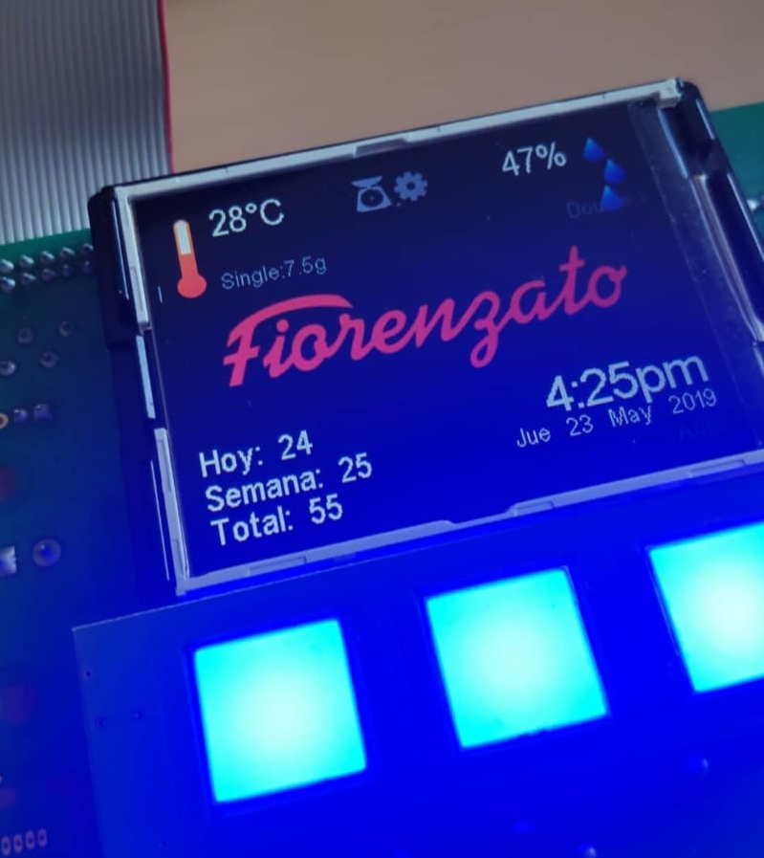
What i’ve done
PC configuration
  Configure and build a workstation
Application programming on Qt
  Serial communication with electronic board
  Electronic board monitoring program
Software test
  Coffee grinder and sterilizing machine board test
Manual work
  Office inventory
  Pieces assembly

Slide 4

My personal comment
Pros
  IT work reality
  Manual work
  Together with a classmate
Cons
  Programming
  Repetitive work
  No supervision

