Slide 1
My Internship Experience
Francesco Milani
5AI
a.s. 2019/2020

Slide 2
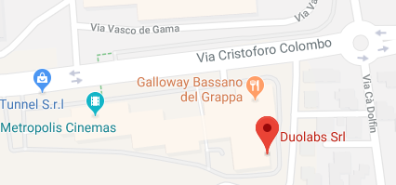
Introduction
- Name: Duolabs Srl
- Location: Via Baggi 28 – Bassano Del Grappa (Legal Office)
-Description: Small company, 4 employees
- Tutor : Riccardo Alessi
- Period : 20 May – 21 June
- Working days: Monday – Friday
- Working time: 8:30 am – 1:00 pm / 2:00 pm – 5:30 pm

Slide 3

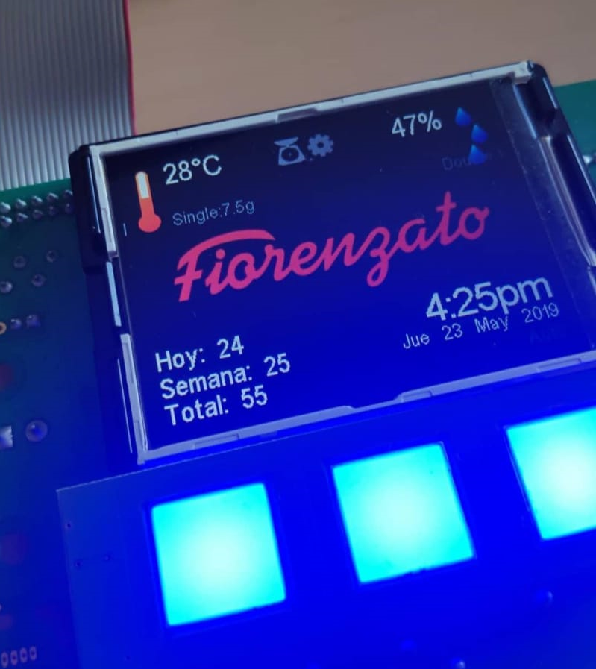
What i’ve done
PC configuration
Configure and build a workstation
Application programming on Qt
Serial communication with electronic board
Electronic board monitoring program
Software test
Coffee grinder and sterilizing machine board test
Manual work
Office inventory
Pieces assembly

Slide 4

My personal comment
Pros
IT work reality
Manual work
Together with a classmate
Cons
Programming
Repetitive work
No supervision

