Slide 1

My Internship Experience
Francesco Milani
5AI
a.s. 2019/2020

Slide 2
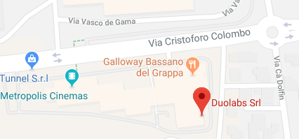
Introduction
Name: Duolabs Srl
Location: Via Baggi 28 – Bassano Del Grappa (Legal Office)
Description: Small company, 4 employees
Tutor : Riccardo Alessi
Period : 20 May – 21 June
Working days: Monday – Friday
Working time: 8:30 am – 1:00 pm / 2:00 pm – 5:30 pm
1

Slide 3

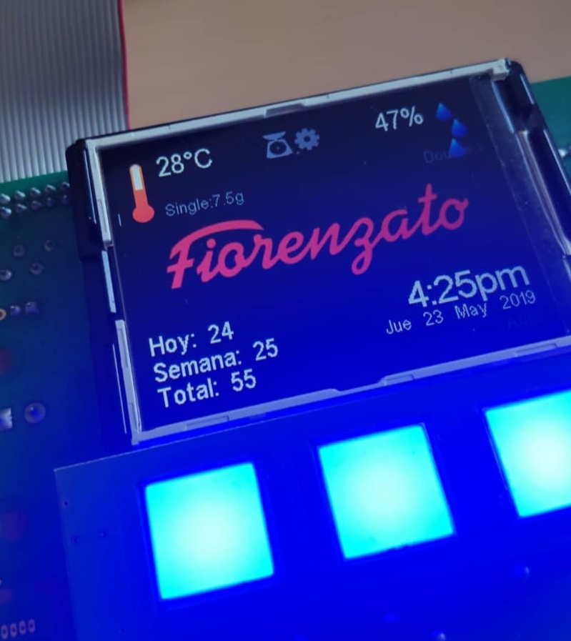
What I’ve done
PC configuration
  Configuring and building a workstation
Application programming on Qt
  Serial communication with electronic board
  Electronic board monitoring program
Software test
  Coffee grinder and sterilizing machine board test
Manual work
  Office inventory
  Assembling pieces
2

Slide 4
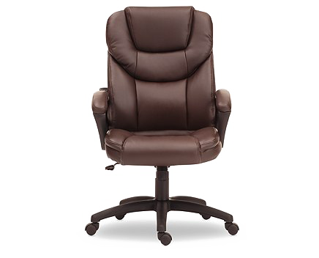
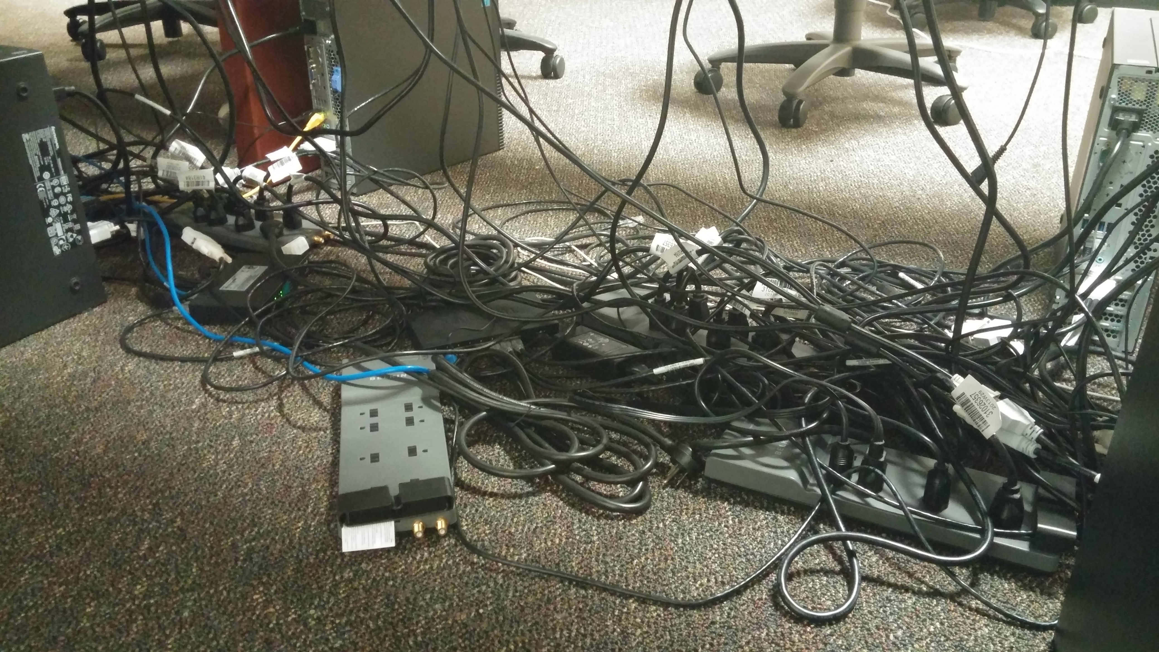
Workplace safety
Hazards and risks
Dangerous iron objects
Power strip on the desk
Confusion on cable management
Safety rules adopted
Desk height for a correct position
Office chair comfortable
PPE required
No suitable PPE rules
Company’s safety
No priority
No particular risks or hazards on IT field
3

Slide 5

My personal comment
Pros
  IT work reality
  Manual work
  Collaboration with a classmate
Cons
  Programming
  Repetitive work
  No supervision
4

