Slide 1
The Airliner
Milani Francesco – 5^AI

Slide 2

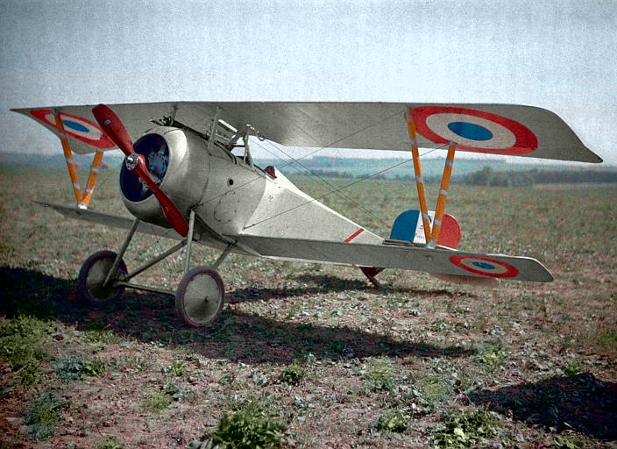
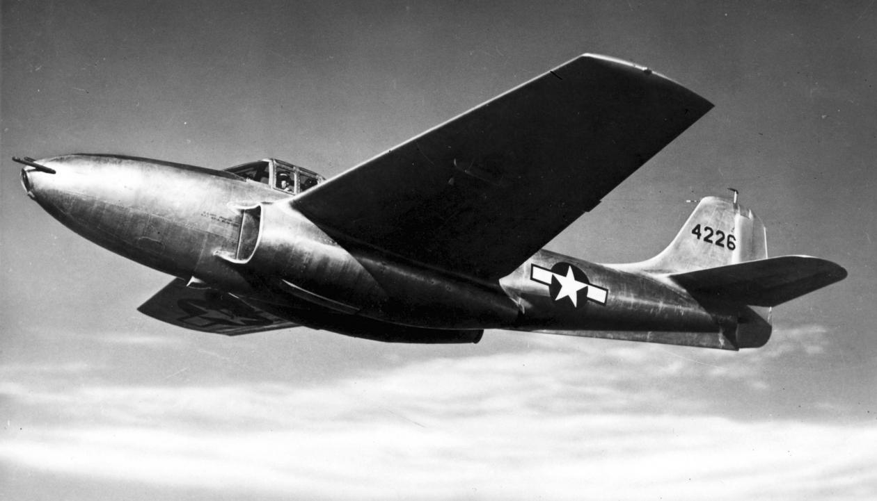
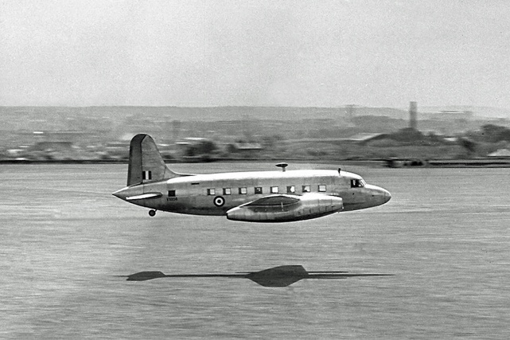
Introduction
1st warplane – World War I
1st Jet Plane – World War II
1st Ariliner – 1952
Major manufacturers: Boeing, McDonnel Douglas, Tupolev, Airbus, Antonov

Slide 3
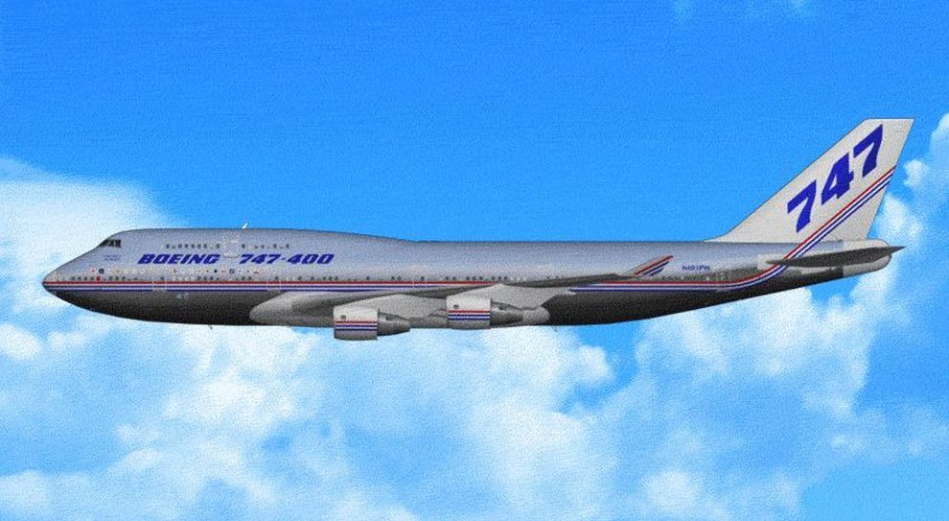
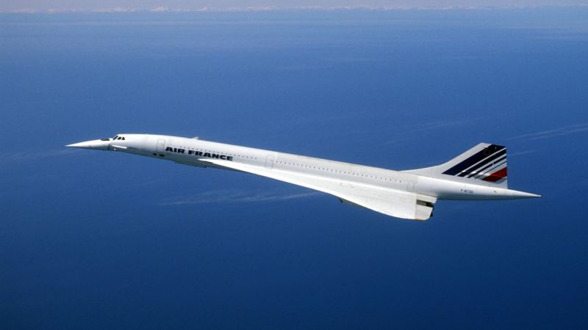
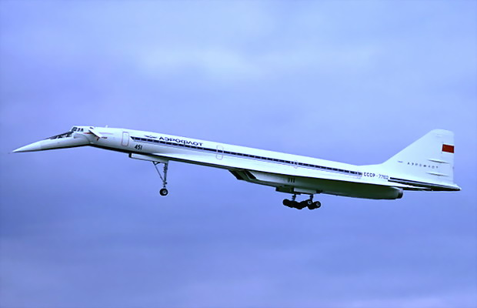
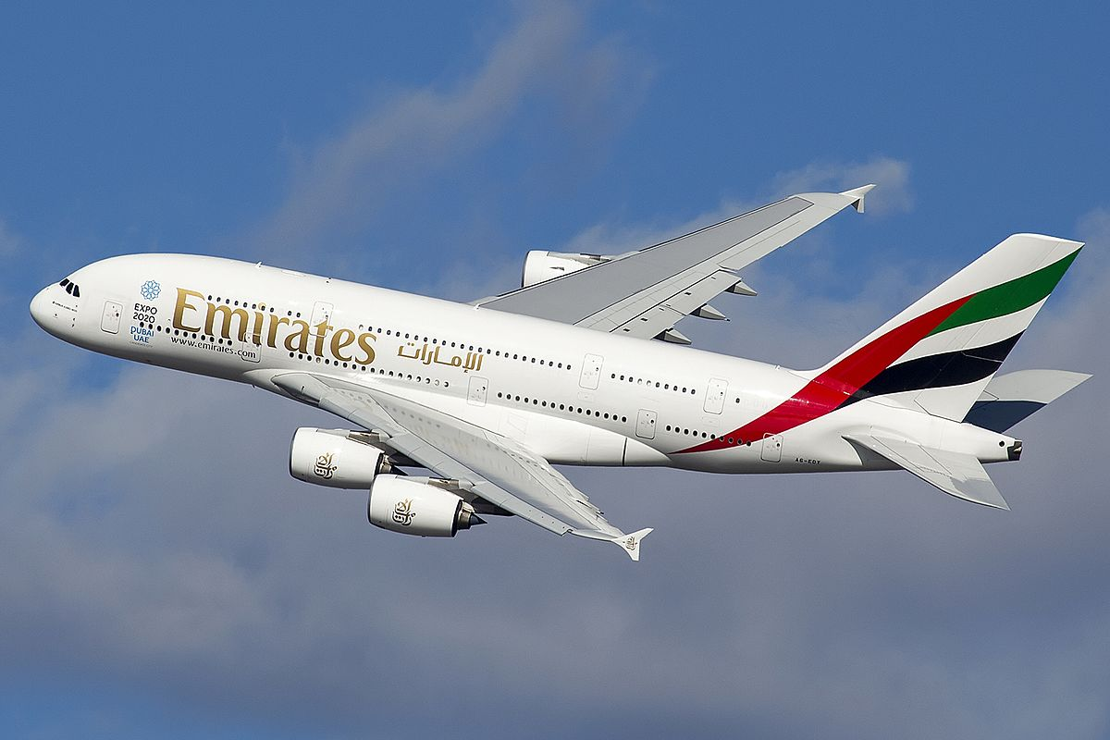
Most famous airliners
Boeing 747
Aérospatiale-BAC Concorde
Tupolev TU-144
Airbus A380

Slide 4
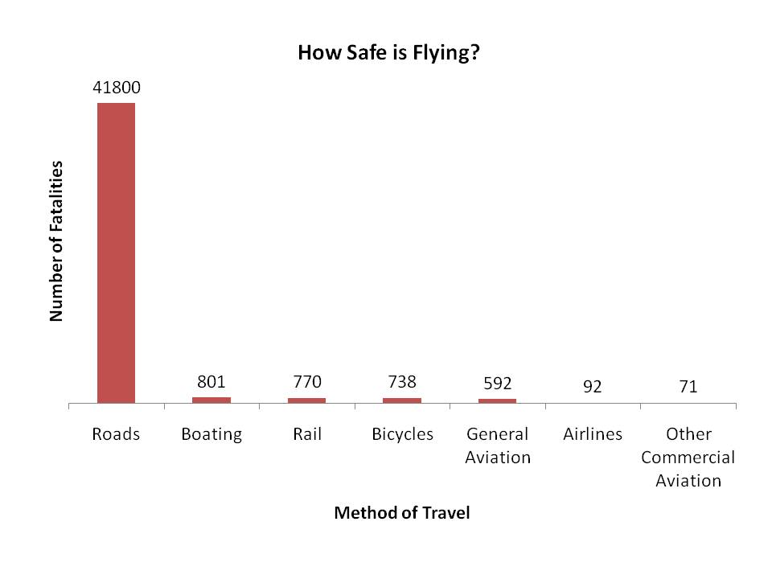
Strong points
Easy to travel over long distances
Travel shortness
Safer than other travel methods
The chart shows that the number of fatalities is very low for airliners in comparison with cars or others method of travel

Slide 5
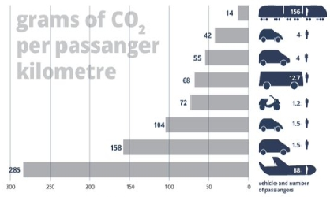
Weak points
Pollution
Expensive
Passengers can be annoying
The chart shows the grams of Co2 per passenger, where we can see that the airliner is more polluting than others vehicles

Slide 6
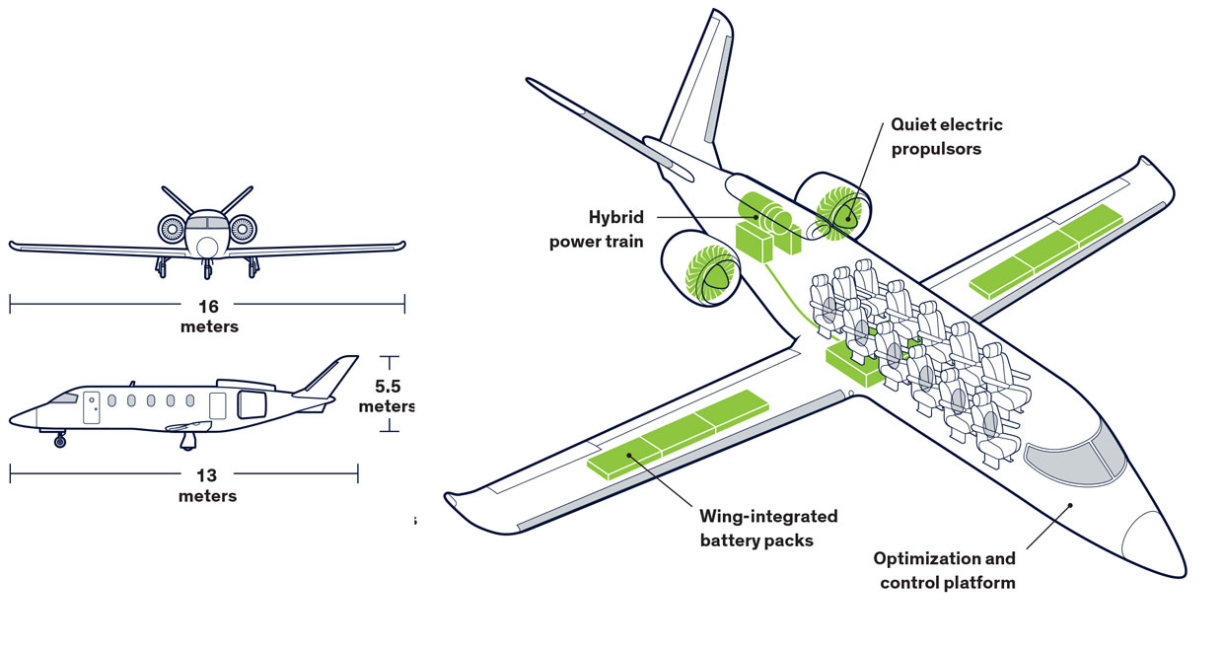
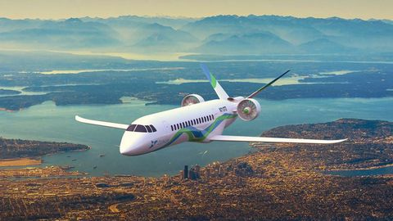
Possible improvements
2020 / 2025
Hybrid airplane
2025 / 2030
E-Plane

Slide 7
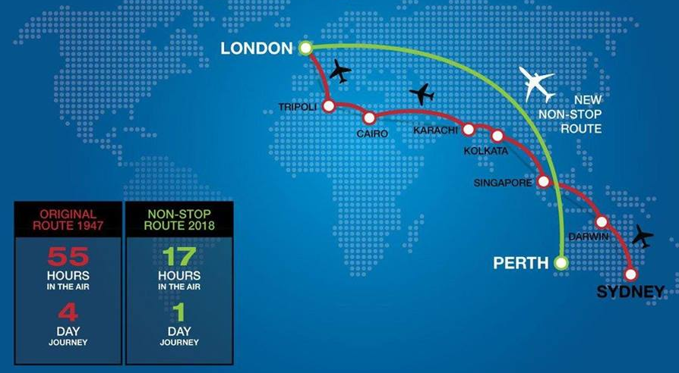
Personal opinion
Best mean of transportation for long distances
Mean transportation of the future
The flying experience is unique

Slide 8
The End

