Slide 1
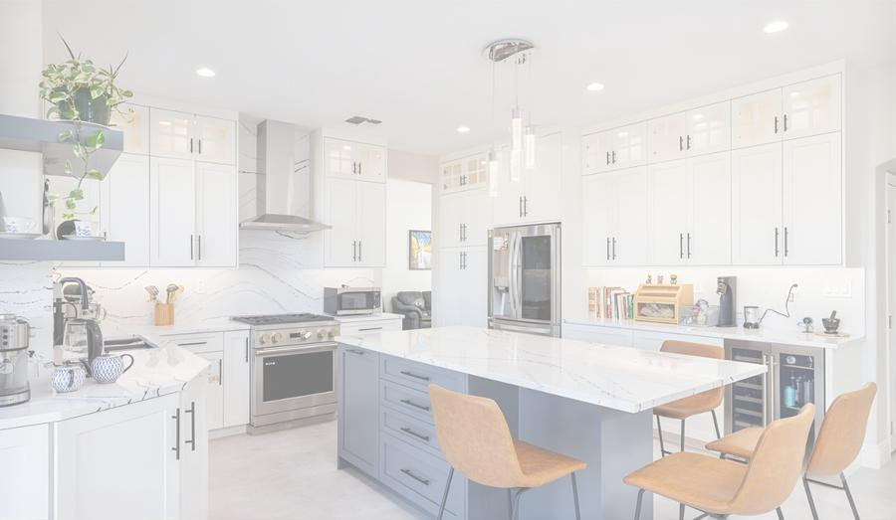
INTRODUCTION PROPOSAL
ABODABLE
RENOVATIONS
Kitchen Cabinet Renovation Services
Imagine your dream kitchen
before we build it.
Virtual Design Technology by
Mile High AI Labs · milehighlabs.ai
ABODABLE RENOVATIONS · Powered by Mile High AI Labs
www.milehighlabs.ai

Slide 2
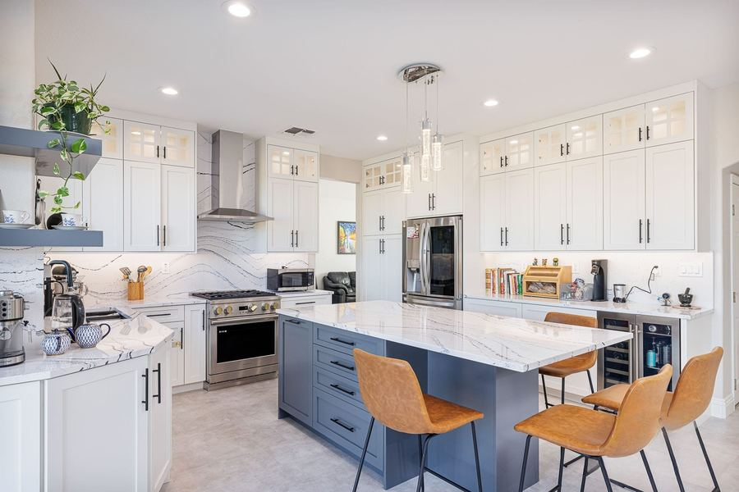
ABOUT US
Renovation You Can
See Before It Happens
At Abodable Renovations, we believe every homeowner and real estate investor deserves confidence before the project begins.
Our AI-powered service starts with a high-fidelity virtual rendering of your renovated kitchen in your chosen style, finish, and hardware.
Once you love what you see, we provide a detailed price estimation and a clear path to making it real.
ABODABLE RENOVATIONS · Powered by Mile High AI Labs
www.milehighlabs.ai

Slide 3
TECHNOLOGY PARTNERSHIP
Virtual Design Powered
by Artificial Intelligence
AI
VISION
BEFORE
YOU
BUILD
Mile High AI Labs is a cutting-edge virtual design studio that transforms renovation concepts into photorealistic renders. Their AI-driven platform maps multiple cabinet styles, finishes, handle options, and materials directly onto images of your actual kitchen — before any physical work begins.
MILE HIGH AI LABS
Virtual Design Partner
milehighlabs.ai
ABODABLE RENOVATIONS · Powered by Mile High AI Labs
www.milehighlabs.ai

Slide 4






WHAT WE OFFER
Our Services
AI-Powered Virtual Design
Style Consultation
Detailed Price Proposal
Photorealistic renders of your new kitchen — in your chosen style, finish, and hardware — before work begins.
Explore modern high-gloss, classic shaker, and more. Paired with knobs, handles, and premium material options.
Comprehensive, itemized estimates covering materials, hardware, labor, and installation with full transparency.
Cabinet Renovation & Install
Hardware & Material Selection
Investment Property Packages
Precision removal and expert installation ensuring the finished result matches your approved design exactly.
Premium hardware and finishes across multiple price tiers to match your aesthetic vision and budget.
ROI-maximizing design choices, rapid turnarounds, and cost-efficient selections for real estate investors.
ABODABLE RENOVATIONS · Powered by Mile High AI Labs
www.milehighlabs.ai

Slide 5
THE PROCESS
How It Works
01
02
03
04
Share Your Space
Design Consultation
Virtual Visualization
Proposal & Build
Send us photos of your current kitchen. We review your layout, cabinet structure, and space.
We discuss your preferred styles, materials, colors, and hardware. Our specialists guide every option.
Mile High AI Labs renders your new kitchen. Review and refine until it matches your exact vision.
You receive a detailed price proposal. Once confirmed, we handle the full renovation start to finish.
ABODABLE RENOVATIONS · Powered by Mile High AI Labs
www.milehighlabs.ai

Slide 6
TRANSFORMATION
GALLERY
Every project below was visualized virtually before the first nail was driven
ABODABLE RENOVATIONS · Powered by Mile High AI Labs
www.milehighlabs.ai

Slide 7
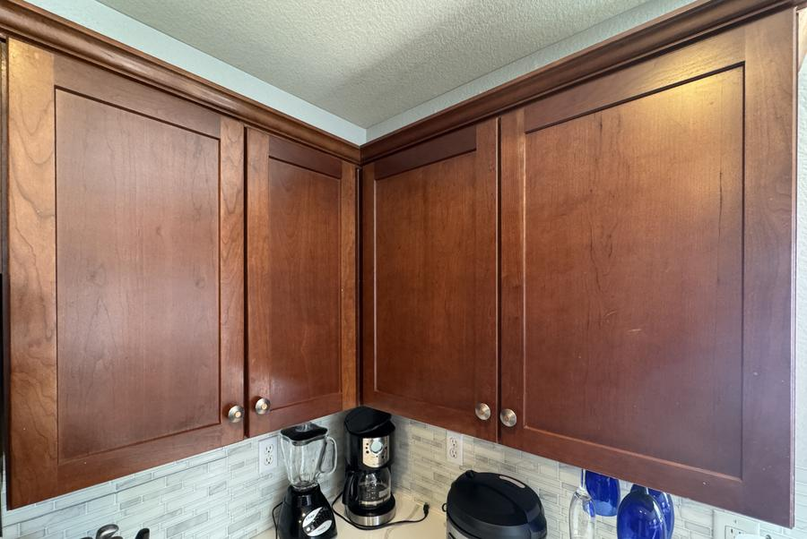
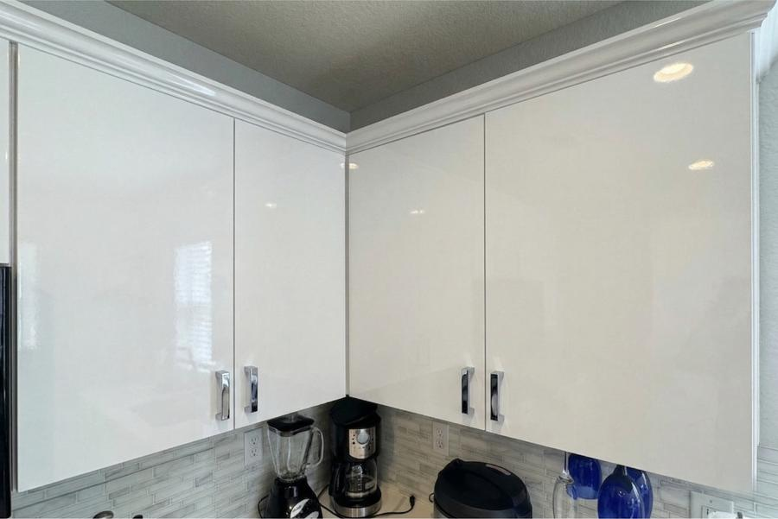
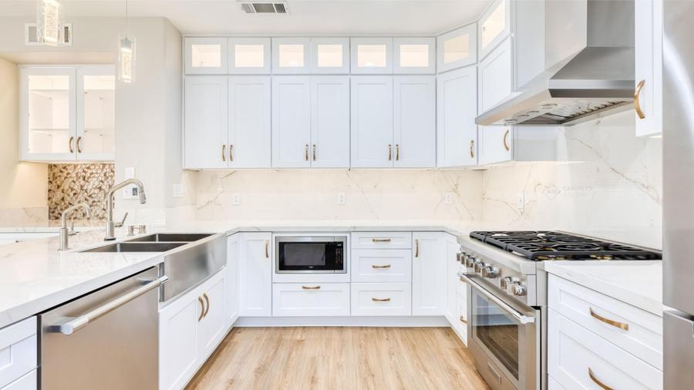
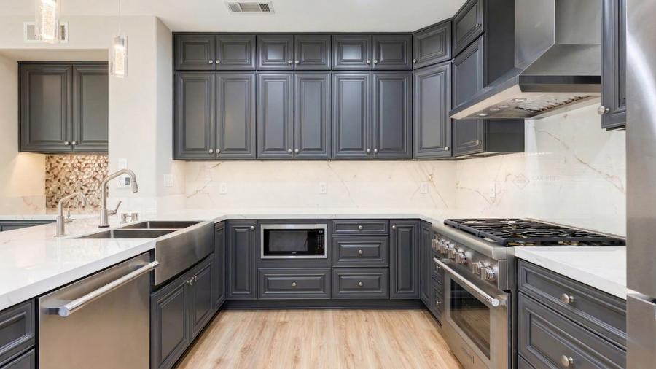
Before & After — 1 of 10
BEFORE
AFTER
BEFORE
AFTER
→
→
Classic Brown → Modern White High-Gloss
Charcoal Gray → Bright White Shaker
Silver bar handles · High-gloss finish · Contemporary style
Gold pull handles · Shaker door profile · Quartz countertops
ABODABLE RENOVATIONS · Powered by Mile High AI Labs
www.milehighlabs.ai

Slide 8
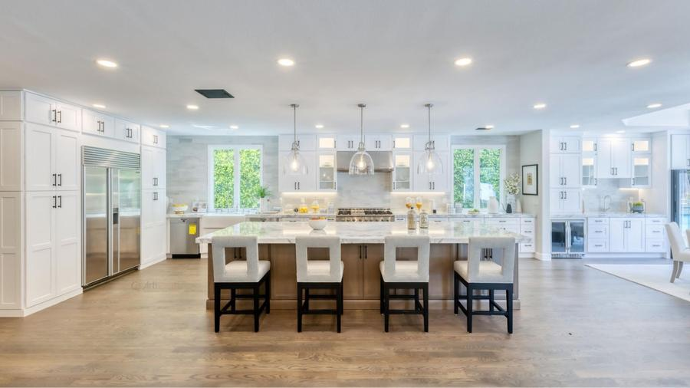
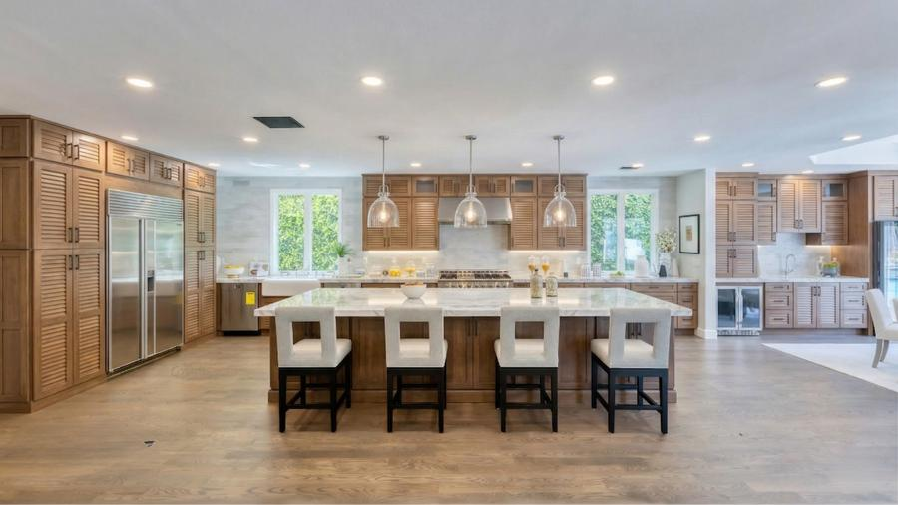
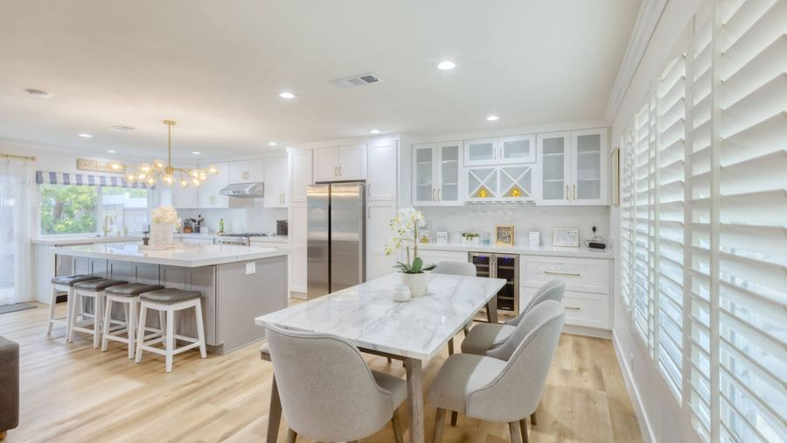
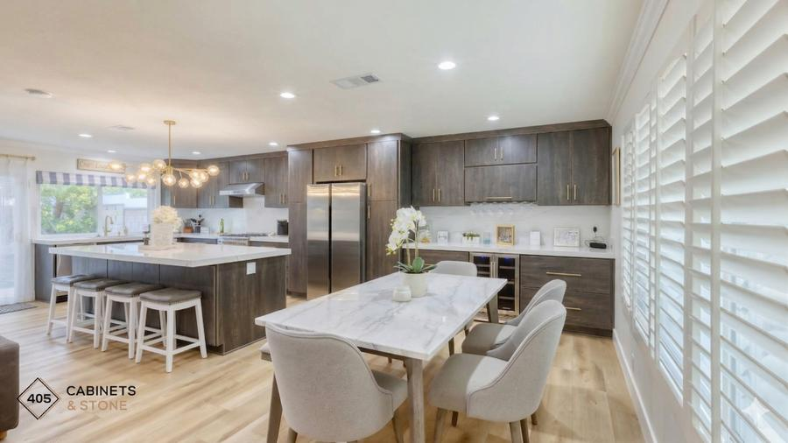
Before & After — 3 of 10
BEFORE
AFTER
BEFORE
AFTER
→
→
Warm Oak → Crisp White Open Kitchen
Bright Open Kitchen → Elevated White & Gold
Black hardware · Open shelving accents · Full kitchen transformation
Gold cabinet hardware · Marble backsplash · Open concept layout
ABODABLE RENOVATIONS · Powered by Mile High AI Labs
www.milehighlabs.ai

Slide 9
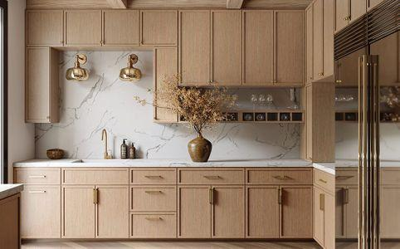
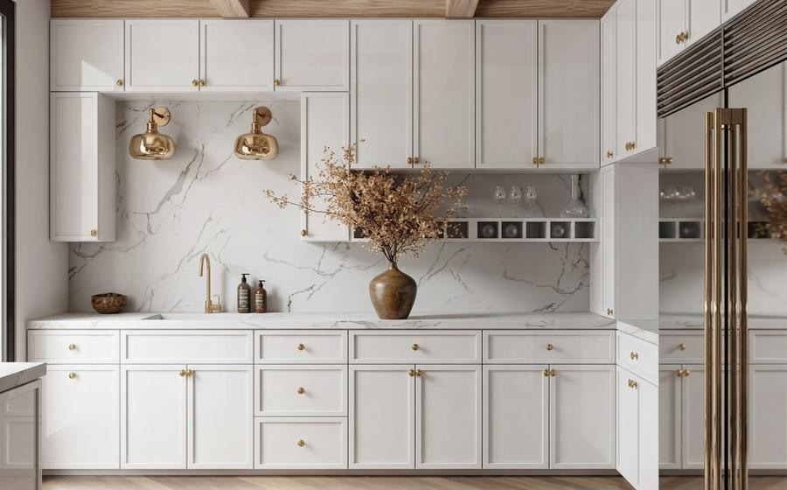
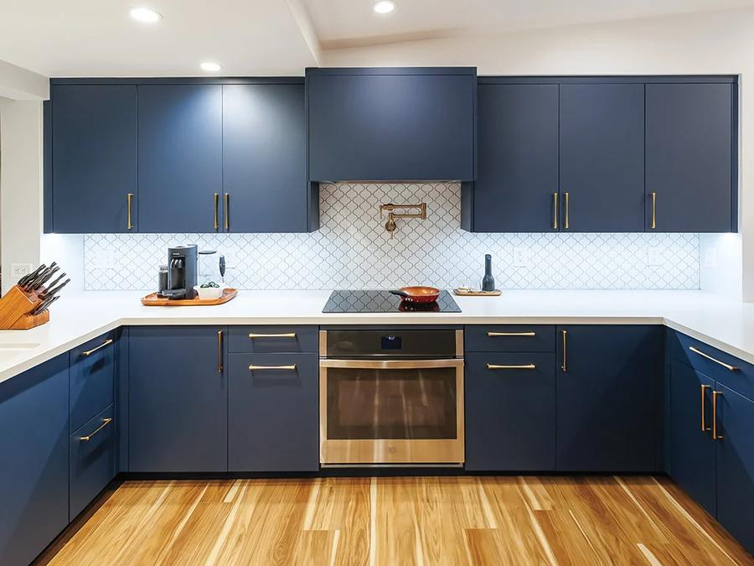
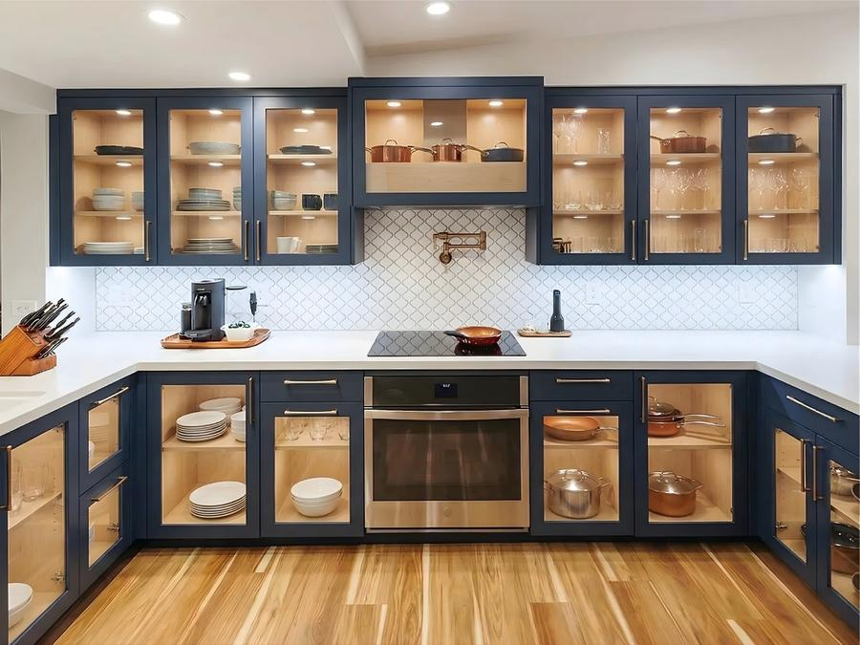
Before & After — 5 of 10
BEFORE
AFTER
BEFORE
AFTER
→
→
Natural Oak → Elegant Cream & Gold
Dated Cabinetry → Fresh Modern Finish
Gold round knobs · Marble countertops · Luxury finish
Updated hardware · New door profiles · Complete restyling
ABODABLE RENOVATIONS · Powered by Mile High AI Labs
www.milehighlabs.ai

Slide 10
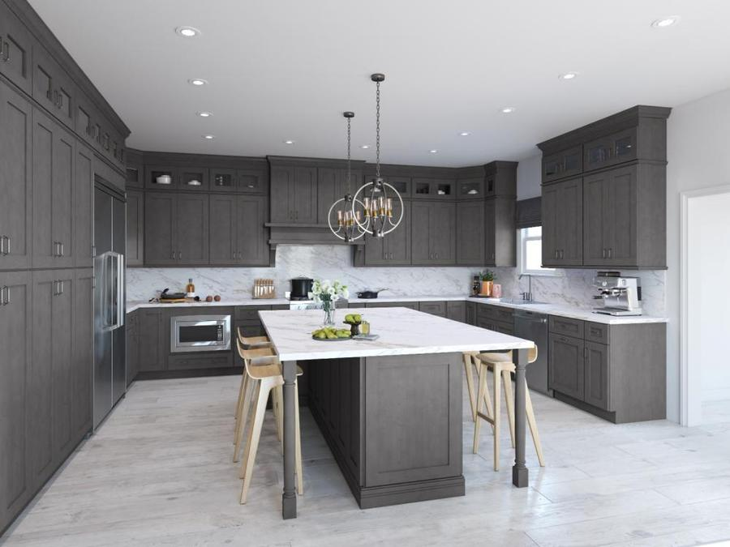
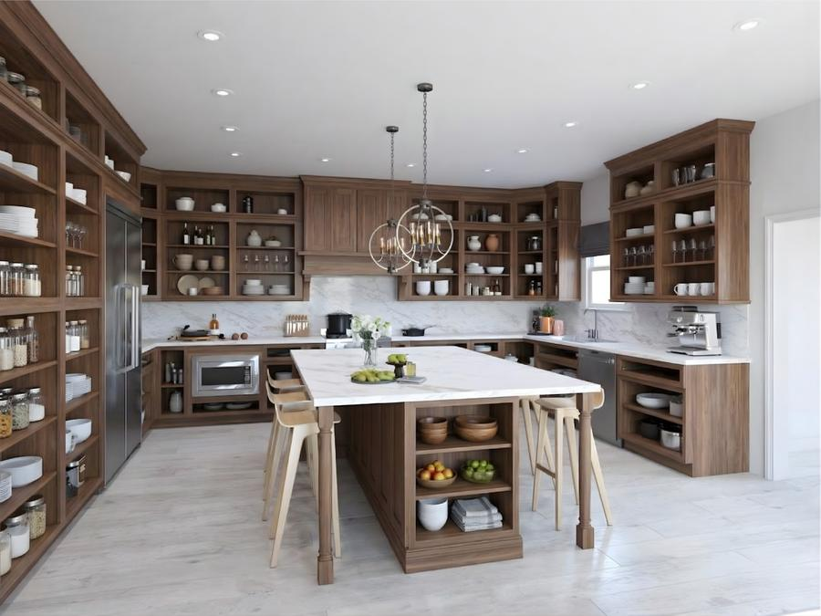
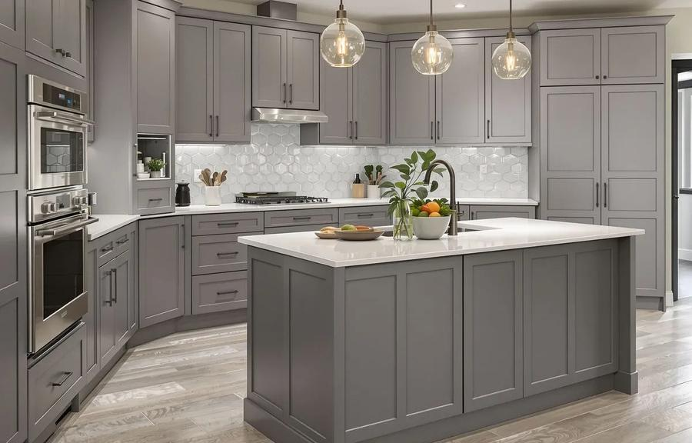
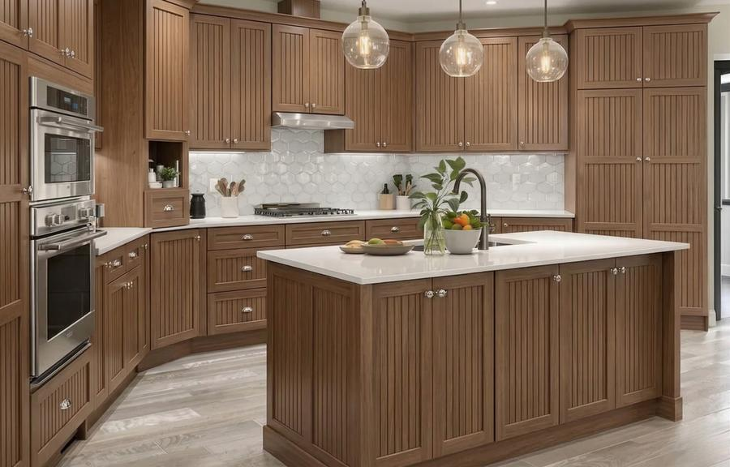
Before & After — 7 of 10
BEFORE
AFTER
BEFORE
AFTER
→
→
Traditional Style → Contemporary Upgrade
Worn Finish → Refreshed & Refined
Brushed nickel hardware · Clean panel doors · Bright finish
Matte hardware · Two-tone color option · Improved storage
ABODABLE RENOVATIONS · Powered by Mile High AI Labs
www.milehighlabs.ai

Slide 11
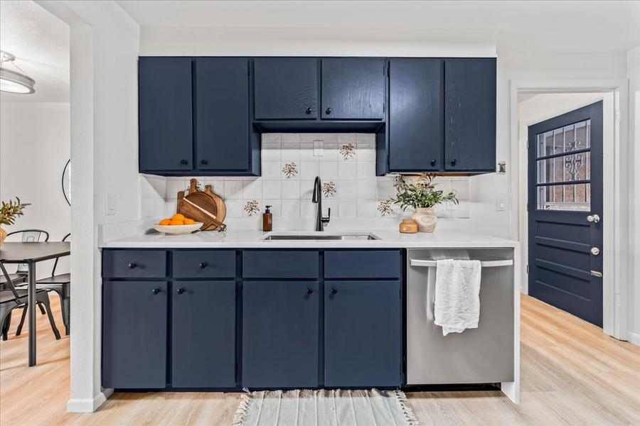
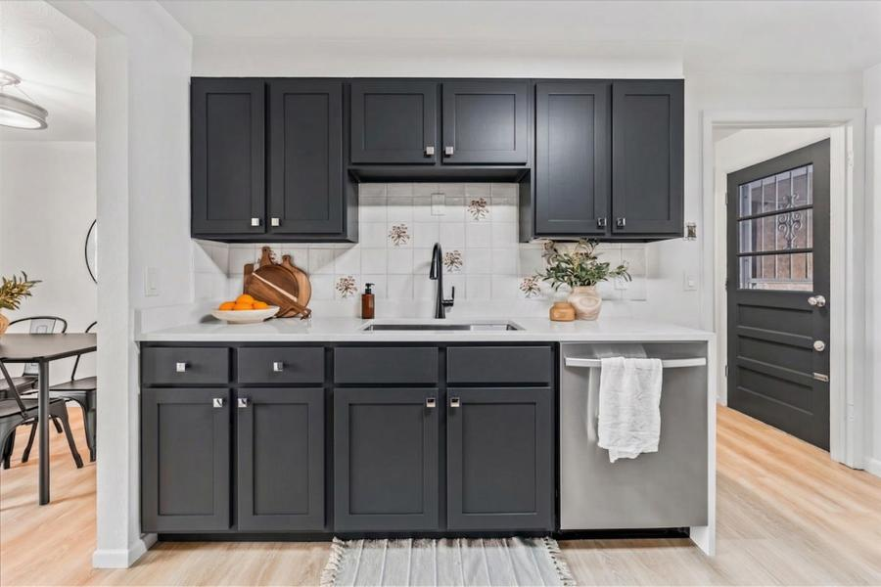
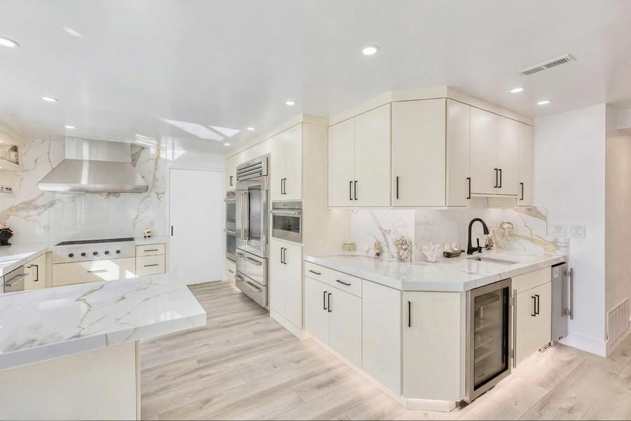
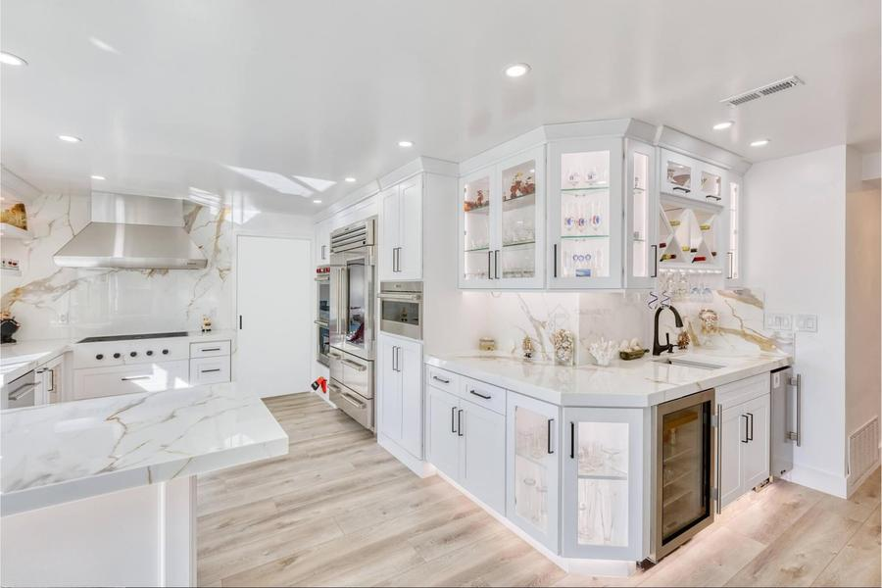
Before & After — 9 of 10
BEFORE
AFTER
BEFORE
AFTER
→
→
Builder-Grade → Custom Elevated Look
Outdated Kitchen → Showroom-Ready
Statement hardware · Premium material upgrade · Designer aesthetic
Mixed metal accents · Custom panel inserts · Full transformation
ABODABLE RENOVATIONS · Powered by Mile High AI Labs
www.milehighlabs.ai

Slide 12






See It Before You Build
Unlimited Style Options
THE
ABODABLE
ADVANTAGE
Approve your design before a single cabinet is touched.
Explore dozens of combinations with zero commitment.
Transparent Pricing
Homeowners & Investors
Full itemized proposals — no hidden fees, ever.
Packages tailored to personal homes and rental/resale.
Fast Turnaround
End-to-End Service
Streamlined process with minimal disruption to your life.
We manage every step from consultation to final walkthrough.
Why Choose Us
ABODABLE RENOVATIONS · Powered by Mile High AI Labs
www.milehighlabs.ai

Slide 13
LET'S GET STARTED
Ready to Reimagine
Your Kitchen?
Schedule a free consultation today. We'll review your space and show you what's possible.
PHONE
EMAIL
+1 (303) 578 2580
services@milehighlabs.ai
→ Book Your Free 15-Min Consultation at cal.com/milehighailabs/15min
ABODABLE RENOVATIONS · Powered by Mile High AI Labs
www.milehighlabs.ai

