Slide 1

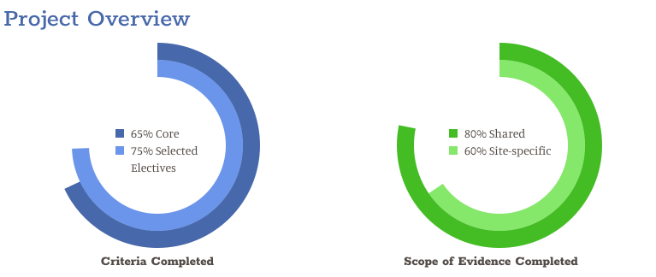
Visualize your Path to Recognition
www.dahsolutions.com
(937) 219-8322

Slide 2
ABOUT US
Who are we?
What do we do?
DAH Solutions helps practices achieve recognition through a proven project management process.
We use custom built tools and software to make every project a success.
Every project follows the basic same process:
Planning - assess what and when
Execution - take action on the plan
Analysis & Reporting - visibility to how we are performing
Review - ensuring documentation meets criteria

Slide 3
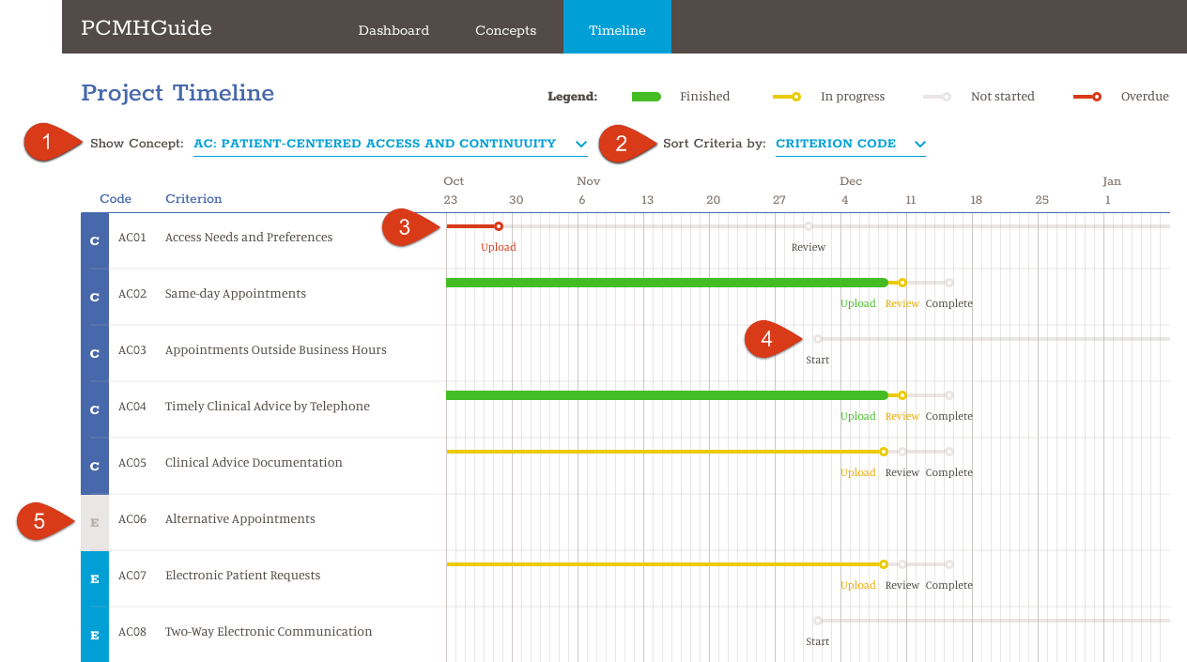
PLANNING
Flexibility
View Concepts
Filter individual Criteria
Clear Path
Know when you are behind
Proactively view upcoming tasks
View/Edit Criteria not selected

Slide 4
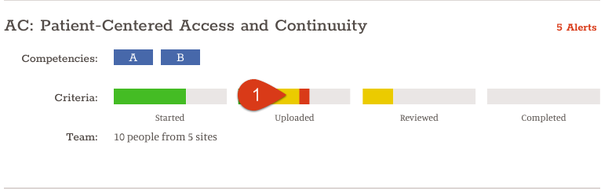
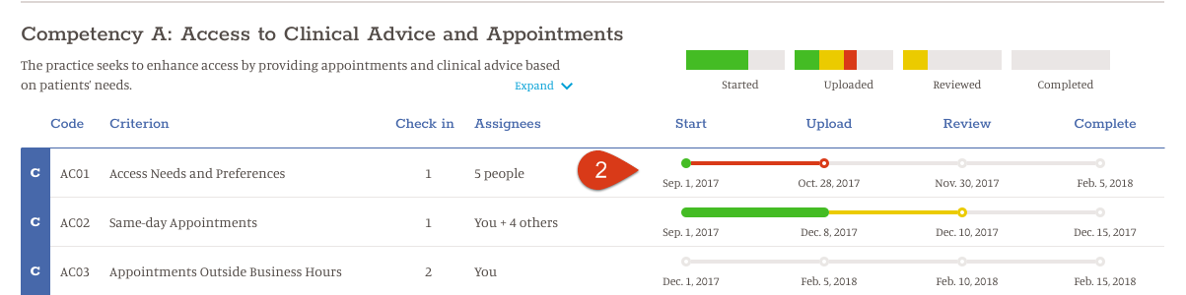
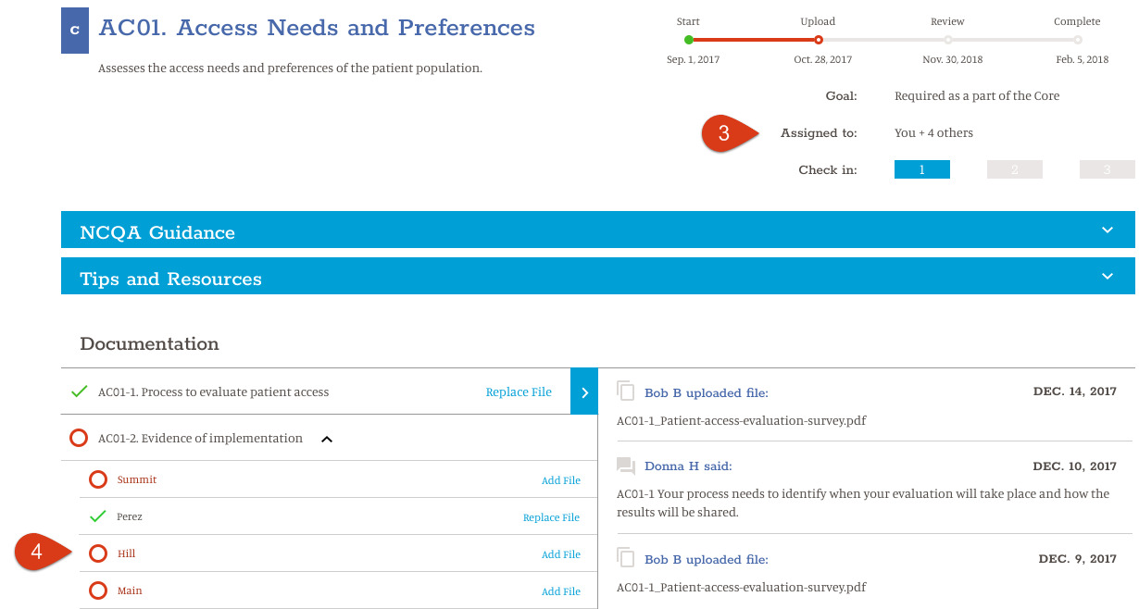
EXECUTION
Visibility
Easily see where to focus
Get into the details, follow the process
Work with DAH & team members
Load documentation for review

Slide 5
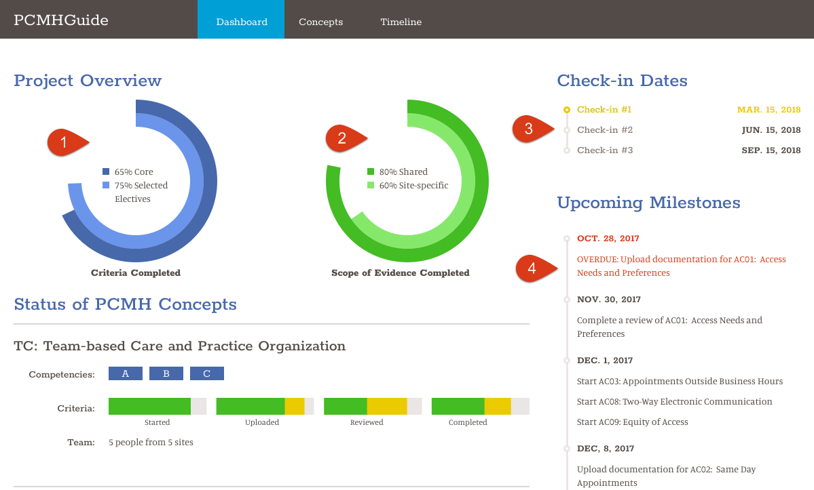
ANALYSIS & REPORTING
Transparency
Real-time project status Core vs. Elective
Shared vs Site Progress
Alignment
Prepare for Check-In
Know what is coming

Slide 6
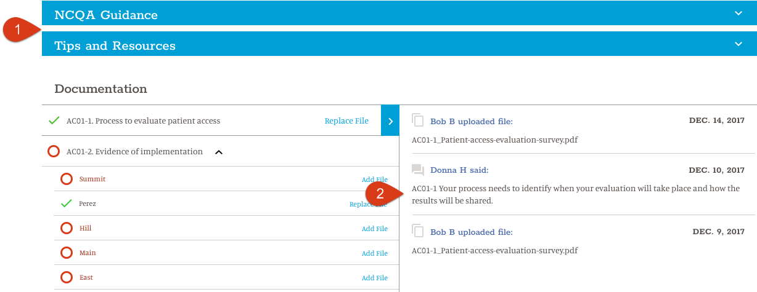
REVIEW
Collaboration
Self service Guidance and Resources are available to ALL team members
Trust the expert! DAH solutions has the experience to review and guide you to a successful Check-In

Slide 7
TRANSFORMATION TIMELINE
Gather Information
(2-3 months)
Engage Practices
(1-2 months)
Implementation
(6-9 months)
Month 3
Engagement
Month 6
Check in #1
Month 9
Check in #2
Month 12
Check in #3
Month 1
Planning
Month 5
Prepare Check-In #1
Month 8
Prepare Check-In #2
Month 11
Prepare Check-In #3

Slide 8

get the Recognition you deserve!

