Slide 1

CBV's
Class Based Views
Class
SoftUni Team
Technical Trainers
Software University
https://softuni.org

Slide 2
Table of Contents
What are CBV's?
Template Views
List Views
Detail Views
CRUD Views
2
Notes:
2

Slide 3
Have a Question?
sli.do
#python-web
Notes:
3

Slide 4

What are CBV's?
CBV

Slide 5
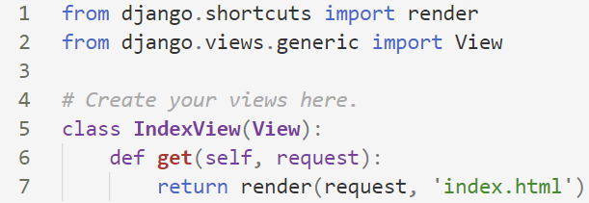
What are CBV's?
A view is a callable which takes a request and returns a response
Class-based views provide an alternative way to implement views as Python objects instead of functions

Slide 6
Built-in Generic Views
Django provides some built-in generic views
View
TemplateView
RedirectView
FormView
ListView
CreateView, UpdtadeView, DeleteView
DetailView

Slide 7
CBV's vs. Function Views - Pros
CBV
easily extended
can use techniques like mixins
handling HTTP methods in separate class methods
built-in generic CBV's
Function View
simple to implement
easy to read
explicit code flow
Straightforward usage of decorators

Slide 8
CBV's vs. Function Views - Cons
CBV
harder to read
implicit code flow
hidden code in parent classes, mixins
use of decorators require extra import
Function View
hard to extend
hard to reuse
handling HTTP methods via conditional branching

Slide 9

Template View

Slide 10
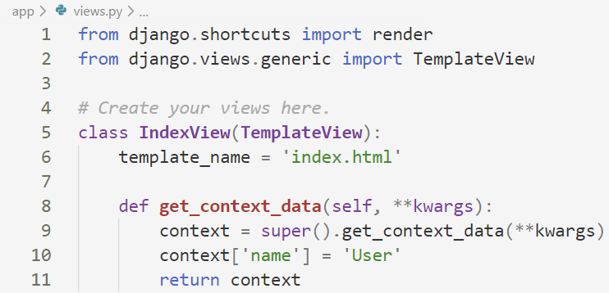
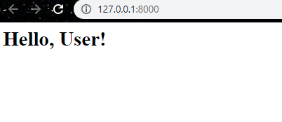
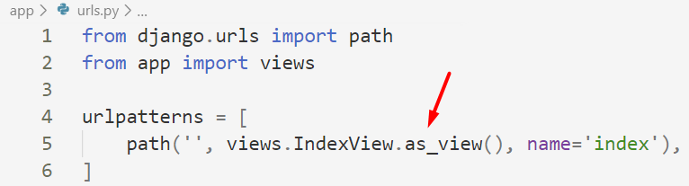
Basic Template View Example
A template view renders a given template, with the context containing parameters captured in the URL

Slide 11

Live Demo
Using Template Views

Slide 12

List Views

Slide 13
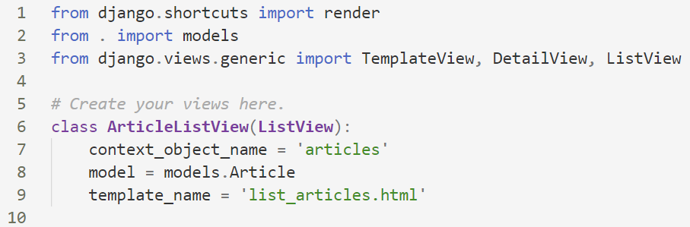
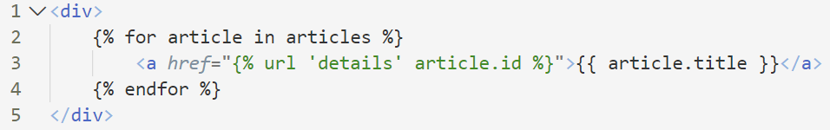
Basic List View Example
A list view is used for representing a list of objects

Slide 14
Live Demo
Using List Views

Slide 15

Detail Views

Slide 16
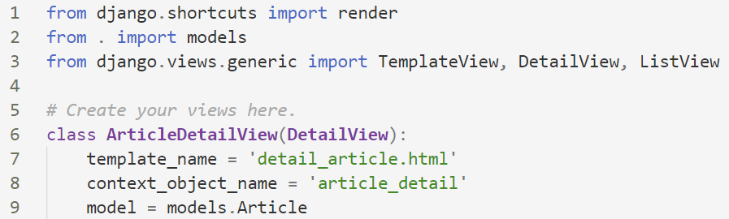
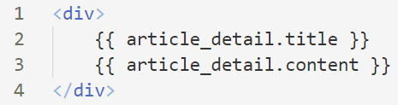
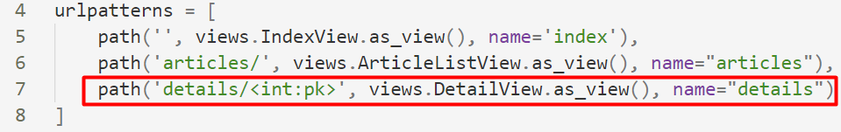
Basic Detail View Example
While this view is executing, self.object will contain the object that the view is operating upon

Slide 17
Live Demo
Using List Views

Slide 18

CRUD Views

Slide 19
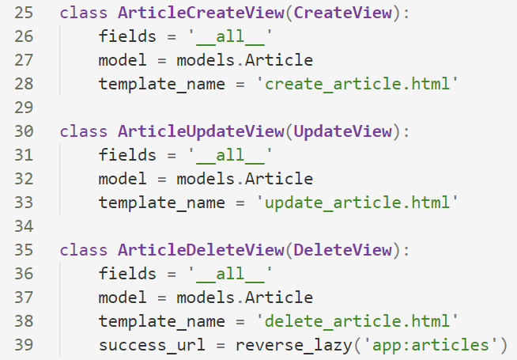
CRUD Views
A Create view displays a form for creating an object
An Update view displays a form for editing an existing object
A Delete view displays a confirmation page and deletes an existing object
Action on success

Slide 20
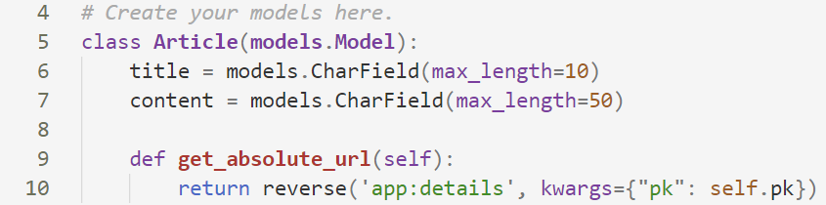
Set up absolute URL
When using a CreateView, we need to use a function in the model called get_absolute_url()
We use it to tell Django how to calculate the canonical URL for an object
Renders the details view after creation

Slide 21
Live Demo
Using CRUD Views

Slide 22

Summary
Class-based views provide an alternative way to implement views as Python objects instead of functions
CBV's are easily extended, as function views are easier to implement
Notes:
22

Slide 23
Questions?
Notes:
23

Slide 24












SoftUni Diamond Partners
Notes:
24

Slide 25




SoftUni Organizational Partners
Notes:
25

Slide 26

License
This course (slides, examples, demos, exercises, homework, documents, videos and other assets) is copyrighted content
Unauthorized copy, reproduction or use is illegal
© SoftUni – https://softuni.org
© Software University – https://softuni.bg
Notes:
26

Slide 27
Trainings @ Software University (SoftUni)
Software University – High-Quality Education, Profession and Job for Software Developers
softuni.bg, softuni.org
Software University Foundation
softuni.foundation
Software University @ Facebook
facebook.com/SoftwareUniversity
Software University Forums
forum.softuni.bg
Notes:
27

Slide 28
Обучения в Софтуерен университет (СофтУни)
Софтуерен университет – качествено образование, професия и работа за софтуерни инженери
softuni.bg
Фондация "Софтуерен университет"
softuni.foundation
Софтуерен университет @ Facebook
facebook.com/SoftwareUniversity
Дискусионни форуми на СофтУни
forum.softuni.bg
Notes:
28

