Slide 1
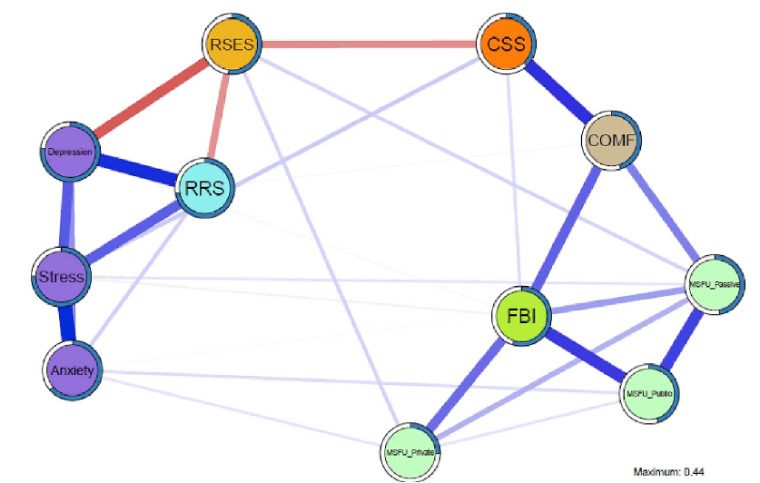
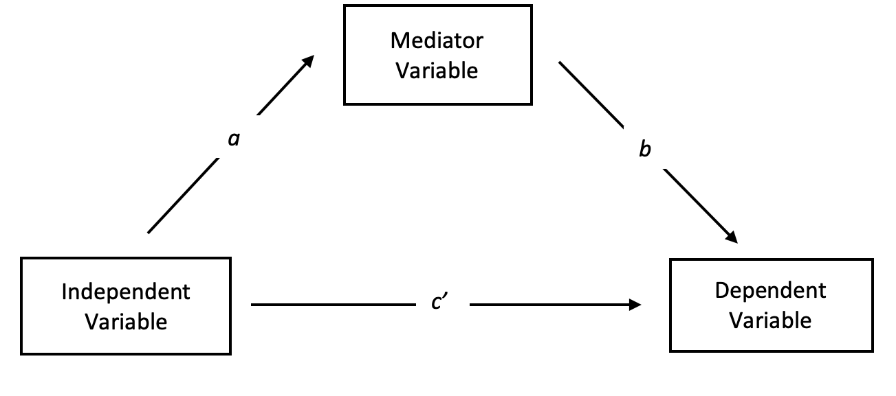
Reanalyzing Through the Lens of Structural Equation Modelling:
The Relationship between Facebook and Indicators of Psychopathology
Ayala Denul, Milena Waterschoot, Jolien De Clercq
Case Studies in the Analysis of Experimental Data

Slide 2

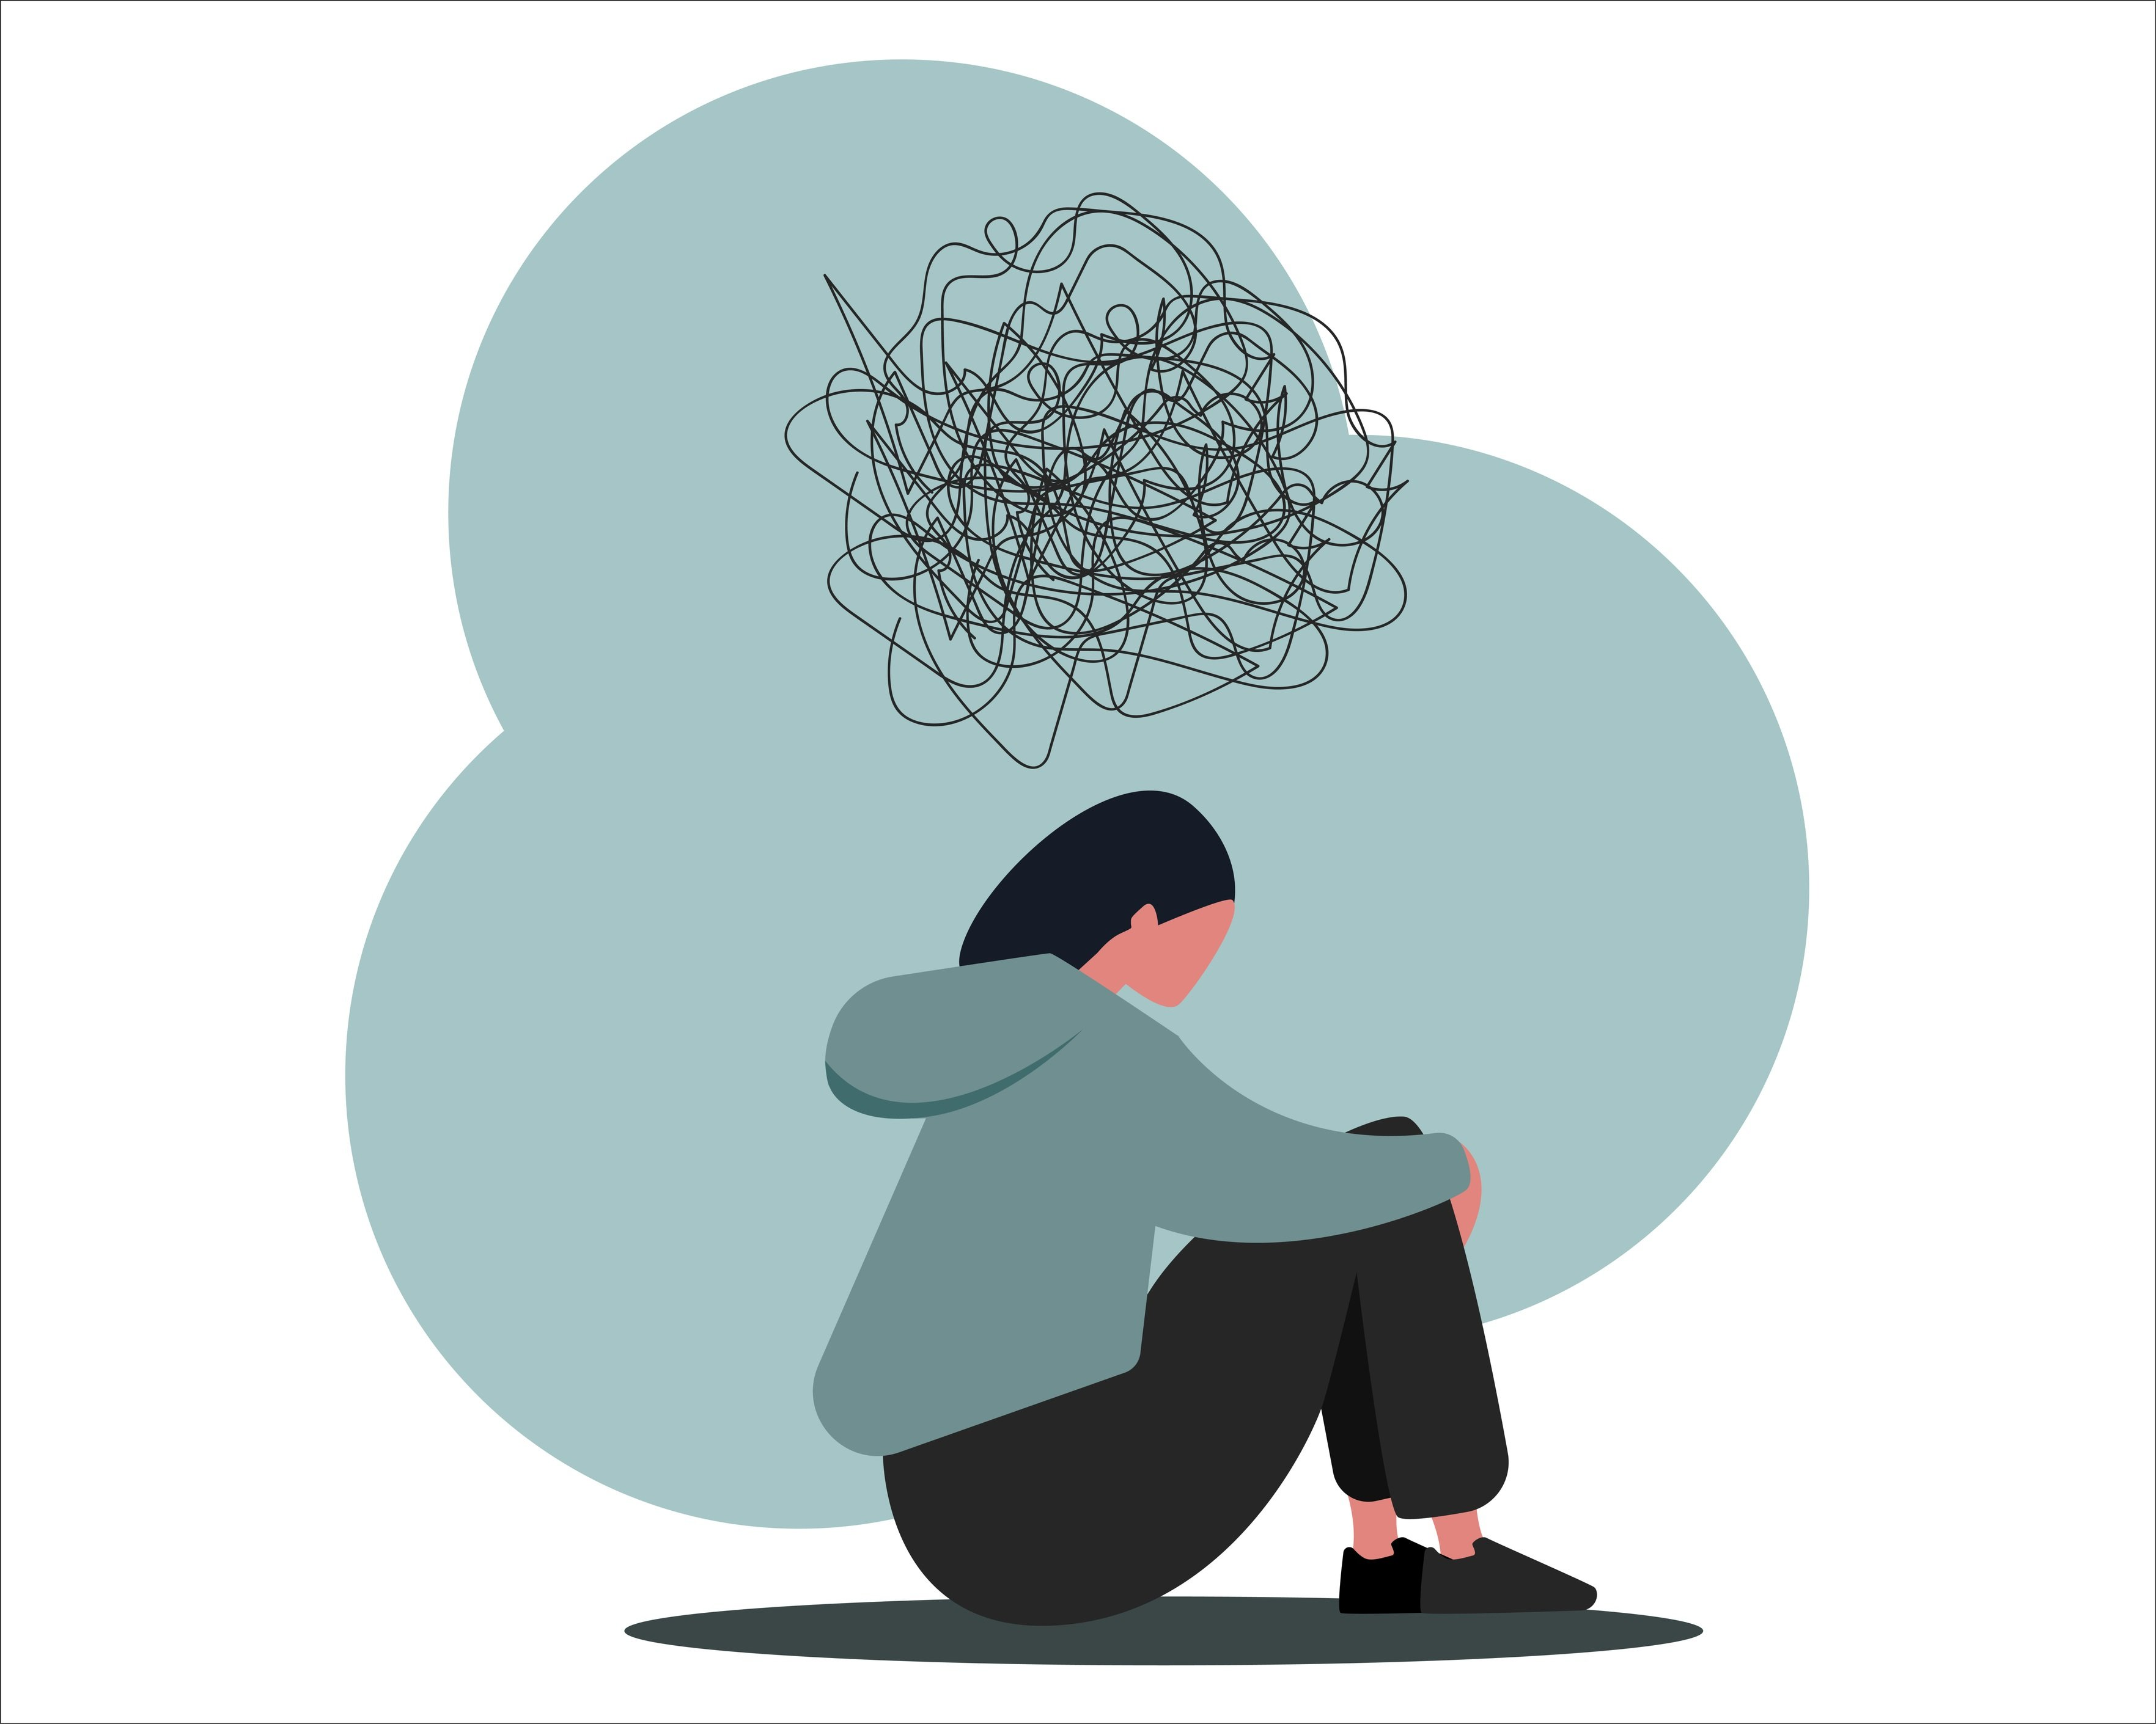

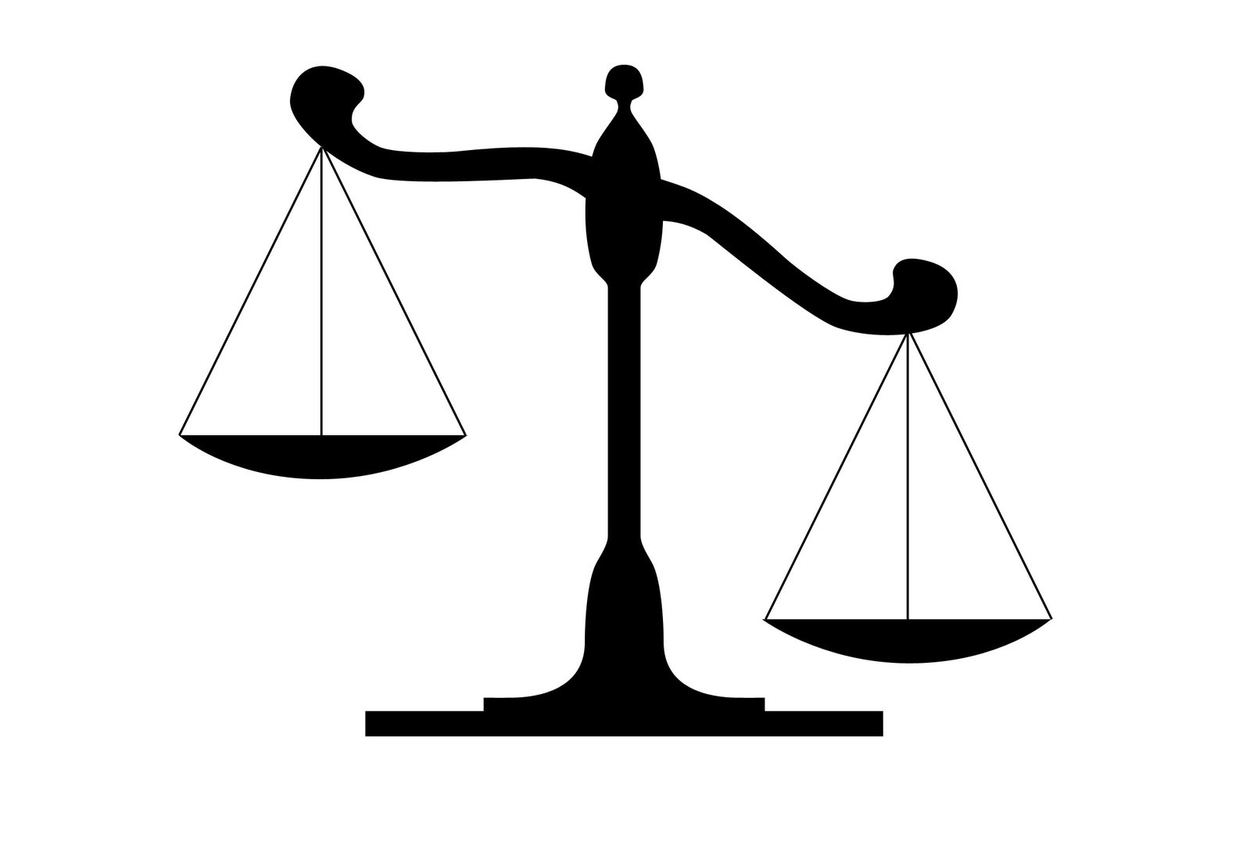
Faelens et al. (2019)
Notes:
We worked further upon the study of Faelens et al.
They examined the relationship between social comparison of facebook, global and contingent self esteem, and rumination, depression, anxiety, and stress.

Slide 3


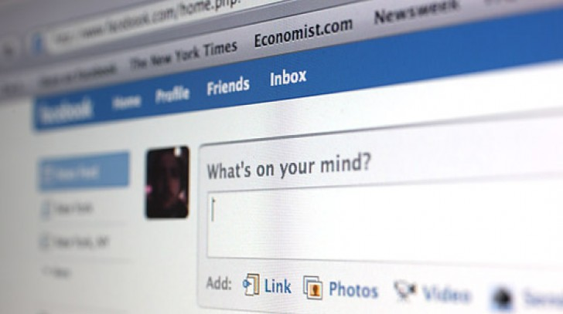
Type of Facebook use
Passive Facebook use
Active Private Facebook use
Active Public Facebook use

Slide 4
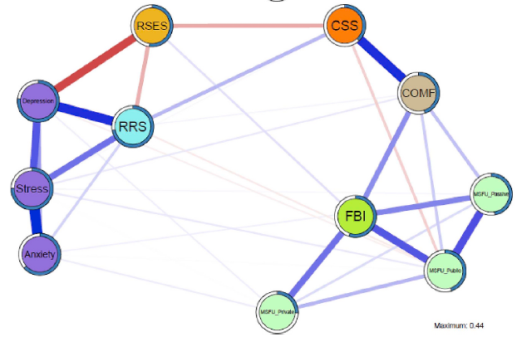


Network analysis vs. Mediation analysis
Data driven exploration
Theory driven confirmation
Notes:
They did this through a network analysis. Network analysis is usually employed to explore the relationships between concepts, without a-priori hypotheses about causality. However, in the discussion, the authors themselves propose a mediation of contingent and global self-esteem. We wanted to test this proposal.

Slide 5
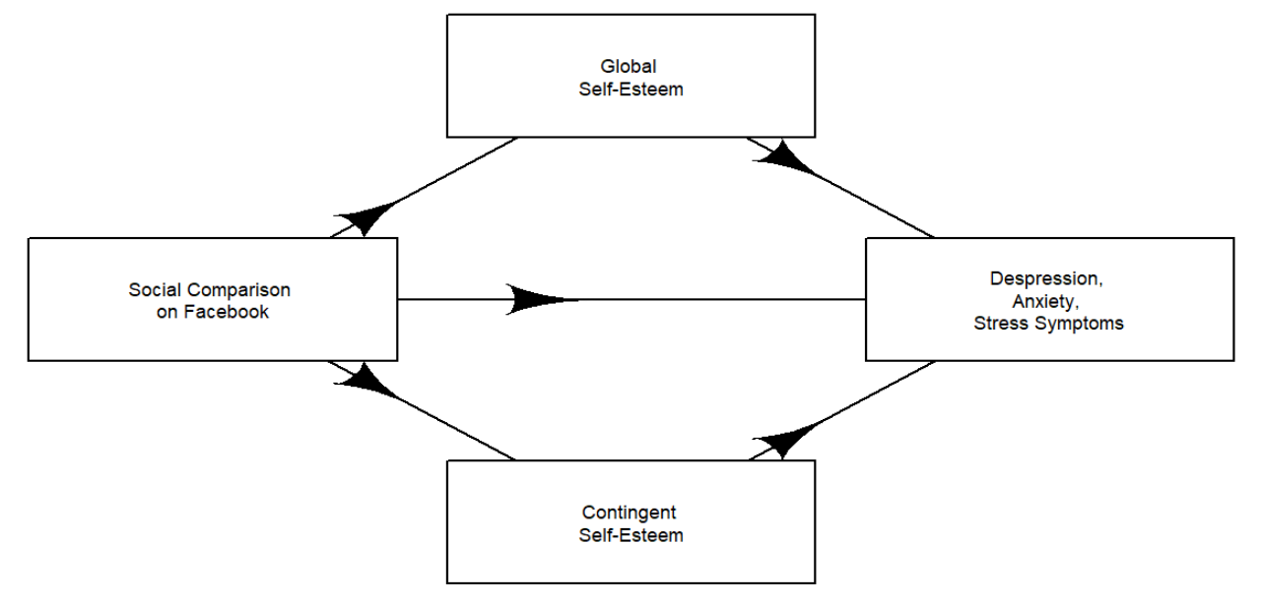
Mediation Model 1

Slide 6
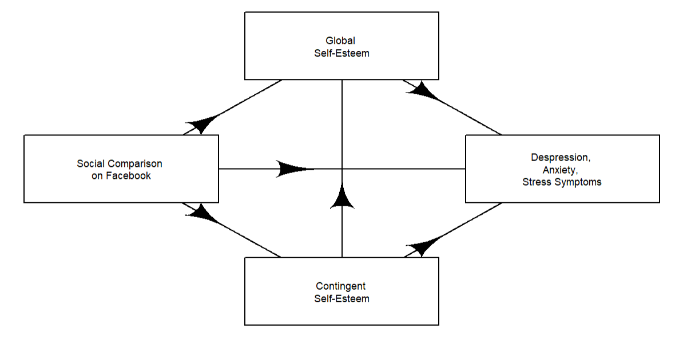
Mediation Model 2

Slide 7

Materials & Methods
Combined data from two samples
Measures included:
Social comparison on Facebook
Contingent self-esteem
Global self-esteem
Depression, anxiety, stress symptoms
Fitted model 1 and 2 with SEM
Model comparison test for nested model
Type of Facebook use

Slide 8
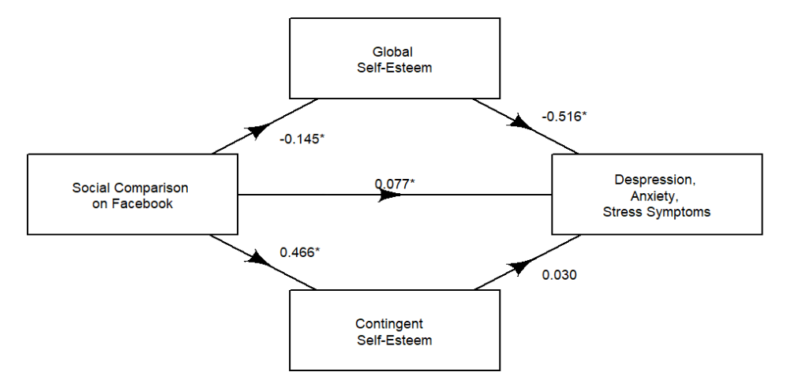
Results
Model 1
Notes:
Direct path between SCF and DAS: the more you compare yourself to your peers on Facebook, the more DAS symptoms you show
Indirect path through GSE: the more you compare yourself to your peers on Facebook, the lower your GSE is. However, the higher your GSE is, the lower your DAS symptoms are.
Indirectt path through CSE is not significant.
This model states that SCF negatively impacts GSE, and that this increase DAS symptoms. On the contrary, a higher GSE will decrease the DAS symptoms.

Slide 9
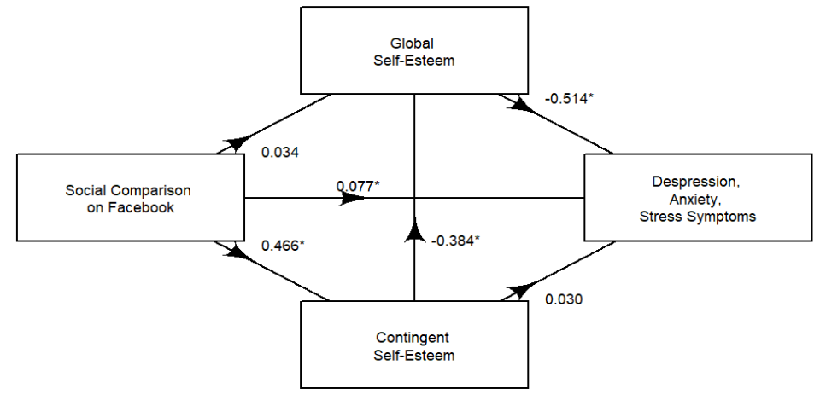



Model 2
Notes:
Again, direct path between SCF and DAS
And an indirect path that consist of two mediators: SCF is connected to CSE, which is connected to GSE, which is connected to DAS
How to interpret this?
The model shows that a strong global self-esteem is a protective factor for DAS symptoms, as the negative coefficient shows.
Moreover, strong contingent self-esteem negatively impacts GSE. Hence, people with a strong CSE are more likely to show DAS symptoms because the CSE lowers the GSE.
Finally, social comparison positively influences CSE.
In sum, SCF will increase CSF, which will decrease the GSE which will increase the DAS

Slide 10
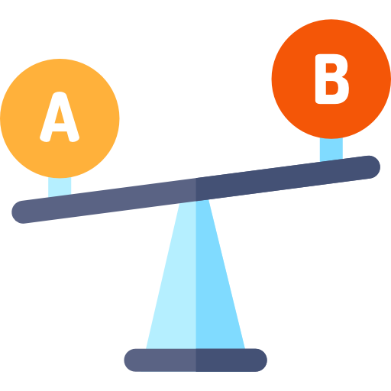
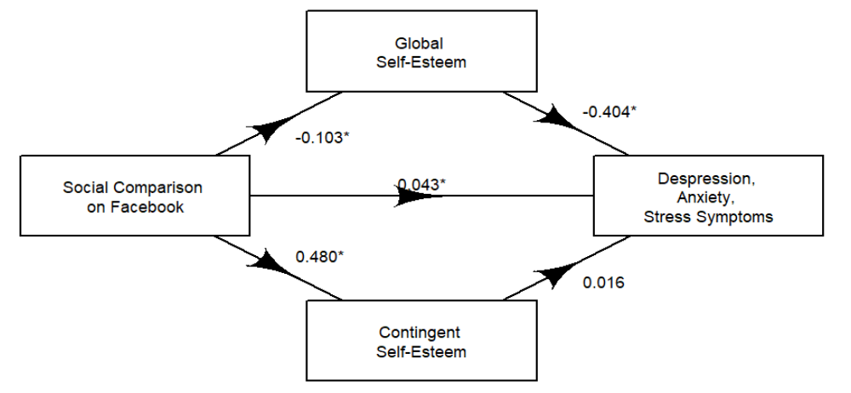
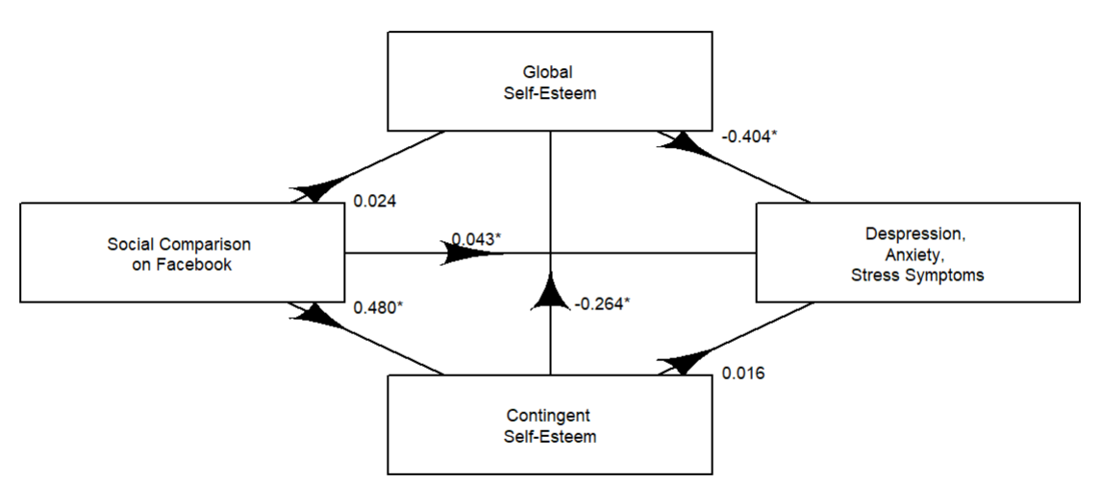

Model comparison
χ²(1, N = 675) = 84.69, p < .001.
Notes:
The model comparison favored the model with the pathway between CSE and GSE
Likelihood ratio test

Slide 11
Type of Facebook use
Significant
Passive Facebook use
β = 0.51, F(1, 671) = 50.31, p < .001
Strongest predictor
Active public Facebook use
β = 0.31, F(1, 671) = 11.61, p < .001
Not significant
Private Facebook use
β = -0.02, F(1, 671) = 0.05, p = .83

Slide 12
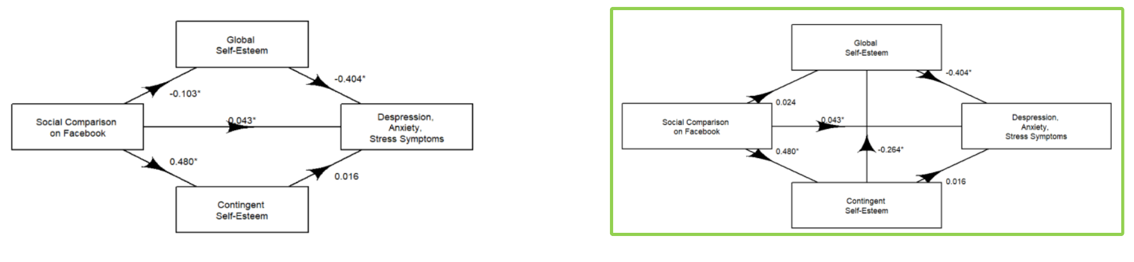
Discussion
1. Model comparison
2. Types of Facebook use
Social comparison on Facebook ~
Notes:
We compared two models, one without a path between contingent self-esteem and global self-esteem and one with. The model comparison test showed that the model with the path between contingent self-esteem and global self-esteem fitted the data the best. In other words, social comparison on Facebook has detrimental effects on individuals' global self-esteem through increased contingent self-esteem.
serial mediation effect between SCF and depression, anxiety, and stress symptoms through CSE and GSE
Additionally we also investigated which type of Facebook use had an effect on social comparison on Facebook. We found that passive and active public Facebook use had significant positive effects.

Slide 13
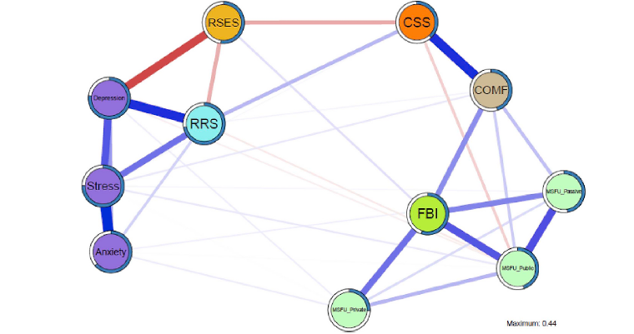
Discussion
3. Comparison with Faelens et al. (2019)

Slide 14
Conclusion
Support for the explorative findings of Faelens et al. (2019)
SEM: theory-driven confirmation
Data driven exploration
Theory driven confirmation
Notes:
Through Structuaral Equation Modeling we found that social comparison on Facebook had a positive direct effect on depression, anxiety, and stress symptoms. Moreover, a serial mediation effect through contingent self-esteem and global self-esteem fits the data the best. Furthermore, we identified passive and active public Facebook use as significant predictors of social comparison, with passive use having the strongest influence.

