Slide 1

AI² – Smart lung diagnosis and personalized follow-up
Hard to get: Patients are waiting up to 52 days to schedule an appointment with a doctor” ⁽¹⁾
Hard to tell: A 20-year literature review in 2001 suggested the level of error for clinically significant or major error in radiology is in the range 2-20% and varies depending on the radiological investigation⁽²⁾
The higher efficiency provided by AI will allow radiologists to perform more value-added tasks, becoming more visible to patients and playing a vital role in multidisciplinary clinical teams⁽³⁾
Among top five top trends for healthcare customer experience⁽⁴⁾
Patient Personalization
Hospitals Using Smart Technology

Slide 2

AI² – Smart lung diagnosis and personalized follow-up
How to enable radiologists to focus on more value-added core responsibilities, while leveraging a smart connected hospital?

Slide 3

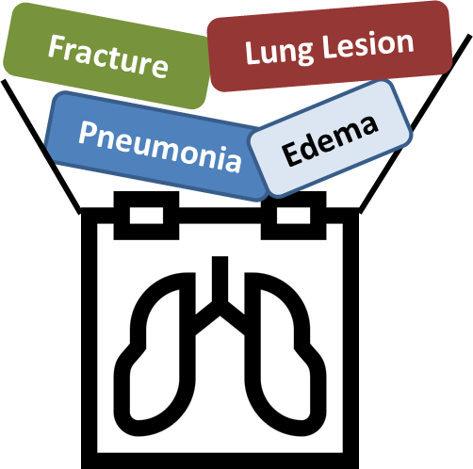




AI¹
AI diagnostic: detection up to 14 different diseases from x-rays
Edema
Optimisation of pulmonologist ‘s calendar, matching patients 'needs ✓
Automated diagnostic assistance
AI²
Prioritization between X-rays results and smart planning of specialists’ calendars
Faster and more accurate diagnosis and treatment ✓
Administrative workflow assistance

Slide 4
Pulmonologist sees her patients and ask for X-rays
Pulmonologist interprets X-rays results and initiate follow-up exams / appointment depending on her availability
Patient A
Patient’s journey
Day 1
Day 40 - Radio 1
Day 60
Patient B
Day 2
Day 45 - Radio 2
Day 56
Patient C
Day 3
Day 35 - Radio 3
Day 75
Patient C had the most serious illness, and would have benefited from being seen 2 weeks before, instead of Patient A (who suffer from a less serious disease)

Slide 5
Pulmonologist sees her patients and ask for X-rays
IA interprets X-rays and depending on the result, is able to optimize pulmonologist ‘s calendar depending on her patients 'needs
Patient A
✓
Patient’s journey
Day 1
Day 40 - Radio 1
Day 60
Patient B
✓
Day 2
Day 45 - Radio 2
Day 56
Patient C
Day 3
Day 35 - Radio 3
Day 40
Day 75

Slide 6
Bibliography
(1) https://www.forbes.com/sites/brucejapsen/2017/03/19/doctor-wait-times-soar-amid-trumpcare-debate/#113483e62e74
(2) Goddard P, Leslie A, Jones A, Wakeley C, Kabala J. Error in radiology. Br J Radiol. 2001;74(886):949–51
(3) Pesapane F, Codari M, Sardanelli F. Artificial intelligence in medical imaging: threat or opportunity? Radiologists again at the forefront of innovation in medicine. Eur Radiol Exp. 2018;2(1):35. Published 2018 Oct 24. doi:10.1186/s41747-018-0061-6
(4) https://www.forbes.com/sites/blakemorgan/2018/01/09/the-top-5-trends-in-customer-experience-for-healthcare/#19398d5923e6

