Slide 1
PLUTO JACKS
NAU ASCE Concrete Canoe 2026
CENE 476 Capstone -- 30% Design Review
February 10, 2026
Team: Trevion | Kayleigh | Amit | Jon | Theo
Advisors: Dr. Lamer PE | Taylor Layland PE
Speaker: Theo
1 / 24
Notes:
We're Pluto Jacks, NAU's 2025-2026 ASCE Concrete Canoe team. Five members. Today we present our 30% progress.

Slide 2
Project Introduction
• Design and build a concrete canoe per ASCE 2026 rules
• National competition: Salt Lake City, University of Utah
• Four event categories: Technical Paper, Oral Presentation, Final Product, Racing
• Team of 5 undergraduate civil engineers at Northern Arizona University
• Faculty Advisor: Dr. Lamer PE
• Graduate Instructor: Taylor Layland PE
[Team Photo Placeholder]
Speaker: Theo
2 / 24
Notes:
Purpose: design and build a concrete canoe per ASCE rules. Competing in Salt Lake City at University of Utah. Five-member team from NAU Civil Engineering.

Slide 3
Project Milestones
Task | Description | Status | Progress
Task 1 | Project Research & Safety | COMPLETE | 100%
Task 2 | Material Testing & Mix Selection | COMPLETE | 100%
Task 3 | Hull Design & Structural Analysis | IN PROGRESS | 60%
Task 4 | Construction & Fabrication | NOT STARTED | 0%
Task 5 | Finishing & Competition Prep | NOT STARTED | 0%
Honest Assessment: We are behind our original schedule.
• Original plan had Task 3 complete by Feb 1 -- revised to Feb 28
• Critical path: Hull design must finalize before mold construction begins
• Mitigation: Increased meeting frequency to 3x/week; parallel-tracking mix optimization
Speaker: Jon
3 / 24
Notes:
Task 1-2 complete. Task 3 hull design at 60%. We ARE behind our original schedule but we've adjusted the timeline. Critical path is hull design finalization.

Slide 4
Task 1.1: Project Research
• ASCE 2026 RFP reviewed cover to cover by all team members
• Key dimensional constraints: maximum 24 ft length, must accommodate 4 paddlers
• Minimum 6 inches of freeboard with 4 paddlers aboard
• Density limitations: concrete must float (< 62.4 PCF)
• Reinforcement: only ASCE-approved fiber or mesh reinforcement
• No metallic reinforcement (rebar, wire mesh) permitted
• Sustainability scoring included for first time in 2026
• Each team member assigned specific rule sections for deep review
Speaker: Kayleigh
4 / 24
Notes:
Every team member read the full ASCE 2026 RFP. Key constraints: 6-inch freeboard minimum, density must be below 62.4 PCF (water), only approved non-metallic reinforcement.

Slide 5
Task 1.2: Sponsorships
• Created personalized outreach videos for each potential sponsor
• Highlighted NAU engineering program and competition visibility
• Sponsors receive logo placement on canoe and in technical paper
Oxendale Auto Group
CONFIRMED
CSEM
CONFIRMED
Additional Sponsors
In Progress
Speaker: Kayleigh
5 / 24
Notes:
We created personalized video pitches for sponsors. Oxendale Auto Group and CSEM have confirmed. We're continuing outreach.

Slide 6
Task 1.3: Lab Safety
• Compiled comprehensive safety binder with all SDS sheets
• Met with lab manager to review emergency procedures
• All team members completed NAU lab safety training
Required PPE
• Safety glasses / goggles
• Nitrile gloves
• N95 dust masks (perlite mixing)
• Closed-toe shoes
• Long sleeves during pours
Identified Hazards:
• Alkaline burns from fresh concrete (pH ~12-13)
• Silica dust inhalation (perlite, fly ash)
• Heavy lifting: mold sections weigh 50+ lbs
• Eye protection required during mixing and testing
Speaker: Kayleigh
6 / 24
Notes:
Safety is paramount. Main hazards: alkaline burns from wet concrete, silica dust from perlite and fly ash, heavy lifting. All members trained, safety binder on-site.

Slide 7
Task 2.1: Material Research
KEY SLIDE -- Aggregate Selection
Specific gravity is the key metric: lower SG = lighter canoe = easier to float
Aggregate | Specific Gravity | Type | Status
Perlite | 0.125 | Volcanic glass | SELECTED
K1 Microspheres | 0.125 | Cenospheres | SELECTED
Poraver | 0.296 | Expanded glass | CANDIDATE
Pumice | 0.641 | Volcanic rock | EVALUATED
Expanded Shale | 1.15 | Lightweight | REJECTED
Natural Sand | 2.65 | Standard | BASELINE
Limestone | 2.70 | Standard | BASELINE
Gravel | 2.75 | Standard | BASELINE
Top 3 aggregates (SG < 1.0) are ultralight -- bottom 4 (SG > 1.0) would make the canoe sink.
Speaker: Theo
7 / 24
Notes:
Eight aggregates evaluated. The key is specific gravity. Low SG = lighter canoe = easier to float. Perlite and K1 microspheres at 0.125 are our primary lightweight aggregates.

Slide 8
Task 2.2: ASTM Testing Standards
ASTM Standard | Test Name | What It Measures | Why It Matters
C39 | Compressive Strength | Max load before crushing | Structural capacity
C143 | Slump Test | Workability / consistency | Thin-shell placement
C138 | Unit Weight | Wet density (PCF) | Must float (< 62.4)
C136 | Sieve Analysis | Particle size distribution | Aggregate grading
C496 | Split Tensile | Indirect tensile strength | Bottom of canoe in tension
C685 | Volumetric Batching | Consistent mix production | Repeatability
All tests performed following ASTM procedures in NAU Concrete Lab.
Speaker: Theo
8 / 24
Notes:
Six ASTM test methods guide our material characterization. Each test gives us a specific property we need for the design. C138 density is the most critical -- we need to be below 62.4 PCF.

Slide 9
ASTM C39: Compressive Strength
• Standard test for compressive strength of cylindrical concrete specimens
• Equipment: Humboldt compression testing machine
• Specimen: 4" diameter x 8" tall cylinders
• Load applied at constant rate until failure
• Failure mode: typically cone or shear fracture pattern
• Results determine if our mix can handle structural loads
• Minimum target: 250 psi at 7 days for thin-shell application
Key Equation
f'c = P / A
(load / cross-section area)
Speaker: Amit
9 / 24
Notes:
ASTM C39 is the gold standard for compressive strength. We use 4x8 cylinders in the Humboldt machine. Load until failure and compute f'c = P/A.

Slide 10
ASTM C143: Slump Test
• Measures workability and consistency of fresh concrete
• Fill cone in 3 layers, rod each layer 25 times, lift cone
• Measure how much the concrete 'slumps' downward
• Target range for canoe: 4-7 inches (fluid enough for thin shell)
• Too low (<3"): won't fill thin mold sections properly
• Too high (>8"): mix may segregate, aggregates settle out
• Thin-shell application demands precise workability control
Speaker: Kayleigh
10 / 24
Notes:
Slump test measures workability. For a thin-shell canoe, we need 4-7 inches of slump. Too stiff and we can't fill the mold; too fluid and aggregates segregate.

Slide 11
ASTM C138: Unit Weight (Density)
CRITICAL MEASUREMENT
THE MOST CRITICAL TEST: Density must be below 62.4 PCF to float.
• Measures wet (fresh) density of concrete in pounds per cubic foot (PCF)
• Fill known-volume container, weigh, compute density = weight / volume
• Water density = 62.4 PCF -- our concrete MUST be lighter
• Target range: 55-65 PCF for lightweight canoe concrete
• Lighter is better, but too light sacrifices strength
• Every aggregate substitution shifts density -- trade-off with strength
THRESHOLD
62.4 PCF
Density of Water
ABOVE = SINKS
BELOW = FLOATS
Speaker: Amit
11 / 24
Notes:
Density is our most critical measurement. 62.4 PCF is water's density -- we must be below this. Our target is 55-65 PCF: light enough to float, dense enough for strength.

Slide 12
ASTM C136: Sieve Analysis
• Determines particle size distribution of aggregates
• Stack of progressively finer sieves shaken mechanically
• Weigh material retained on each sieve
• Well-graded blend: reduces void space between particles
• Fewer voids = less cement paste needed = lower density
• Critical for our ultralight aggregates (perlite, K1, Poraver)
• Sieve sizes: #4, #8, #16, #30, #50, #100, #200, pan
Speaker: Kayleigh
12 / 24
Notes:
Sieve analysis gives us particle size distribution. A well-graded blend reduces voids, meaning we need less cement paste. This helps keep density low while maintaining packing efficiency.

Slide 13
ASTM C496: Split Tensile Strength
• Splitting cylinder test: load cylinder on its side
• Compressive line load induces transverse tension
• Concrete is WEAK in tension -- typically ~10% of compressive strength
• The bottom of the canoe hull is in tension under loading
• This drives our reinforcement strategy (fiber mesh)
• Formula: fct = 2P / (pi * L * D)
Why This Matters:
Canoe bottom is in TENSION under paddler weight. Concrete cracks in tension first.
Speaker: Amit
13 / 24
Notes:
Concrete is weak in tension, about 10% of its compressive strength. The bottom of the canoe hull is in tension when paddlers sit on it, so tensile strength and fiber reinforcement are critical.

Slide 14
ASTM C685: Volumetric Batching
Proof of Work
• Volumetric batching ensures consistent, repeatable mixes
• Each ingredient measured by volume rather than weight for field practicality
• Lab batching procedure documented step-by-step
• Dust masks required during perlite and fly ash handling
• Mix quantities scaled from lab trial (0.1 CY) to production (0.5 CY)
• Graduate Instructor guidance: "Show proof, not just results"
[Lab Mixing Photo]
[Cylinder Casting Photo]
[Testing Photo]
Speaker: Kayleigh
14 / 24
Notes:
GI said show proof not just results. This slide shows our actual lab work -- batching, casting cylinders, and testing. Dust masks are essential for perlite handling.

Slide 15
Task 2.3: Mix Selection Process
3 Precursor
Mixes
Literature review
& material screening
3 Trial
Mixes
Lab-batched
& ASTM-tested
Decision
Matrix
Weighted criteria
scoring
• Systematic approach: research-based precursors -> lab testing -> data-driven selection
• Each mix tested per ASTM C39, C143, C138, C496
• Decision matrix weighted by project priorities (density 30%, strength 25%, workability 20%, cost 15%, sustainability 10%)
Speaker: Theo
15 / 24
Notes:
Our process: three precursor mixes from literature, three lab trial mixes, then a weighted decision matrix to select the best. This ensures a data-driven, defensible choice.

Slide 16
Mix 1: High-Strength Baseline
Property | Result | Target | Verdict
Compressive Strength (7-day) | 3,116 psi | > 250 psi | PASS
Tensile Strength | 385 psi | > 40 psi | PASS
Density | 78.4 PCF | < 62.4 PCF | FAIL
Slump | 1.5" | 4-7" | MARGINAL
DENSITY FAILURE: 78.4 PCF > 62.4 PCF
This mix would SINK. Strong but way too heavy.
Speaker: Theo
16 / 24
Notes:
Mix 1 was our high-strength baseline. Excellent compressive strength at 3,116 psi, but density of 78.4 PCF is way above the 62.4 threshold. This canoe would sink.

Slide 17
Mix 2: Slag Cement Addition
Property | Mix 1 | Mix 2 | Change
Compressive (7-day) | 3,116 psi | ~2,800 psi | Slight decrease
Density | 78.4 PCF | 83.6 PCF | WORSE (+5.2)
Slump | 1.5" | 2.0" | Improved
Additive | -- | Slag cement | Added
• Slag cement improved workability (slump: 1.5" -> 2.0")
• But density got WORSE: 83.6 PCF (even heavier than Mix 1)
• Trade-off lesson: slag helps workability but hurts density
• Key insight: must change AGGREGATES, not just cementitious materials
Speaker: Theo
17 / 24
Notes:
Mix 2 added slag cement. Workability improved slightly, but density got WORSE at 83.6 PCF. This taught us that to fix density, we need to change the aggregates, not just the cement.

Slide 18
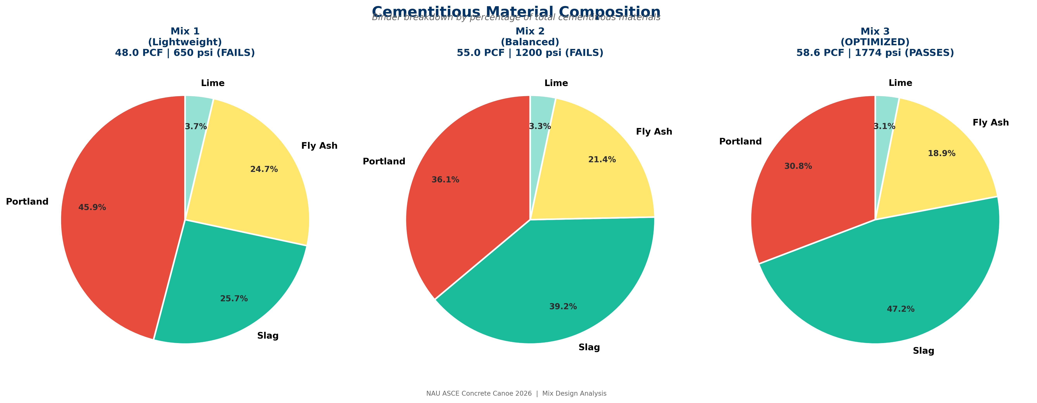
Mix 3: Lightweight Breakthrough
MOST IMPORTANT RESULT
Key Changes from Mix 1/2:
IT FLOATS!
58.6 PCF < 62.4 PCF
Density below water threshold
• Portland cement cut in HALF: 97 lbs vs 209 lbs
• Added fly ash as supplementary cementitious material
• Increased perlite and K1 microsphere content
• Result: dramatically lower density
Property | Result | Target
Density | 58.6 PCF | < 62.4 PCF
Compressive (7-day) | 307 psi | > 250 psi
Slump | 6.0" | 4-7"
Cost | $1,200/CY | Minimize
Speaker: Theo
18 / 24
Notes:
Our breakthrough. Portland cement cut in half, added fly ash, increased perlite and K1. Density dropped to 58.6 PCF -- below 62.4. This mix FLOATS. Compressive at 307 psi meets our minimum. 6-inch slump is excellent workability.

Slide 19
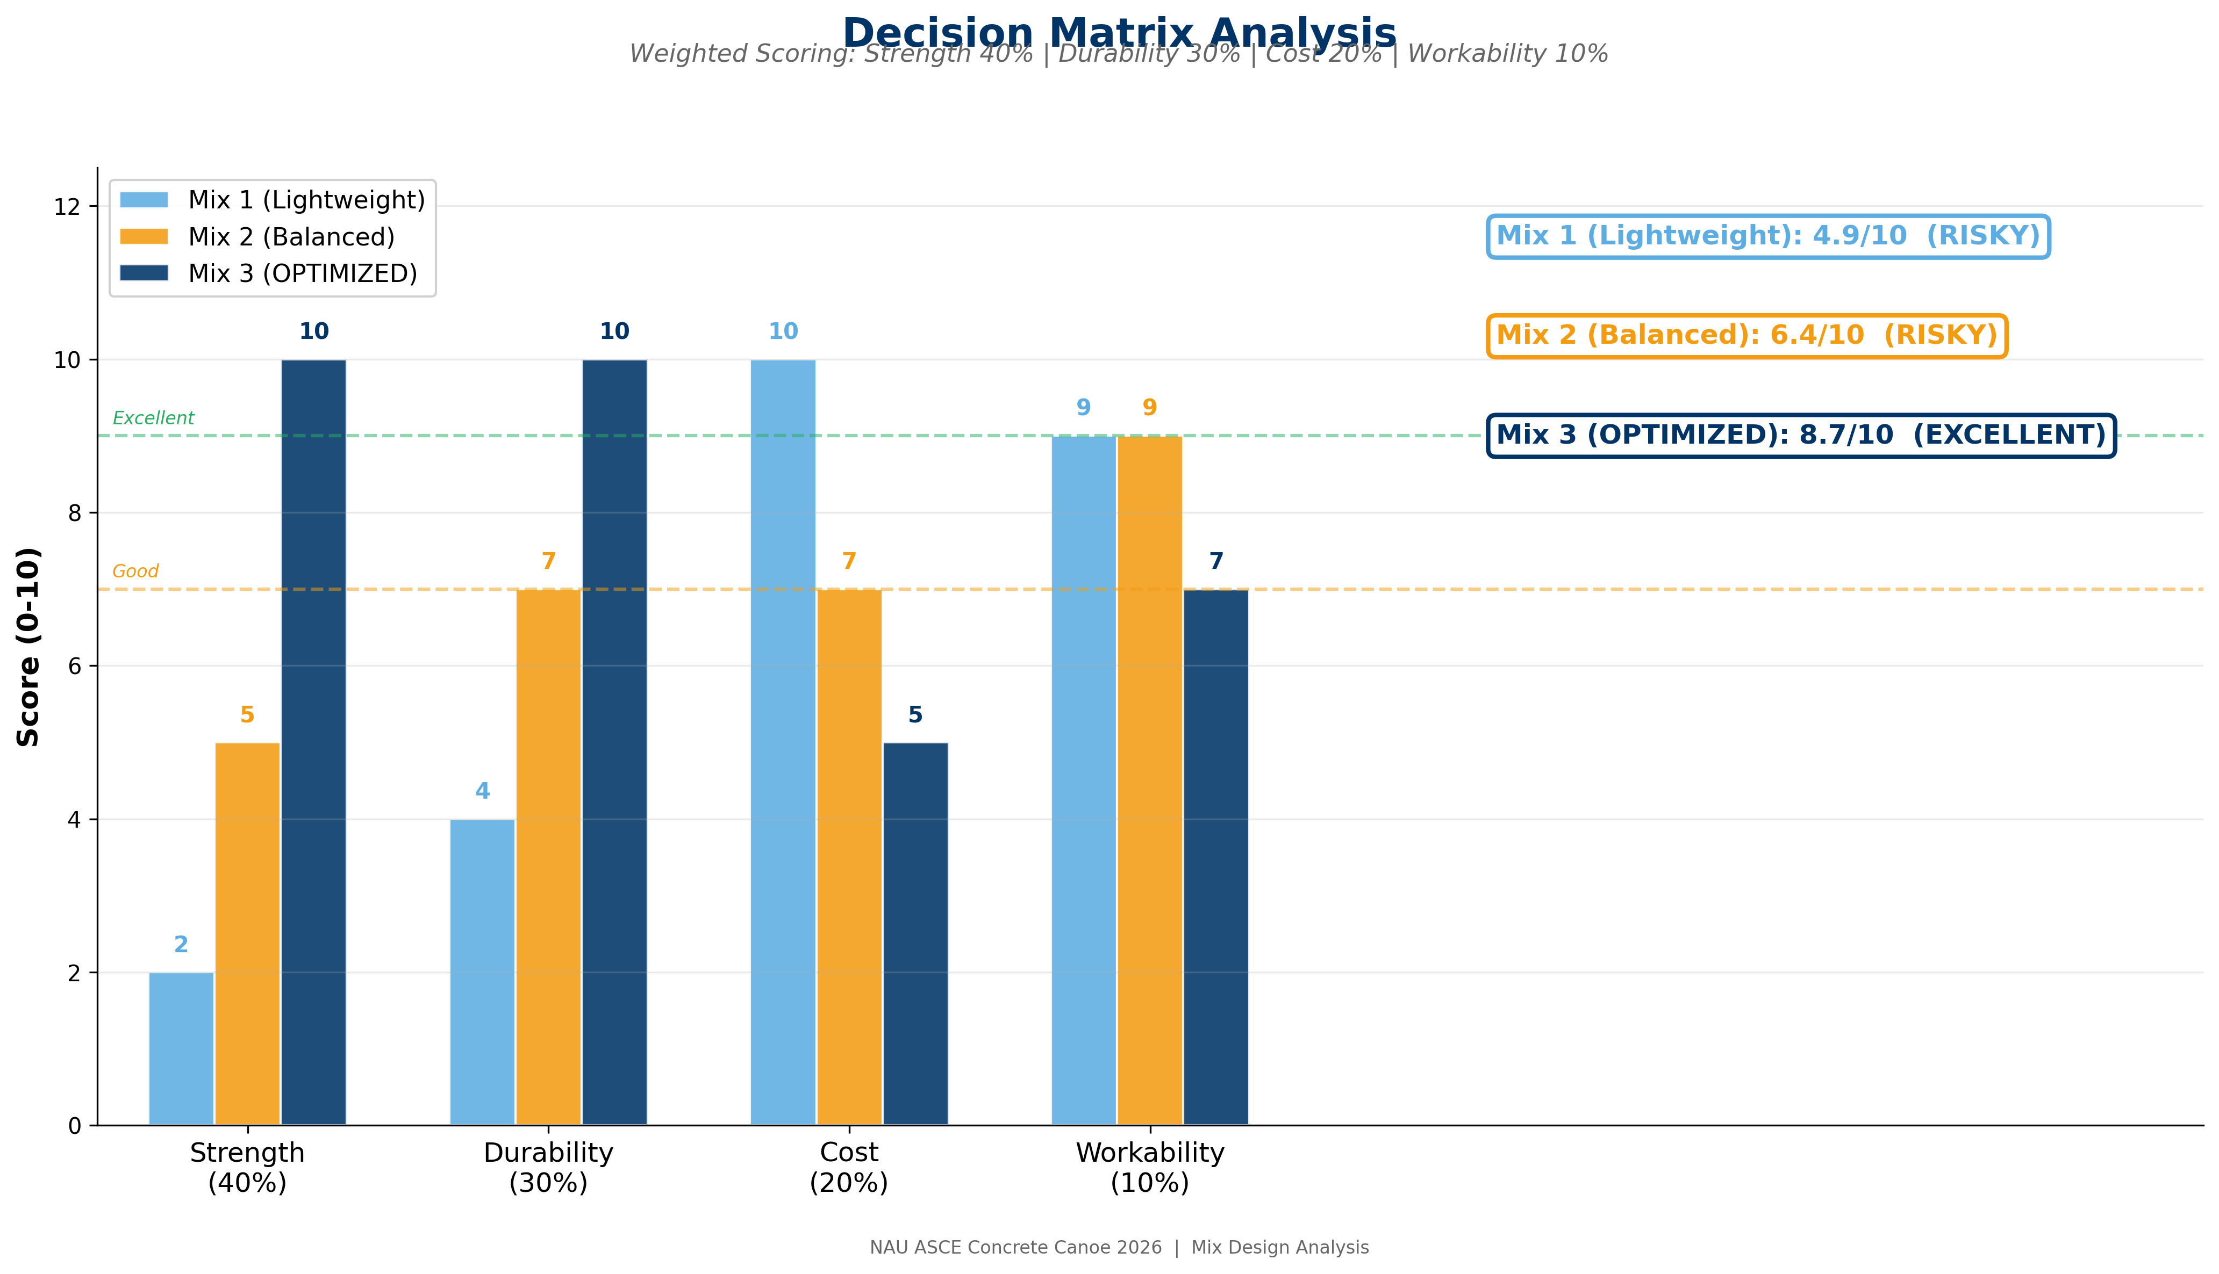
Task 2.4: Decision Matrix
• Density weighted 30% -- floating is non-negotiable
• Compressive strength: 25%
• Workability: 20%
• Cost: 15%
• Sustainability: 10%
Mix | Score | Rank
Mix 1: Baseline | 65.20 | 3rd
Mix 2: Slag | 73.53 | 1st
Mix 3: Lightweight | 70.07 | 2nd
Speaker: Theo
19 / 24
Notes:
Decision matrix with density weighted at 30% because floating is non-negotiable. Mix 2 scores highest at 73.53, Mix 3 close at 70.07. Both have strengths we want to combine.

Slide 20
Selected Approach: Optimized Mix 2 + Mix 3 Aggregates
Strategy: Combine Mix 2's cementitious system with Mix 3's aggregate ratios
Mix 2 brings workability and strength from slag cement
Mix 3 brings the lightweight aggregate ratios that achieved 58.6 PCF
Next Steps for Mix Optimization:
• Target: bring density below 62.4 PCF while maintaining strength > 250 psi
• Optimize perlite/K1 ratio for best density-strength trade-off
• Test 28-day strength (expect significant gains over 7-day)
• Scale from 0.1 CY trial batch to 0.5 CY production batch
• Finalize mix design by March 1 for construction start
Speaker: Theo
20 / 24
Notes:
Going forward: optimize Mix 2 by incorporating Mix 3's aggregate ratios. The goal is to get the best of both -- workability from slag cement and low density from ultralight aggregates.

Slide 21
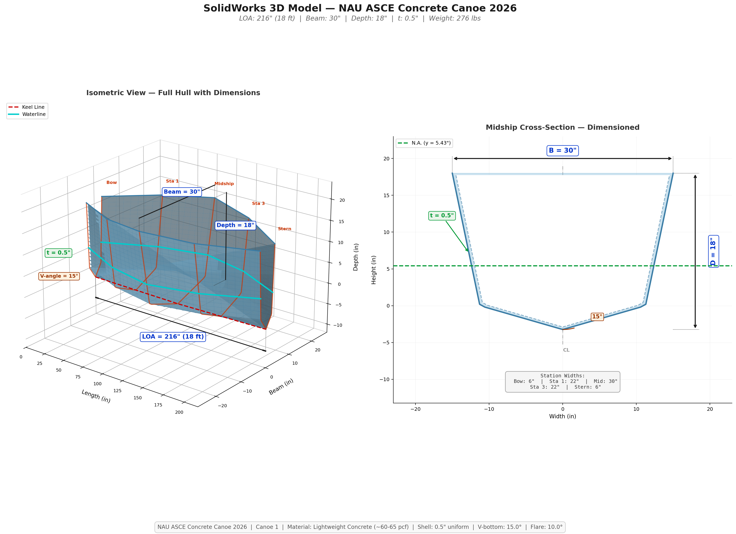
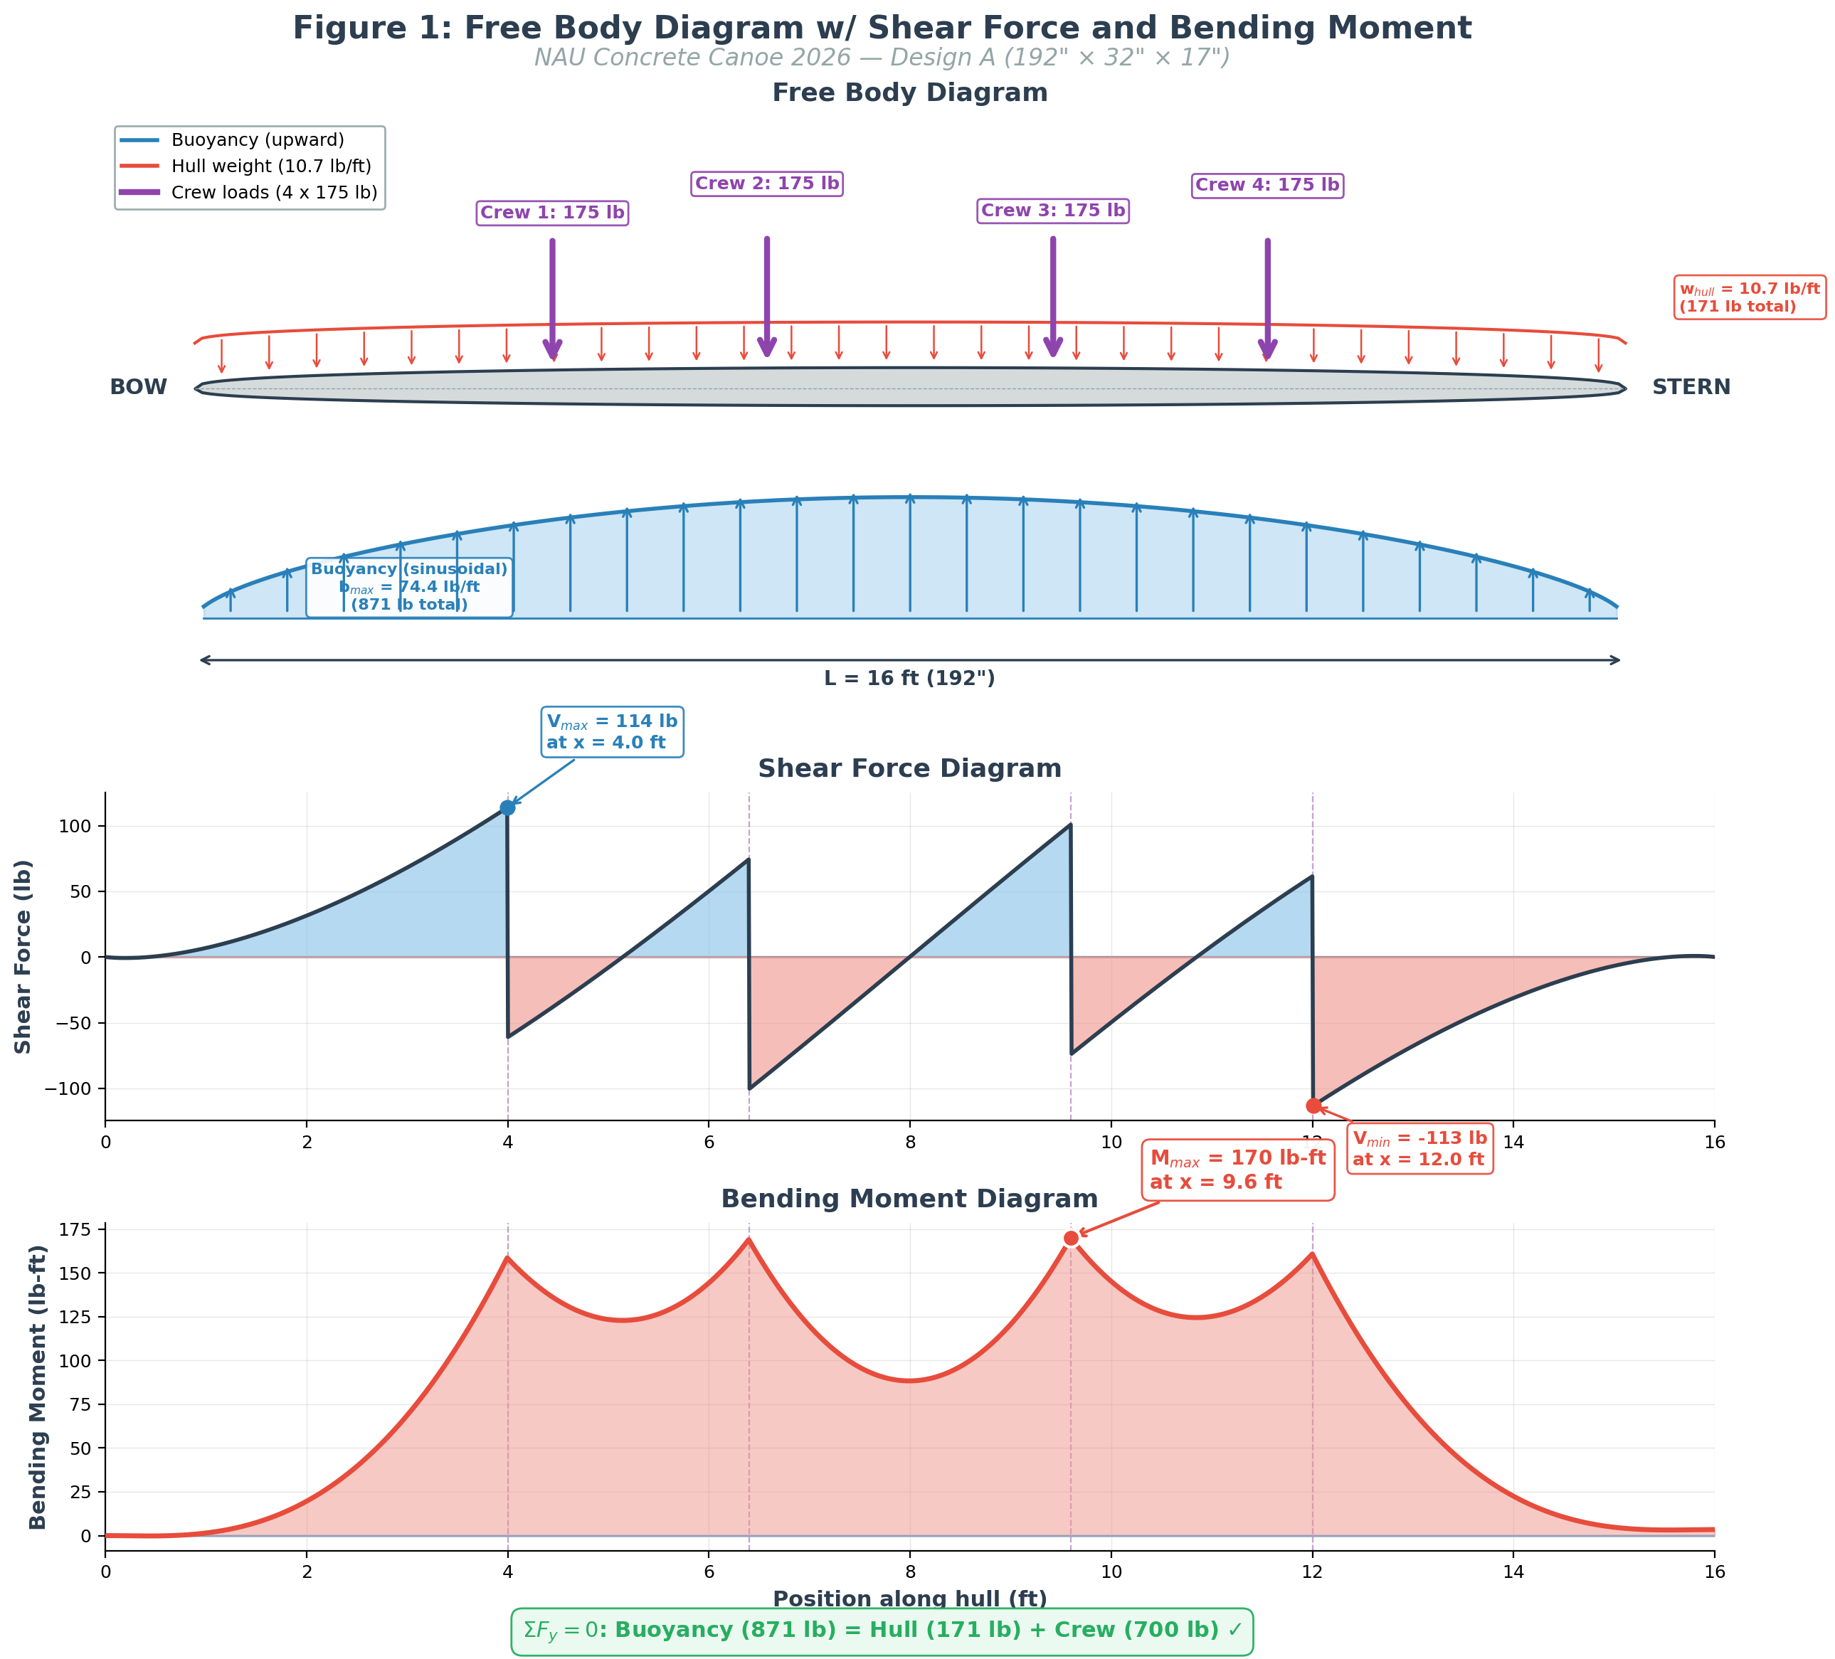
Task 3.1: Hull Design -- Design Criteria & Preliminary Results
CRITICAL SLIDE
ASCE 2026 Requirements
Candidate Design Results
Parameter | Requirement
Freeboard (4-person) | >= 6.0"
Metacentric Height (GM) | >= 6.0"
Safety Factor | >= 2.0 (ACI 318-25 LRFD)
Punching Shear DCR | < 1.0 (ACI 22.6.5.2)
Density | < 62.4 PCF
Parameter | Value | Status
Dimensions | 216" x 36" x 18" | --
Thickness | 0.75" | --
Weight | ~318 lbs | --
Freeboard | 12.82" | PASS
Metacentric Ht | 15.34" | PASS
Safety Factor | 6.39 | PASS
Punch DCR | 0.189 | PASS
Structural analysis per ACI 318-25 LRFD. Cross-checked: Python v2.1 + Excel
Speaker: Trevion
21 / 24
Notes:
ASCE requires 6-inch minimum freeboard and adequate stability. Our 216x36x18 design gives 12.82 inches of freeboard -- double the minimum -- and a safety factor of 6.39. Full shear/moment diagrams at 60% review.

Slide 22
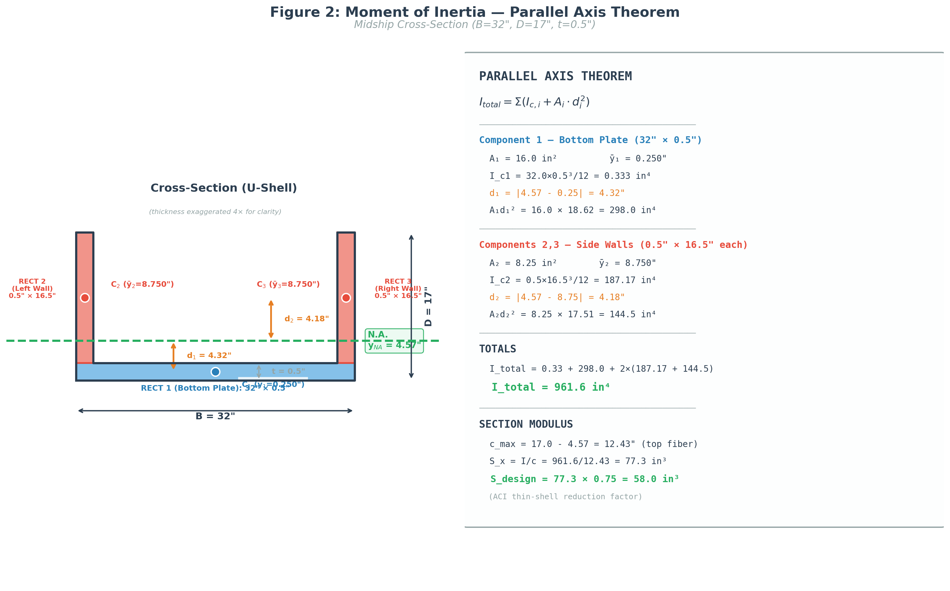
Structural Analysis -- FBD & Section Properties
Parallel axis theorem applied
to U-shell cross section
Full structural analysis with shear/moment diagrams at 60% review
Speaker: Trevion
22 / 24
Notes:
Free body diagram showing distributed loading, buoyancy, and crew weight. Section properties computed using parallel axis theorem for the U-shell cross section. Full analysis coming at 60% review.

Slide 23
3D Hull Model -- SolidWorks Dimensions
Speaker: Trevion
23 / 24
Notes:
SolidWorks 3D model showing full dimensions of our 216x36x18 inch hull design. The model is used for volume calculations, mold design, and construction drawings.

Slide 24
References
[1] ACI 318-25, Building Code Requirements for Structural Concrete, ACI, 2025
[2] ASCE 2026 Concrete Canoe Competition Rules & Regulations
[3] ASTM C39/C39M-21, Standard Test Method for Compressive Strength
[4] ASTM C143/C143M-20, Standard Test Method for Slump
[5] ASTM C138/C138M-17a, Standard Test Method for Unit Weight
[6] ASTM C136/C136M-19, Standard Test Method for Sieve Analysis
[7] ASTM C496/C496M-17, Standard Test Method for Splitting Tensile
[8] ASTM C685/C685M-17, Standard Specification for Volumetric Batching
[9] Lewis, E.V., Principles of Naval Architecture, SNAME, 1988
[10] Beer, Johnston, DeWolf, Mechanics of Materials, 8th Ed.
Speaker: Theo
24 / 24
Notes:
References for all standards, codes, and textbooks cited in this presentation. ACI 318-25 is the primary structural code. ASCE 2026 RFP governs all competition requirements.

