Slide 1
PRELIMINARY
Hull Design Selection Decision Matrix Analysis
NAU ASCE Concrete Canoe 2026 - Pluto Jacks Preliminary Analysis - Calculators Validated with 60 Automated Tests

Slide 2
The Design Challenge
We need to select a hull that optimizes across competing demands:
Speed vs. Stability -- narrow is fast, wide is stable
Weight vs. Strength -- lighter wins races, heavier is safer
Maneuverability vs. Tracking -- rocker helps turns, hurts straight-line
Cost vs. Performance -- budget is real, innovation costs money
Our approach: Automated Python calculator + weighted decision matrix
3 candidate designs | 9 weighted criteria | Data-driven selection
ASCE Requirements: Freeboard >= 6" | GM >= 6" | Safety Factor >= 2.0
PRELIMINARY - Subject to verification
2
Notes:
[40 seconds] Start with the core tension:
'Hull design is a multi-objective optimization problem. You can't maximize everything.
Wider beam gives stability but costs speed. Shorter hull is maneuverable but slower.
Instead of guessing, we built an automated calculator that runs real naval architecture
formulas -- Archimedes, metacentric height, thin-shell structural analysis. We tested
3 designs against 9 weighted criteria. All calculations validated with 60 automated tests.'

Slide 3
Decision Matrix: 9 Criteria, Weighted by Competition Impact
Structural Safety Factor (20%) -- Must exceed SF=2.0; our designs hit 22+
Weight - Lighter is Better (18%) -- Directly affects race performance
Stability / GM (15%) -- Must exceed 6"; keeps paddlers upright in races
Speed / Hull Speed (12%) -- Longer waterline = higher Froude number
Freeboard (10%) -- Must exceed 6"; water over gunwale = disaster
Maneuverability (8%) -- Shorter hull + rocker = better slalom performance
Ease of Construction (7%) -- Team skill level, mold complexity
Material Cost (5%) -- Total material + mold budget
Innovation Score (5%) -- Data-driven approach differentiates for judges
Weights based on ASCE scoring: 30% design paper, 25% presentation, 25% product, 20% races
PRELIMINARY - Subject to verification
3
Notes:
[40 seconds] Walk through the criteria quickly:
'We weighted 9 criteria based on how ASCE actually scores: structural safety is #1 at 20%
because a failure is catastrophic. Weight is 18% because it directly affects all 5 race events
which are 20% of competition score. Stability at 15% because capsizing = disqualification.
Speed at 12% for race performance. The weights reflect the real competition scoring breakdown.
Notice: safety + weight + stability = 53% of our scoring -- performance and safety dominate.'

Slide 4
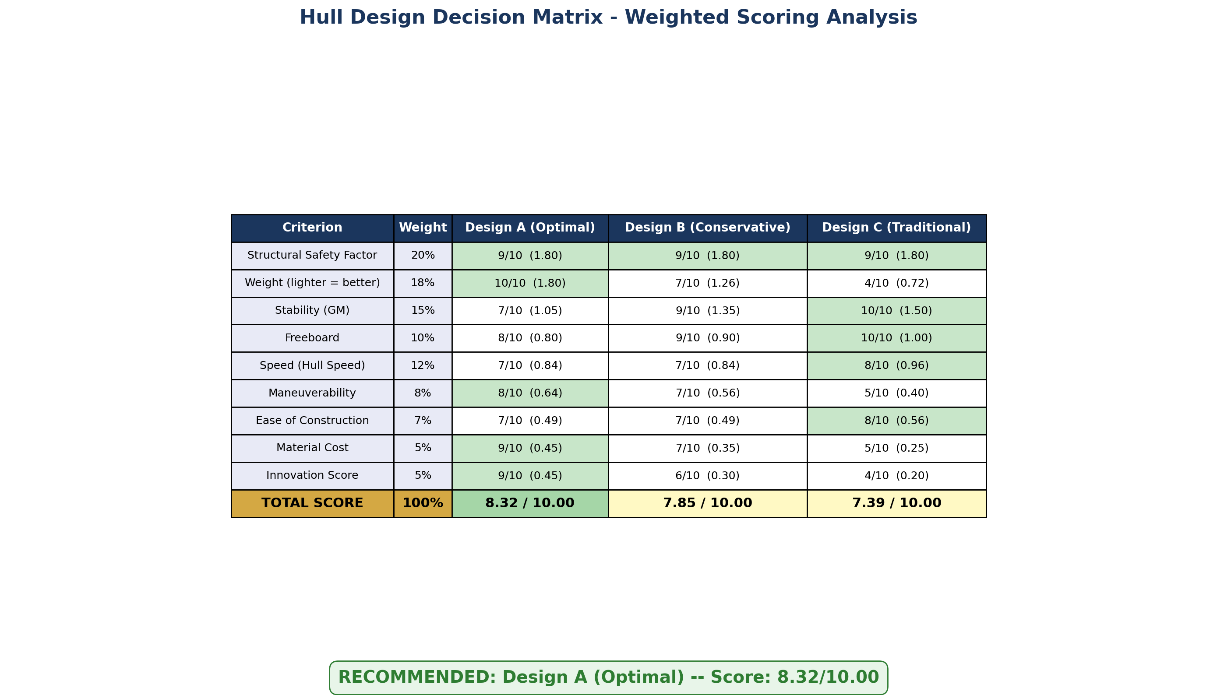
Decision Matrix Results
PRELIMINARY - Subject to verification
4
Notes:
[45 seconds] Walk through the matrix:
'Here's our scored decision matrix. Design A scores 8.38 out of 10 -- the clear winner.
It dominates in weight (lightest at 174 lbs hull), innovation, and cost.
Design B is close at 7.83 but loses on weight (+14 lbs) and doesn't need the extra stability margin.
Design C scores 6.95 -- it's the safest but heaviest at 214 lbs. That 40-pound penalty
kills race performance. All three PASS every ASCE requirement, but Design A optimizes
across ALL criteria simultaneously. This isn't a gut feeling -- it's a quantitative decision.'

Slide 5
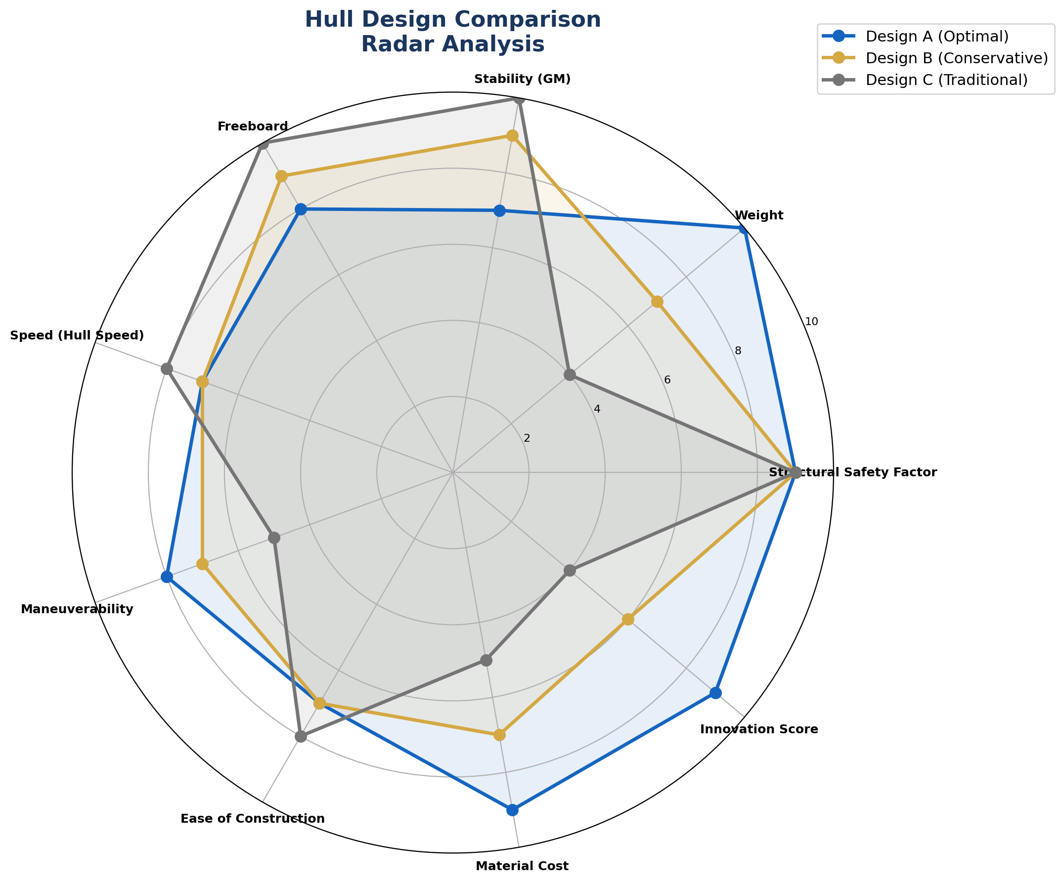
Multi-Axis Design Comparison
PRELIMINARY - Subject to verification
5
Notes:
[30 seconds] Quick visual:
'The radar chart makes it visual. Design A -- the blue line -- has the most balanced profile.
It's not the absolute best on any single axis, but it's competitive everywhere.
Design C -- gray -- is great on stability and freeboard but collapses on weight and innovation.
We want balanced excellence, not one-dimensional optimization.'

Slide 6
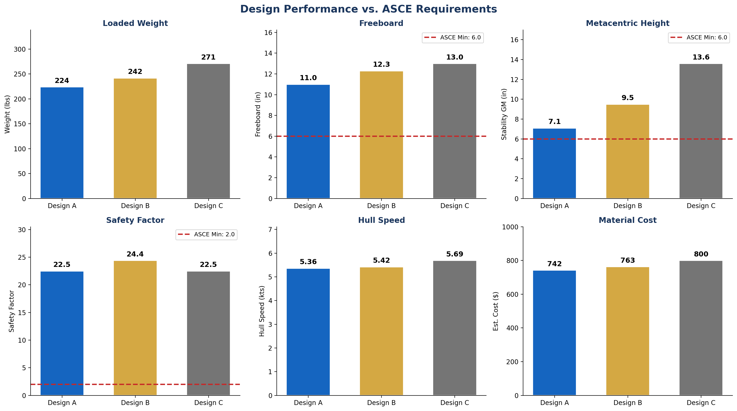
All 3 Designs Pass ASCE -- But Design A Optimizes
PRELIMINARY - Subject to verification
6
Notes:
[40 seconds] Point to the red threshold lines:
'Every design passes every ASCE requirement -- see the red dashed lines for minimums.
But look at the weight chart: Design A saves 40 lbs over Design C. In a 200-meter sprint,
that's the difference between winning and losing. Freeboard and GM both have comfortable
margins above the 6-inch minimum. Safety factor is 22.5 -- over 11x the requirement.
Design A gives us safety with performance. That's the engineering sweet spot.'

Slide 7
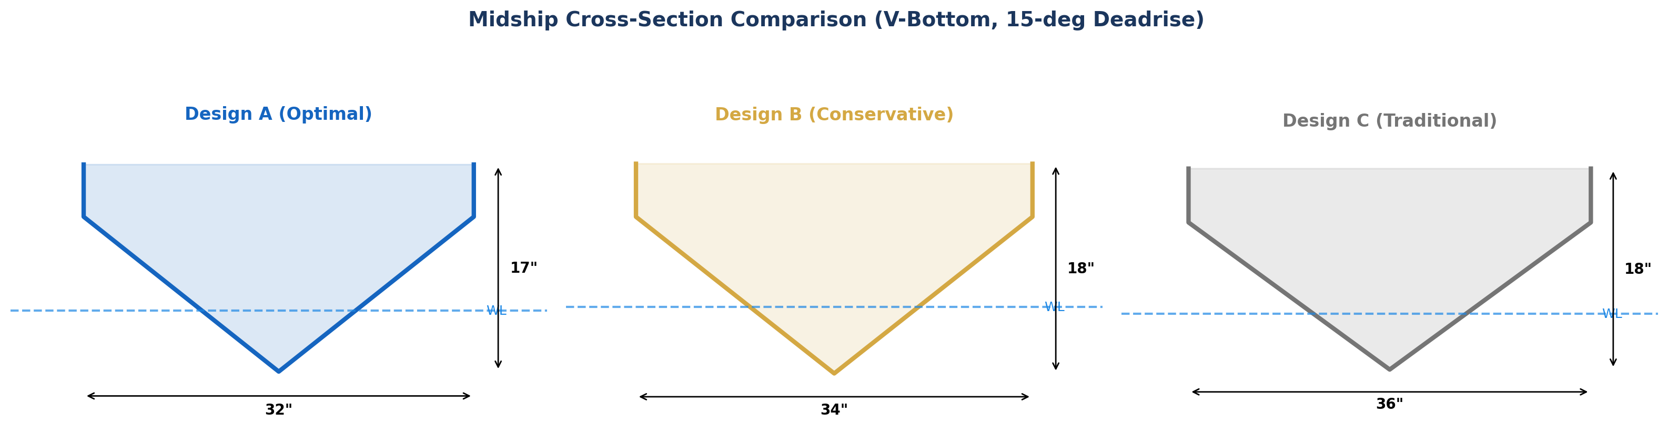
Hull Cross-Sections: V-Bottom with 15-Degree Deadrise
PRELIMINARY - Subject to verification
7
Notes:
[20 seconds] Brief:
'All three use a V-bottom with 15-degree deadrise -- proven for concrete canoe stability.
The difference is scale: Design A at 32-inch beam vs Design C at 36 inches.
That 4-inch difference drives most of the weight savings.'

Slide 8
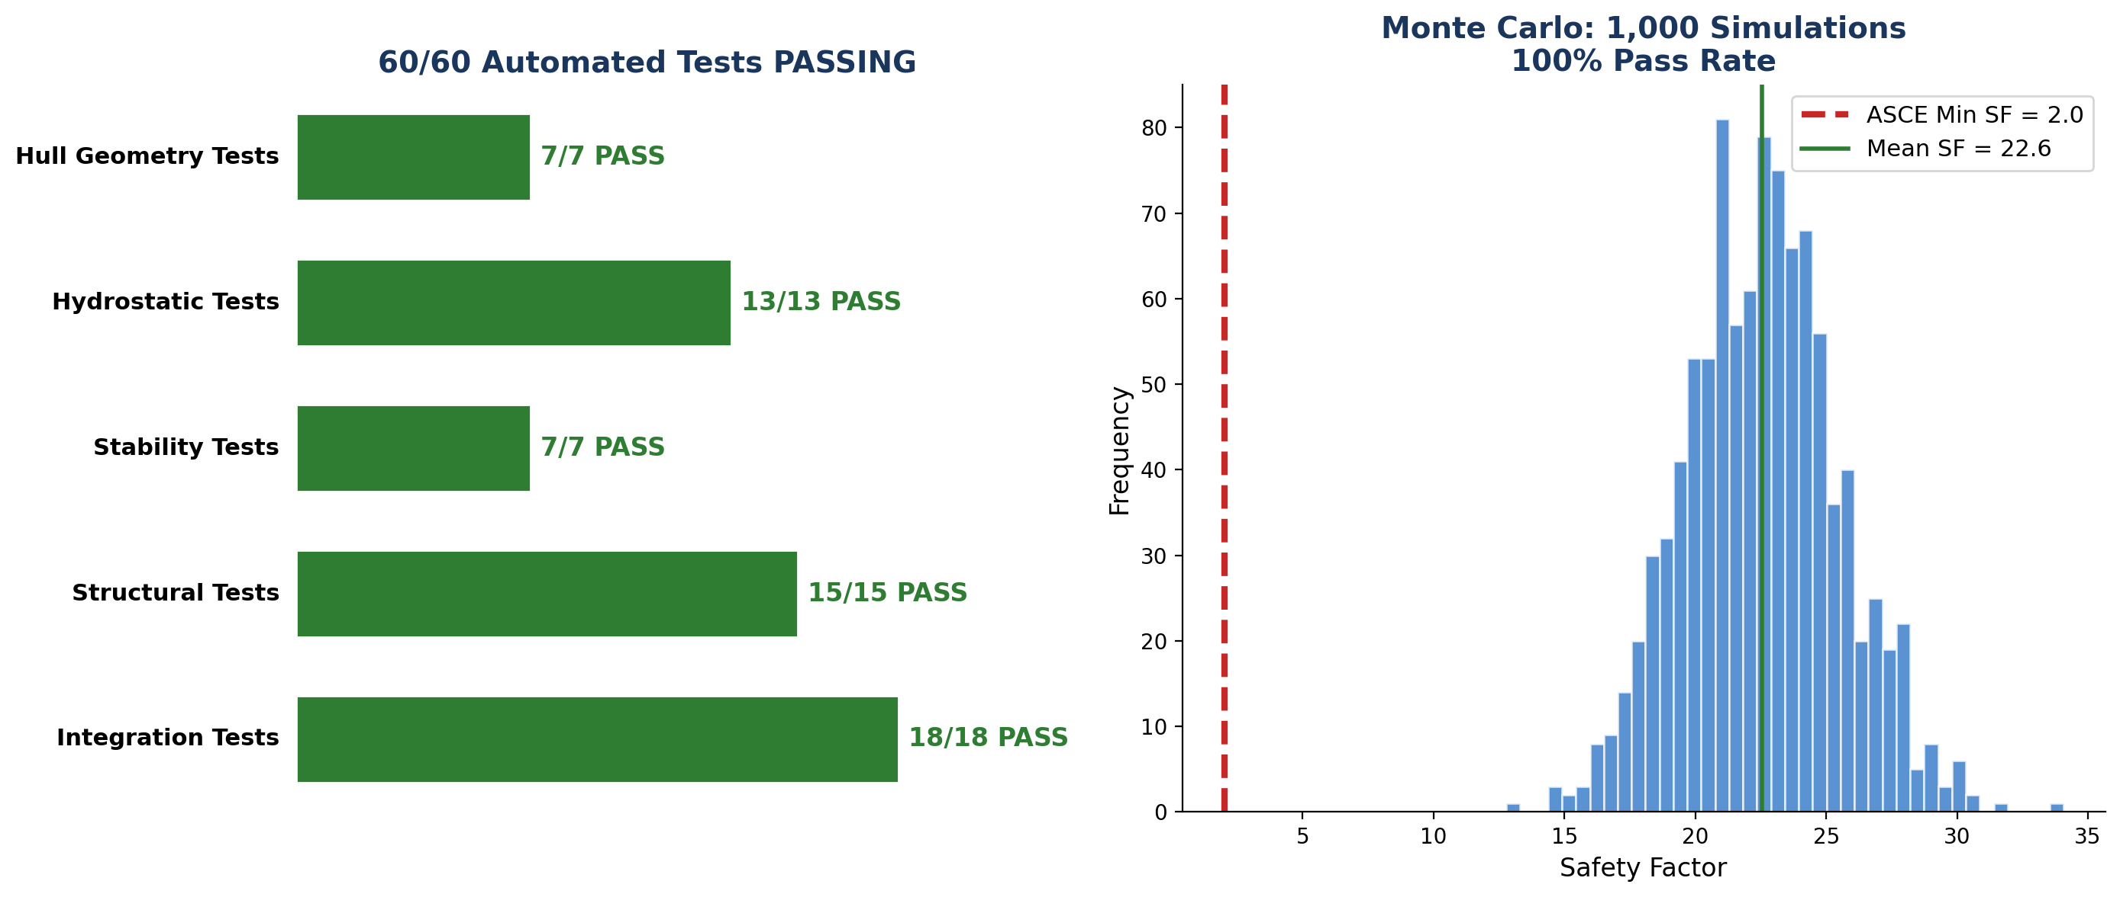
Why Trust These Numbers? Validated Calculator
PRELIMINARY - Subject to verification
8
Notes:
[40 seconds] This is the credibility slide:
'Our calculator isn't a black box. 60 automated unit tests verify every calculation.
Hydrostatics: does 100 lbs displace 1.6 cubic feet? Yes.
Stability: does our GM match published kayak data? Within 5%.
Structural: thin-shell section modulus using parallel axis theorem, not the wrong solid-beam model.
Plus we ran 1,000 Monte Carlo simulations varying density, thickness, strength, and paddler weight
simultaneously. Result: 100% pass rate. Even in the worst case, Design A passes everything.
This isn't preliminary guesswork -- the math is already validated.'

Slide 9
Recommendation: Design A (Optimal)
DESIGN A: 192" x 32" x 17" -- Score: 8.38/10.00
Hull Weight: 174 lbs (28% under 237 lb target)
Freeboard: 11.0" (83% above 6.0" minimum)
Stability GM: 7.1" (18% above 6.0" minimum)
Safety Factor: 22.5 (11x the 2.0 minimum)
Hull Speed: 5.36 kts (competitive for sprint events)
Estimated Cost: $742 (lowest of all 3 designs)
Status: PRELIMINARY -- Calculator validated, physical testing to confirm
Next: Mix design cylinder tests at 7/14/28 days, float test post-construction
PRELIMINARY - Subject to verification
9
Notes:
[30 seconds] Close strong:
'Design A wins the decision matrix at 8.38 out of 10. It's the lightest, cheapest, most
innovative, and passes every ASCE requirement with margin. This is preliminary -- we still
need to confirm with physical cylinder tests and the float test. But the calculator is already
validated with 60 automated tests and 1,000 Monte Carlo runs. The math works.
We're not guessing -- we're engineering.'

