Slide 1



DATA DESCRIPTION
- Summaries of data presented in a form that is easy to understand.

Slide 2


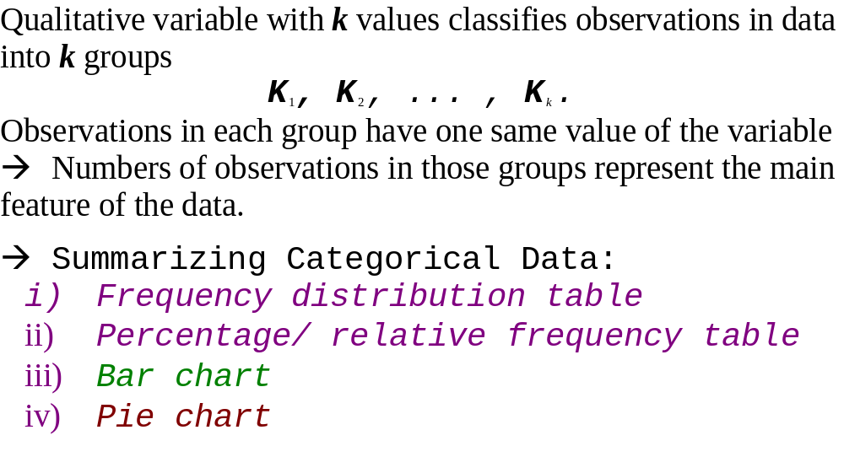

Slide 3

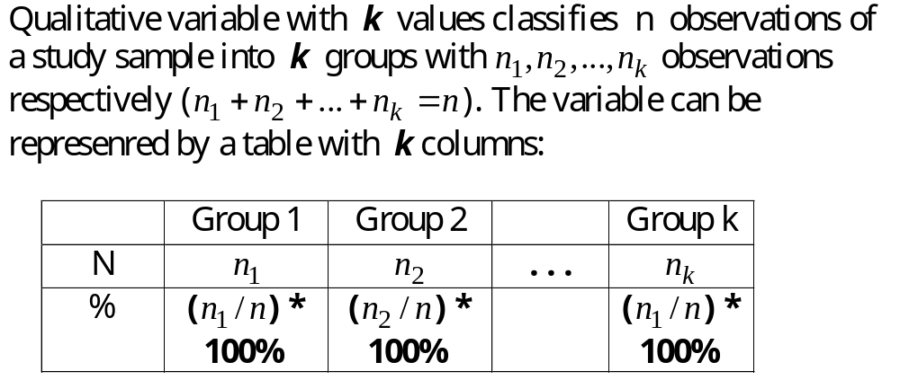
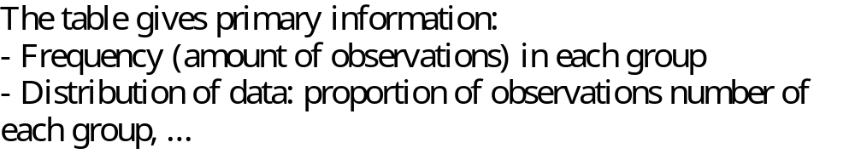

Slide 4

Relative Frequency Distribution
The relative frequency of a class is the fraction or proportion of the total number of data items belonging to the class.
A relative frequency distribution is a tabular summary of a set of data showing the relative frequency for each class.

Slide 5

Percent Frequency Distribution
The percent frequency of a class is the relative frequency multiplied by 100.
A percent frequency distribution is a tabular summary of a set of data showing the percent frequency for each class.

Slide 6
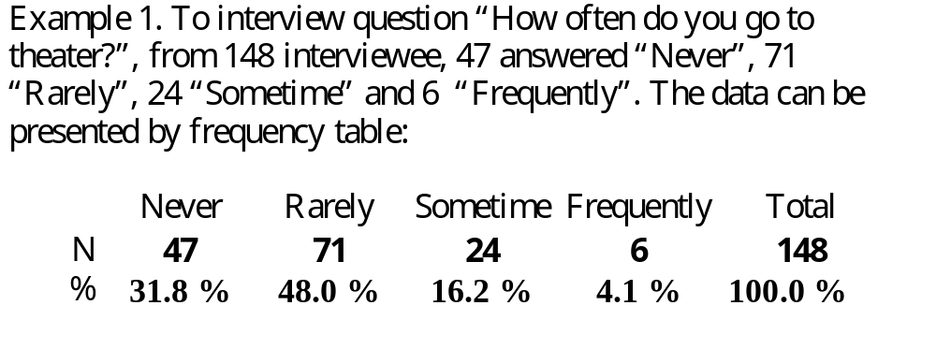

Slide 7

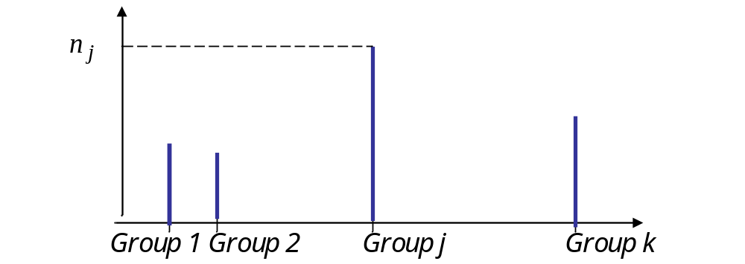


Slide 8
Bar Chart
A bar chart is a graphical display for depicting qualitative data.
On one axis (usually the horizontal axis), we specify the labels that are used for each of the classes.
A frequency, relative frequency, or percent frequency scale can be used for the other axis (usually the vertical axis).
Using a bar of fixed width drawn above each class label, we extend the height appropriately.
  The bars are separated to emphasize the fact that each class is a separate category.

Slide 9
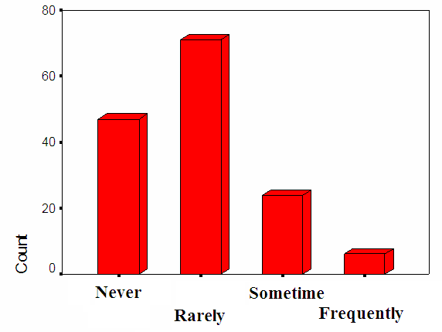

Slide 10


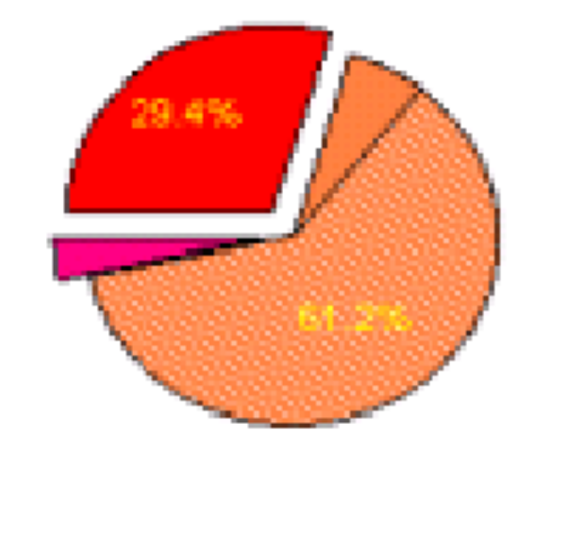


Slide 11
Pie Chart
The pie chart is a commonly used graphical display for presenting relative frequency and percent frequency distributions for categorical data.
First draw a circle; then use the relative frequencies to subdivide the circle into sectors that correspond to the relative frequency for each class.

Slide 12
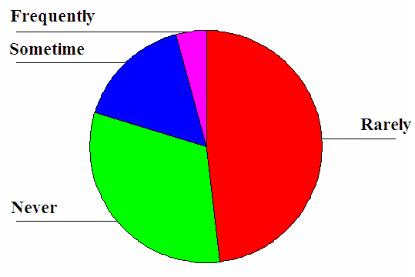

Slide 13


Using Excel to Describe Categorical Variables
Excel has functions for computing the parameters of categorical variables and draw graphs:
SUM, COUNT, COUNTIF used to compute the frequencies.
BAR, PIE used to draw the bar charts and pie charts.

Slide 14

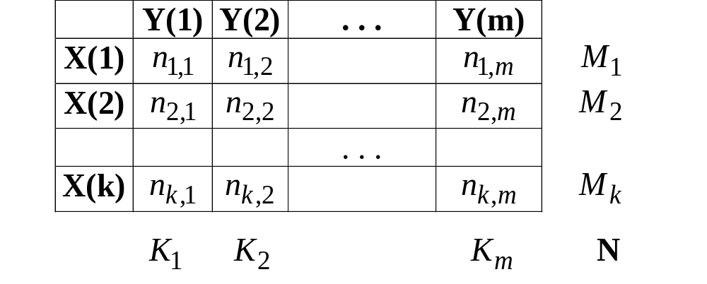
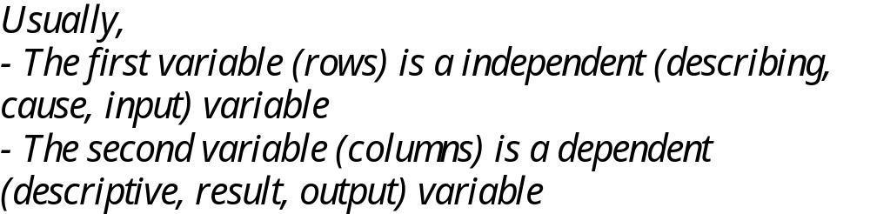

Slide 15
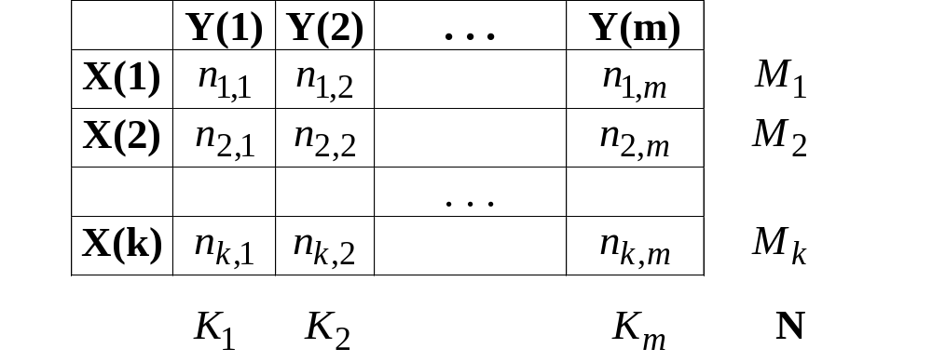
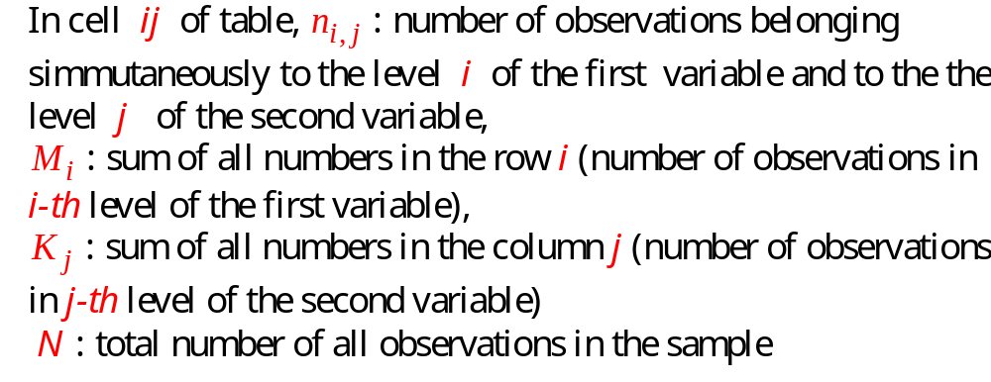

Slide 16
Crosstabulation: Row or Column Percentages
Converting the entries in the table into row percentages or column percentages can provide additional insight about the relationship between the two variables.

Slide 17
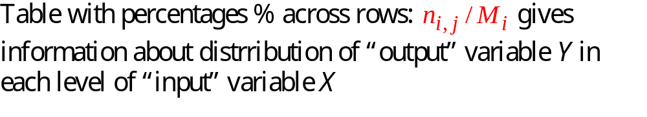
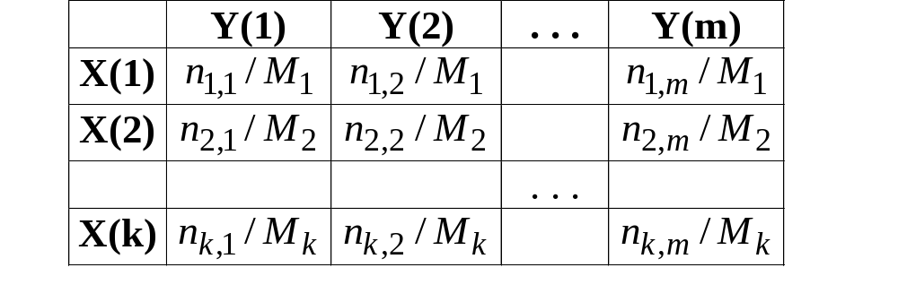

Slide 18
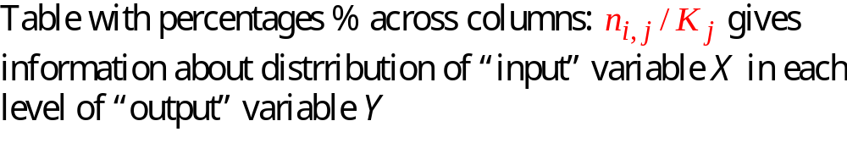
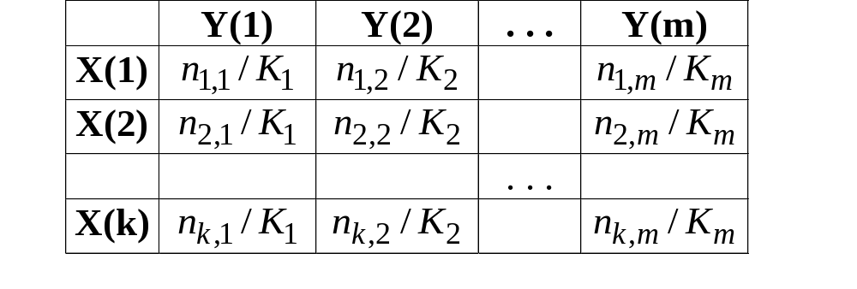

Slide 19

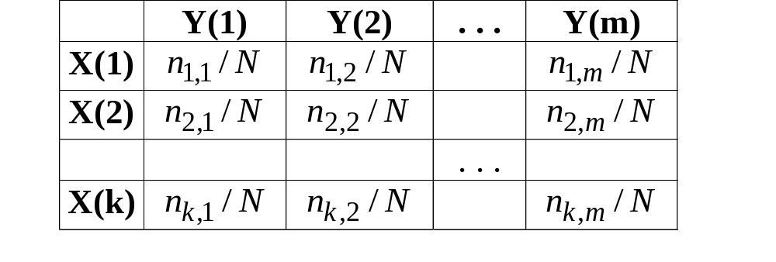

Slide 20
Side-by-Side Bar Chart
A side-by-side bar chart is a graphical display for depicting multiple bar charts on the same display.
Each cluster of bars represents one value of the first variable.
Each bar within a cluster represents one value of the second variable.

Slide 21

Side-by-Side Bar Chart
Finger Lake Homes
20
18
16
< $250,000
> $250,000
14
12
Frequency
10
8
6
4
2
Home Style
Colonial
Log
Split-Level
A-Frame

Slide 22
Stacked Bar Chart
A stacked bar chart is another way to display and compare two variables on the same display.
It is a bar chart in which each bar is broken into rectangular segments of a different color.
If percentage frequencies are displayed, all bars will be of the same height (or length), extending to the 100% mark.

Slide 23

Stacked Bar Chart
Finger Lake Homes
40
36
32
28
< $250,000
24
> $250,000
Frequency
20
16
12
8
4
Home Style
Colonial
Log
Split
A-Frame

Slide 24

Stacked Bar Chart
Finger Lake Homes
100
90
80
70
60
< $250,000
Percentage Frequency
> $250,000
50
40
30
20
10
Home Style
Colonial
Log
Split
A-Frame

Slide 25
Choosing the Type of Graphical Display
Displays used to make comparisons:
Side-by-Side Bar Chart to compare two variables
Stacked Bar Chart to compare the relative frequency or Percent frequency of two categorical variables

Slide 26
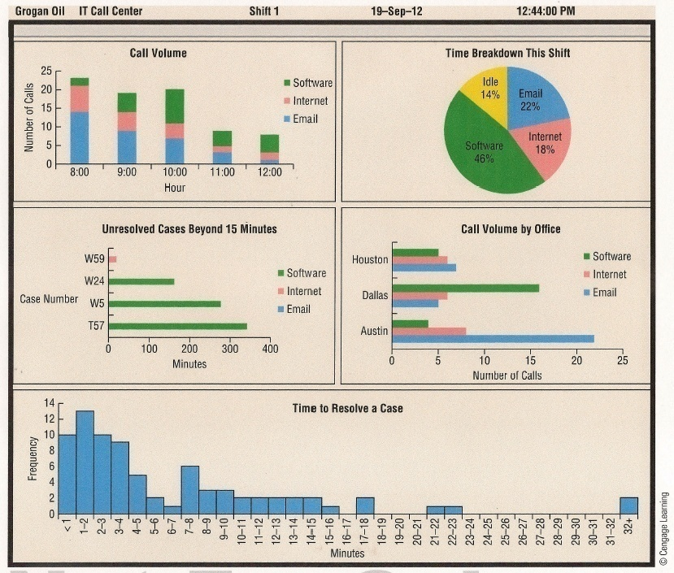
Example

Slide 27
Using Excel to Describe Categorical Variables
Excel has functions for computing the parameters of categorical variables and draw graphs:
SUM, COUNT, COUNTIF, COUNTIFS used to compute the frequencies.
BAR used to draw the bar charts.

Slide 28

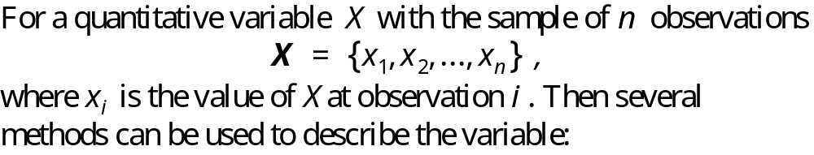





Slide 29


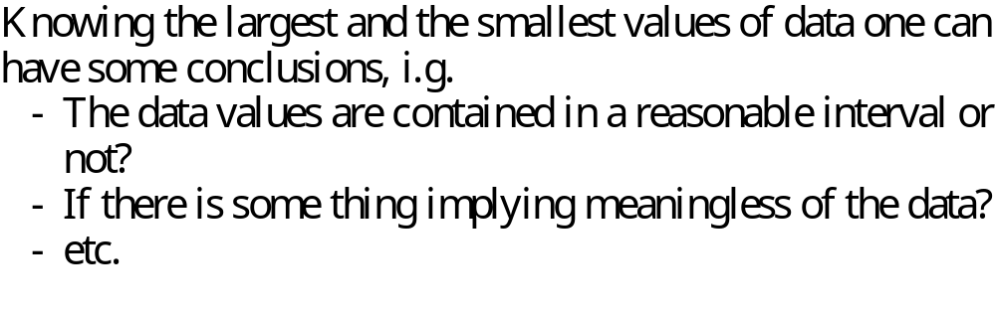

Slide 30

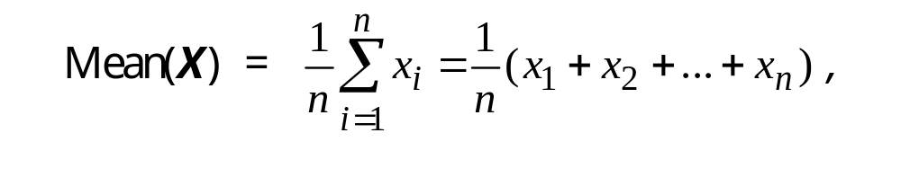
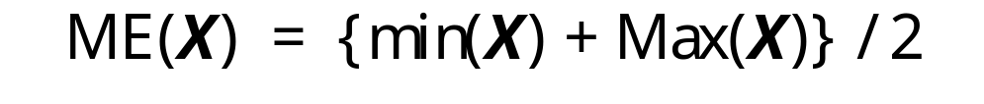

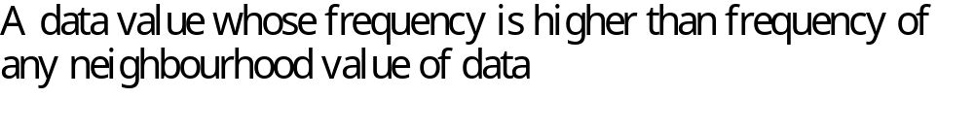

Slide 31
Mode
The mode of a data set is the value that occurs with greatest frequency.
The greatest frequency can occur at two or more different values.
If the data have exactly two modes, the data are bimodal.
If the data have more than two modes, the data are multimodal.

Slide 32
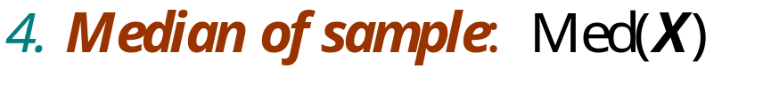
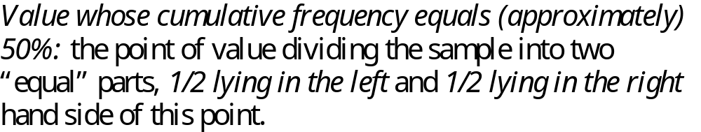
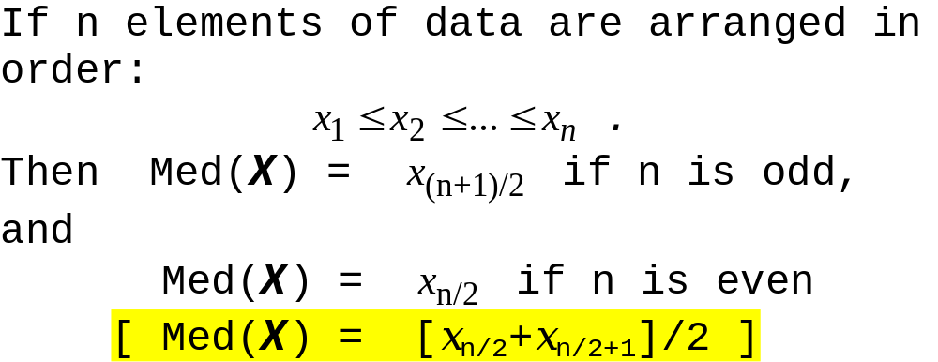

Slide 33
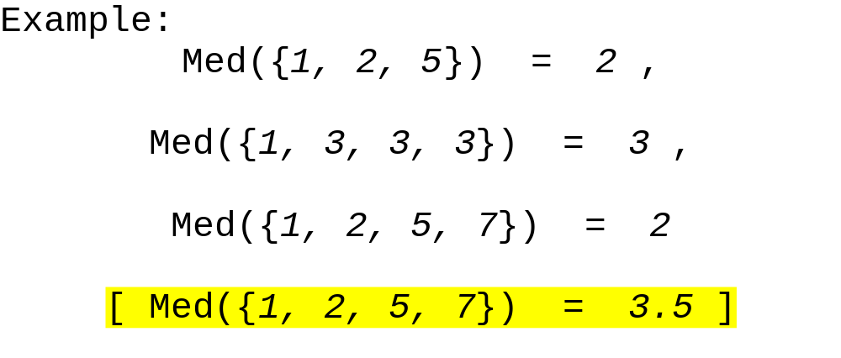

Slide 34
Median
The median of a data set is the value in the middle when the data items are arranged in ascending order.
Whenever a data set has outlier extreme values, the median is the preferred measure of central location.
The median is the measure of location most often reported for annual income and property value data.
A few extremely large incomes or property values can inflate the mean.

Slide 35

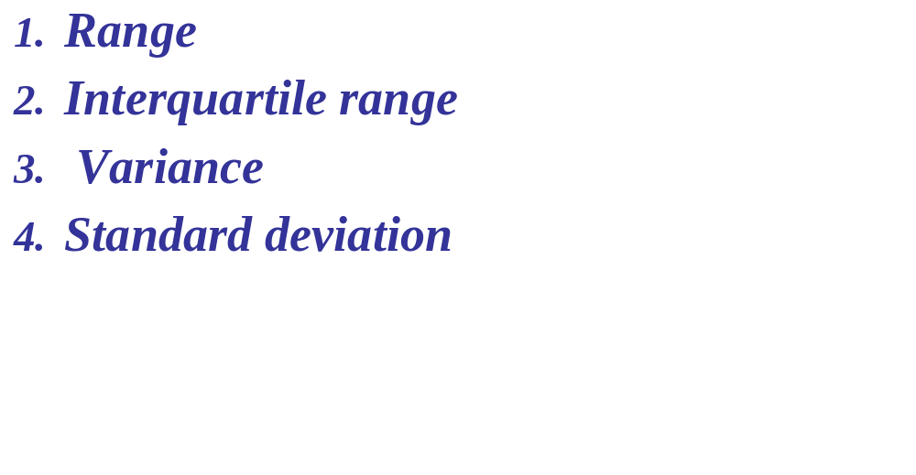

Slide 36
1. Range
The range of a data set is the difference between the largest and smallest data values.
Range = Largest value – Smallest value
It is the simplest measure of variability.
It is very sensitive to the smallest and largest data values.

Slide 37
2. Interquartile Range
The interquartile range of a data set is the difference between the third quartile and the first quartile.
It is the range for the middle 50% of the data.
It overcomes the sensitivity to extreme data values.

Slide 38
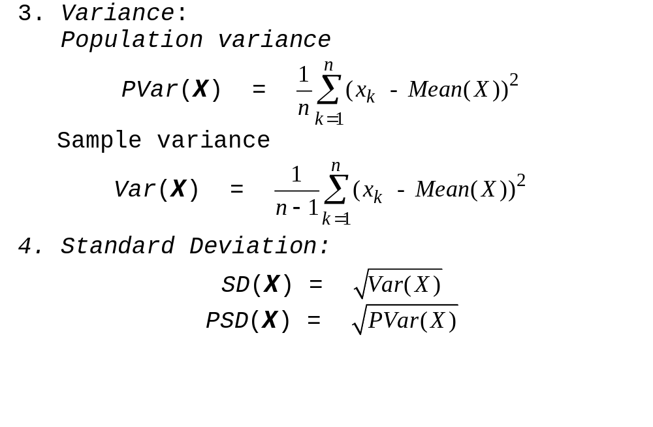

Slide 39

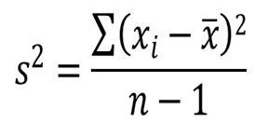
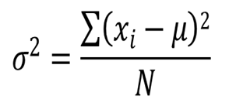
Variance
The variance is the average of the squared differences between each data value and the mean.
for a
sample
for a
population

Slide 40



Standard Deviation
The standard deviation is computed as follows:
for a
sample
for a
population

Slide 41


Standard Deviation
The standard deviation of a data set is the positive square root of the variance.
It is measured in the same units as the data, making it more easily interpreted than the variance.

Slide 42

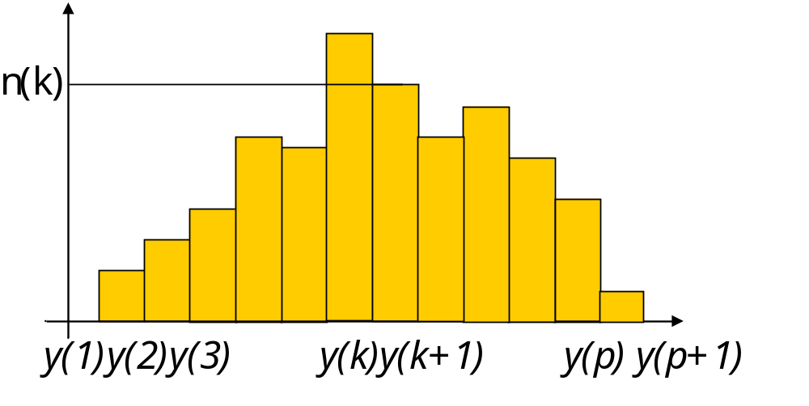
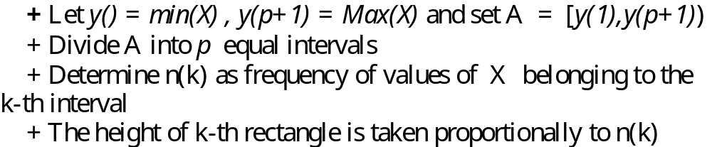

Slide 43

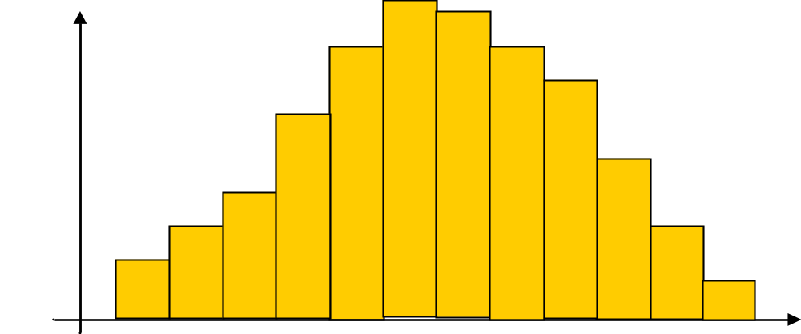
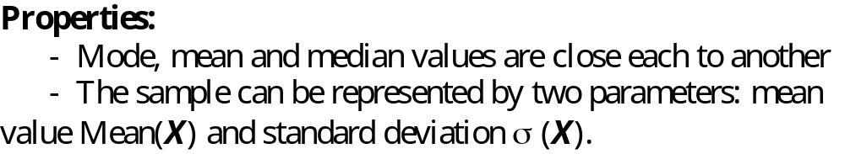
TÝnh chÊt:
- mèt, trung vÞ vµ gi¸ trÞ trung b×nh cña mÉu t­¬ng ®èi gÇn nhau.
- cã thÓ dïng 2 gi¸ trÞ: trung b×nh Mean(X) vµ ®é lÖch tiªu chuÈn σ (X) ®ã ®Ó tãm t¾t mÉu.

Slide 44

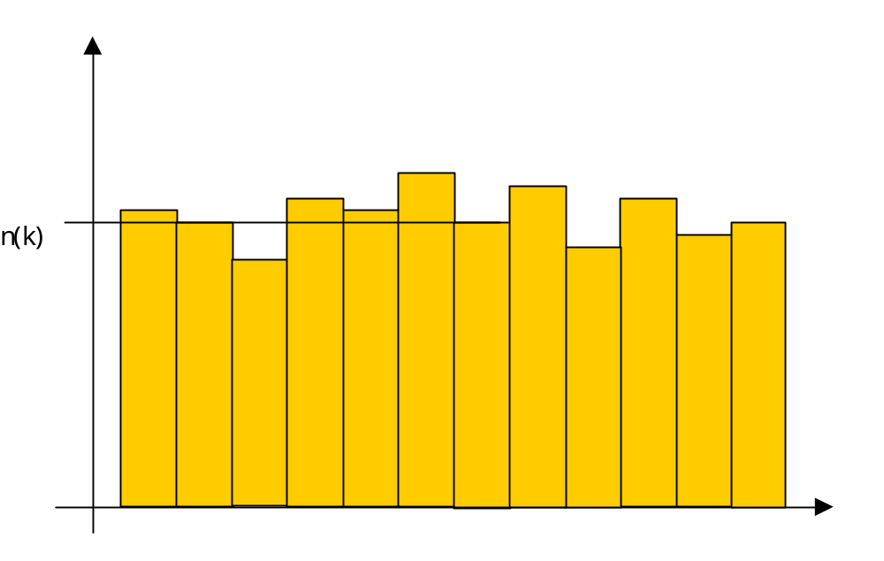
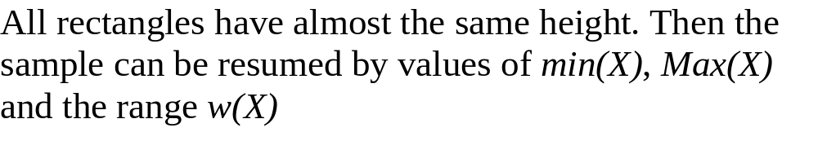

Slide 45
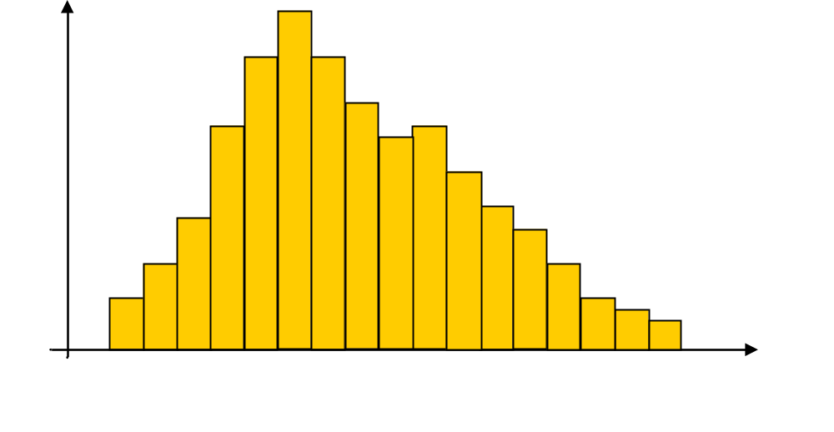
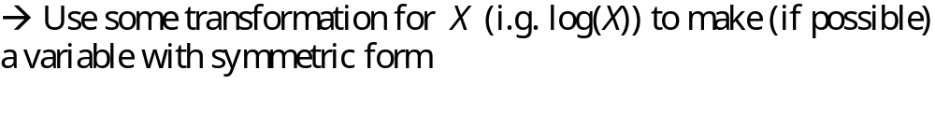

Slide 46

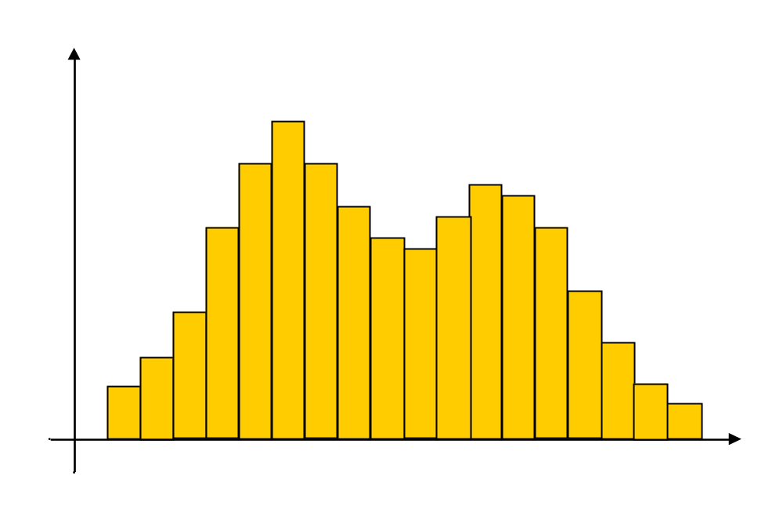
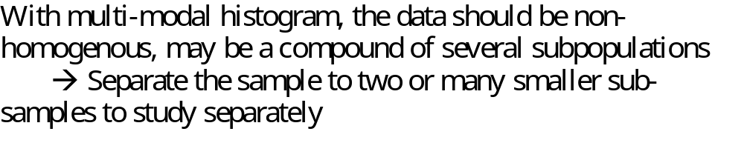

Slide 47

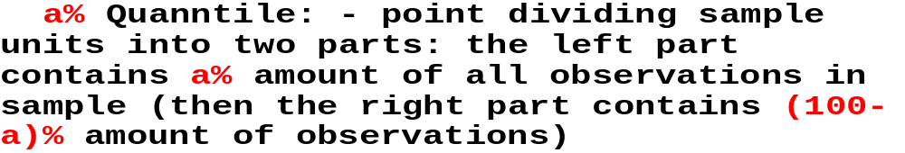
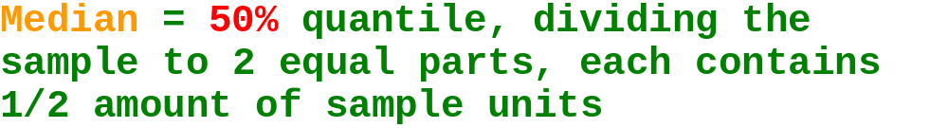
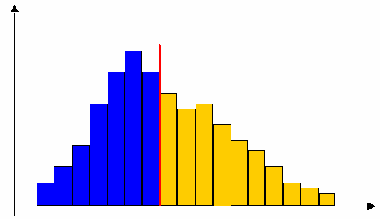

Slide 48
Percentiles
The pth percentile of a data set is a value such that at least p percent of the items take on this value or less and at least (100 - p) percent of the items take on this value or more.
A percentile provides information about how the data are spread over the interval from the smallest value to the largest value.

Slide 49

Percentiles
Arrange the data in ascending order.
Compute L_{p}, the location of the pth percentile.
L_{p} = [(p/100)(n + 1)]

Slide 50


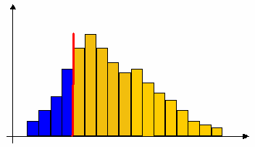
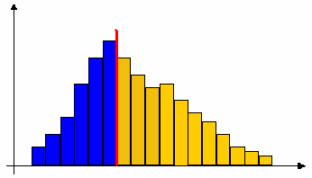
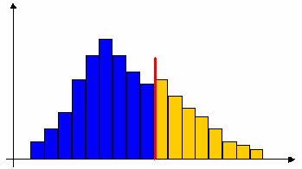
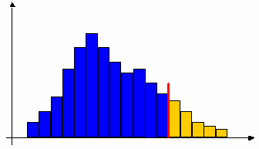

Slide 51
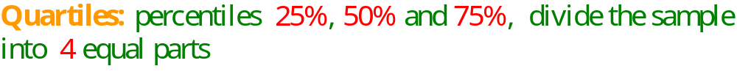
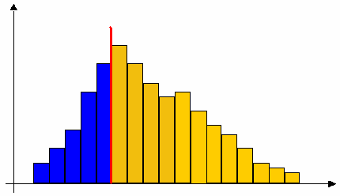



Slide 52
Quartiles
Quartiles are specific percentiles.
First Quartile = 25th Percentile
Second Quartile = 50th Percentile = Median
Third Quartile = 75th Percentile

Slide 53




Slide 54



Slide 55


Slide 56






Slide 57


Five-Number Summaries and Box Plots
Summary statistics and easy-to-draw graphs can be used to quickly summarize large quantities of data.
Two tools that accomplish this are five-number summaries and box plots.

Slide 58


Five-Number Summary
1. Smallest Value
2. First Quartile
3. Median
4. Third Quartile
5. Largest Value

Slide 59


Box Plot
A box plot is a graphical summary of data that is based on a five-number summary.
A key to the development of a box plot is the computation of the median and the quartiles Q₁ and Q₃.

Slide 60
Box Plot
Limits are located (not drawn) using the interquartile range (IQR) multiplied by 1.5
Data outside these limits are considered outliers.
The locations of each outlier is shown with the symbol * .

Slide 61
Box Plot
Example: Apartment Rents
Whiskers (dashed lines) are drawn from the ends of the box to the smallest and largest data values inside the limits.
575
600
625
650
675
700
725
500
525
550
Smallest value
inside limits = 525
Largest value
inside limits = 715

Slide 62






Slide 63


Using Excel to Describe Quantitative Variables
MIN, MAX used to compute the extreme values.
AVERAGE, MODE , MEDIAN used to compute the Mean, Mode and median parameters.
VARP, VAR, STDEVP, STDEV used for the Variance and Standard Deviation parameters.
PERCENTILE, QUARTILE used for the Percentile and Quartile parameters.
HISTOGRAM used to draw the Histograms.

Slide 64



Slide 65




Slide 66
Scatter Diagram and Trend-line
A scatter diagram is a graphical presentation of the relationship between two quantitative variables.
The general pattern of the plotted points suggests the overall relationship between the variables.
One variable is shown on the horizontal axis and the other variable is shown on the vertical axis.
A trend-line provides an approximation of the relationship.

Slide 67
Scatter Diagram
A Positive Relationship
y
x

Slide 68
Scatter Diagram
A Negative Relationship
y
x

Slide 69
Scatter Diagram
No Apparent Relationship
y
x

Slide 70




Slide 71

Measures of Association Between Two Variables
Often a manager or decision maker is interested in the relationship between two variables.
Two descriptive measures of the relationship between two variables are covariance and correlation coefficient.

Slide 72





Slide 73


Covariance
For samples:
For populations:

Slide 74

Covariance
The covariance is a measure of the linear association between two variables.
Positive values indicate a positive relationship.
Negative values indicate a negative relationship.

Slide 75





Slide 76


Correlation Coefficient
For samples:
For populations:

Slide 77




Slide 78
Correlation Coefficient
The coefficient can take on values between -1 and +1.
Values near -1 indicate a strong negative linear relationship.
Values near +1 indicate a strong positive linear relationship.
The closer the correlation is to zero, the weaker the relationship.

Slide 79






Slide 80




Slide 81




Using Excel to Describe Quantitative Variables
Excel has functions for computing the parameters of quantitative variables and draw graphs:
MIN, MAX, MED, MODE, QUARTILE, PERCENTILE used to compute the Minimum, Maximum, Median, Mode, Quartiles, Percentiles.
AVERAGE, AVERAGEIF, AVERAGEIFS used to compute the Mean Values.
VAR, VARP, STDEV, STDEVP used to compute the Sample Variance, Population Variance, Sample Standard Deviation, Population Standard Deviation.
COVAR, CORREL used to compute the Covariance, Correlation Coefficient.
HISTOGRAM, SCATTER used to draw the Histogram and Scatter Plot.

