Slide 1
Parameter estimation
“Estimation”: Using low accurate measuring tools (using data collected in a very limited sample of population) to determine as precisely as possible value of a certain parameter (of all population).

Slide 2
Population
Sampling
Sample
Estimation
Laws
Hypothesis tests

Slide 3
Parameter Estimation
* Estimation methods
* Distribution of estimated parameters
* Comparing distribution of estimated parameter wit Normal distribution
* Confidence Interval of estimation (Interval Estimation)

Slide 4
Estimation of rate (proportion, probability)
Example: - Tossing a coin: What is possibility to get “figure side”?
Tossing a dice: What is probability to get the side with six points ?
Tobacco smoking study: How large is smoking rate in elderly people (over 60) ?
Proportion of rural households using rain water?

Slide 5
Usually it is very hard to determine exactly the real value of concerned parameter. The one must estimate the value by using some suitable method
Meet with some error in estimation
Need to evaluate accuracy of estimation: with a given precise level the estimation result is acceptable or not?
To determine possible accuracy of estimation with given precise level, we need to know distribution of the estimation

Slide 6
Distribution of variable
The set of values of a set of data, possibly grouped into classes, together with their frequencies or relative frequencies
Distribution of variable: the set of possible values with their probability

Slide 7
Example:
- Tossing a coin: Possibility to get “figure side” = 1/2 → uniform distribution of two values “figure side” and “number side”
Tossing a dice: Probability to get the side with six points = 1/6 → uniform distribution of 6 values
* , ** , *** , **** , ***** and ******
Tossing 6 dices: Non-uniform distribution of 31 values 6* , 7* , 8* , … , 35* and 36*

Slide 8
Concept of probability distribution
* Discrete distributions: Variable X with
Value: X₁ X₂ X₃ . . . X_{n}
| | | |
Probability: p₁ p₂ p₃ p_{n}
        P {X=X₁} = p₁ >= 0
        P {X=X₂} = p₂ >= 0
        . . .
        P {X=X_{n}} = p_{n} >= 0
        p₁ + p₂ + . . . + p_{n} = 1 (100%)

Slide 9
Concept of probability distribution
* Discrete distributions:
p₆
p₃
p₂
p₁
x₁ x₂ x₃ x_{n}

Slide 10

Discrete Probability Distributions
The probability distribution is defined by a probability function, denoted by f (x), that provides the probability for each value of the random variable.

Slide 11



Expected Value
The expected value, or mean, of a random variable is a measure of its central location.
E (x) = μ = Σ x f (x)
The expected value is a weighted average of the values the random variable may assume. The weights are the probabilities.

Slide 12



Variance and Standard Deviation
The variance summarizes the variability in the values of a random variable.
Var (x) = σ ² = Σ(x - μ)²f (x)
The variance is a weighted average of the squared deviations of a random variable from its mean. The weights are the probabilities.
The standard deviation σ is defined as the positive square root of the variance.

Slide 13
Concept of probability distribution
* Continuous distributions: Variable X taken value x inside interval (a;b) with density function f(x) >= 0

Slide 14
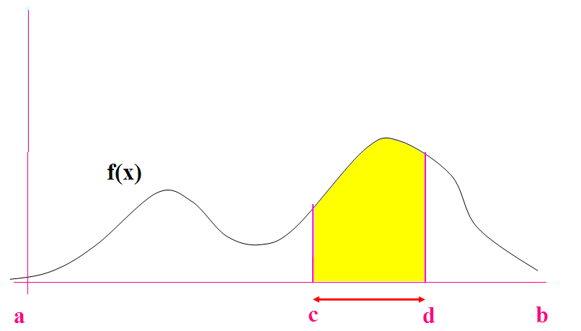
Concept of probability distribution
* Continuous distributions:

Slide 15
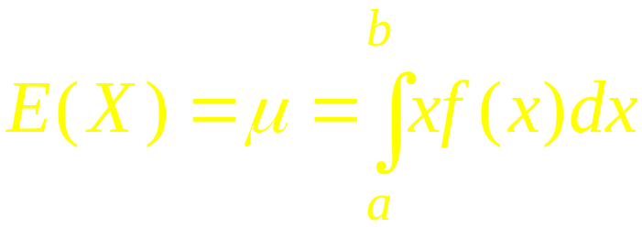
Expected Value
The expected value, or mean, of a continuous random variable with density function f(x):
The expected value is a “continuous weighted” average of the values the random variable.

Slide 16



Variance and Standard Deviation
The variance summarizes the variability in the values of a random variable.
The variance is a continuously weighted average of the squared deviation of a random variable from its mean. The continuous weight is the probability density function.
The standard deviation σ is defined as the positive square root of the variance.

Slide 17
Estimation of rate (proportion, probability)
In study population let’s consider a binary variable X with two values 0 and 1
Suppose X takes value 1 with rate (proportion, probability) p and value 0 with rate 1 – p , where p is unknown
(0 < p <1)

Slide 18
Estimation of rate (proportion, probability)
Usually we estimate the rate p by taking a sample of the variable X with n observations
x(1), x(2), … , x(n) .
Determine the number m(p) of values 1 among the n observations and perform the proportion
m(p) / n
as an estimated value of the rate p .
That way of estimation is “reasonable ” or not?

Slide 19
THEOREM (Louvlier). The proportion
m(p) / n
tends to p when n tens to infinity (is very large).
The theorem proved mathematically shows the taking the proportion m(p) / n for estimation of the rate p is completely “reasonable”: we can get the “true” rate when the sample size is very large.

Slide 20
Distribution of sample rate (proportion)
Let X be a binary variable taken value 1 with unknown probability p and taken value 0 with probability 1 – p (Bernoulli’s distribution).
Estimating p : perform a sample x(1), x(2), … , x(n) of X and take m(p) / n as an estimation of p
(m(p) = number of 1’s appeared in the sample).
Quantity m(p) / n should take values
0/n , 1/n , 2/n , … , (n-1) / n , n/n ,
each with certain “possibility” (probability)

Slide 21
Distribution of sample rate (proportion)
Quantity m(p) / n is a random variable with binomial distribution with parameters p and n noted by B(p;n)

Slide 22
Binomial Distribution B(p;n)
0
1
2
3
4
5
6
7
8
9
Parameters of binomial distribution are the rate p and number n of experiments

Slide 23



Binomial Probability Distribution
Expected Value
E(x) = μ = np
Variance
Var(x) = σ ² = np(1 – p)
Standard Deviation
SD(x) = σ = (np(1 – p))^{1/2}

Slide 24

Excel to Compute Binomial Probabilities
BINOMDIST is used to compute the probability and cumulative probability.

Slide 25
Distribution of sample rate (proportion)
Binomial distribution can be used to evaluate error in estimating p by m(p) / n
For small n, calculation with binomial distribution is practicable
For n large the calculation is very cumbersome → approximate Binomial distribution by Normal distribution
B(p;n) ~ N(p;p(1-p)/n)

Slide 26
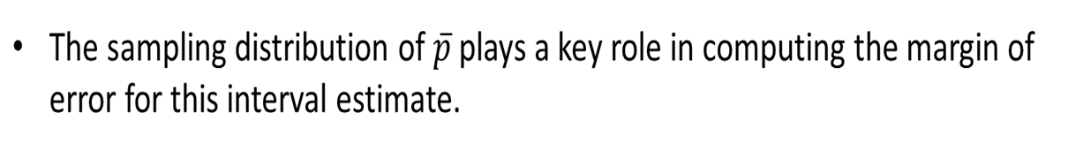
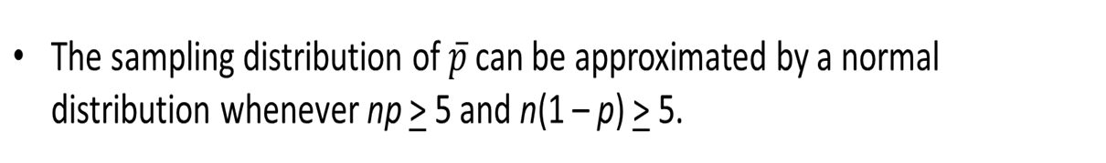
Distribution of estimation of proportion

Slide 27
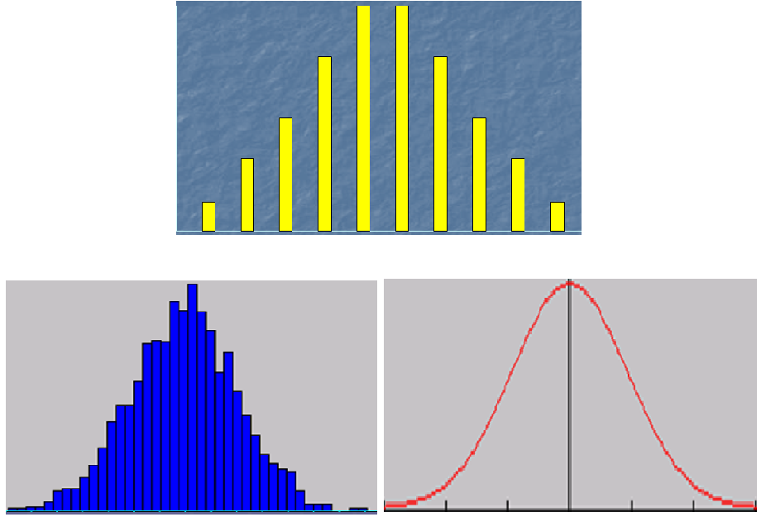
Approximation of B(p;n) by N(p;p(1-p)/n)

Slide 28
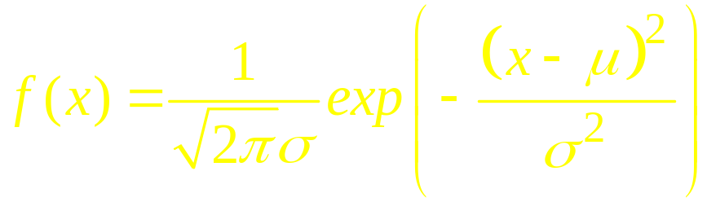
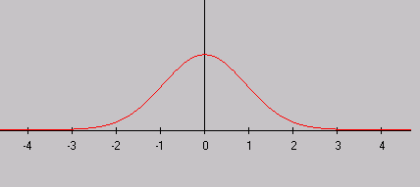
Normal distribution (Gaussian distribution) N(μ;σ²)
Normal distribution defined by its expectation μ and variance σ²

Slide 29
Normal distribution N(μ;σ²)
Expected Value
E(X) = μ
Variance
Var (X) = σ ²
Standard Deviation
SD(X) = σ

Slide 30
Standard normal distribution N(0;1)
Expected Value
E(Z) = 0
Variance
Var (Z) = 1
Standard Deviation
SD(Z) = 1

Slide 31
Distribution transformation
Linear transformation Y = aX + b
E(Y) = a.E(X) + b ;
Var(Y) = a²Var(X) ; SD(Y) = |a|.SD(X)
Standardization transformation
Y = (X - E(X)) / SD(X).
Then E(Y) = 0 ; Var(Y) = 1 ; SD(Y) = 1
Standardization of normal distribution X ~ N(μ;σ²)
Z = (X - µ) / σ .
Then E(Z) = 0 ; Var(Z) = 1 ; SD(Z) = 1
Z is called standard normal, Z ~ N(0;1)

Slide 32
Normal Probability Distribution
99.72%
96.44%
68.26%
x
μ
μ + 3σ
μ – 3σ
μ – 1σ
μ + 1σ
μ – 2σ
μ + 2σ

Slide 33

Using Excel to Compute Normal Probabilities
Excel has two functions for computing cumulative probabilities and x values for any normal distribution:
NORMDIST is used to compute the cumulative probability given an x value.
NORMINV is used to compute the x value given a cumulative probability.

Slide 34

NORMDIST(x, MEAN,SD,cum) = Prob{X<x}
  X ~ N(MEAN,SD^2), cum = TRUE
NORMSDIST(z, cum) = Prob{Z<z}
  Z ~ N(0,1), cum = TRUE

Slide 35

NORMINV = inverse function of NORMDIST
  NORMSINV = inverse function of NORMSDIST
  NORMSINV(cumulative-probability)
  Z_{α/2} = NORMSINV(1- α/2)
  NORMSDIST(Z_{α/2}) = 1- α/2

Slide 36
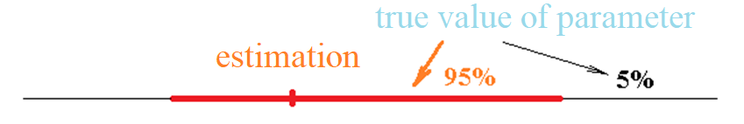
Confidence Interval of estimation
Confidence interval of an estimation is a segment on the number line that overlaps the estimated value of a parameter, indicating the true value of the parameter is likely to lie in that line with a given probability a (usually take a = 95%,➔ 95%CI)

Slide 37
Confidence interval of estimation
(interval estimation)
Confidence Interval of estimation is an interval containing the estimated value of parameter, informing the true value of parameter can be some point inside the interval with given probability a .
For a variable with normal distribution with expectation p and variance p . (1-p) / n
95% Confidence Interval of estimation of p is the interval

Slide 38
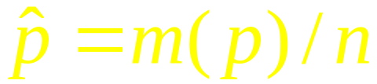
Confidence interval of proportion
Proportion is a quantity with distribution approximate to Normal Distribution,
95% Confidence Interval of proportion is
where

Slide 39
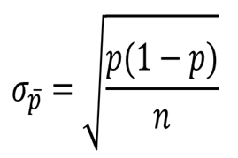
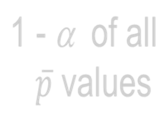



Interval Estimate of a Population Proportion
α /2
α /2
p

Slide 40
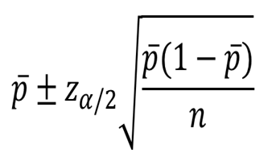
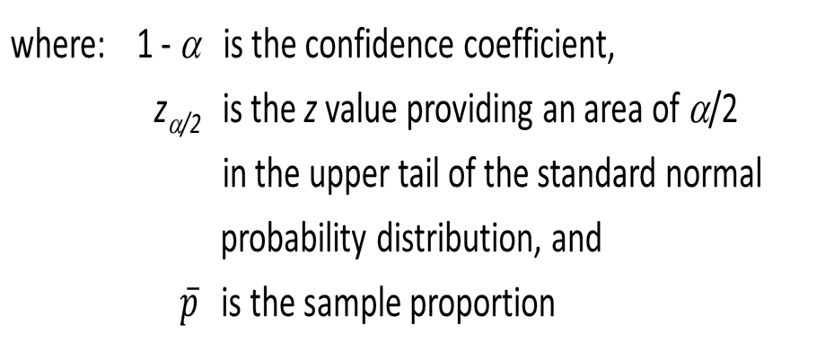
Interval Estimate of a Population Proportion
Interval Estimate

Slide 41
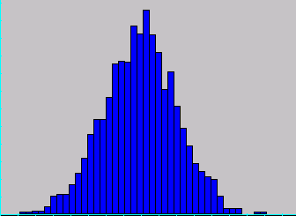
Normal distribution

Slide 42
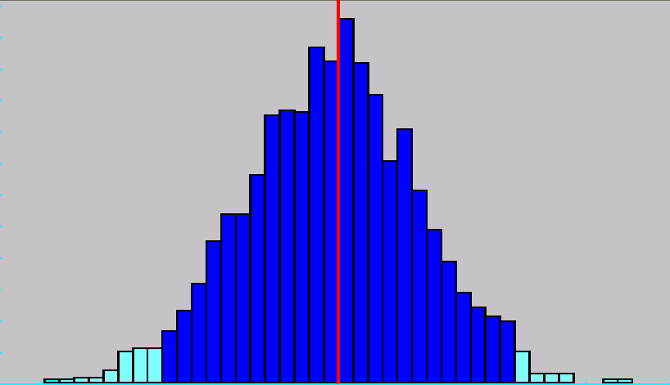
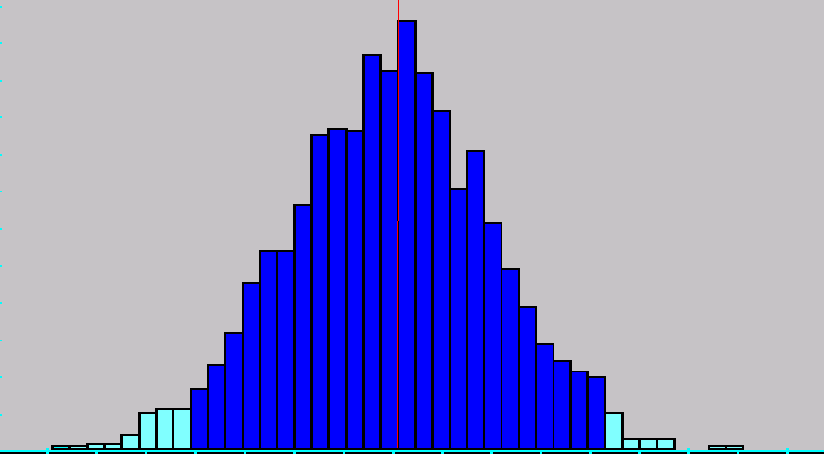
95% Confidence Interval

Slide 43
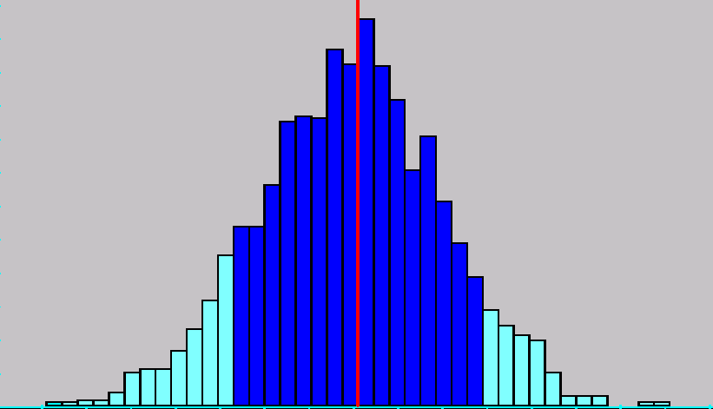
70% Confidence Interval

Slide 44
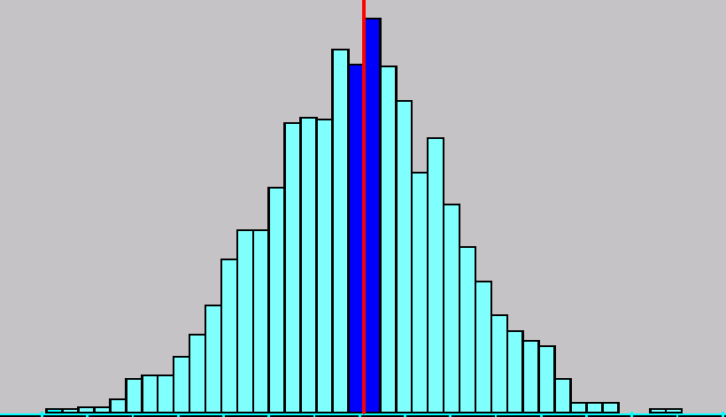
10% Confidence Interval

Slide 45

EXCEL PRACTICE
z_{α/2} =NORMSINV(1- α/2)
  z_{α/2} =NORM.S.INV(1- α/2)

Slide 46
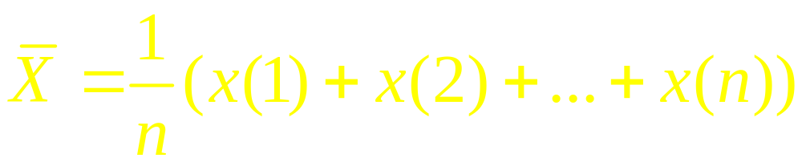
Estimation of Expectation
Expectation of variable =
Mean value of variable in whole population
To estimate the expectation of a quantitative variable X, a sample x(1), x(2), … , x(n) is selected and sample mean value (sample average)
can be taken as an estimated value of expectation parameter E(X) of X

Slide 47
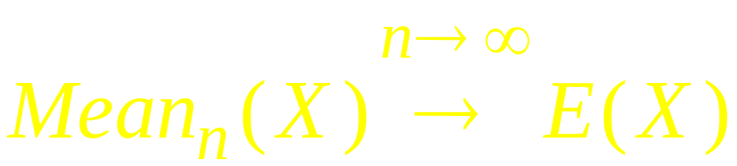
Conclusion : Sample mean value is a “good” estimation of Expectation:
The estimation is very close to true value of expectation if sample size n is very large.

Slide 48
Problem: Although Sample mean value is a “good” estimation of Expectation, there exists always some error of that estimation
→ How to evaluate the error in that estimation?
→ Need to know about distribution of sample mean value

Slide 49


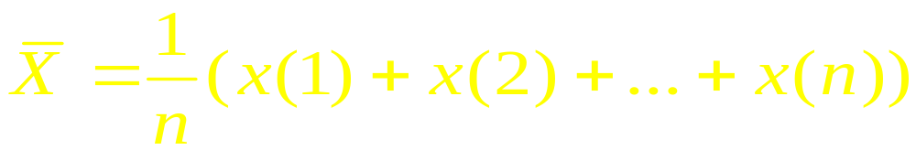

Distribution of sample mean value
THEOREM. Let variable X have normal distribution with expectation and variance and select a sample x(1), x(2), … , x(n) of that variable. Then the sample mean value
is a quantity with normal distribution with mean value equal and variance equal .

Slide 50
Interval Estimate of a Population Mean:
In order to develop an interval estimate of a population mean, the margin of error must be computed using either:
  the population standard deviation σ , or
  the sample standard deviation s
σ is rarely known exactly, but often a good estimate can be obtained based on historical data or other information.
We refer to such cases as the σ known case.

Slide 51


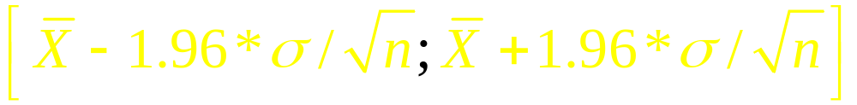
Confidence Interval of sample mean value
Confidence Interval of estimation is an interval containing the estimated value, confirming the true value of estimated parameter should be a point of that interval with a given probability a
For a normal distributed estimation quantity with expectation and variance , the 95% Confidence Interval (a = 95%) is defined by

Slide 52
Normal distribution

Slide 53
Confidence Interval

Slide 56
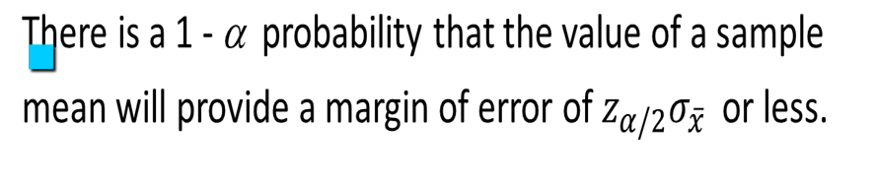
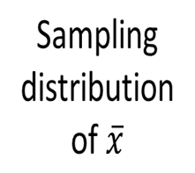
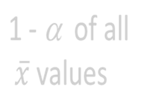



Interval Estimate of a Population Mean: σ Known
α/2
α/2
μ

Slide 57
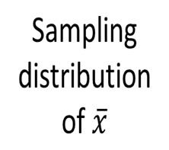
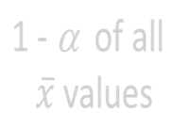





Interval Estimate of a Population Mean: σ Known
α/2
α/2
μ
interval
does not
include μ
interval
includes μ

Slide 58
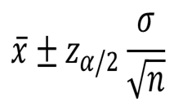
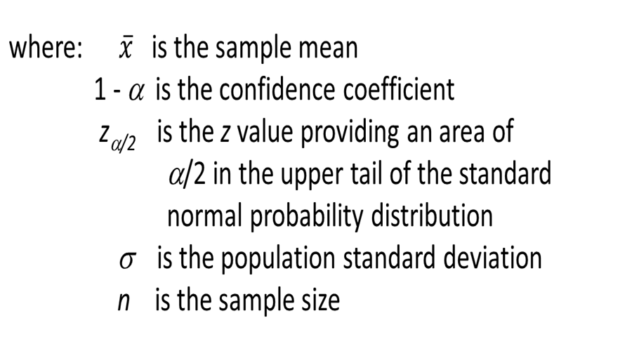
Interval Estimate of a Population Mean: σ Known
Interval Estimate of μ

Slide 59
Interval Estimate of a Population Mean: σ Known
Values of z_{α/2} for the Most Commonly Used Confidence Levels
Confidence Table
Level α α/2 Look-up Area z_{α/2}
90% 0.10 0.05 0.9500 1.645
95% 0.05 0.025 0.9750 1.960
99% 0.01 0.005 0.9950 2.576

Slide 60
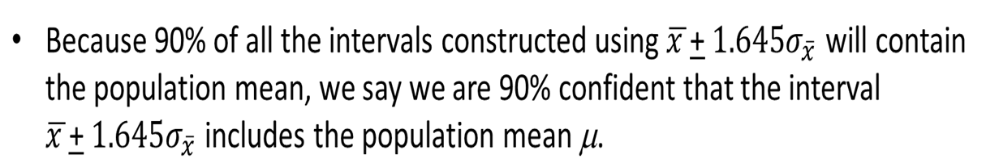
Meaning of Confidence
We say that this interval has been established at the 90% confidence level.
The value 0.90 is referred to as the confidence coefficient.

Slide 61
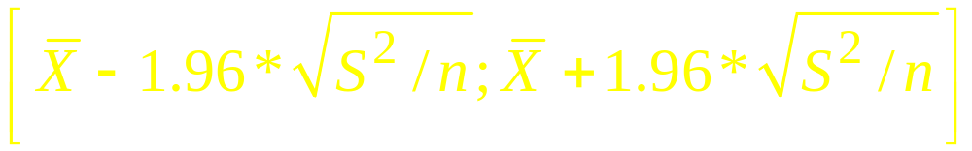
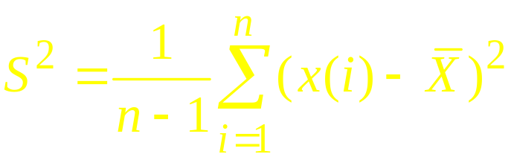
Confidence Interval of sample mean value for quantitative variable with unknown variance
If sample size n is very large then mean value of a variable with finite variance is an estimation of expectation with 95% Confidence Interval (a = 95%) given by
where

Slide 62
Interval Estimate of a Population Mean: σ unknown
If an estimate of the population standard deviation σ cannot be developed prior to sampling, we use the sample standard deviation s to estimate σ .
This is the σ unknown case.
In this case, the interval estimate for μ is based on the t distribution.

Slide 63

t Distribution
The t distribution is a family of similar probability distributions.
A specific t distribution depends on a parameter known as the degrees of freedom.

Slide 64


t Distribution
A t distribution with more degrees of freedom has less dispersion.
As the degrees of freedom increases, the difference between the t distribution and the standard normal probability distribution becomes smaller and smaller.

Slide 65



t Distribution
Standard
normal
distribution
t distribution
(20 degrees
of freedom)
t distribution
(10 degrees
of freedom)
z, t
0

Slide 66

t Distribution
For more than 100 degrees of freedom, the standard normal z value provides a good approximation to the t value.

Slide 67
Interval Estimate of a Population Mean: σ Unknown
At 95% confidence, α = .05, and α/2 = .025.
t_{.025} is based on n - 1 = 16 - 1 = 15 degrees of freedom.
Degrees
Area in Upper Tail
of Freedom
.20
.10
.05
.025
.01
.005
15
.866
1.341
1.753
2.131
2.602
2.947
16
.865
1.337
1.746
2.120
2.583
2.921
17
.863
1.333
1.740
2.110
2.567
2.898
18
.862
1.330
1.734
2.101
2.520
2.878
19
.861
1.328
1.729
2.093
2.539
2.861
.
.
.
.
.
.
.

Slide 68

t Distribution
Degrees
Area in Upper Tail
of Freedom
.20
.10
.05
.025
.01
.005
.
.
.
.
.
.
.
50
.849
1.299
1.676
2.009
2.403
2.678
60
.848
1.296
1.671
2.000
2.390
2.660
80
.846
1.292
1.664
1.990
2.374
2.639
100
.845
1.290
1.660
1.984
2.364
2.626
.842
1.282
1.645
1.960
2.326
2.576
(bottom row is standard normal z values)

Slide 69
Using Excel to Compute t - Distribution
Excel has two functions for computing cumulative probabilities and x values for any t - distribution:
T.DIST is used to compute the cumulative probability given an x value.
T.INV is used to compute the x value given a cumulative probability.

Slide 70
T.DIST(t, DF, cum) = Prob{X<t}
  X ~ T(DF), cum = TRUE

Slide 71

T.INV = inverse function of T.DIST
  t_{α/2} = T.INV(DF, 1- α/2)
  T.DIST(t_{α/2}, DF, TRUE) = 1- α/2

Slide 72
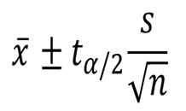
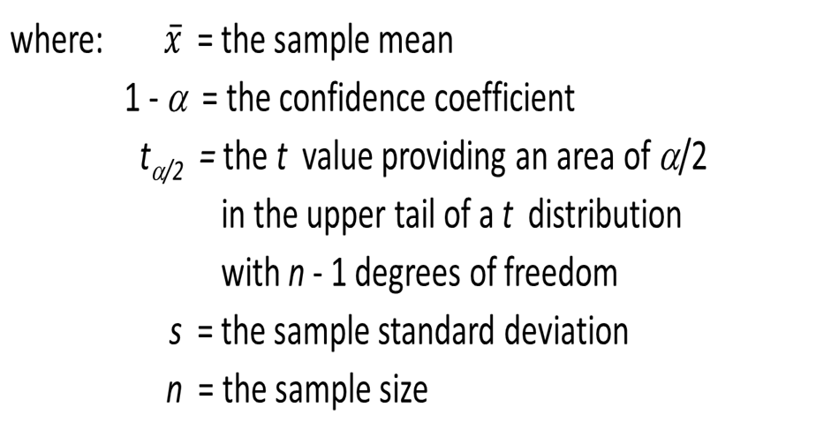
Interval Estimate of a Population Mean: σ Unknown
Interval Estimate

Slide 73

EXCEL PRACTICE
Sample size:
n = COUNT(A:A)
Mean value:
Mean(X)=AVERAGE(A:A)
Sample Standard Deviation:
S-SD = STDEV.S(A:A)
= STDEV(A:A)
T - factor
  t_{α/2} = T.INV(n-1, 1- α/2)
  = TINV(n-1, α)

Slide 74




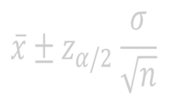
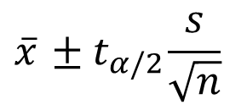
Summary of Interval Estimation Procedures for a Population Mean
Yes
Can the
population standard
deviation σ be assumed
known ?
No
Use the sample
standard deviation
s to estimate σ
σ Known
Case
Use
Use
σ Unknown
Case

