Slide 1
Hypothesis Test
“ Hypothesis Test”: A procedure for deciding between two hypotheses (null hypothesis – alternative hypothesis) on the basis of observations in a random sample

Slide 2

Sampling models
One sample model
One sample model usually concerns with an intervention on population: If the intervention should make some change in population?

Slide 3
One – sample Hypothesis test
Compare proportion to a given value of rate
Compare mean value to a given value of expectation

Slide 4
Example 1. If in Ha Dong District less than 90% motorcyclists use helms?
Example 2. If proportion of girl-students equals to 50% ?
Example 3. If in Viet Nam bred feeding is popular among more than 70% women?

Slide 5
Test 1. Compare proportion to a given rate
Two tails (sides) test:
(Null) Hypothesis H₀: p = q
Alternative Hypothesis H_{a}: p differs from q
Lower (left) tail test:
(Null) Hypothesis H₀: p ≥ q
Alternative Hypothesis H_{a}: p < q
Upper (right) tail test:
(Null) Hypothesis H₀: p ≤ q
Alternative Hypothesis H_{a}: p > q

Slide 6

Test 1. Compare proportion to a given rate
- a sample of n independent observations collected from a binary variable X taking value 1 with (unknown) probability p (0 < p < 1) and value 0 with probability 1 – p → Given a number q , how to have a conclusion comparing p with q based on information of the sample?

Slide 7
Solution
By Moivre-Laplace Theorem, for large sample size, n×p ≥ 5 and n×(1-p) ≥ 5, sample proportion m(p)/n of appearance of number 1 has distribution approximate to normal distribution with expectation p and variance p ×(1-p)/n. Then a testing procedure can be as follows:
Step 1. Estimate a sample proportion by
p^ = m(p) / n
Calculate z-test statistic
z_{q} = (p^-q)/[p^ ×(1-p^)/n]^{1/2}

Slide 8
P-value Approach
Two tails (sides) test:
(Null) Hypothesis H₀: p = q
Alternative Hypothesis H_{a}: p ≠ q

Slide 9
Step 2. (two sides test)
Approach A (p-value method): Calculate the probability such that the distance from estimate point to p^ should be more than |q – p^| :
b = P{|Y – q| > |p^ – q|} = P{|Z| > | z_{q}|}
where Y is a normal variable with mean p^ and variance p^ ×(1-p^)/n,
while Z is the standard normal variable (the normal variable with mean 0 and variance 1).
b = Probability (p-value) of wrong decision of excluding estimation value q (saying that q differs from true value of p) when this value should be a “good” value of estimation

Slide 10
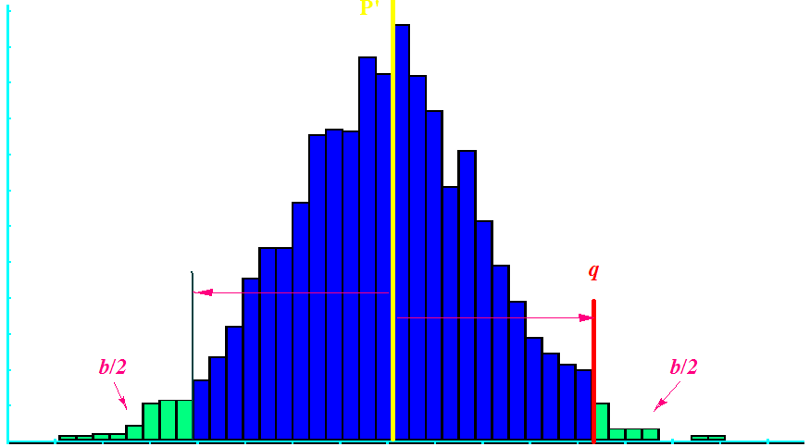

Slide 11
Step 3. (two sides test)
Compare b to the significance level α
(α = 10%, 5%, 1%, …)
If b ≤ α → reject the hypothesis H₀, conclude that q differs from p, because possibility of getting mistake in decision is “very small”
* If b > α → accept the hypothesis H₀, confirm q = p, because possibility of having mistake by rejecting the hypothesis is too high.

Slide 12
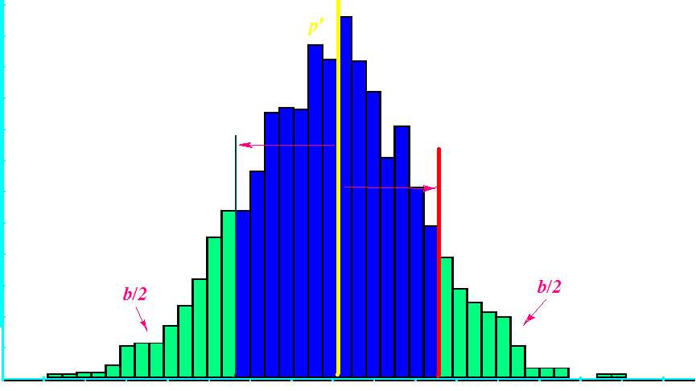

Slide 13
Critical value Approach
Two tails (sides) test:
(Null) Hypothesis H₀: p = q
Alternative Hypothesis H_{a}: p ≠ q

Slide 14
Step 2. (two sides test)
Approach B (critical value method): With the given significance level α (α = 10%, 5%, 1%, …), calculate the critical value z_{1-α/2}, the number point such that 1-α/2 is the probability of the standard normal variable Z taking values smaller or equal to z_{1-α/2}:
1-α/2 = P{Z ≤ z_{1-α/2}}

Slide 15
Step 3. (two sides test)
Compare absolute value of the z-test statistic (| z_{q} |) too the critical value z_{1-α/2}
(α = 10%, 5%, 1%, …)
If | z_{q} | ≥ z_{1-α/2} → reject the hypothesis H₀, conclude that q differs from p.
* If | z_{q} | < z_{1-α/2} → accept the hypothesis H₀, confirm q = p.

Slide 16
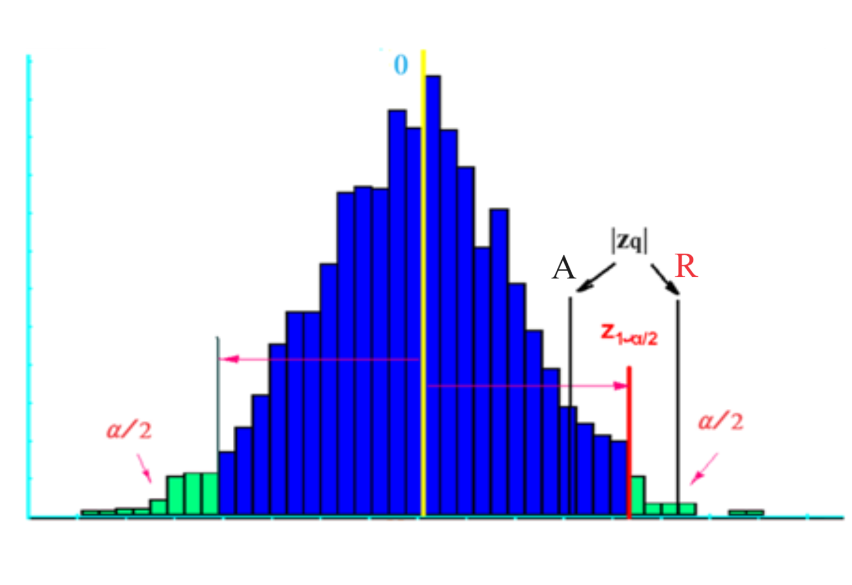

Slide 17
Confidence Interval Approach
Two tails (sides) test:
(Null) Hypothesis H₀: p = q
Alternative Hypothesis H_{a}: p ≠ q

Slide 18
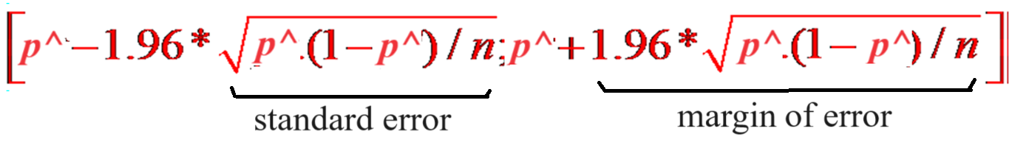
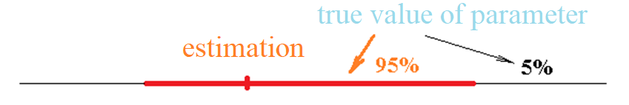
Approach C. Using confidence interval
With confidence level of 95%, we can use confidence interval for hypothesis testing:
Decide
Reject the Hypothesis H if the confidence interval does not contain the point q
Accept the Hypothesis H if the confidence interval contains the point q

Slide 19


Using Excel to Compute Normal P-value and Critical Value
Excel has two functions for computing P-value and critical respect to normal distribution:
NORMDIST, NORMSDIST are used to compute the P-values.
NORMINV and NORMSINV are used to compute the Critical values.

Slide 20
Compare mean value to a given value of expectation

Slide 21
Test 2. Compare mean value to a given value of expectation
Problem: Taking a sample from a variable X with normal distribution, we need to compare the expectation μ of X to a given value u.
Hypothesis
H₀: μ = u
Alternative Hypothesis
H_{a}: μ differs (≠, ≤, ≥) from u

Slide 22
Two tails (sides) test:
(Null) Hypothesis H₀: μ = u
Alternative Hypothesis H_{a}: μ differs from u
Lower (left) tail test:
(Null) Hypothesis H₀: μ ≥ u
Alternative Hypothesis H_{a}: μ < u
Upper (right) tail test:
(Null) Hypothesis H₀: μ ≤ u
Alternative Hypothesis H_{a}: μ > u

Slide 23
Compare mean value when variance of variable is unknown

Slide 24




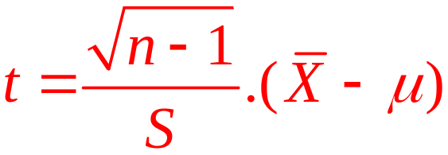
For testing the above hypothesis, the distribution of sample mean value must be known. When variance of variable is unknown the following theorem can be applied:
Theorem. Let be a sample of n independent observations taken from a normal distributed variable X with expectation , is sample mean value and is sample variance. Then the (new) variable
has T-Student distribution with (n-1) degrees of freedom.

Slide 25
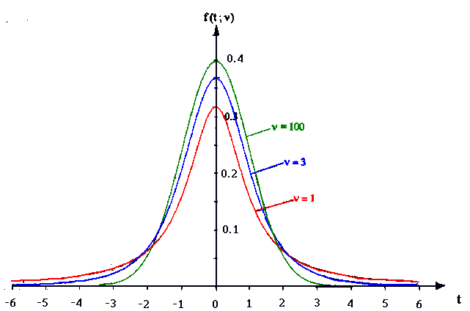

Student (T) distribution
Parameter of Student Distribution: “Degree of Fredom”

Slide 26



t Distribution
Standard
normal
distribution
t distribution
(20 degrees
of freedom)
t distribution
(10 degrees
of freedom)
z, t
0

Slide 27

t Distribution
For more than 100 degrees of freedom, the standard normal z value provides a good approximation to the t value.

Slide 28
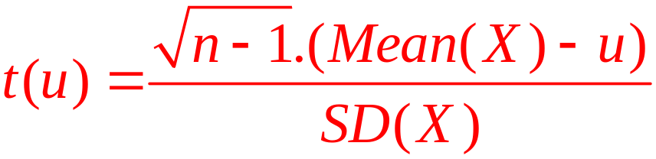
Steps of Testing
Step 1. Estimate sample Mean Value Mean(X) Standard Deviation SD(X)
Step 2. Calculate the statistic
where n is sample size and u is the given value to which the mean value has be compared

Slide 29
P-value Approach
Two tails (sides) test:
(Null) Hypothesis H₀: μ = u
Alternative Hypothesis H_{a}: μ differs from u

Slide 30
Step 2. (two sides test)
Approach A (p-value method): Calculate the probability
b = P{|T(n-1)| ≥ |t(u)|} ,
where T(n-1) is a variable which has Student distribution with (n-1) degrees of freedom.
b = Probability (p-value) of wrong decision of excluding estimation value u when this value should be a “good” value of estimation

Slide 31
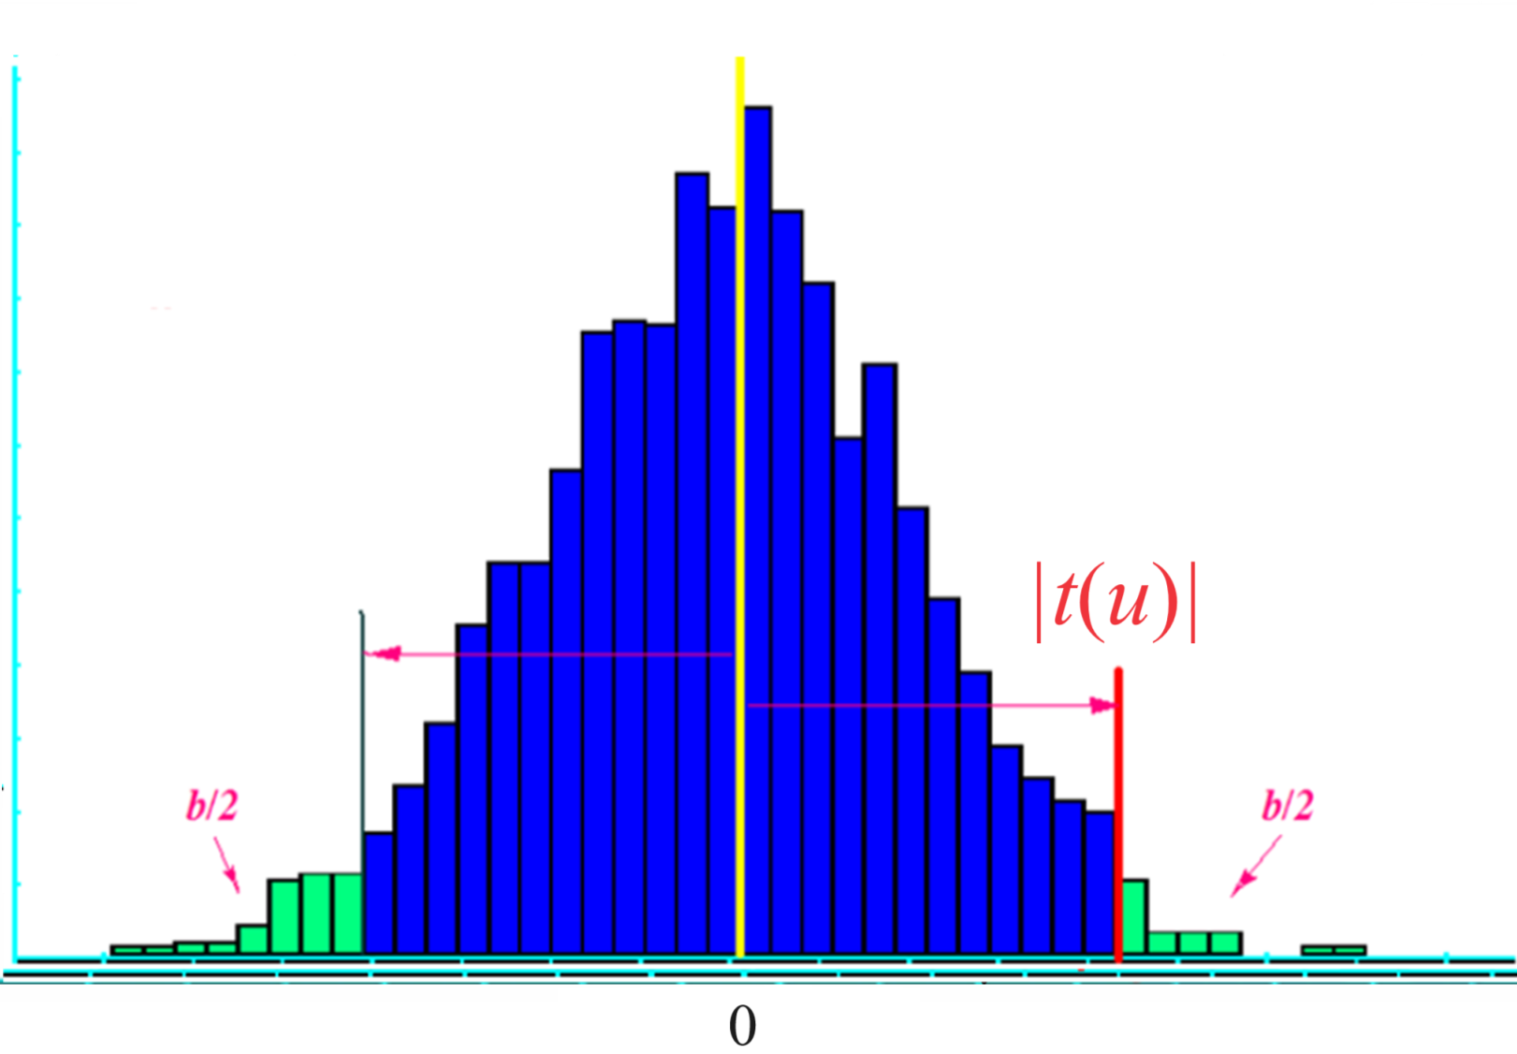

Slide 32
Step 3. (two sides test)
Compare b to the significance level α
(α = 10%, 5%, 1%, …)
If b ≤ α → reject the hypothesis H₀, conclude that μ differs from u, because possibility of getting mistake in decision is “very small”
* If b > α → accept the hypothesis H₀, confirm μ = u, because possibility of having mistake by rejecting the hypothesis is too high.

Slide 34
Critical value Approach
Two tails (sides) test:
(Null) Hypothesis H₀: μ = u
Alternative Hypothesis H_{a}: μ differs from u

Slide 35
Step 2. (two sides test)
Approach B (critical value method): With the given significance level α (α = 10%, 5%, 1%, …), calculate the critical value t_{1-α/2}, the number point such that 1-α/2 is the probability of the Student distributed variable T(n-1) taking values smaller or equal to t_{1-α/2}:
1-α/2 = P{T(n-1) ≤ t_{1-α/2}}

Slide 36
Step 3. (two sides test)
Compare absolute value of the t-test statistic (|t(u)|) too the critical value t_{1-α/2}
(α = 10%, 5%, 1%, …)
If |t(u)| ≥ t_{1-α/2} → reject the hypothesis H₀, conclude that μ differs from u.
* If |t(u)| < t_{1-α/2} → accept the hypothesis H₀, confirm μ = u.

Slide 37
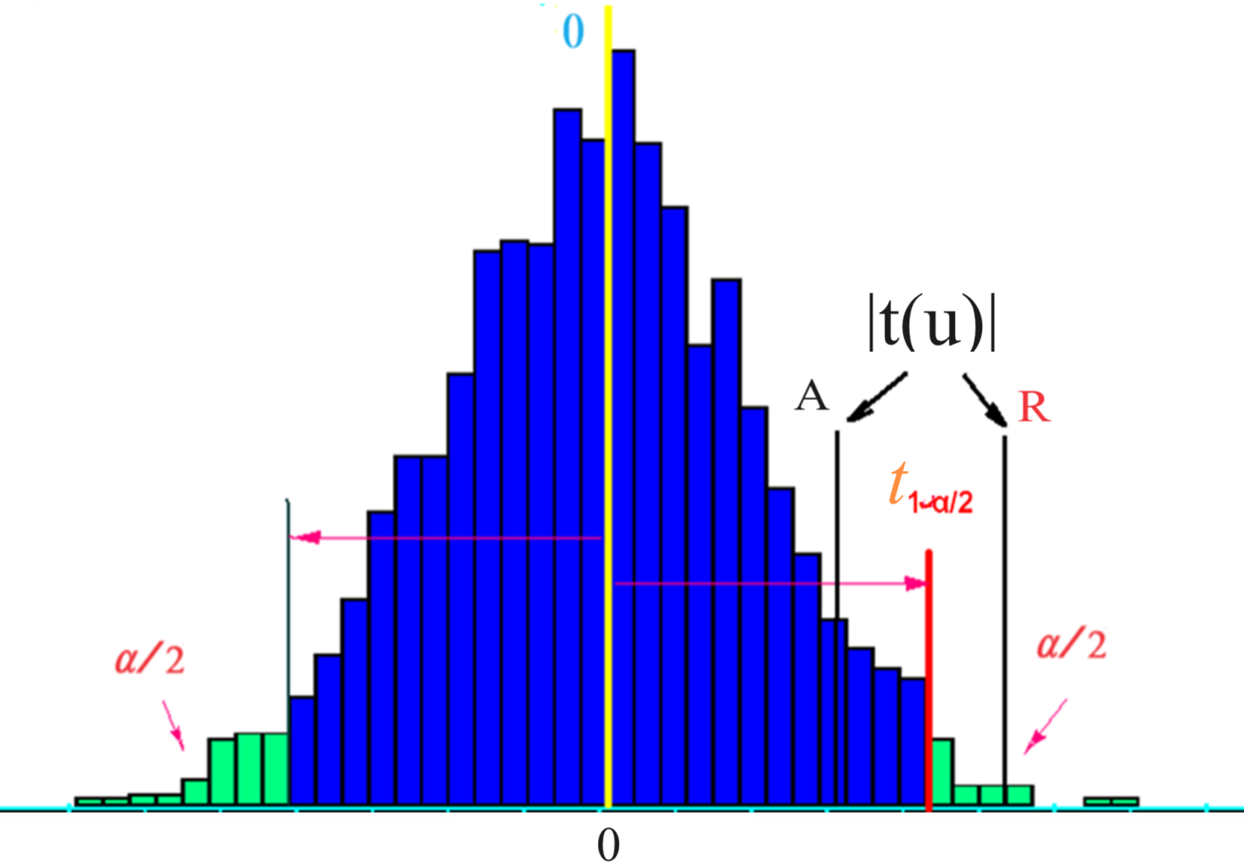

Slide 38
Confidence Interval Approach
Two tails (sides) test:
(Null) Hypothesis H₀: μ = u
Alternative Hypothesis H_{a}: μ differs from u

Slide 39
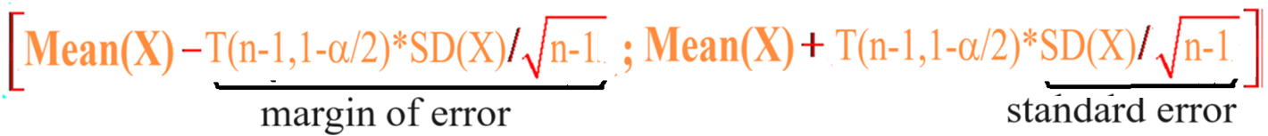
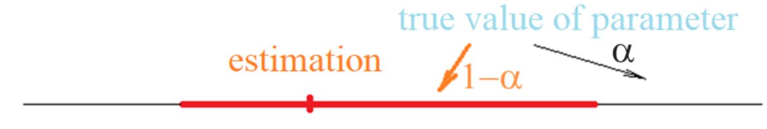
Approach C. Using confidence interval
With confidence level of (1-α), we can use confidence interval for hypothesis testing:
Decide
Reject the Hypothesis H if the confidence interval does not contain the point u
Accept the Hypothesis H if the confidence interval contains the point u

Slide 40
Using Excel to Compute Student P-value and Critical Value
Excel has two functions for computing P-value and critical respect to Student distribution:
TDIST is used to compute the P-values.
TINV is used to compute the Critical values.

