Slide 1
Hypothesis tests for two independent samples
Compare two proportions
Compare mean values of two populations

Slide 2
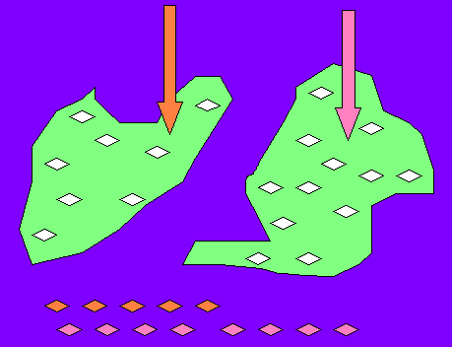
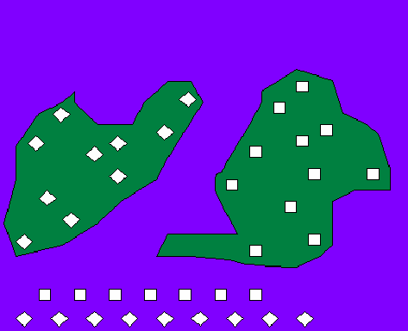
B. Two independent samples model
Model of two groups of objects with different
Intervention levels,
Individual proper

Slide 3
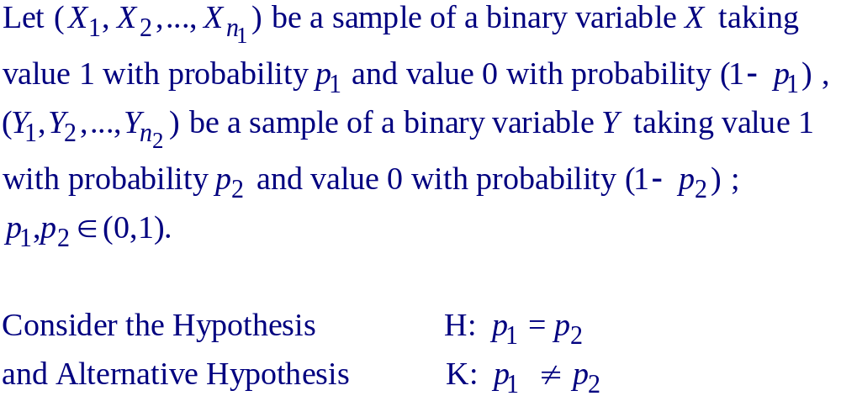
Compare two proportions – the case of large sample sizes (using Normal distribution)

Slide 4
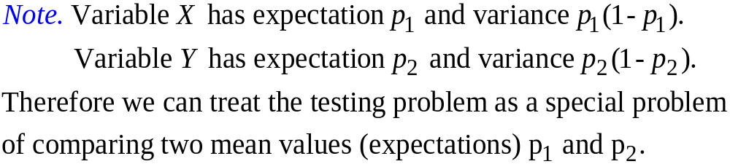

Slide 5
By Moivre-Laplace Theorem, for large sample size, n₁×p₁ ≥ 5 and n₁×(1-p₁) ≥ 5, n₂×p₂ ≥ 5 and n₂×(1-p₂) ≥ 5, the sample proportions m(p₁)/n₁ and m(p₂)/n₂ of appearance of number 1 have distributions approximate to normal distribution with expectation p₁, p₂ and variance p₁ ×(1-p₁)/n₁, p₂ ×(1-p₂)/n₂, respectively. Denote m₁ = m(p₁) and m₂ = m(p₂).

Slide 6
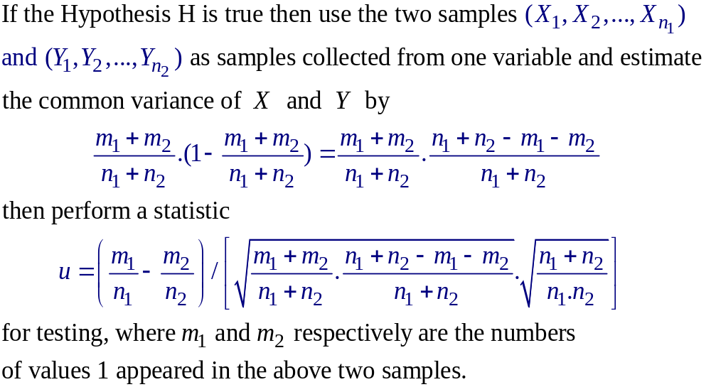

Slide 7
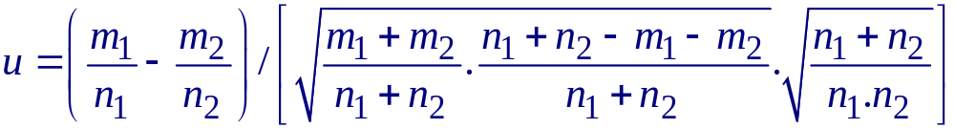
By Central Limit Theorem, when sample sizes are large, the difference Mean(X) - Mean(Y) has a distribution very close to Normal distribution. Then the testing procedure can be as follows:
Step 1. Calculate value of statistic
Step 2. Taking Normal distribution N(0,1) find the probability (p-value)
b = P { | N(0,1) | > | u | }

Slide 8
Step 3. Compare the probability b (p-value) to the given ahead significance α
* If b ≥ α → Accept Hypothesis H , confirm the equality of two proportions
* If b < α → Reject Hypothesis H and conclude two proportions to be different
(One-tail tests can be done similarly)

Slide 9
Version B. Using Normal critical value
Looking in Table of Normal distribution find out critical value u_{α/2} of Normal distribution (the critical value for α = 5% equals 1.96)
Decide
- Reject Hypothesis H if
|u| ≥ u_{α/2}
- Accept Hypothesis H if
|u| < u_{α/2}

Slide 10
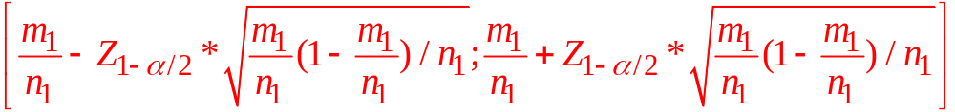
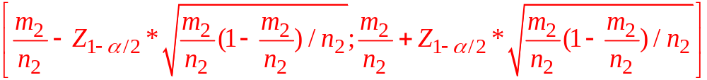
Version C. Using confidence intervals
Use confidence intervals (with significance level of α) of estimated proportions for testing:
Decide
Reject Hypothesis H if the two intervals disjoin
Accept Hypothesis H if the two intervals have nonempty intersection

Slide 11
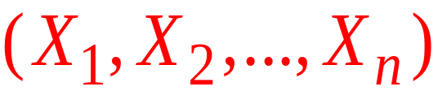


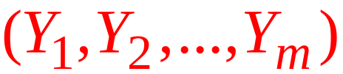




Compare two mean values
Let be a sample of n independent observations from a variable X with expectation and variance
be a sample of m independent observations from a variable Y with expectation and variance
Problem: Compare two expectations and .
→ Estimate and compare two mean values and .

Slide 12

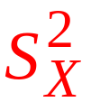

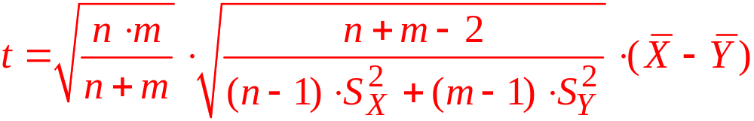
The problem can be solved by using the following Theorem:
Theorem. Let and be two samples of n independent observations selected correspondingly from a variable X with sample mean and sample variance and from a variable Y with sample mean and sample variance (both variables are normal distributed with common variance). If the hypothesis H is true (µ₁ = µ₂) then the variable (statistic)
has Student distribution with (n+m-2) degrees of freedom.

Slide 13
Hypothesis Tests
Hypothesis
H: µ₁ = µ₂
Alternative Hypothesis
K: µ₁ ≠ µ₂

Slide 14
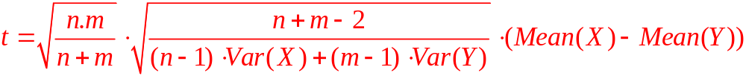
Steps of testing
Step 1. Estimate sample mean values Mean(X) , Mean(Y) and sample variances Var(X) , Var(Y)
Step 2. Calculating perform the quantity

Slide 15
Step 3 (p-value approach). Taking a variable T^{(n+m-2)} of Student distribution with (n + m - 2) degrees of freedom calculate the p-value (probability)
b = P { | T^{(n+m-2)} | ≥ | t | }

Slide 16
Step 4. Compare the p-value b with a given ahead significance level α (=5%, 1%, 0.5% or 0.1%):
+ If b ≥ α → accept Hypothesis H and conclude
µ₁ = µ₂
+ If b < α → reject Hypothesis H and confirm
µ₁ ≠ µ₂

Slide 17
Version B. Using Student critical value
Calculate the critical value T^{(n+m-2)}_{(1-α/2)} of Student distribution with n+m-2 degrees of freedom (α is a given ahead significance level =5%, 1% or 0.5%)
Decide
- Reject Hypothesis H if
|t| ≥ T^{(n+m-2)}_{(1-α/2)}
- Accept Hypothesis H if
|t| < T^{(n+m-2)}_{(1-α/2)}

Slide 18
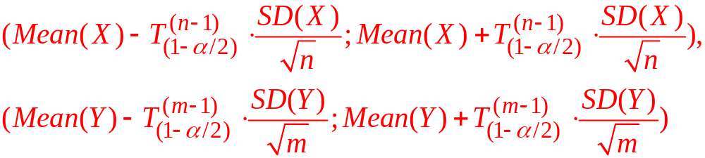
Version C. Using confidence intervals
When degree of freedom (sample size) is large, Student distribution approximates Normal distribution. Then we can use confidence intervals (with significance level of 5%) for testing:
Decide
Reject Hypothesis H if the two intervals disjoin
Accept Hypothesis H if the two intervals have nonempty intersection

Slide 19
Test for two related (paired) samples
Compare two mean values

Slide 20
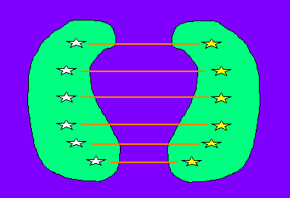
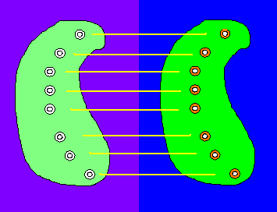
C. Model of two dependent (paired) samples
Two dependent samples model is used in a study when
A) Each object in the first sample is chosen together with a similar (paired) object in the second sample, or
B) Any object in the second sample is the same one in the first sample, but the measures in the two samples are taken under different conditions.

Slide 21
Compare mean values of two related samples
For related variables X and Y , the comparison of mean values is equivalent to the comparison the mean value of the difference variable X – Y to value 0 → the problem reduces to one-sample model.

Slide 22









Compare mean values of two related samples
Hypothesis
Alternative Hypothesis
where and are the expectations of X and Y
With ,
comparing expectations of to 0:
Hypothesis
Alternative Hypothesis

Slide 23





Compare mean values of two related samples
With the empirical value of the test statistic
Compare the empirical value of the t-test statistic with the critical value , which is the
percentile of the Student distribution with n-1 degrees of freedom:
- If ➔ reject the hypothesis H ,
- If ➔ accept H .

Slide 24





Compare mean values of two related samples
b) Taking a random variable T having Student distribution with n-1 degrees of freedom, calculate the probability of significance
Compare the probability of significance with the significance level :
- If ➔ reject H ,
- If ➔ accept H .

Slide 25

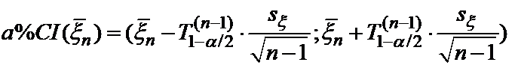


Compare mean values of two related samples
c) Determine the 95% confidence interval of the estimation :
Compare 0 to the confidence interval:
- If ➔ reject H,
- If ➔ accept H .

