Slide 1

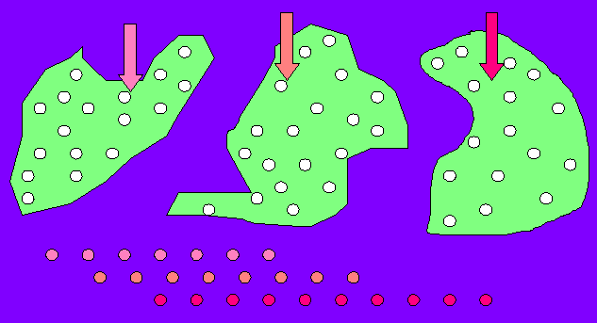
Model of multi-independent samples

Slide 2
Hypothesis tests for several independent samples
Compare several proportions
Compare mean values of several populations

Slide 3
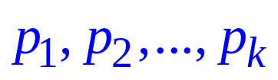
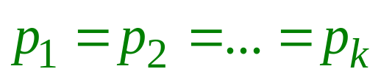

Compare several proportions
Let X be a binary variable taking two values 0 and 1 . Collecting data from that variable under k different conditions we have a sample containing k groups of observations related with the conditions
Let
be probabilities of appearance of value 1 of variable X under each of the above k conditions.
Hypothesis H :
Alternative Hypothesis
K: there is certain difference between

Slide 4
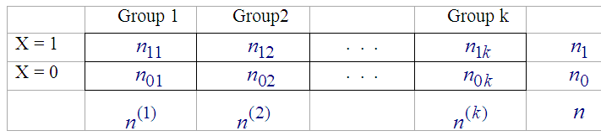
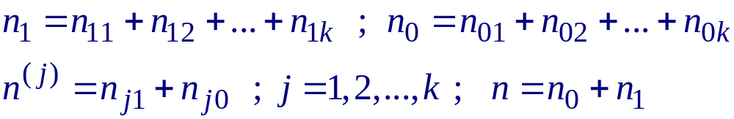
Data: Perform a 2xk table of 2 rows and k columns: each column for one group, the 1rst row for value 1, the 2nd row for value 0 of the variable at observations:
Table 1. Observed frequency

Slide 5
Compare several proportions
If the hypothesis is correct, the proportion of occurrence of 1 estimated commonly to all columns (conditions) is equal to
n₁ / n = p^
The proportion of occurrence of 0 estimated commonly to all columns is equal to
n₀ / n = 1 – p^

Slide 6
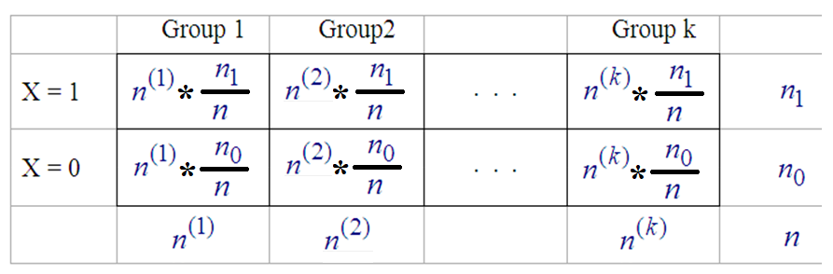
Perform the table of expected (theoretical) frequencies of the hypothesis:
Table 2. predicted (expected) frequency

Slide 7
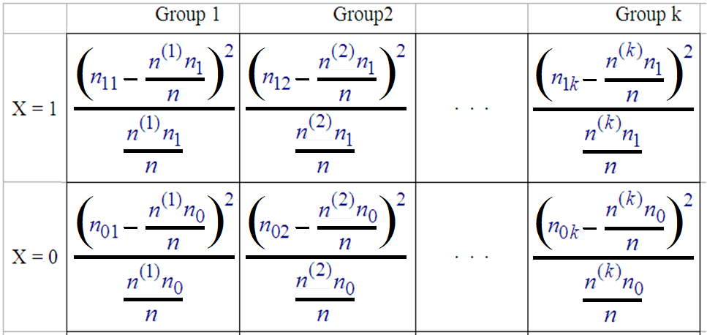
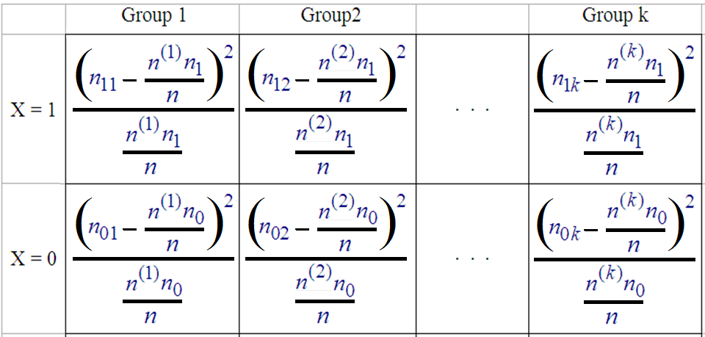
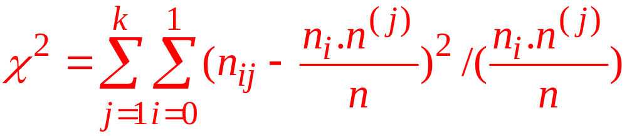
Perform the table of the test statistic:

Slide 8
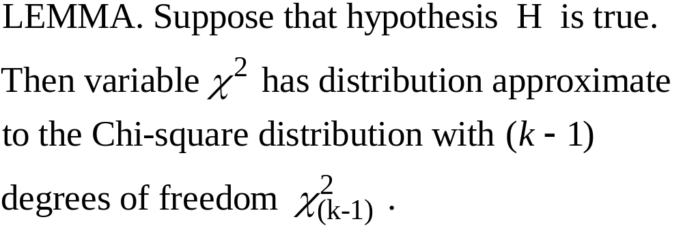

Slide 9
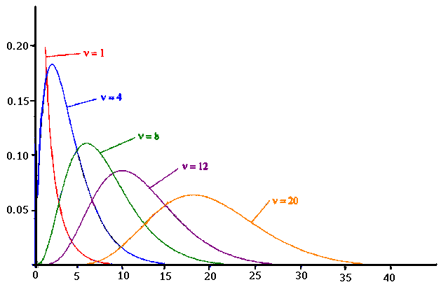
Density function of Chi – squared distribution

Slide 10


Using Excel to Compute Chi – squared Distribution
Excel has two functions for computing cumulative probabilities and x values for any Chi - squared distribution:
CHI.DIST is used to compute the cumulative probability given an x value, p-value.
CHI.INV is used to compute the x value given a cumulative probability, critical value.

Slide 11

Method A (p-value):
Step 1. Taking a variable ꭓ²_{(k-1)} of Chi-squared distribution with (k-1) degrees of freedom calculate the probability (p-value)
b = P {ꭓ²_{(k-1)} > } .
Step 2. Compare the probability b to the given ahead significance level α :
* If b ≥ α → accept hypothesis H , conclude the all proportions are equal
* If b < α → reject hypothesis H , confirm the appearance of some difference between proportions.

Slide 12
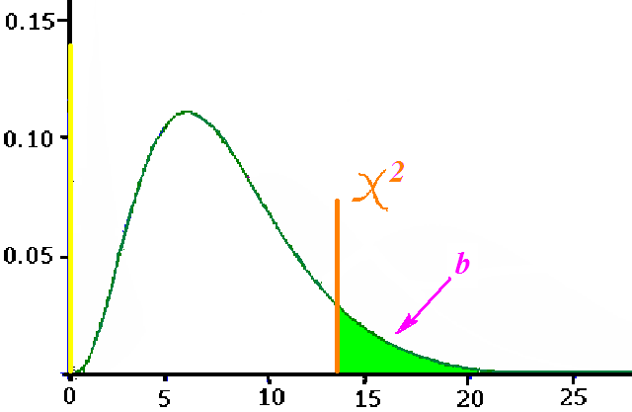

Slide 13
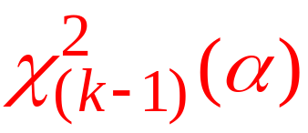
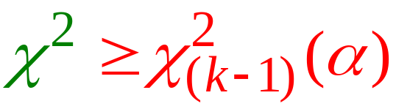
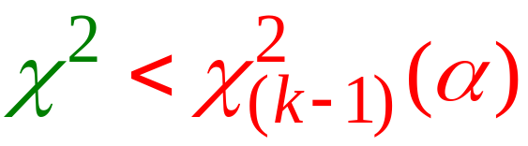
Method B. (Critical value)
Looking in Table of Chi-squared distribution to find critical value of Chi-squared distribution with k-1 degrees of freedom (α is a given ahead significance level =5%,1% or 0.5%)
Decide
- Reject Hypothesis H: = if
- Accept Hypothesis H: = if

Slide 14



One-way Analysis of Variance
The one-factor analysis of variance (ANOVA) test is an extension of the T-test method that compares the mean values to the multi-independent samples’ model: For normally distributed random variables
with common variance and expectations ,
consider the hypothesis:

Slide 15


Analysis of Variance:
H₀: μ₁ = μ₂ = μ₃ = . . . = μ_{k}
H_{a}: Not all population means are equal
If H₀ is rejected, we cannot conclude that all population
means are equal.
Rejecting H₀ means that at least two population means
have different values.

Slide 16

Analysis of Variance:
Assumptions for Analysis of Variance
For each population, the response (dependent) variable is normally distributed.
The variance of the response variable, denoted σ ², is the same for all of the populations.
The observations must be independent.

Slide 17










One-way Analysis of Variance
Consider the sample of observations in the i-th group, corresponding to the variable , including observation, .
Consider the model
where is the deviation of each observation in the group from the group mean , and the common mean of all observations in the data, is the difference between the group mean and the overall mean, obviously

Slide 18







One-way Analysis of Variance
The total volatility in the i-th group, , is equal to
and
is the adjusted variance of the random variable .
is the sum of all volatility in all groups.
Denote the total number of observations by
We can take
as an estimate of the common variance of all variables

Slide 19


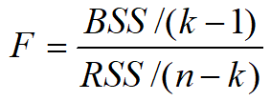
One-way Analysis of Variance
is the total variation between the group means ,
reflecting the random variation from group to group of the considered quantity .
Ratio between two variances
is the test statistic for hypothesis H comparing mean values.

Slide 20
One-way Analysis of Variance
Lemma. If the hypothesis H is true, then the ratio (test statistic) F has a Fisher-Snedecor distribution with (k-1) and (n-k) degrees of freedom.
With the above lemma, the testing problem has approaches of p-value or critical value.

Slide 21
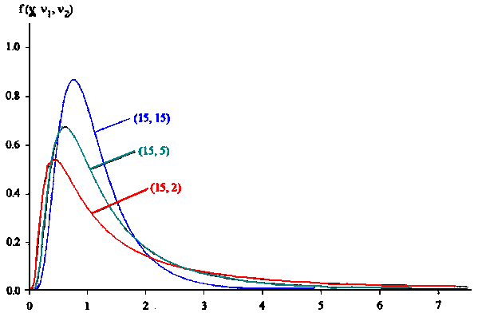
Density function of Fisher-Snedecor distribution (F)

Slide 22





One-way Analysis of Variance
Compare the value of the test statistic F with the critical value , which is the (1 - ) percentile of the Fisher-Snedecor distribution with and degrees of freedom: -
If ➔ rejects hypothesis H,
If ➔ accepts H .

Slide 23
The F Test
Reject H₀
Do Not Reject H₀
α
F_{α}
Critical Value

Slide 24






One-way Analysis of Variance
b) With FS being a random variable with a Fisher-Snedecor distribution with and degrees of freedom , calculate the probability of significance
Compare the probability of significance of the test statistic with the significance level (=5%):
If ➔ rejects hypothesis H,-
If ➔ accepts H.

Slide 25
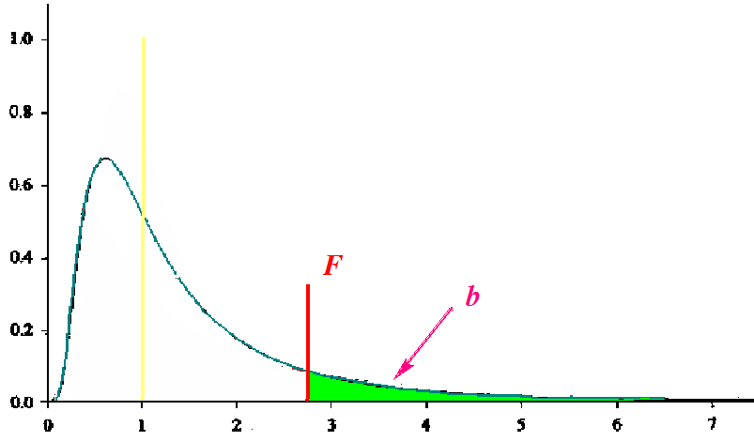
The right-tailed probability of Fisher-Snedecor distribution (F)

Slide 26
Using Excel to Compute Fisher - Snedecor Distribution
Excel has two functions for computing cumulative probabilities and x values for any Fisher - Snedecor distribution:
F.DIST is used to compute the cumulative probability given an x value, p-value.
F.INV is used to compute the x value given a cumulative probability, critical value.

