Slide 1
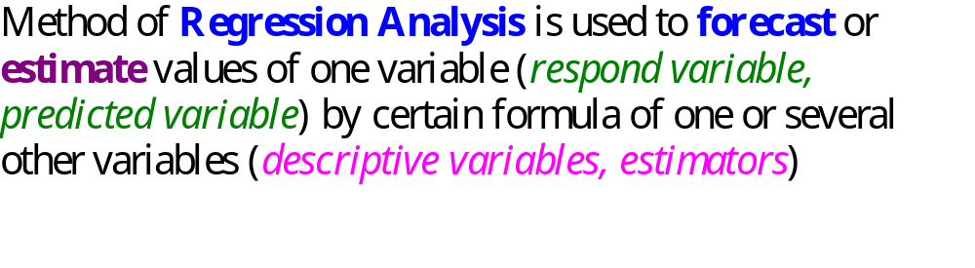
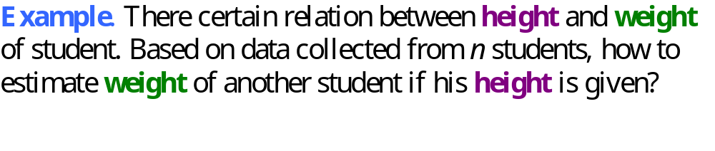
Regression Analysis

Slide 2
Simple Linear Regression
Simple linear regression involves one independent variable and one dependent variable.
The relationship between the two variables is approximated by a straight line.

Slide 3

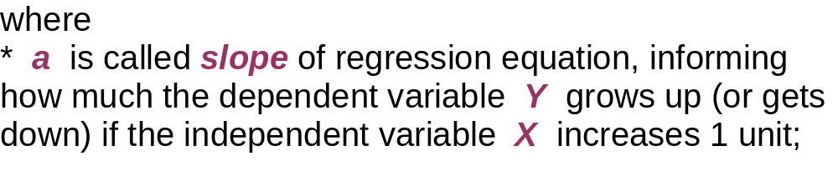
* b is called regression constant (intercept), showing the intersection point of regression line and vertical axis, that is the value of Y when X takes value 0;
* e is residual of regression, indicates error of estimation at each point of observation.

Slide 4
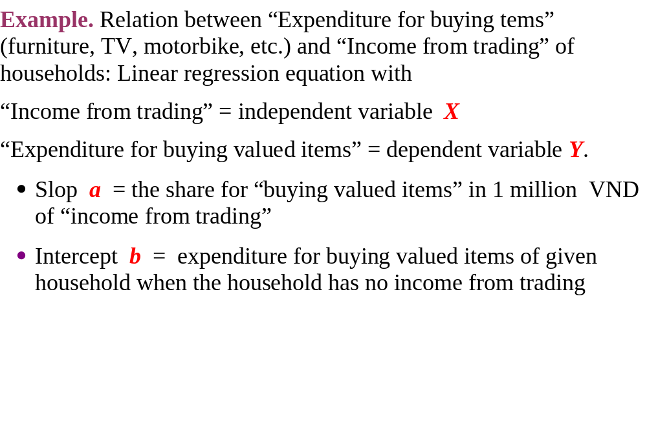

Slide 5

Simple Linear Regression Equation
Positive Linear Relationship
y
Regression line
Slope a is positive
Intercept b
x

Slide 6
Simple Linear Regression Equation
Negative Linear Relationship
y
Intercept b
Regression line
Slope a is negative
x

Slide 7
Simple Linear Regression Equation
No Relationship
y
Regression line
Intercept b
Slope a is 0
x

Slide 8
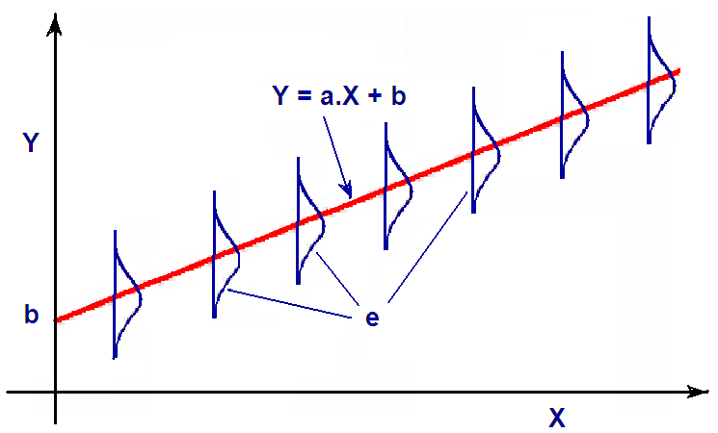
Linear Regression model

Slide 9
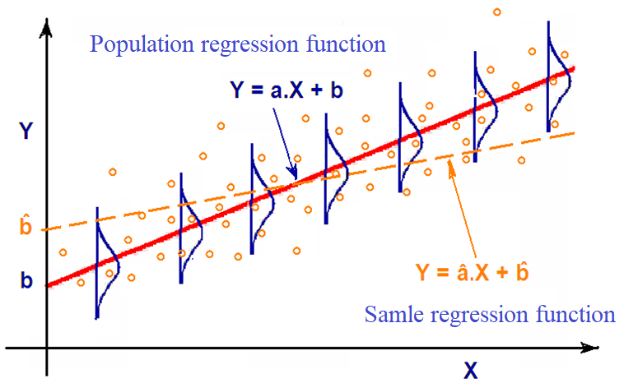


Slide 10
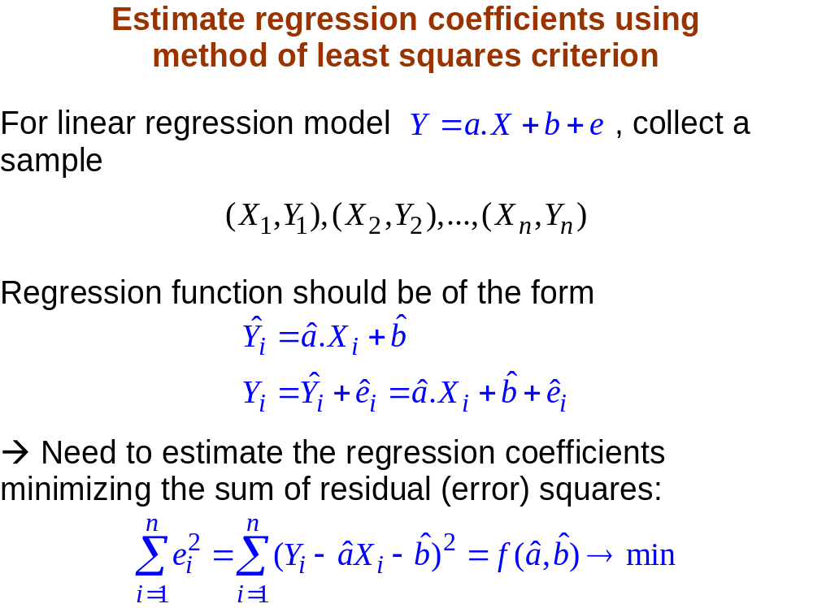

Slide 11
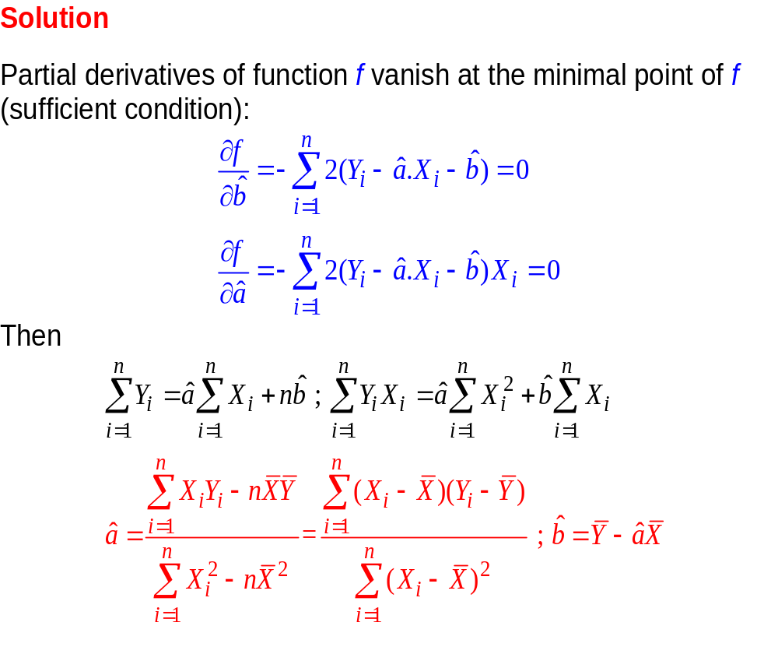

Slide 12

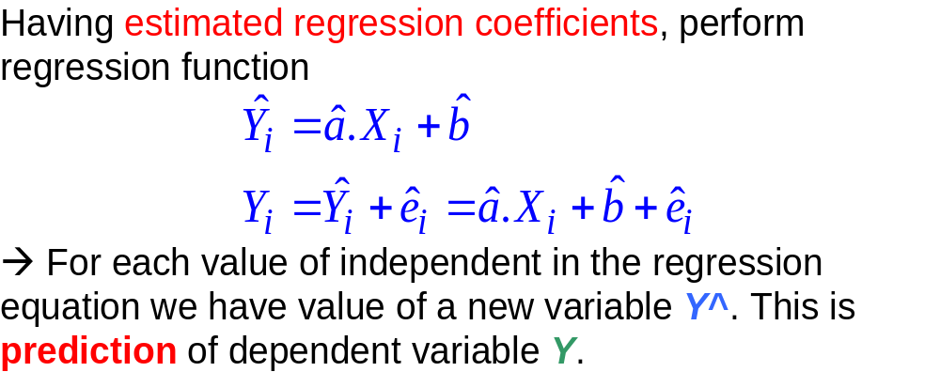
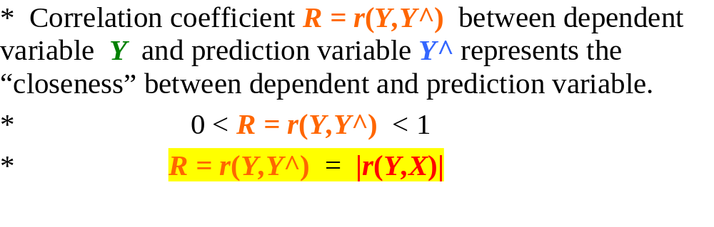

Slide 13

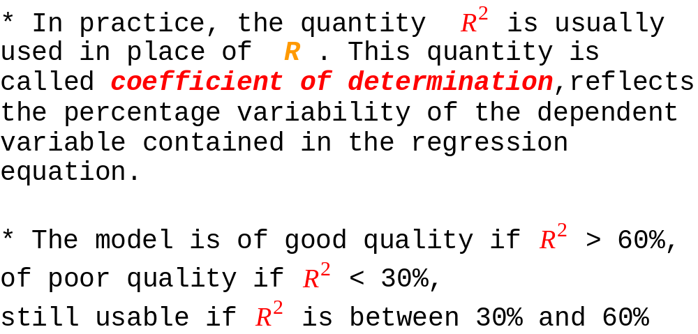

Slide 14
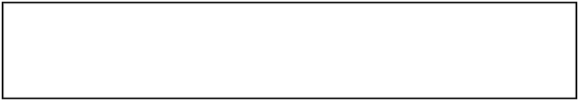
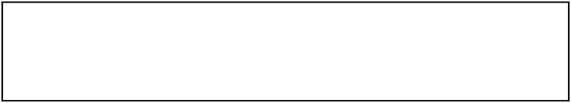
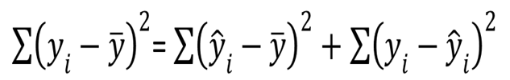
Coefficient of Determination
(Alternative approach)
SST = SSR + SSE
where:
SST = total sum of squares
SSR = sum of squares due to regression
SSE = sum of squares due to error

Slide 15
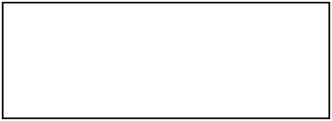
Coefficient of Determination
The coefficient of determination is:
R² = SSR/SST
where:
SSR = sum of squares due to regression
SST = total sum of squares

Slide 16



Testing for Significance
To test for a significant regression relationship, we must conduct a hypothesis test to determine whether the value of a is zero.
Two tests are commonly used:
t Test
and
F Test
Both the t test and F test require an estimate of σ ², the variance of ε in the regression model.

Slide 17

Theorem. Assuming that the errors of the regression model are independent and have Normal distributions with zero mean value and the common variance, the regression parameters are estimated the ordinary least squares (OLS) method. Then the two statistics
have Student distribution with (n-2) degrees of freedom.

Slide 18
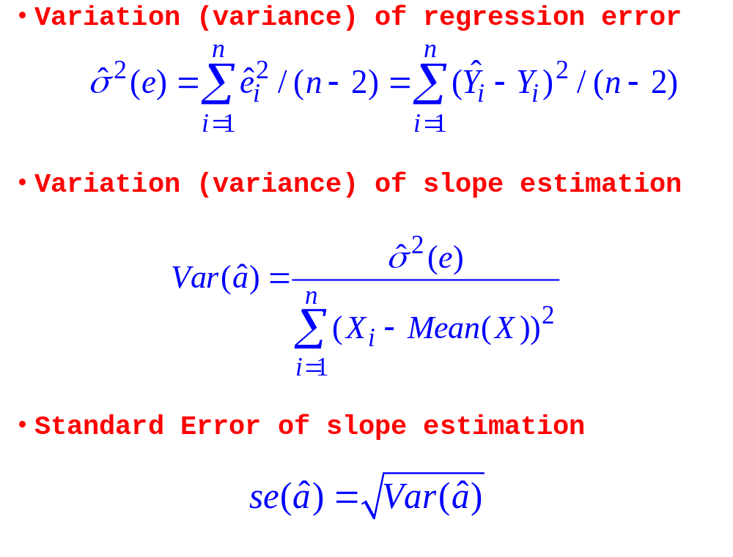

Slide 19
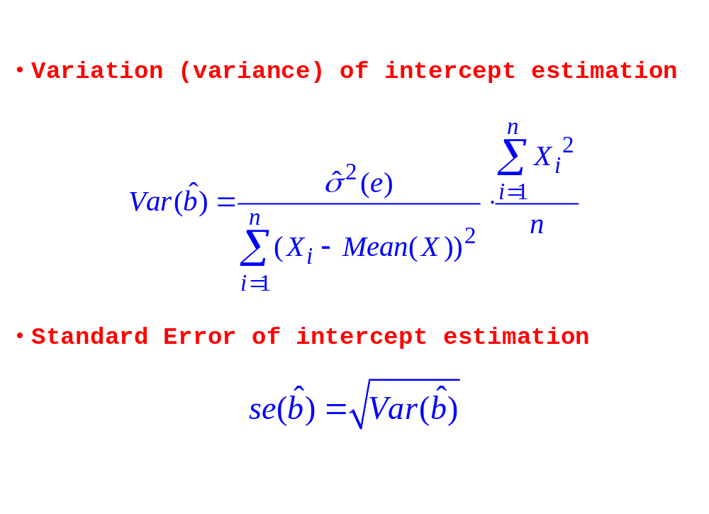

Slide 20

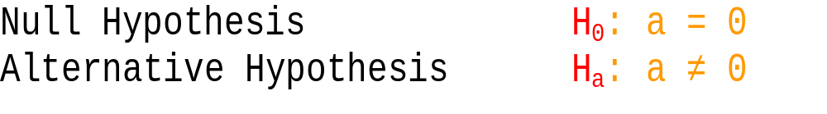
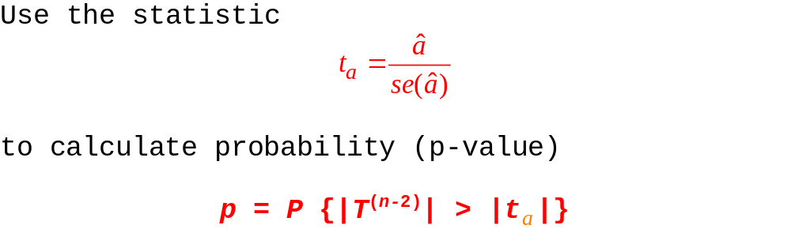

Slide 21
Compare the p-value to the significance level α.
If p ≥ α ➔ Accept the hypothesis, consider a = 0, between Y and X there is no linear relationship, increase of X does not lead Y to increase or decrease.
If p < α ➔ Reject the hypothesis, assert a ≠ 0, the conclusion between Y and X really has a strong linear relationship, the increase in the value of X will lead to an increase (if a > 0), or reduce (if a < 0) the value of Y.
The test for intercept coefficient b is also carried out in the same way.

Slide 22

Confidence Interval for a and b
The form of a confidence interval for a and b are:
(a^ – t_{1-α/2}s_{a^}; a^ + t_{1-α/2}s_{a^})
(b^ – t_{1-α/2}s_{b^}; b^ + t_{1-α/2}s_{b^})
where
a^ and b^ are the point estimators,
t_{1-α/2}s_{a^} and t_{1-α/2}s_{b^} are the margins of error,
t_{1-α/2} is the t value providing an area of α/2 in the upper tail of a t distribution with n – 2 degrees of freedom.

Slide 23
Confidence Interval for a (or b)
We can use a confidence interval for a (or b) to test the hypotheses just used in the t test.
H is rejected if 0 (the hypothesized value of a (or b)) is not included in the confidence interval for a (or b, respectively) .

Slide 24

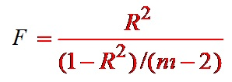
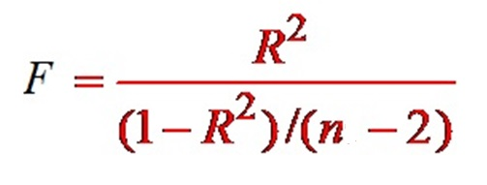

Testing for Significance: F Test
Hypotheses
Test Statistic
H: a = 0
K: a ≠ 0

Slide 25
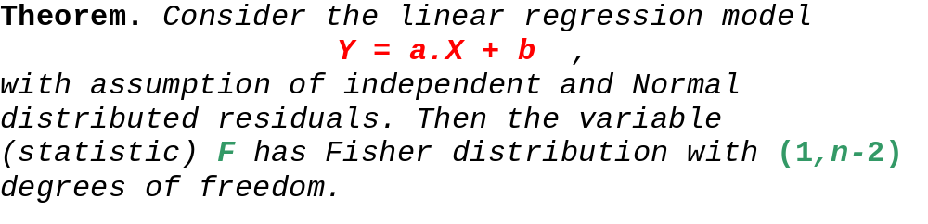
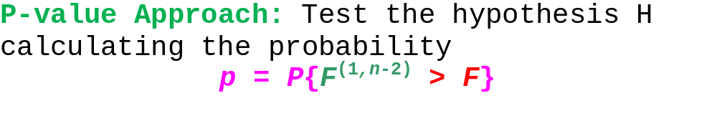
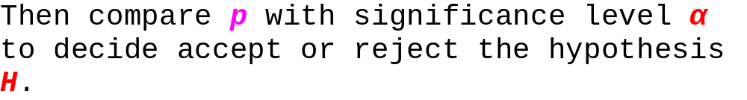

Slide 26
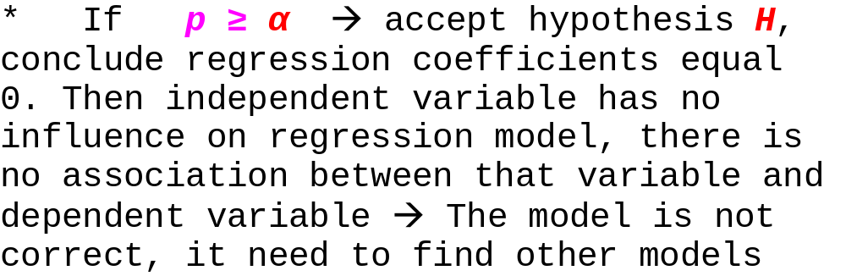
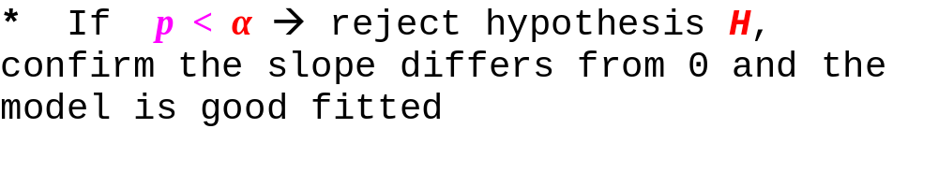

Slide 27


Using Excel to Compute Regression Parameters
Excel has two functions for computing the parameters of Simple Linear Regression Model:
INTERCEPT is used to compute the intercept parameter of the model.
SLOPE is used to compute the slope parameter of the model.

