Slide 1
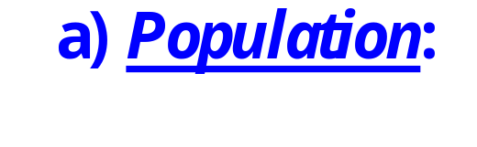

What is Statistics ?

Slide 2



Slide 3
Population
Sampling
Sample
Estimation
Laws
Hypothesis tests

Slide 4
Population
How to do the sampling
- Representative for the population of study
- Corresponding to study target

Slide 5
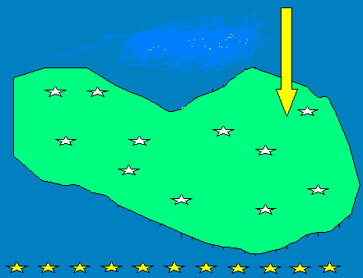
Sampling models
One sample model
One sample model usually concerns with an intervention on population: If the intervention should make some change in population?
Choose individuals from the population randomly to perform a sample

Slide 6
Example 1. If in Ha Dong more than 90% motorcyclists use helms?
Example 2. If proportion of girl-students less than 50% ?
Example 3. If in Viet Nam bred feeding is popular among more than 70% women?

Slide 7
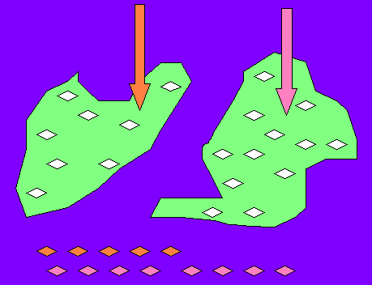
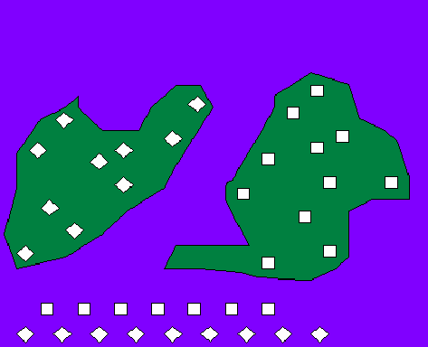
B. Two independent samples model
Model of two groups of objects with different
Intervention levels,
Individual proper

Slide 8
Example 1. If women are better in foreign languages than men?
Example 2. If there is any difference between Ha Noi and Ho Chi Minh City in immigration from rural areas?
Example 3. If quality of coffee produced in Lam Dong is different than that in Dak Lak?

Slide 9
Notes:
In the model of two independent samples a) Observations numbers in two groups (sample sizes) may be different
b) Observations of each group are independent from those of the second group
c) Sampling: Observations must be randomly selected from each of two groups

Slide 10
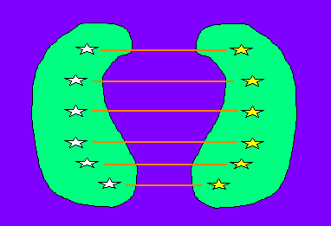
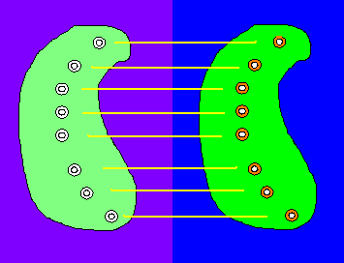
C. Model of two dependent (paired) samples
Two dependent samples model is used in a study when
A) Each object in the first sample is chosen together with a similar (paired) object in the second sample, or
B) Any object in the second sample is the same one in the first sample, but the measures in the two samples are taken under different conditions.

Slide 11
Notes: In the model of two paired samples
A) Observations amounts (sample sizes) of two samples are equal
B) Information taken from one observation is related with that of correspondingly paired observation
C) In pairing to perform the samples, all factors which may influence on study issues must be taken into account

Slide 12
Example 1. To investigate the influence of cigarette on hypertension disease: perform two samples of smoking and nonsmoking people, each person from the nonsmoking group is paired with one smoking person similar about age, sex, weight, height, occupation, etc.
Example 2. Comparing 2022 and 2023 there is a changing in persons’ opinion about Covid Vaccination?

Slide 13
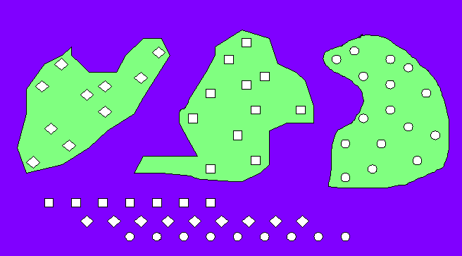
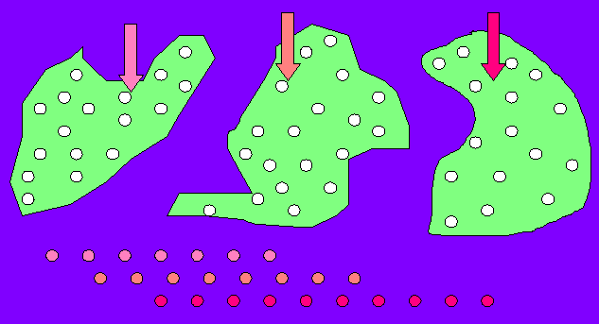
D. Model of multi-independent samples

Slide 14
Notes:
In the model of multi- independent samples a) Observations numbers in groups (sample sizes) may be different
b) Observations of each group are independent from those of other groups
c) Sampling: Observations must be randomly selected from each of groups

Slide 15
Example 1. Compare examination results of several high schools in Ha Noi
Example 2. Compare salary in different economic sectors
Example 3. Water supplying of ethnic groups?

Slide 16
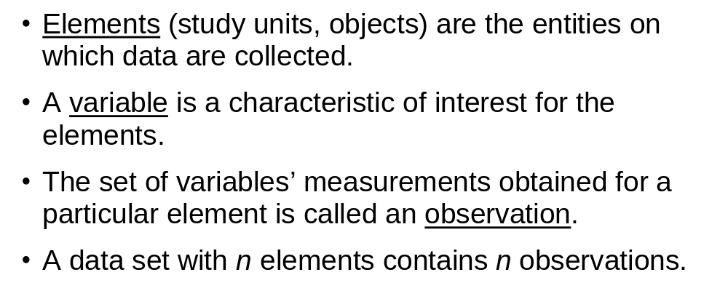
Statistical data

Slide 17

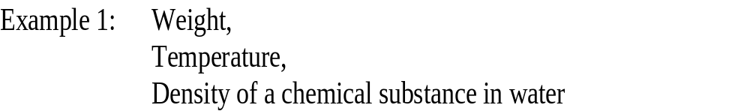
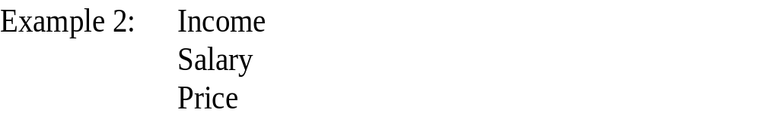
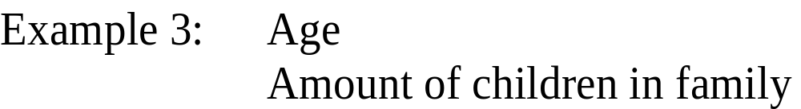
Notice:
Quantitative variable data indicate how many or how much.
Quantitative variable data are always numeric.

Slide 18
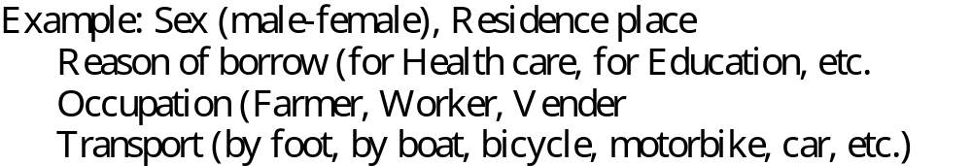


Slide 19



Slide 21

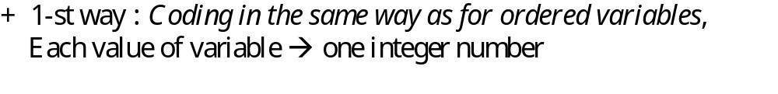
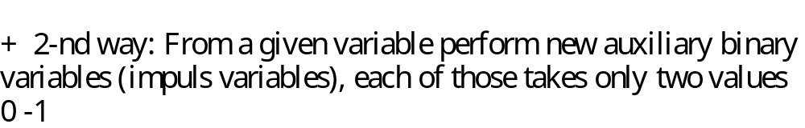

Slide 22














Slide 23
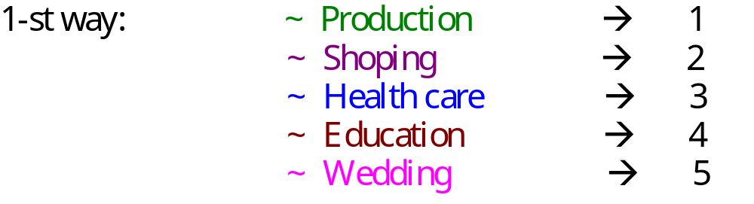
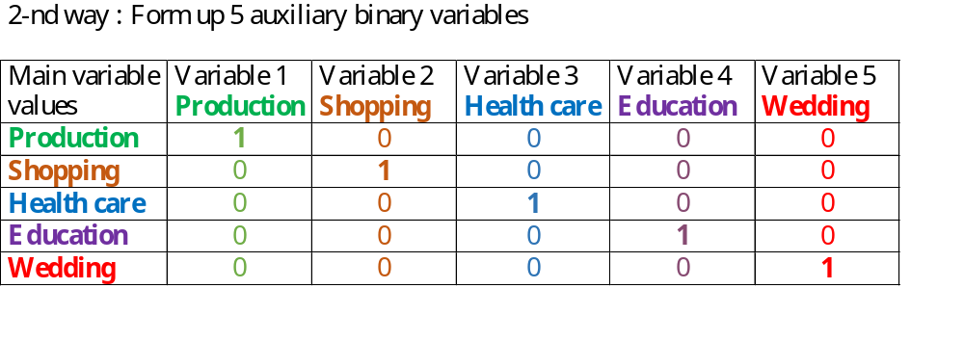

Slide 24

