Slide 1
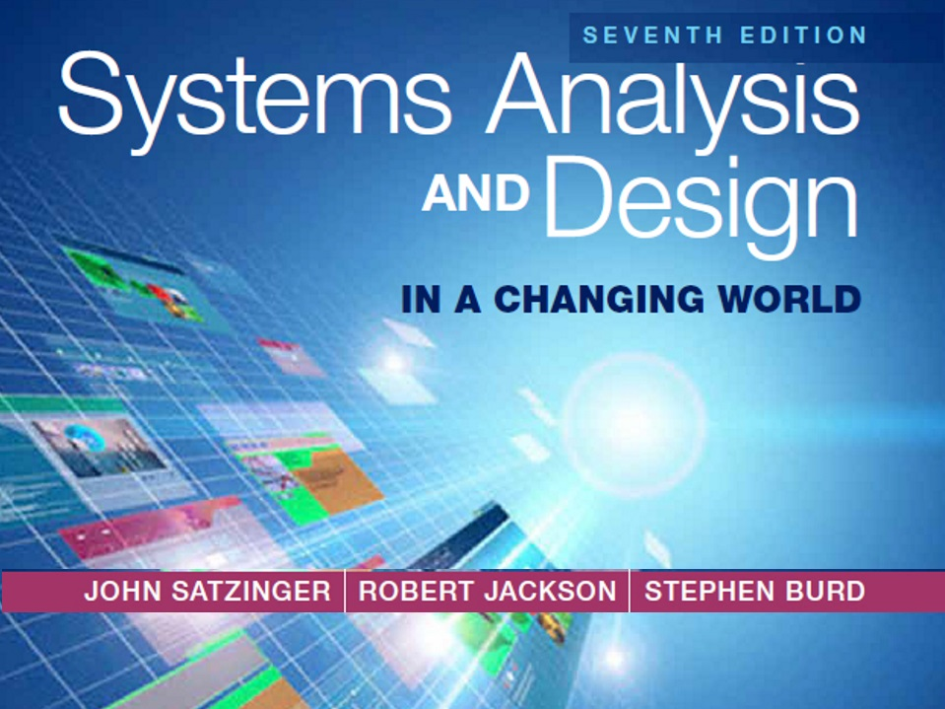
Chapter 2

Slide 2
Investigating System Requirements
Chapter 2
Systems Analysis and Design in a Changing World 7th Ed
Satzinger, Jackson & Burd

Slide 3
Chapter 2 Outline
The RMO Consolidated Sales and Marketing System Project
Systems Analysis Activities
What Are Requirements?
Stakeholders
Information-Gathering Techniques
Models and Modeling
Documenting Workflows with Activity Diagrams

Slide 4
Learning Objectives
Describe the activities of systems analysis
Explain the difference between functional and nonfunctional requirements
Identify and understand different kinds of stakeholders and their contributions to requirements definition
Describe information-gathering techniques and determine when each is best applied
Describe the role of models in systems analysis
Develop UML activity diagrams to model workflows

Slide 5
Overview
Chapter 1 introduced the system development lifecycle (SDLC) and demonstrated its use for a small project
This chapter expands the SDLC processes to cover a wider range of concepts, tools and techniques
Core process 3: Discover and understand the details of the problem or need—is the main focus of systems analysis
Systems analysis activities are detailed in this chapter
A larger Ridgeline Mountain Outfitters (RMO) project is introduced that will be used throughout the text to illustrate analysis and design

Slide 6
Ridgeline Mountain Outfitters (RMO)
RMO has an elaborate set of information systems that support operations and management
Customer expectations, modern technological capabilities, and competitive pressures led RMO to believe it is time to upgrade support for sales and marketing
A new Consolidated Sales and Marketing System was proposed
This is a major project that grew out of the RMO strategic planning process

Slide 7
RMO Information Systems Strategic Plan
Technology architecture— the set of computing hardware, network hardware and topology, and system software employed by the organization
Application architecture—the information systems that supports the organization (information systems, subsystems, and supporting technology)

Slide 8
RMO Existing Application Architecture
Supply Chain Management (SCM)
5 years old; Java/Oracle
Tradeshow system will interface with SCM
Phone/Mail Order System
12 years old; Visual Studio/MS SQL
Reached capacity; minimal integration
Retail Store System
Older package solution; minimal integration
Customer Support System (CSS)
Web based system; evolved over the years, minimal integration

Slide 9
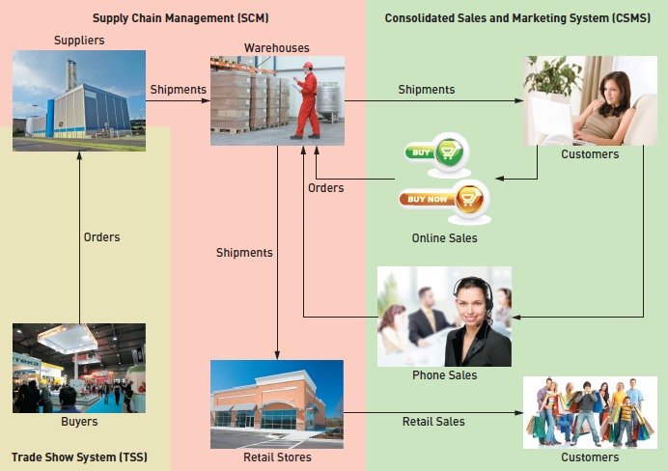
Proposed Application Architecture: Integrate SCM and New CSMS

Slide 10
New Consolidated Sales and Marketing System (CSMS)
Sales Subsystem
Integrates online, phone, and retail stores
Order Fulfillment Subsystem
Track shipments, rate products and services
Customer Account Subsystem
Shopping history, linkups, “mountain bucks” rewards
Marketing Subsystem
Promotional packages, partner relationships, more complete merchandise information and reporting

Slide 11
Systems Analysis Activities
The New Consolidated Sales and Marketing System (CSMS) will require discovering and understanding extensive and complex business processes and business rules
The SDLC indicates the project starts with identifying the problem, obtaining approval, and planning the project (as seen in Chapter 1)
To get to the heart of systems analysis, this text skips right to analysis activities generally and the specifically for the RMO CSMS project (Core Process #3)
Project planning and project management are covered I detail later in the text

Slide 12
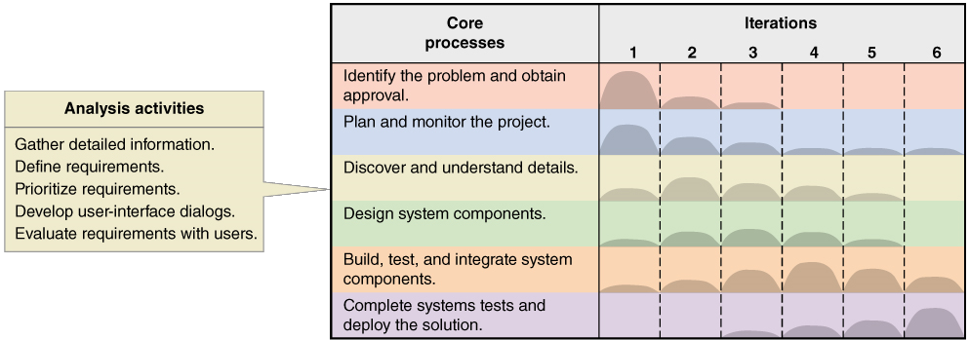
Systems Analysis Activities Involve discovery and understanding

Slide 13
Systems Analysis Activities
Gather Detailed Information
Interviews, questionnaires, documents, observing business processes, researching vendors, comments and suggestions
Define Requirements
Modeling functional requirements and non-functional requirements
Prioritize Requirements
Essential, important, vs. nice to have
Develop User-Interface Dialogs
Flow of interaction between user and system
Evaluate Requirements with Users
User involvement, feedback, adapt to changes

Slide 14
What Are Requirements?
System Requirements =
Functional requirements
Non-functional requirements
Functional Requirements– the activities the system must perform
Business uses, functions the users carry out
Shown as use cases in Chapter 1
Non-Functional Requirements– other system characteristics
Constraints and performance goals

Slide 15
FURPS+ Requirements Acronym
Functional requirements
Usability requirements
Reliability requirements
Performance requirements
Security requirements
+ even more categories…

Slide 16
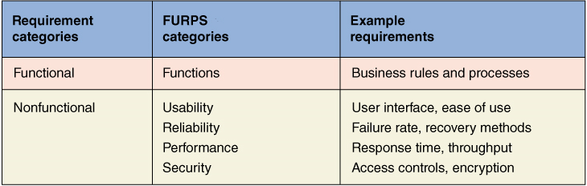
FURPS+ Requirements Acronym

Slide 17
Additional Requirements Categories
Design constraints –
Specific restrictions for hardware and software
Implementation requirements
Specific languages, tools, protocols, etc.
Interface requirements
Interface links to other systems
Physical requirements
Physical facilities and equipment constraints
Supportability requirements
Automatic updates and enhancement methods
Systems Analysis and Design in a Changing World, 7th Edition - Chapter 2

Slide 18
Stakeholders Who do you involve and talk to?
Stakeholders– persons who have an interest in the successful implementation of the system
Internal Stakeholders– persons within the organization
External stakeholders – persons outside the organization
Operational stakeholders – persons who regularly interact with the system
Executive stakeholders– persons who don’t directly interact, but use the information or have financial interest

Slide 19
Stakeholders of a comprehensive accounting system for public company

Slide 20
Stakeholders For RMO CSMS Project
Phone/mail sales order clerks
Warehouse and shipping personnel
Marketing personnel who maintain online catalog information
Marketing, sales, accounting, and financial managers
Senior executives
Customers
External shippers (e.g., UPS and FedEx)

Slide 21
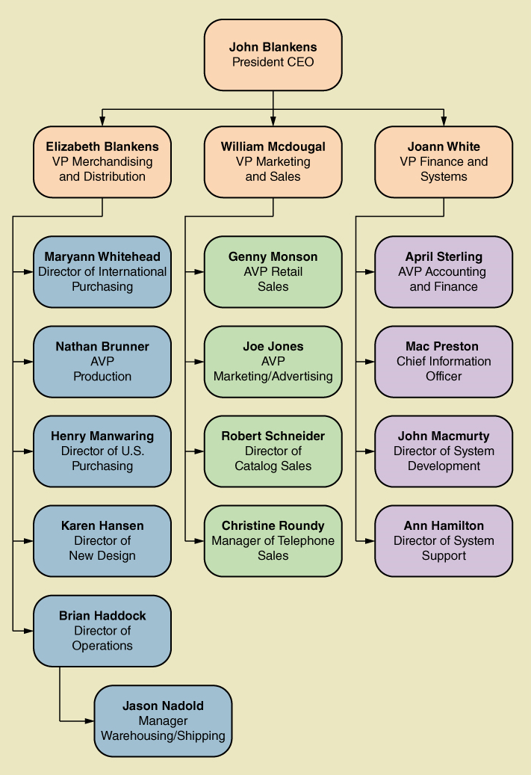
RMO Internal Stakeholders

Slide 22
Information Gathering Techniques
Interviewing users and other stakeholders
Distributing and collecting questionnaires
Reviewing inputs, outputs, and documentation
Observing and documenting business procedures
Researching vendor solutions
Collecting active user comments and suggestions

Slide 23
Interviewing Users and Other Stakeholders
Prepare detailed questions
Meet with individuals or groups of users
Obtain and discuss answers to the questions
Document the answers
Follow up as needed in future meetings or interviews

Slide 24
Themes for Information Gathering Questions

Slide 25
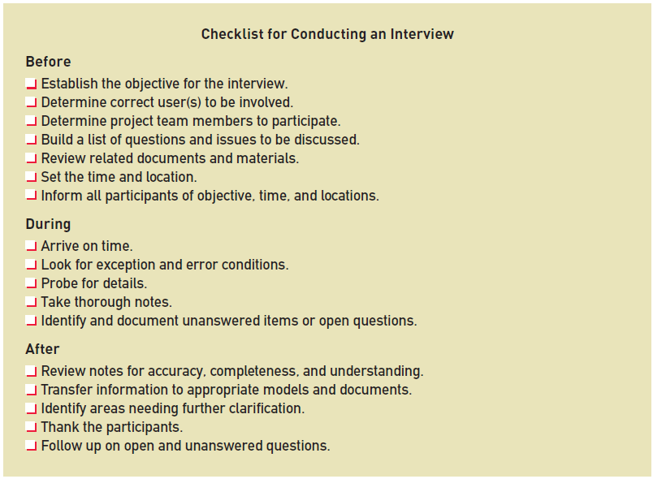
Preparing for the Interview

Slide 26
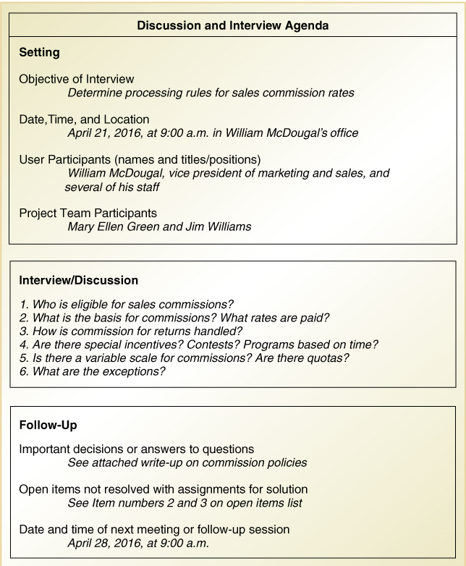
Interview Session Agenda

Slide 27
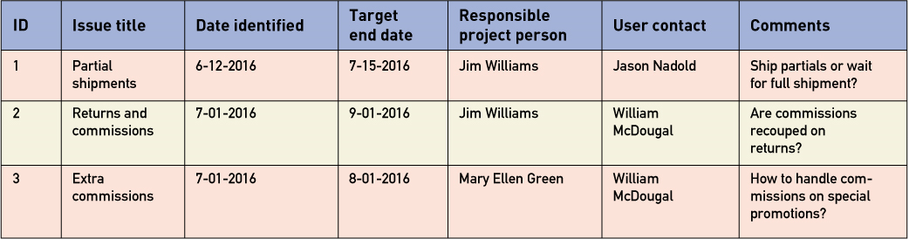
Keeping an Open Items List

Slide 28
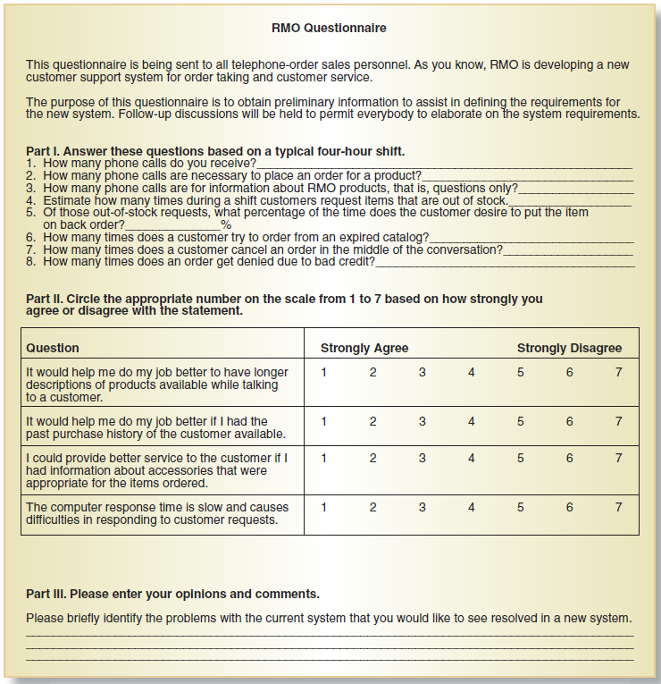
Distribute and Collect Questionnaires

Slide 29
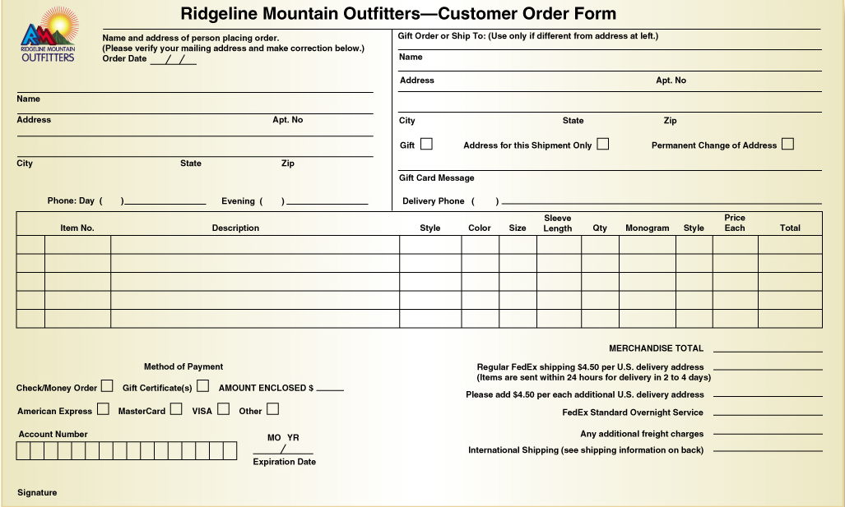
Review Inputs, Outputs, and Procedures

Slide 30
Additional Techniques
Observe and Document Business Processes
Watch and learn
Document with Activity diagram (next section)
Research Vendor Solutions
See what others have done for similar situations
White papers, vendor literature, competitors
Collect Active User Comments and Suggestions
Feedback on models and tests
Users know it when the see it

Slide 31
Models and Modeling
How do we define requirements? After collecting information, create models
Model– a representation of some aspect of the system being built
Types of Models
Textual model– something written down, described
Graphical models– diagram, schematic
Mathematical models– formulas, statistics, algorithms
Unified Modeling Language (UML)
Standard graphical modeling symbols/terminology used for information systems

Slide 32
Reasons for Modeling
Learning from the modeling process
Reducing complexity by abstraction
Remembering all the details
Communicating with other development team members
Communicating with a variety of users and stakeholders
Documenting what was done for future maintenance/enhancement

Slide 33
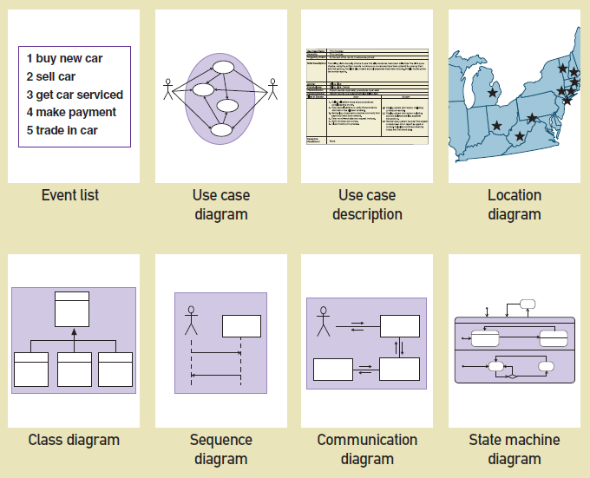
Some Analysis and Design Models

Slide 34
Documenting Workflows with Activity Diagrams
Workflow– sequence of processing steps that completely handles one business transaction or customer request
Activity Diagram– describes user (or system) activities, the person who does each activity, and the sequential flow of these activities
Useful for showing a graphical model of a workflow
A UML diagram

Slide 35
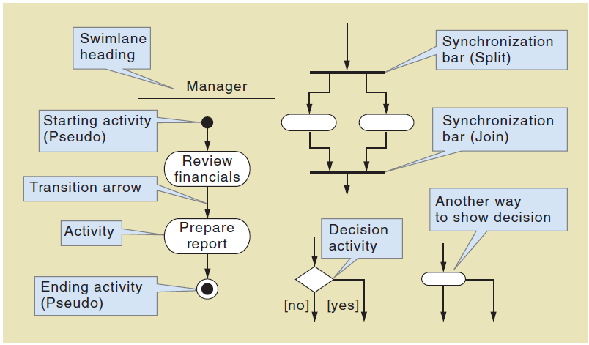
Activity Diagrams Symbols

Slide 36
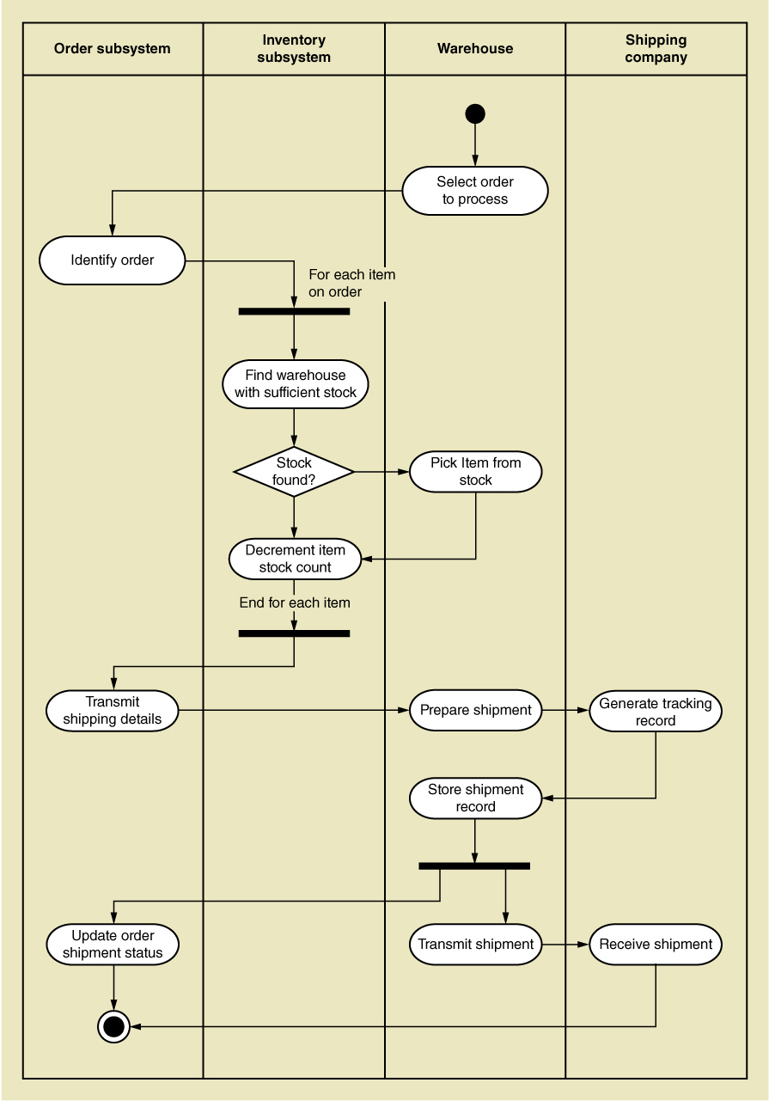
Activity Diagram for RMO Order Fulfillment

Slide 37
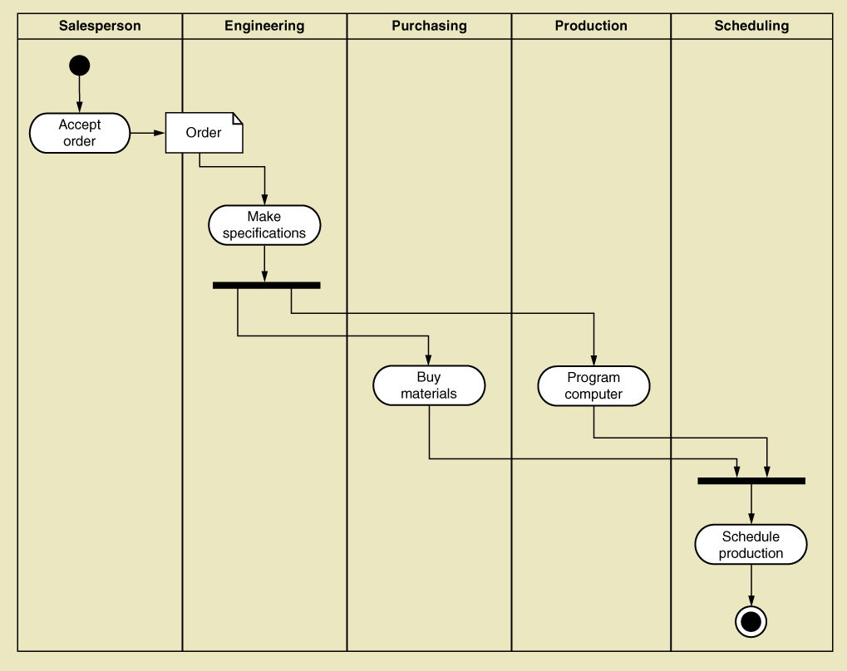
Activity Diagram with Concurrent Paths

Slide 38
Summary
Systems analysis activates correspond to the core SDLC process Discover and understand details
System projects originate from the information system strategic plan, which contains an technology architecture plan and an application architecture plan
The RMO CSMS Project will be used throughout the text as an example of analysis and design

Slide 39
Summary
Systems analysis involves defining system requirements– functional and non-functional
Analysis activities include
Gather detailed information
Define requirements
Prioritize requirements
Develop user-interface dialogs
Evaluate requirements with users
FURPS+ is the acronym for functional, usability, reliability, performance, and security requirements

Slide 40
Summary
Stakeholders are the people who have an interest in the success of the project
There are internal vs. external stakeholders and operational vs. executive stakeholders

Slide 41
Summary
Information gathering techniques are used to collect information about the project
Interviews, questionnaires, reviewing documents, observing business processes, researching vendors, comments and suggestions
The UML Activity Diagram is used to document (model) workflows after collecting information
Models and modeling are used to explore and document requirements
Unified Modeling Language (UML) is the standard set of notations and terminology for information systems models

