Slide 1
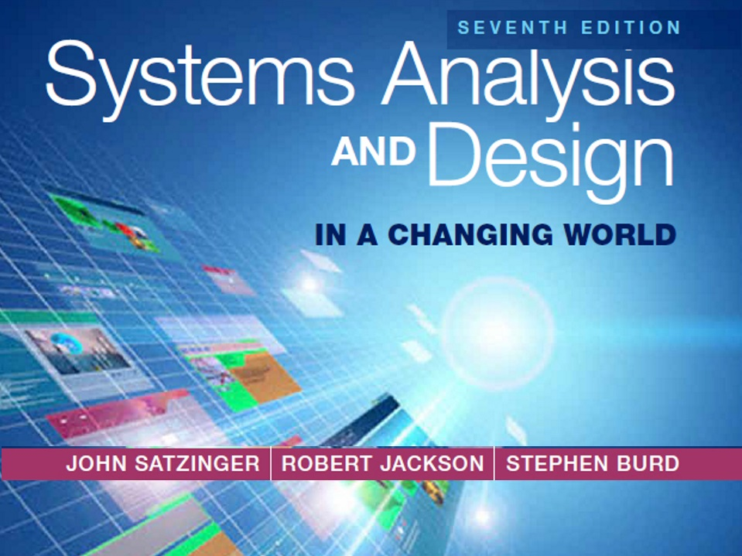
Online Chapter A

Slide 2
The Role of the Systems Analyst
Online Chapter A
Systems Analysis and Design in a Changing World 7th Ed
Satzinger, Jackson & Burd
Systems Analysis and Design in a Changing World, 7th Edition - Online Chapter A
©2016. Cengage Learning. All rights reserved.

Slide 3
Online Chapter A Outline
The Analyst as a Business Problem Solver
Systems That Solve Business Problems
Required Skills of the Systems Analyst
Analysis-Related Careers

Slide 4
Learning Objectives
Explain the key role of a systems analyst in business
Describe the various types of systems and technologies an analyst might use
Explain the importance of technical skills, people skills, and business skills for an analyst
Explain why ethical behavior is crucial for a systems analyst’s career
Describe various job titles in the field and places of employment where analysis and design work is done

Slide 5
Overview
People today are attracted to information systems careers because information technology (IT) can have a dramatic impact on productivity and profits
It is the people who develop information system solutions that harness the power of the technology that makes these benefits possible
The key to successful system development is thorough systems analysis and design to understand what the business requires from the information system

Slide 6
Overview (continued)
Systems analysis – the process of understanding and specifying in detail what the information system should accomplish
Systems design – the process of specifying in detail how the many components of the information system should be physically implemented
Systems analyst –a business professional who uses analysis and design techniques to solve business problems by using information technology
This text is about the tools and techniques used by a systems analyst to develop information systems

Slide 7
Problems to be Solved
Customers want to order products any time of the day or night. So, the problem is how to process those orders around the clock without adding to the selling cost.
Production needs to plan very carefully the amount of each type of product to produce each week. So, the problem is how to estimate the dozens of parameters that affect production and then allow planners to explore different scenarios before committing to a specific plan.
Suppliers want to minimize their inventory holding costs by shipping parts used in the manufacturing process in smaller daily batches. So, the problem is how to order in smaller lots and accept daily shipments to take advantage of supplier discounts.

Slide 8
Problems to be Solved (continued)
Marketing wants to better anticipate customer needs by tracking purchasing patterns and buyer trends. So, the problem is how to collect and analyze information on customer behavior that marketing can put to use.
Management continually wants to know the current financial picture of the company, including profit and loss, cash flow, and stock market forecasts. So, the problem is how to collect, analyze, and present all the financial information management wants
Employees demand more flexibility in their benefits programs, and management wants to build loyalty and morale. So, the problem is how to process transactions for flexible health plans, wellness programs, employee investment options, retirement accounts, and other benefit programs offered to employees.

Slide 9
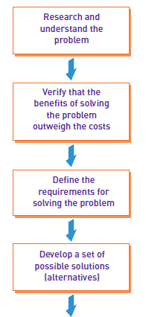
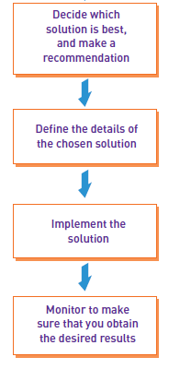
Analyst’s Approach to Problem Solving

Slide 10
Systems Concepts
System – a collection of interrelated components that function together to achieve some outcome
Information system – a collection of interrelated components that collect, process, store, and provide as output the information needed to complete business tasks
Subsystem – a system that is part of a larger system
Functional decomposition – dividing a system into components based on subsystems that are further divided into smaller subsystems
System boundary – the separation between a system and its environment that inputs and outputs must cross
Automation boundary – the separation between the automated part of a system and the manual part of a system

Slide 11
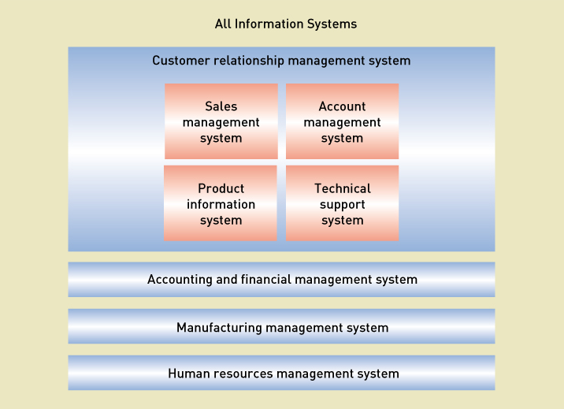
Information Systems and Subsystems
Systems Analysis and Design in a Changing World, 7th Edition - Online Chapter A
©2016. Cengage Learning. All rights reserved.
11

Slide 12
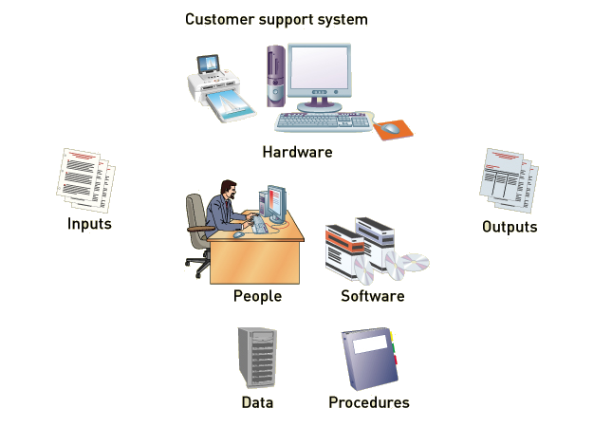
System Components
Systems Analysis and Design in a Changing World, 7th Edition - Online Chapter A
©2016. Cengage Learning. All rights reserved.
12

Slide 13
Systems Concepts

Slide 14
Types of Information Systems
Customer relationship management (CRM) system – a system that supports marketing, sales, and service operations involving direct and indirect customer interaction
Supply chain management (SCM) system – a system that seamlessly integrates product development, product acquisition, manufacturing, and inventory management
Accounting and financial management (AFM) system – a system that records accounting information needed to produce financial statements and other reports used by investors and creditors
Human resource management (HRM) system – a system that supports such employee-related tasks as payroll, benefits, hiring, and training

Slide 15
Types of Information Systems
Manufacturing management system – a system that controls internal production processes that turn raw materials into finished goods
Knowledge management system (KMS) – a system that supports the storage of and access to documents from all parts of the organization
Collaboration support system (CSS) – a system that enables geographically distributed personnel to collaborate on projects and tasks
Business intelligence system – a system that supports strategic planning and executive decision making
Enterprise resource planning (ERP) – a process in which an organization commits to using an integrated set of software packages for key information systems

Slide 16
Types of Information Systems

Slide 17
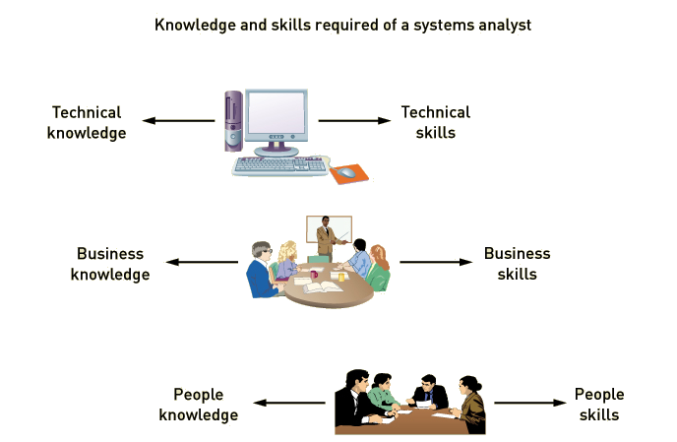
Knowledge and Skills Required of a systems analyst

Slide 18
Knowledge and Skills Tools and techniques
Tools – a software application that assists developers in creating models or other components required for a project
Techniques –strategies for completing specific system development activities
Project planning techniques
Cost/benefit analysis techniques
Interviewing techniques
Requirements modeling techniques
Architectural design techniques
Network configuration techniques
Database design techniques

Slide 19
Technical Knowledge and Skills
Computers and how they work
File, database, and storage hardware and software
Input and output hardware and software
Computer networks and protocols
Programming languages, operating systems, and utilities
Communication and collaboration technology such as digital telephones, videoconferencing, and Web-based document management systems

Slide 20
Business Knowledge and Skills
What business functions do organizations perform?
How are organizations structured?
How are organizations managed?
What type of work goes on in organizations (finance, manufacturing, marketing, customer service, etc)?
What the specific organization does
What makes it successful
What its strategies and plans are
What its traditions and values are

Slide 21
People Knowledge and Skills
Interpersonal skills are perhaps the analyst’s most important skills because analysts rely on others, including managers, users, programmers, technical specialists, customers, and vendors, to take a system from initial idea to final implementation
The analyst must develop rapport with users who may be resistant to change, negotiate with management for such resources as budget, time, and personnel, and manage development personnel with many different skills, capabilities, and attitudes
The analyst must be an effective teacher, mentor, confidant, collaborator, manager, and leader, shifting easily among those roles many times over the course of a typical work day

Slide 22
Analysis Related Careers
Employment in the fields of information systems and computer technology spans a wide variety of skills, organizations, and roles
In-house development, including analysis and design, is especially common in security-sensitive industries, national defense, and research and development in national laboratories
Many software development jobs have shifted to companies that produce and sell ERP and package software
Changes in software development, technology, and business practices have created many new career opportunities for analysts, including sales and support of ERP software; business analysts for user organizations; auditing, compliance, and security; and Web development

Slide 23
A Variety of Job Titles
Programmer analyst
Business systems analyst
System liaison
End-user analyst
Business consultant
Systems consultant
Systems support analyst
Systems designer
Software engineer
System architect
Web architect
Webmaster
Web developer

Slide 24
Summary
A system’s analyst is someone who solves business problems by using information systems technology
Problem solving means looking into the problem in great detail, understanding everything about the problem, generating several alternatives for solving the problem, and then picking the best solution.
Information systems are usually part of the solution, and information systems development is much more than writing programs
A system is a collection of interrelated components that function together to achieve some outcome

Slide 25
Summary (continued)
Information systems components can be thought of as subsystems that interact or as hardware, software, inputs, outputs, data, people, and procedures
Many different types of systems solve organizational problems, including customer relationship management systems, supply chain management systems, human resource management systems, manufacturing management systems, accounting and financial management systems
A systems analyst needs broad knowledge and a variety of skills, including technical, business, and people knowledge and skills

Slide 26
Summary (continued)
Systems analysis and design work is done by people with a variety of job titles—not only systems analyst but programmer analyst, systems consultant, systems engineer, and Web developer, among others
Analysts also work for consulting firms, as independent contractors, and for companies that produce software packages

