Slide 1
GTM HACKATHON · ZENABM
↗
One trial. One useful
first-week next step.
GTMHack2 turns permitted ABM signals into an evidence-linked plan and a human-reviewable draft - in five minutes.
DRAFT-ONLY
HUMAN REVIEW
Notes:
[Sources]
Repository narrative: docs/PROJECT_BRIEF.md; docs/ARCHITECTURE.md.

Slide 2
THE ORIGINAL PRODUCT PROMISE
02
The first days of a trial decide whether value becomes visible.
GTMHack2 does not build a generic chatbot or an automatic sender. It creates a short, defensible first-week growth brief for one selected trial.
THE DELIVERABLE
A report
A CRM draft
A reviewable message
No automatic outreach. No invented claims.
Notes:
[Sources]
Product promise and MVP: docs/PROJECT_BRIEF.md. Review-only boundary: docs/ARCHITECTURE.md.

Slide 3
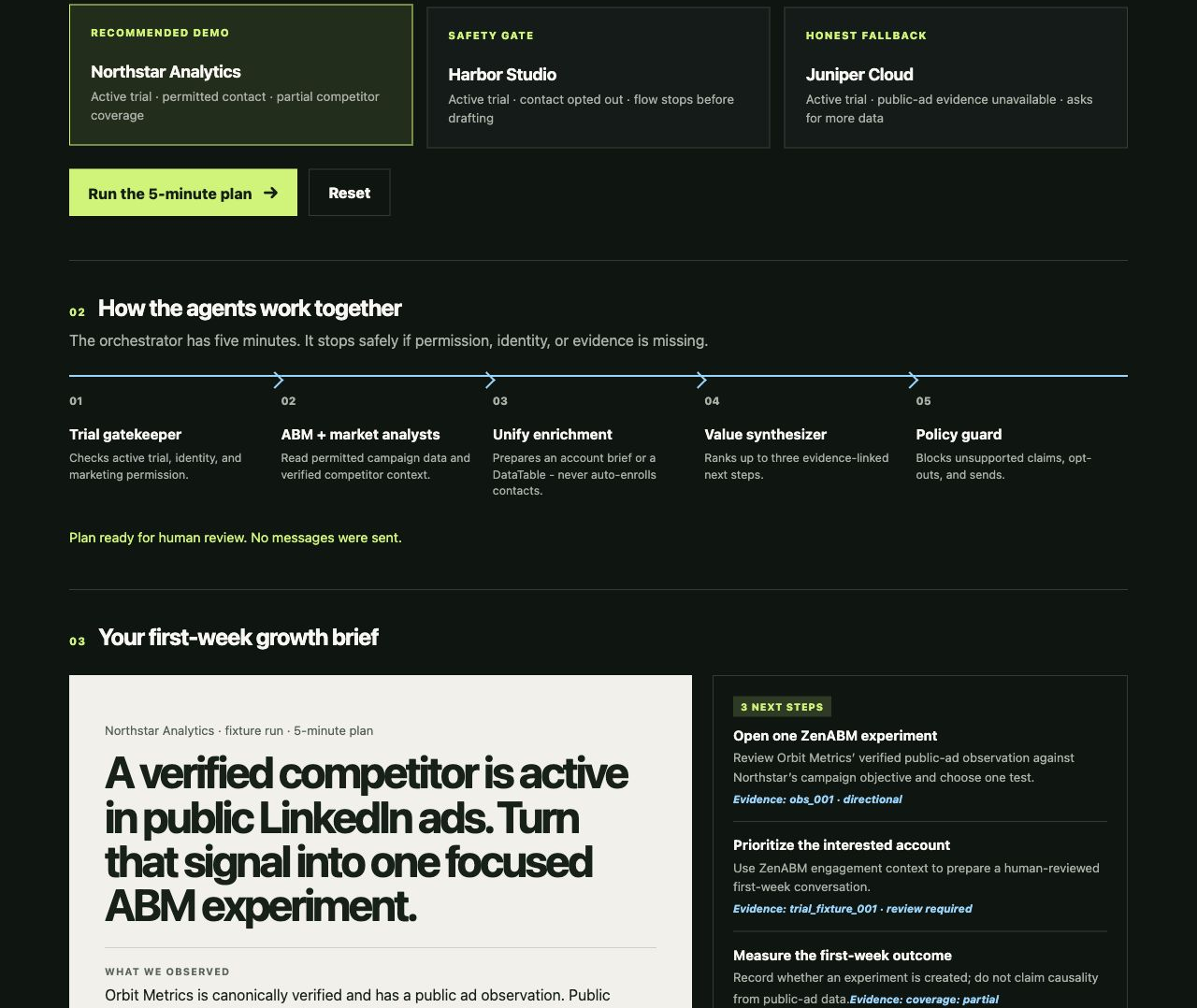
THE INTERACTIVE DEMO
03
The presentation starts
with a single choice.
Pick a fixture trial, run the agent handoffs, and inspect the brief. The entire story is visible on one click-through page.
Recommended flow: Northstar Analytics
Notes:
[Sources]
Product screenshot created from demo/index.html, demo/app.js, and sanitized fixture data in fixtures/ashtree/verified-competitor.input.json.

Slide 4
THE CONTROL PLANE
04
Specialist agents do their jobs. One orchestrator keeps the promise.
1
2
3
4
5
Trial gate
→
ABM + market
→
Unify context
→
Synthesis
→
Policy
Active trial, identity, permission
Owned signals + verified competitor context
Bounded account brief or DataTable
Three evidence-linked actions
No unsupported claim, no send
Five-minute timebox. If required evidence is absent, return an honest partial brief or stop safely.
Notes:
[Sources]
Orchestration sequence and stop conditions: agents/00-orchestrator.md; docs/ARCHITECTURE.md. Unify boundary: agents/07-unify-enrichment.md.

Slide 5
EVIDENCE, NOT INVENTION
05
The strongest feature is knowing what not to claim.
WE CAN SAY
WE DO NOT SAY
Orbit Metrics is verified, and a public ad observation is available.
Spend, clicks, creative, targeting, or causal impact.
Evidence: obs_001 · directional confidence
Public visibility is partial; impressions are unknown.
That honesty is why a trial user can trust the next step.
Notes:
[Sources]
Sanitized fixture: fixtures/ashtree/verified-competitor.input.json. Public-ad coverage constraints: docs/ARCHITECTURE.md and context/linkedin-ad-library-usecases/docs/api-knowledge-base/constraints.md.

Slide 6
WHY UNIFY FITS
06
Unify adds account context - not a shortcut around permission.
For one verified trial account only
UNIFY
Input
Company name + domain + explicit research question
bounded
research
only
Output
Bounded account brief or DataTable reference
Limits
Free/user-owned sources first; no person discovery
Never
No Lists, sequences, enrollment, tasks, or sending
Notes:
[Sources]
Unify integration boundary: agents/07-unify-enrichment.md; docs/CREDENTIALS.md. This deck represents the fixture demo; live Unify tools were unavailable in the authoring workspace.

Slide 7
THE DEMO
Pick a trial.
See the evidence.
Approve the next move.
GTMHack2 makes the first five minutes of a ZenABM trial feel useful - before anyone asks for a conversion.
github.com/MilesatAshvantAnand/gtmhack2
Notes:
[Sources]
Core value proposition: docs/PROJECT_BRIEF.md; demo presenter flow: demo/README.md.

