Slide 1
Screenless Displays
Serenity Kunz & Miley Lai
B4

Slide 2

Overview
Background
History
Plan & Implementation
Pros
Cons
Summary
References

Slide 3
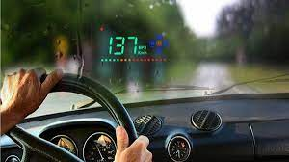
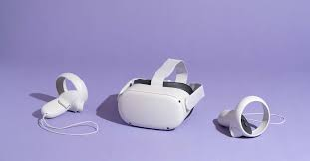
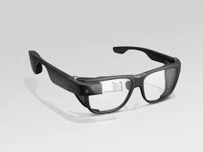
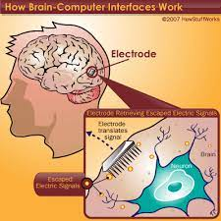
Background
Three types of Screenless Displays
Visual Image-VRG, HUD
Retinal Display-VRD
Synaptic Interface
Google Glass- first tech closely related
HUD (Heads Up Display)
VRG
Synaptic Interface
Notes:
First technology closely related to screenless display is Google Glass, which is worn by users as glasses. Help users communicate with the computer via Natural Language Processing.
Screenless displays are an intelligence technology- it helps humans process info and view the world.
Visual Image - Most common form of screenless display, light deflected from intermediate object before reaching the viewer’s eyes.
Ex: Holograms, VR (Virtual Reality) goggles, and Heads-up Display in airplanes.
HUD (Heads Up Display)
Transparent displays
Aircraft and possibly cars
VRG (Virtual Reality Goggles)
VR headsets
Physical object on eyes
Retinal Display - Includes images reaching the retina of viewer’s eyes. No screen, projector, no source of deflection or reflection. Only shown to viewer’s eyes.
VRD (Virtual Retinal Display)
Image projected onto retinas
augmented reality
Synaptic Interface - Form screenless technology: includes images, but reaches to the brain instead of the retina. Information transmitted directly to viewer’s brain. Helpful for blind people. Also called Brain Machine Interface.

Slide 4
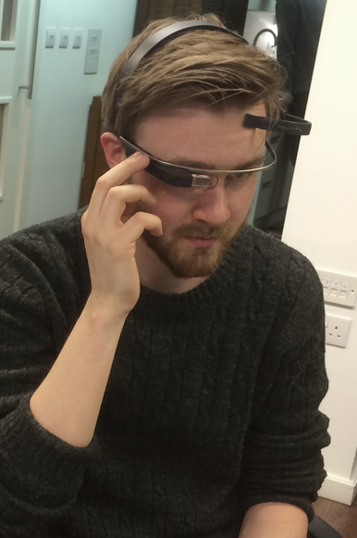
Background
Google Glass + app (MindRDR)
Closest thing to official screenless displays
Sensor picks up brainwaves
Correlates with focus
Mostly hands free
Google Glass: Reading your mind with new app
Notes:
Started with just the glasses
App was added later on
Around $1,800 if you wanted to buy now
Still in research and not yet reviewed or approved by Google
Simple set up and work

Slide 5
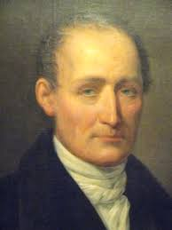

History
When were Screenless Displays invented?
Visual Image: 1826-1827
Retinal Display: 1986-1992
Synaptic Interface: 1969 - 1970
Joseph Nicéphore Niépce
Thomas Furness
Notes:
Visual Image - Invented by: Joseph Nicéphore Niépce, a French scientist.
Retinal Display - Idea from Kazuo Yoshinaka in 1986.
Invented the idea in University of Washington by Thomas Furness and his colleague Joel S. Kollin. Completed project either 1991-1992.
Synaptic Interface - Invented around 1970s in California in University of California, Los Angeles by testing on Monkeys.

Slide 6
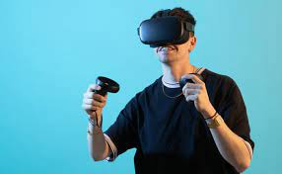
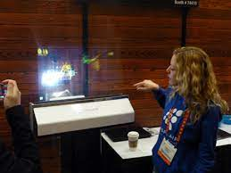
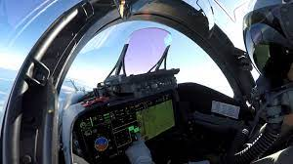
Plan and Implementation
Gaming
Health/medical
Transportation
Consumers
Industries/Factories/marketing

Slide 7
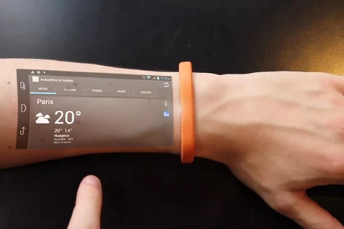
Pros
No toxic materials used to build
Doesn’t take up much space
Better quality and less power
Helps visually impaired & older people
Easy to carry & access
Notes:
VRG & VRD would help the visually impaired and those who start to lose vision as they get older

Slide 8
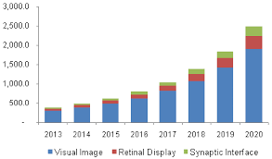
Cons
Expensive
Uncertainty- still still in research
Limited availability
Resources needed
Notes:
Synaptic Interface is still in research- as it’s the direct transmission of images to the brain with an object placed “into” the head- seems sketchy to some
Very costly especially when it comes to cost of producing it and the materials needed
Aren’t available to everyone

Slide 9

Summary
Screenless Displays are greatly beneficial, organized, and minimalistic!
Notes:
Screenless Displays is greatly beneficial to businesses, factories, industries, consumers, and more! It can greatly impact and help improve the development in them by faster research, reach to consumers, produce, minimization, etc. Also being able to manipulate with the images’ sizes.
Minimization can help save room and space. Also can help save data. Includes transmitting files, data, or/and images.
Screenless Displays can also help stay organized during research by minimizing amount of files/data or manipulating the sizes that takes up space.

Slide 10
References
Screenless Displays: The Real Life Holograms – The Hawk Eye
Screenless Display Market Size, Share and Analysis | Forecast - 2030
Screenless Displays- The Emerging Computer Technology
Emerging Technology: Screenless Display and their Types
Need-know-screenless-display-technology
Notes:
Background slide references: Ncbi.nlm.nih.gov/pmc/articles , Nationalgeographic.com/photography/article/milestones-photography , Sociology/retinal_scanning_virtual_retinal_displays
Others: Screenless Display - Mepits , Screenless-Displays-Opportunities-Challenges-and-Risk-Factors ,

