Slide 1
Sarvajanik College of Engineering and Technology
Department Name: Artificial Intelligence & Data Science
Project-1(BTAI16701)
NeuroTwin AI : AI Based Neurological Health Monitoring System
Presented By:
Ashvini Dahivelkar [ET24BTAI801]
Dharmika Gajera [ET24BTAI802]
Dhruvi Kuvadiya [ET24BTAI803]
Mili Moradiya [ET24BTAI806]
Supervised By: Dr. Mitali H. Desai [Assistant Professor of IT Department]

Slide 2
Introduction
NeuroTwin AI is a personalized AI-based platform for longitudinal monitoring of neurological health. It creates an individual Digital Brain Twin by analyzing multiple behavioral and cognitive indicators.
Multimodal Assessment: Analyzes voice, hand movement, facial behavior, typing, memory .
Personalized Baseline: Establishes a baseline from the user's own historical performance rather than relying only on population averages.
Explainable AI: Uses SHAP-based feature attribution to show which factors contribute to the detected changes.
Objectives :
Detect early neurological changes via continuous monitoring
Enable simple, low-cost, longitudinal self-monitoring of subtle neurological changes through one unified patient dashboard
Compare each user against their own baseline (not population averages)
Provide explainable insights using SHAP-based feature attribution

Slide 3
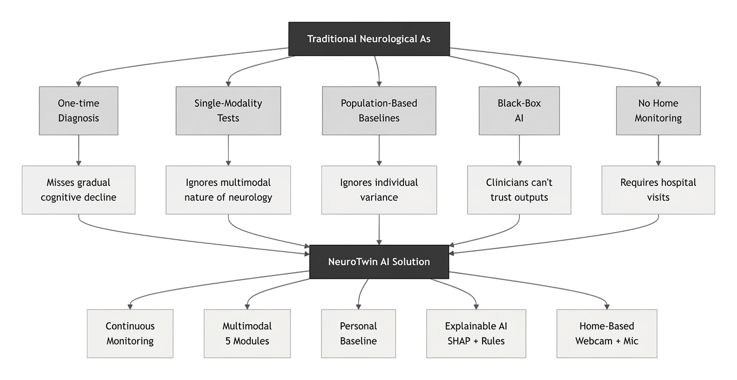
Problem Definition

Slide 4
Motivation
Early Detection: Identify subtle changes in voice, facial behavior, movement, and cognitive performance to support timely medical consultation.
Personalized Monitoring: Compare a person with their own historical baseline, rather than relying only on population-level thresholds.
Multimodal Assessment: Combine voice, facial, movement, typing, and cognitive signals instead of depending on a single biomarker.
Longitudinal Analysis: Monitor performance over time to detect meaningful deviations and emerging trends.
Current Gap
  Single Biomarker → Voice OR tremor-based assessment
  No Personal Baseline → Mainly population comparison
  Limited Explainability → Predictions without clear reasons
  Fragmented Assessment → Different signals analyzed separately
  Limited Context → AI outputs can be difficult to interpret

Slide 5
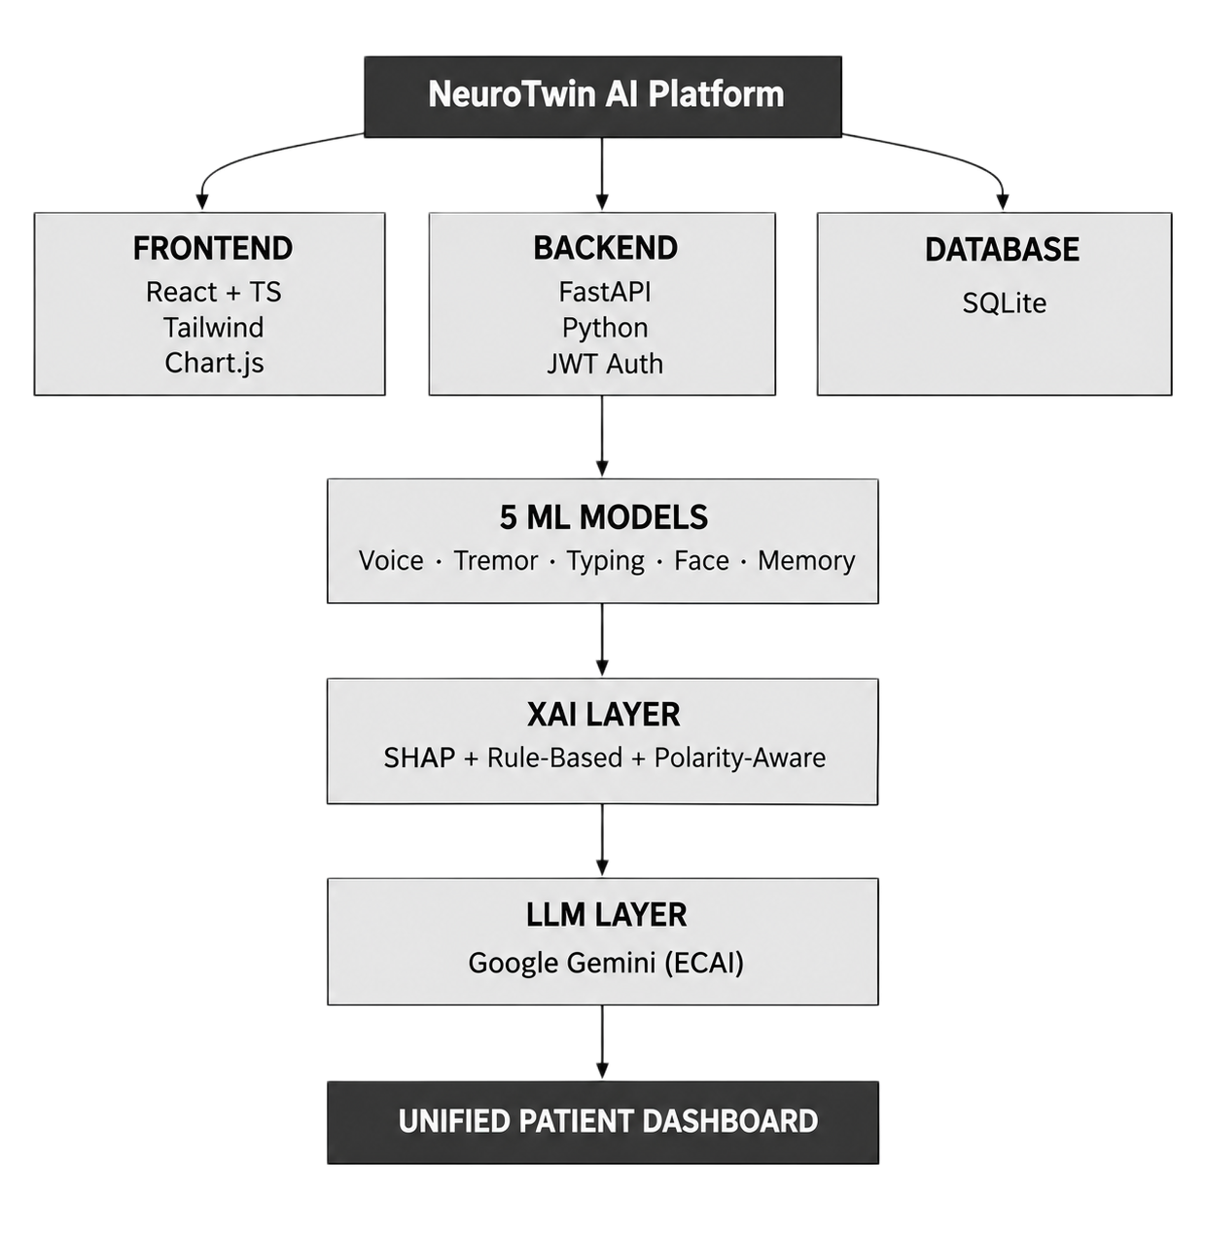
Proposed Solution
Core design: One Patient Dashboard → One Weekly Assessment → Five Integrated Modules → One Digital Brain Twin.
Five modules: Voice Analysis, Hand Tremor Test, Memory Recall, Typing Pattern, and Facial Movement.
Each weekly assessment is compared with the user’s personal baseline to generate a Brain Health Score, trends, and explainable insights.

Slide 6
Methodology
USER & FRONTEND
Dashboard • Assessments • Brain Health Profile • Chat • Reports
API & BACKEND
React/TS → REST API → FastAPI + Python → JWT authentication
ASSESSMENT MODELS
Voice XGBoost • Tremor XGBoost • Typing LSTM • Face CNN • Memory rules
XAI + LLM
SHAP for voice/tremor/typing • Rule-based face/memory • Gemini ECAI
DATA & OUTPUT
SQLite → Personal Baseline → Brain Health Profile → Trends + Reports

Slide 7
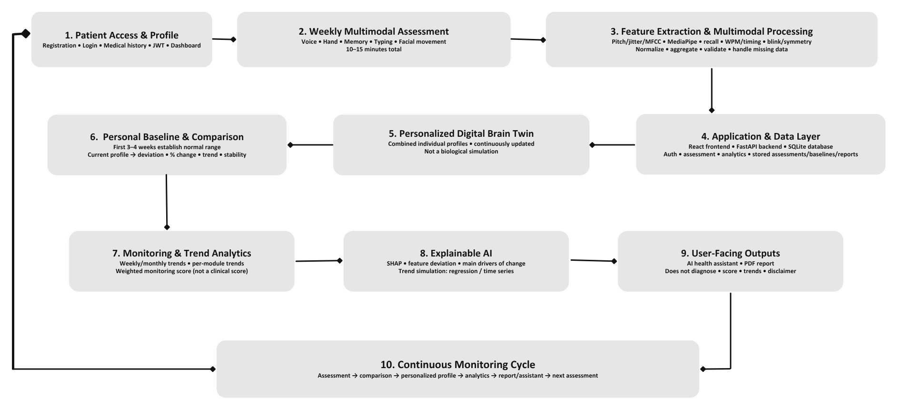
System Architecture

Slide 8
Technologies Learned
FastAPI
React + TypeScript
XGBoost
REST API, JWT auth, async routes
Production-grade backend
Multi-role SPA and dynamic dashboard Component architecture
Voice & tremor classifiers
Gradient boosting for tabular data
TensorFlow / Keras
Librosa
MediaPipe + OpenCV
Typing LSTM + Face CNN
Deep learning for sequences/images
Pitch, jitter, shimmer, MFCC
Audio feature pipeline
Hand landmarks + facial mesh
Real-time computer vision
SHAP
Google Gemini
SQLAlchemy + Tailwind
Feature attribution for 3 modules
Explainable AI
Grounded ECAI responses
Prompt engineering + context
13+ normalized tables + responsive UI Data modeling + UI styling

Slide 9
Model Performance
Voice
Hand Tremor
XGBoost – Selected: Best overall performance, efficient handling of complex voice patterns, and strong SHAP explainability.
Random Forest – Rejected: Reliable benchmark model, but showed lower performance and less optimization compared with XGBoost.
SVM – Rejected: Effective for smaller/high-dimensional data, but requires sensitive tuning and becomes less efficient as data grows.
XGBoost – Selected: XGBoost was selected for its high accuracy,stable performance, making it reliable for tremor prediction.
Random Forest– Rejected: slightly higher accuracy, it showed less robustness and generalization compared with XGBoost.
Gradient Boosting – Rejected: performance variation made its predictions less stable and reliable.
Custom CNN — SELECT: Best suited for our face-emotion task, with the highest accuracy and efficient performance.MobileNetV3 — NOT SELECTED: Designed for lightweight real-time use, but its lower accuracy reduced its suitability for our task.ResNet50 — NOT SELECTED: Designed for deep feature learning, but its higher complexity did not improve our results.
GRU — Rejected: Only 2–3% accuracy gain, within the ±10–14% variability, so no significant advantage over LSTM.Bi-LSTM — Rejected: Requires complete input sequences, making it unsuitable for real-time weekly monitoring.LSTM — Selected: Offers comparable accuracy, efficient sequential processing, and better deployment suitability for NeuroTwin AI.
Face Expression
Typing
Custom CNN —Selected: Best suited for our face-emotion task, with the highest accuracy and efficient performance.
MobileNetV3 — Rejected: Designed for lightweight real-time use, but its lower accuracy reduced its suitability for our task.
ResNet50 —Rejected: Designed for deep feature learning, but its higher complexity did not improve our results.
LSTM — Selected: Offers comparable accuracy, efficient sequential processing, and better deployment suitability for NeuroTwin AI.
GRU — Rejected: Only 2–3% accuracy gain, within the ±10–14% variability, so no significant advantage over LSTM.
Bi-LSTM — Rejected: Requires complete input sequences, making it unsuitable for real-time weekly monitoring.
9

Slide 10
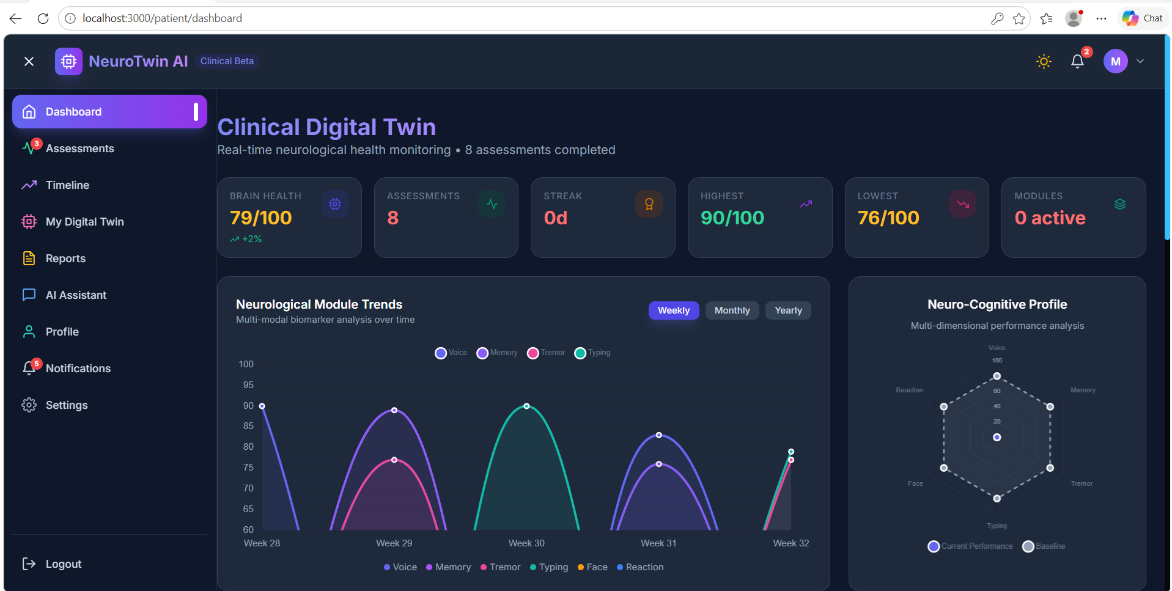
Results and Implementation
(or Working Demo)

Slide 11
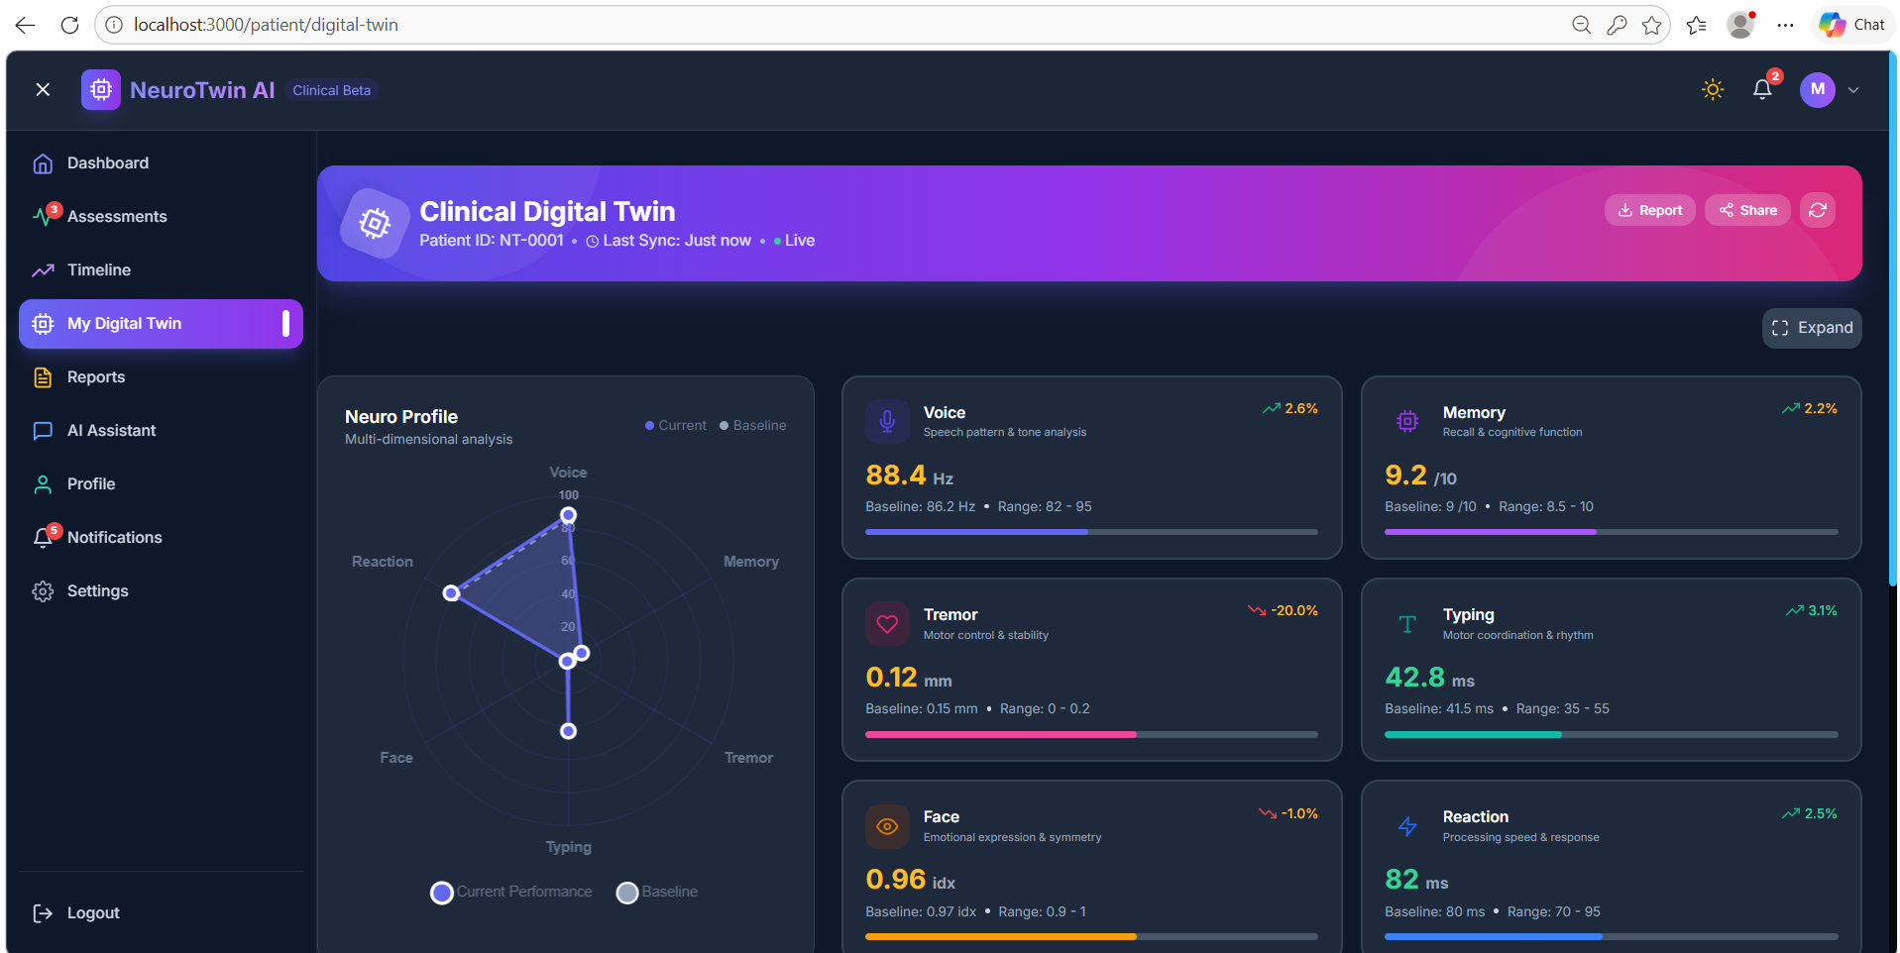
Results and Implementation
(or Working Demo)

Slide 12
Novelty and Scope
Digital Brain Twin : Personalized longitudinal neurological model
5-Module Multimodal : Voice + tremor + face + memory + typing
Personalized Baseline : Compares against the user's own history
Hybrid XAI : SHAP + rule-based explanations by model type
ECAI Chatbot : LLM grounded in real SHAP values
Polarity-Aware XAI : Corrects explanation sign for risk vs health models
Full-Stack Architecture : JWT auth, API, database, Docker-ready structure

Slide 13
Timeline Chart for Project Work
Phase 1
Problem Definition
Phase 2
Requirement Analysis
Phase 3
Literature & Dataset Study
Phase 4
System Design
Phase 5
UI/UX Design
Phase 6
Model Training
Phase 7
Frontend Development
Phase 8
Integration & Testing
W1
W2
W3
W4
W5
W6
W7
W8
W9
W10
W11
W12
W13

Slide 14
References
Research Papers
Hoang, T.-H., Zallek, C., and Do, M. N., “Smartphone-Based Digitized Neurological Examination Toolbox for Multi-Test Neurological Abnormality Detection and Documentation,” IEEE Journal of Biomedical and Health Informatics, vol. 28, no. 12, pp. 7457–7468, 2024. DOI: 10.1109/JBHI.2024.3439492.
IEEE Xplore
Little, M. A., McSharry, P. E., Hunter, E. J., Spielman, J., and Ramig, L. O., “Suitability of Dysphonia Measurements for Telemonitoring of Parkinson’s Disease,” IEEE Transactions on Biomedical Engineering, vol. 56, no. 4, pp. 1015–1022, 2009. DOI: 10.1109/TBME.2008.2005954.
IEEE Xplore / DOI
Ramirez, J., et al., “Multimodal Assessment of Parkinson's Disease: A Deep Learning Approach,” IEEE Journal of Biomedical and Health Informatics, vol. 23, no. 4, pp. 1618–1630, 2019. DOI: 10.1109/JBHI.2018.2866873.
IEEE Xplore
Frameworks & Libraries
MediaPipe Documentation: MediaPipe Documentation
OpenAI Whisper: Whisper GitHub Repository
librosa Documentation: librosa Documentation
Scikit-learn Documentation: Scikit-learn Documentation
SHAP Documentation: SHAP Documentation
FastAPI Documentation: FastAPI Documentation
React Documentation: React Documentation

