Slide 1
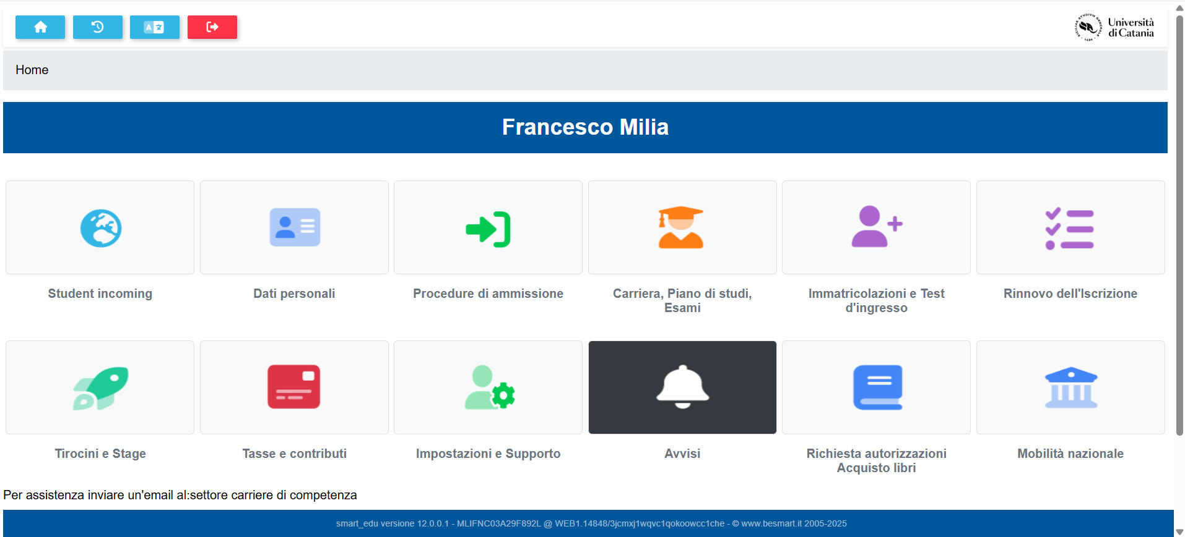
https://studenti.smartedu.unict.it/Home

