Slide 1
Project Number 610905
FP7-ICT-2013-10

Slide 2










OSMOSE Consortium

Slide 3
OSMOSE Security Layer

Slide 4
Most important aspects of the Security
Confidentiality, Integrity, Availability
Authentication
Authorization

Slide 5
Authentication vs Authorization (1/2)
Authentication is the establishment and verification of user identity.
Authorization is the granting of permission to access specific information and carry out specific actions.
Authentication is a prerequisite for authorization.
Access privileges can be granted in many ways:
Individually at the resource level
Role-based access control
Policy-based

Slide 6
Authentication vs Authorization (2/2)
Authentication credentials are used for the proper authorization.
The common practices used are:
Username and passwords
Email-based identification and authentication
Security tokens in combination with passwords
Digital certificates (on PC or smart cards)

Slide 7
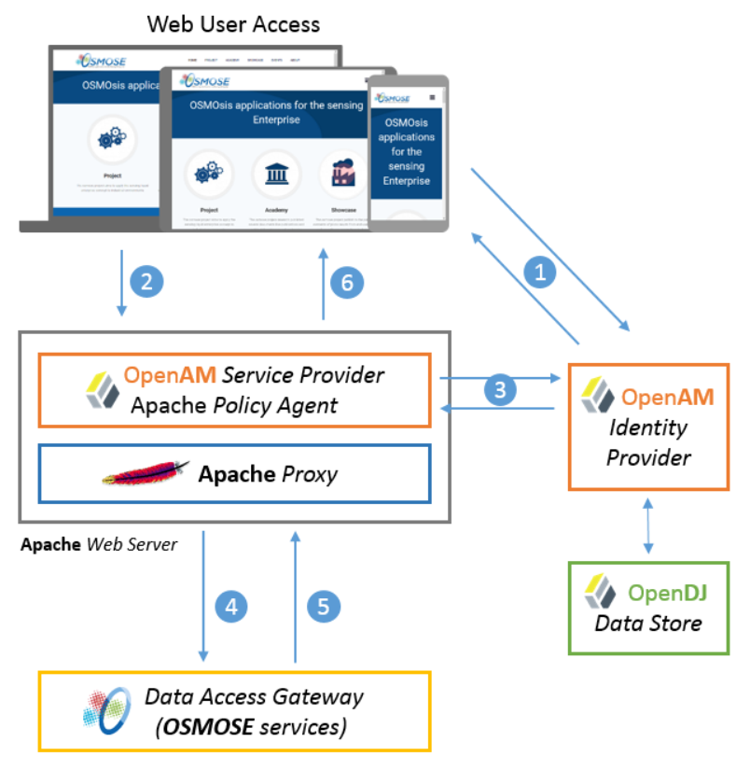
OSMOSE Proposed Architecture

Slide 8
Technologies chosen
OpenAM – Open source access management, entitlements and federation server platform. Supports 20+ authentication methods, authorization with XACML, federation between SAML, WS-Federation, OpenID Connect protocols and OAuth2 client and provider.
OpenDJ - LDAP (Lightweight Directory Access Protocol) server developed by ForgeRock (but other servers could be used) - this is to store all information about the users.
OpenAM Web Policy Agent provided by ForgeRock and running on Apache HTTP Server
Apache HTTP Server used as a reverse proxy

Slide 9
Technologies chosen
OpenAM
Refer to the official guides of the used tools to retrieve the specific user manual:
OpenAM: http://openam.forgerock.org/openam-documentation/openam-doc-source/doc/admin-guide/index.html

Slide 10
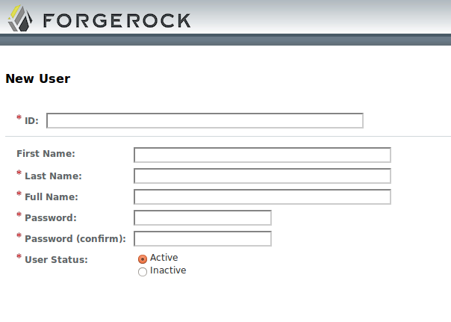
HOW TO SETUP
We assume what you already have OpenAM running
Next step to do is to configure groups and policies using the OpenAM console at https://<hostname>:<tomcatport>/openam to define the rules for data access control and allow only the intended users to access specific resources.

Slide 11
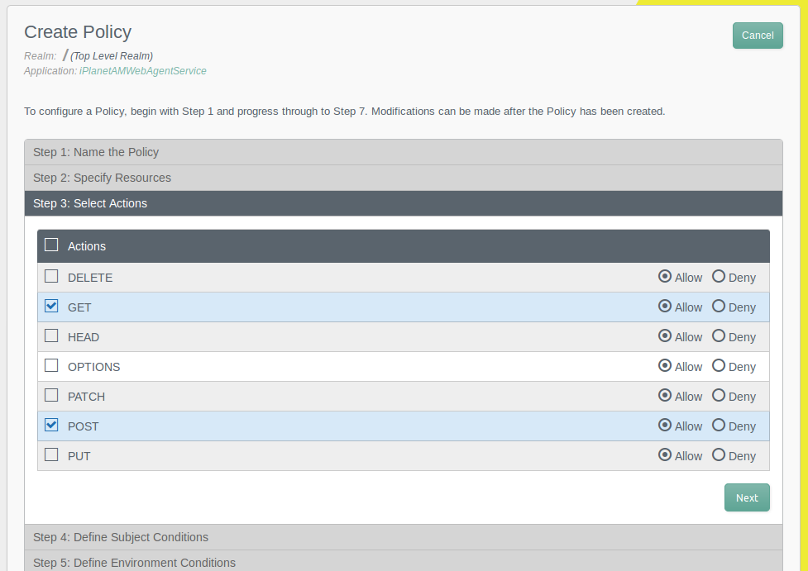
HOW TO SETUP
Define the policy using this UI:

Slide 12
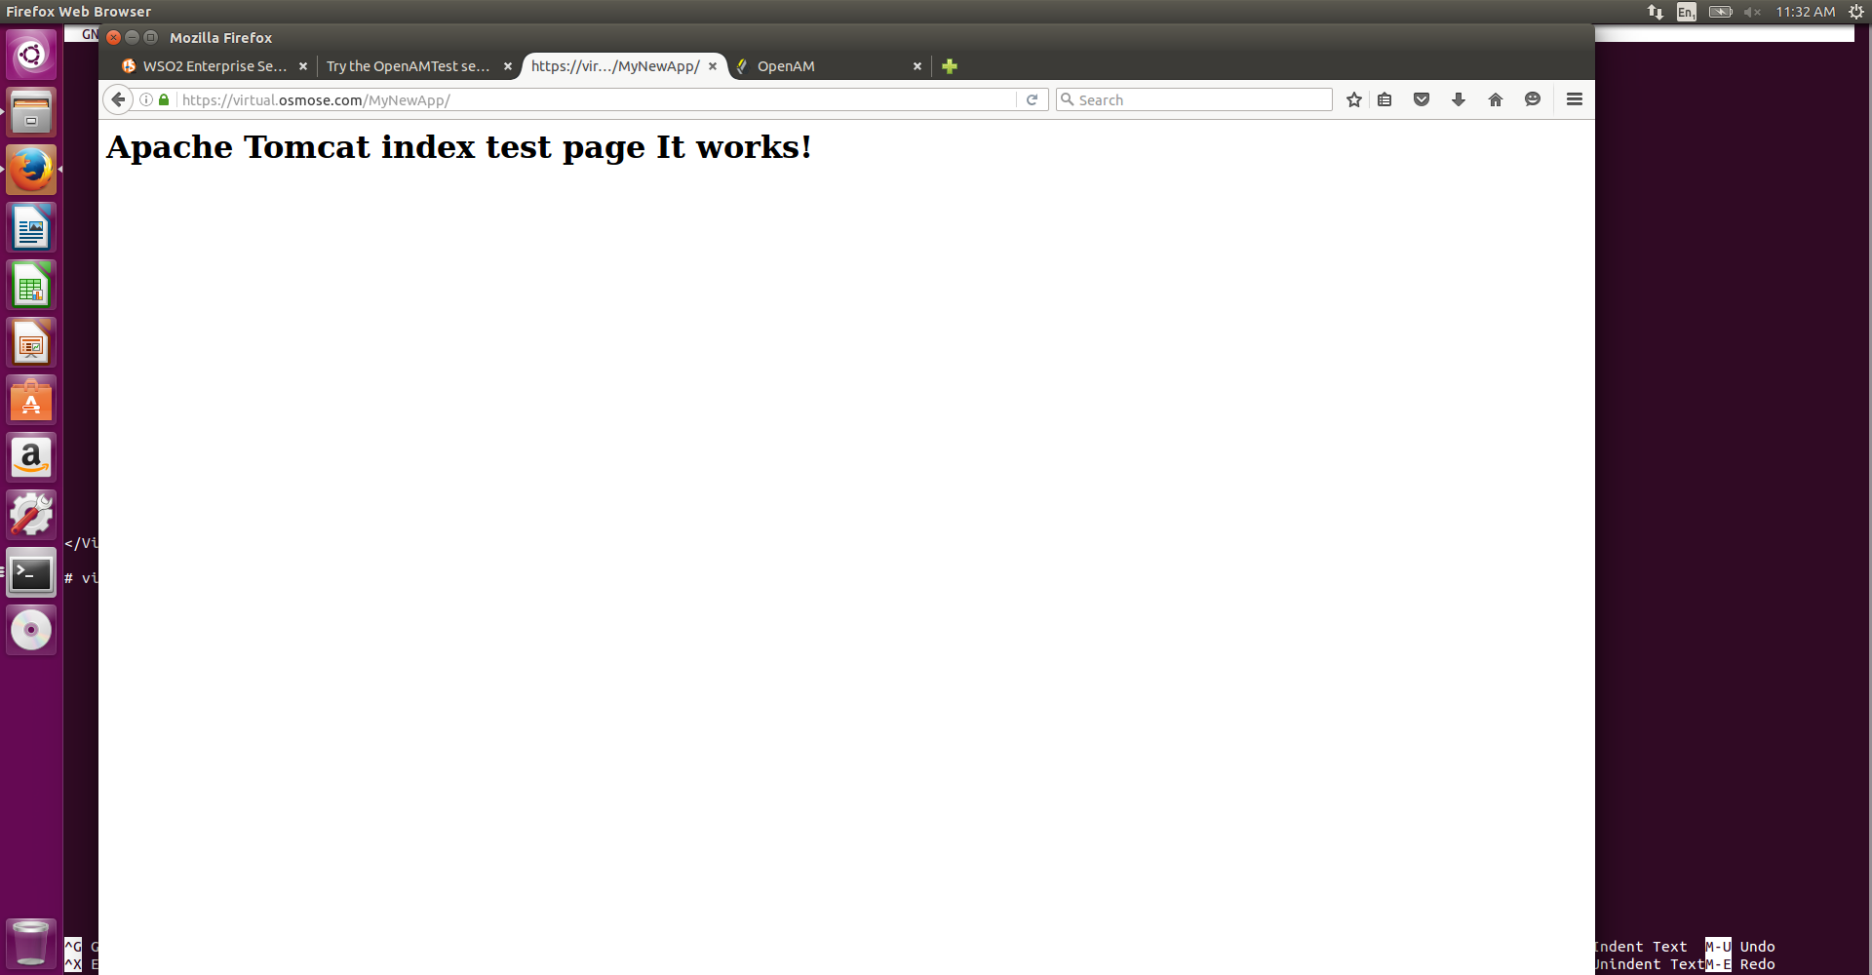
HOW TO SETUP
We assume you have a URL to protect for example this one:
https://virtual.osmose.com/MyNewApp/ and the user test1

Slide 13
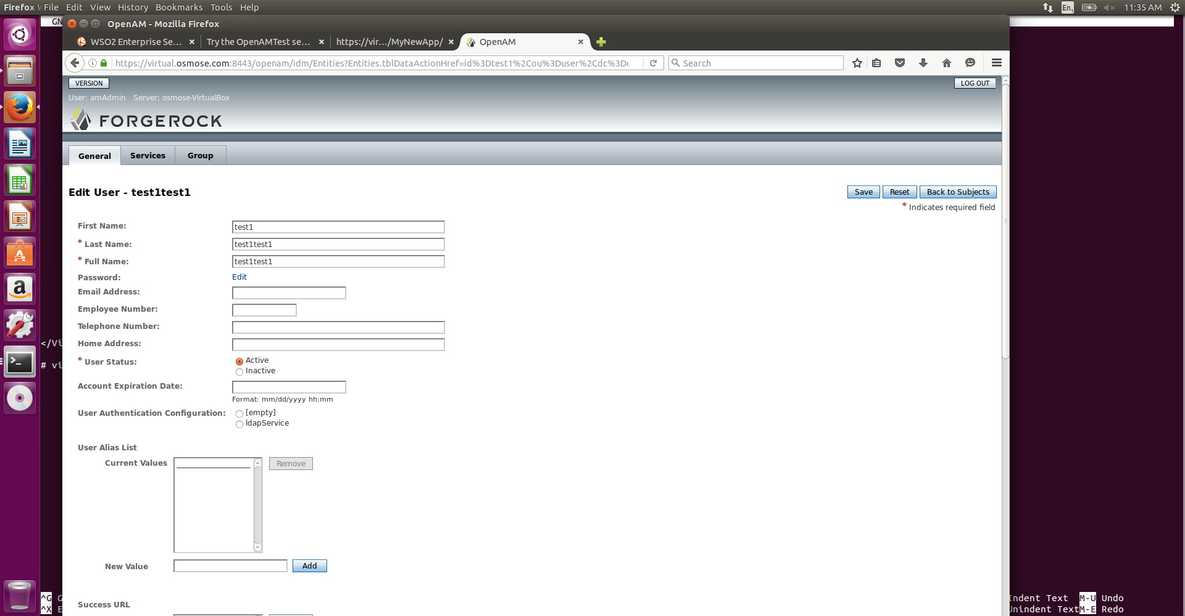
HOW TO SETUP
Define the policy for the user test1

Slide 14
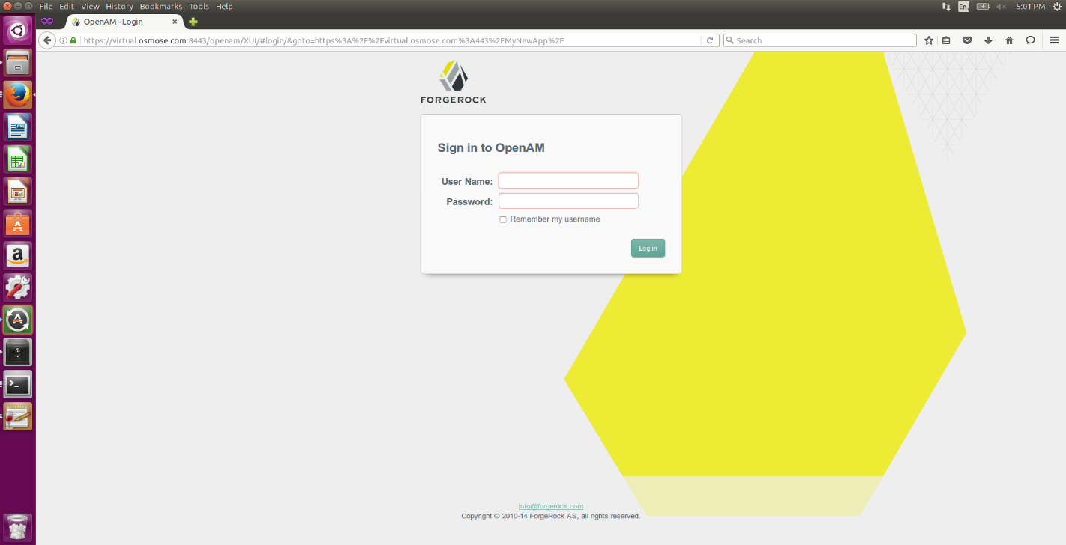
HOW TO SETUP
Go to the OpenAM management console http://virtual.osmose.com/idp/task/Home

Slide 15
HOW TO SETUP
Go to the OpenAM management console http://virtual.osmose.com/idp/task/Home
And log in with proper credential

Slide 16
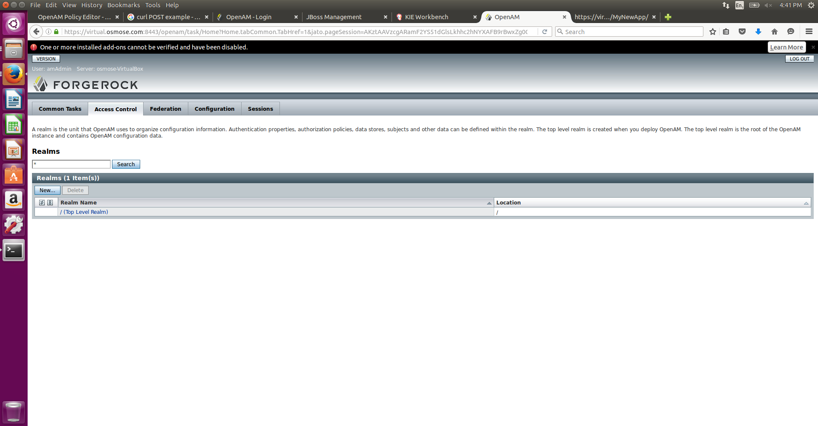
HOW TO SETUP
Go to Access Control

Slide 17
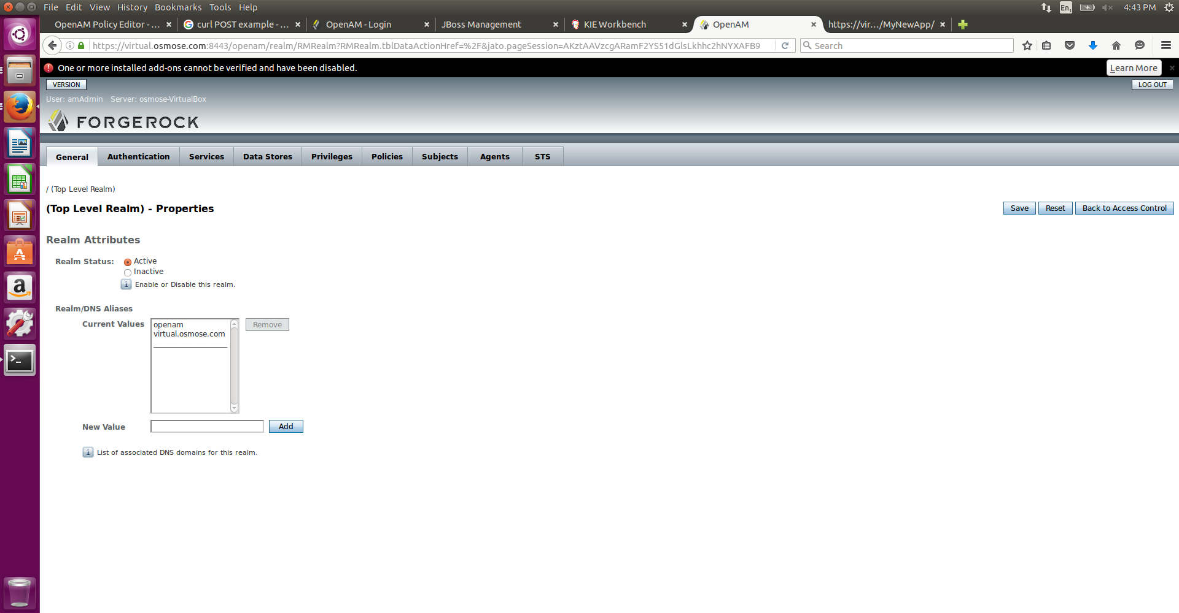
HOW TO SETUP
Go to Top Level Realm

Slide 18
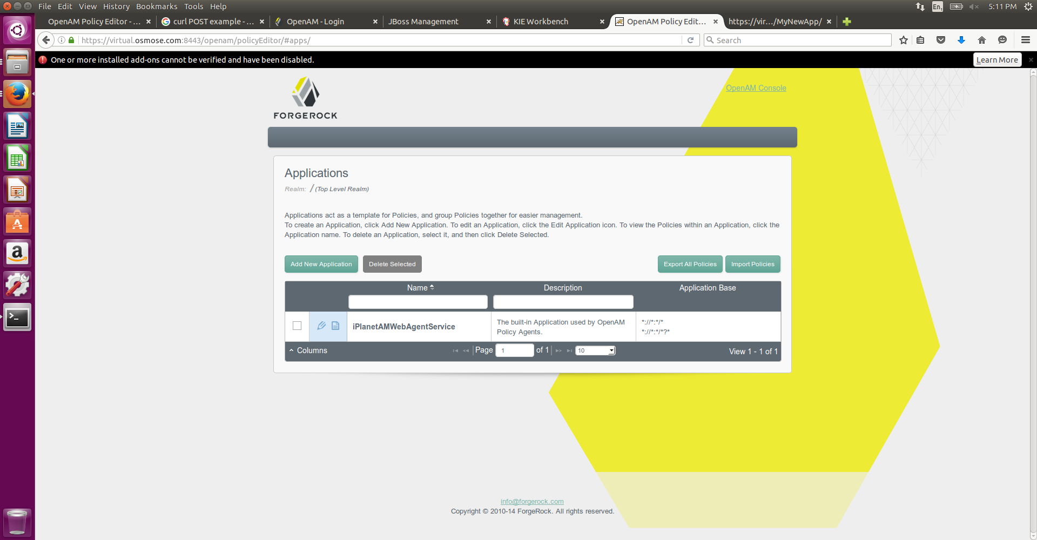
HOW TO SETUP
Go to Policies and click on iPlanetAMWebAgentService to add or modify policies.

Slide 19
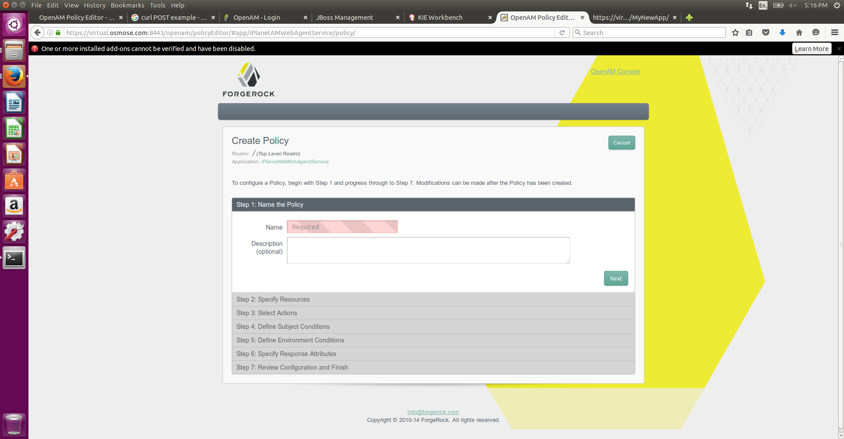
HOW TO SETUP
Add new policy and give it a name

Slide 20
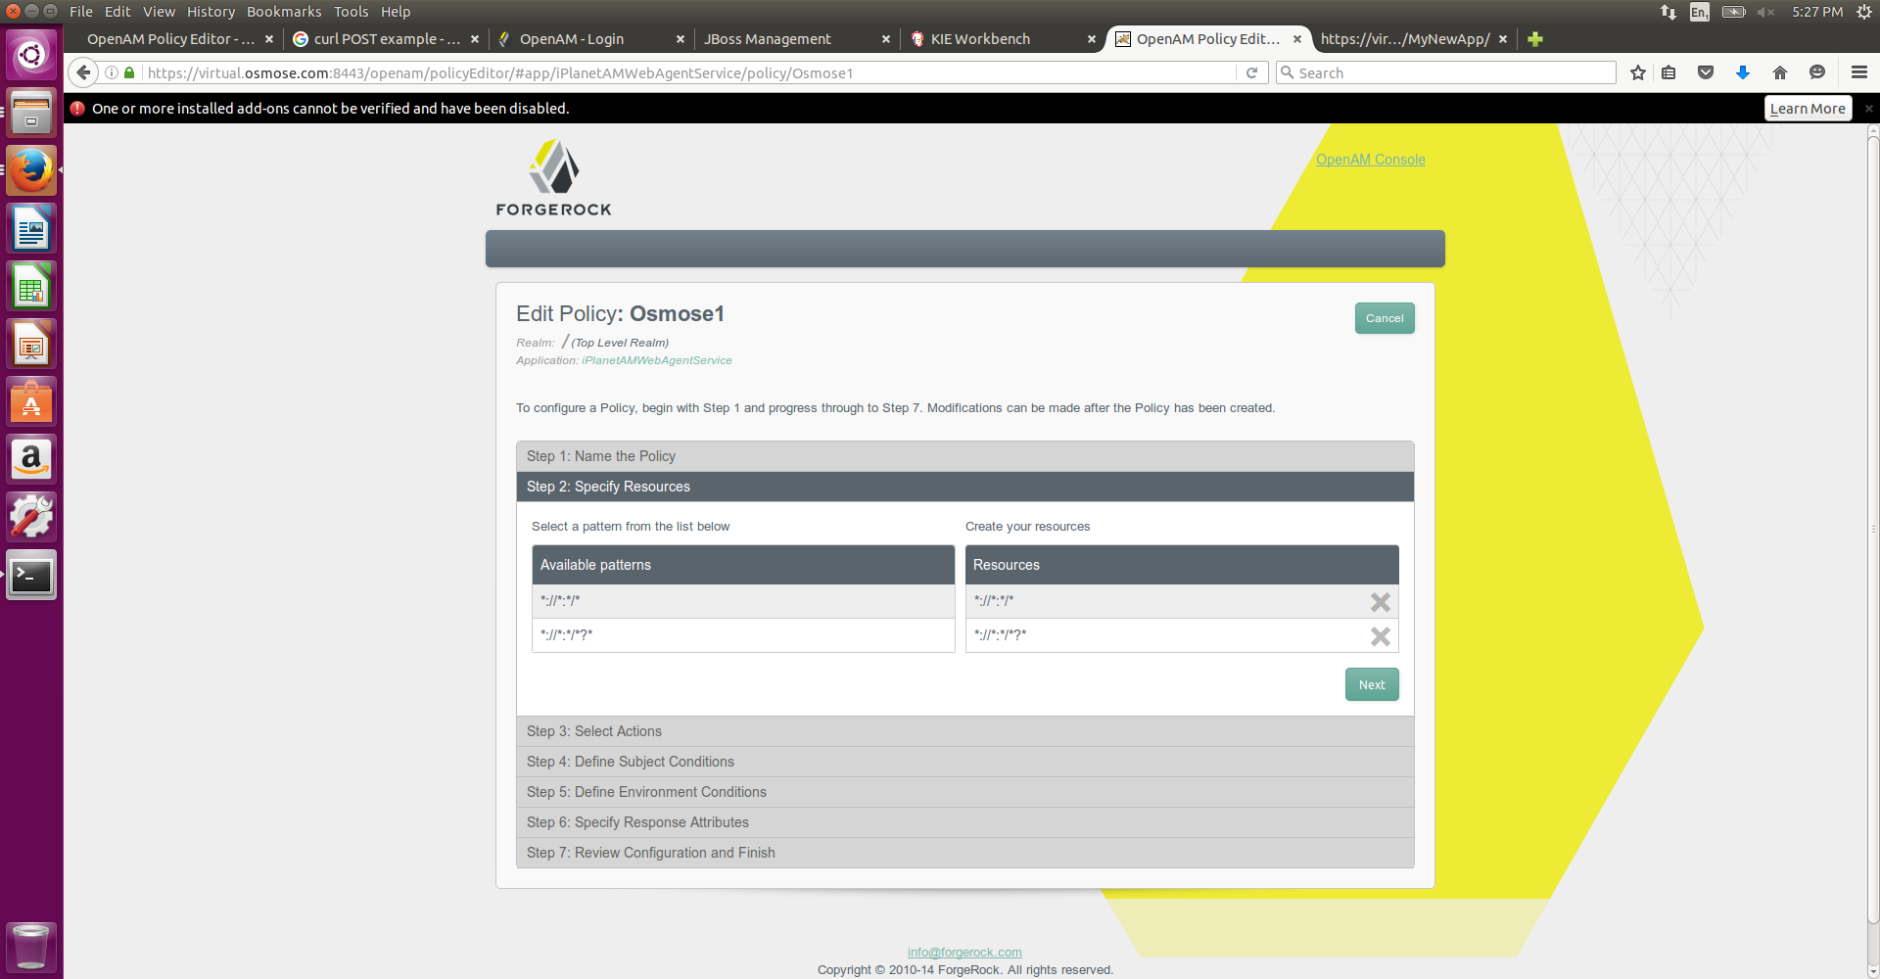
HOW TO SETUP
Click on the first pattern and fill in the fields so that you have the resource to protect, and then click the plus symbol to add it

Slide 21
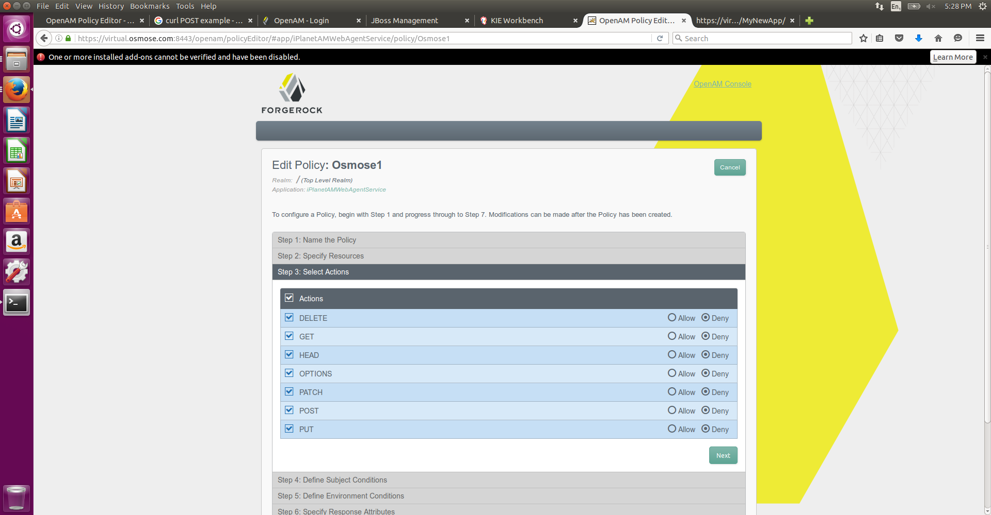
HOW TO SETUP
Actions; Check all boxes and deny everything

Slide 22
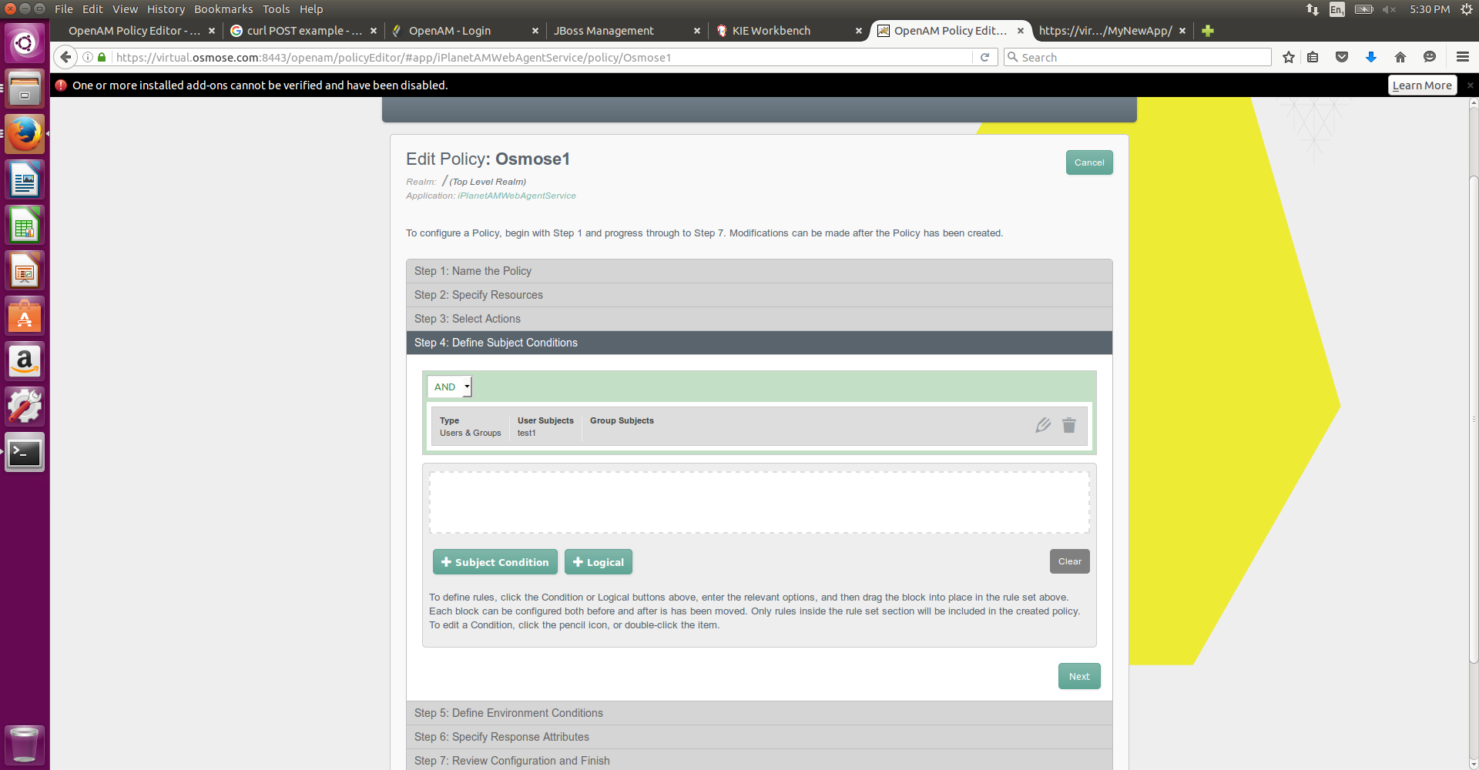
HOW TO SETUP
Define subject conditions

Slide 23
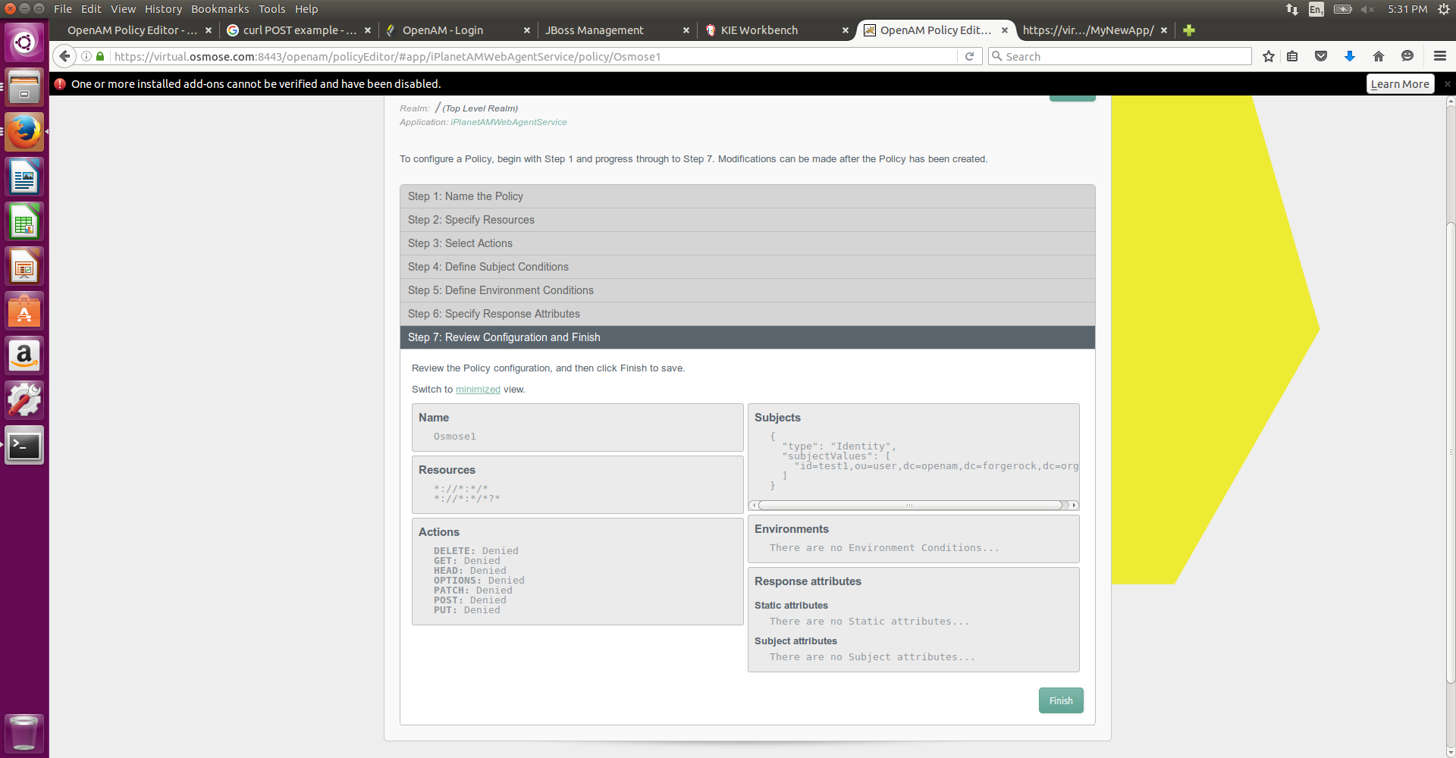
HOW TO SETUP
Jump to step 7 and verify if evrything correct

Slide 24

HOW TO VERIFY
Try to access to the URL protected with the test1 user credential

Slide 25






OSMOSE Project
Project Website:
http://www.osmose-project.eu
OSMOSE is a project co-funded by the European Union 7th Framework Programme:
Project Number: 610905
Project Acronym: OSMOSE
Project title: OSMOsis applications for the Sensing Enterprise
Call (part) Identifier: FP7-ICT-2013-10
Duration in months: 36
Starting date: 01.10.2013
Total Project Costs: 4.569.622 €
Requested EU contribution: 2.870.000 €
https://www.facebook.com/OSMOSEProject
https://twitter.com/OSMOSEProject
http://www.linkedin.com/groups/OSMOsis-applications-Sensing-Enterprise-OSMOSE-6506419
https://plus.google.com/+Osmose-projectEu

Slide 26
Thanks

