Slide 1
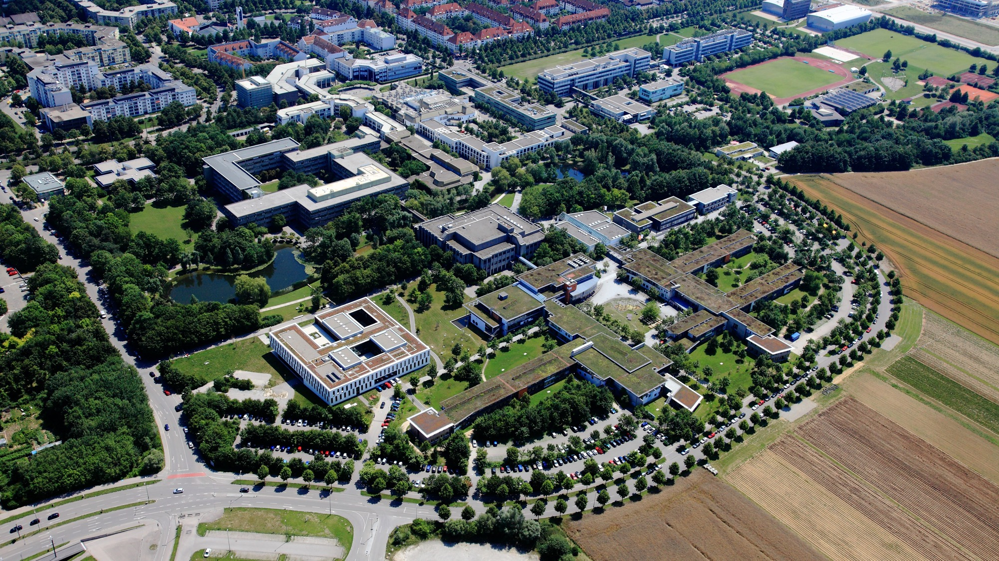









Deep Learning Challenge
Dennis Rall
Jakob Schaefer

Slide 2
Agenda
1
Methodology
2
Results
3
Possible challenges & further steps

Slide 3
Methodology
  Transfer Learning: from pretrained VGG16-Model
  Image Augmentation: Random crops, blurring, left-right-flips
  Regularization: Dropouts

Slide 4
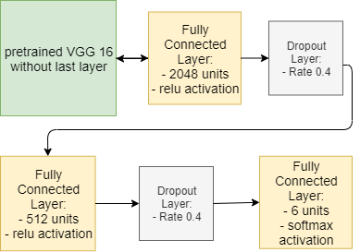
Methodology
  Optimizer: Adam (learning rate: 1e-5)
  Batch_size: 32
  Unfreezed VGG16 net
  6 epochs

Slide 5
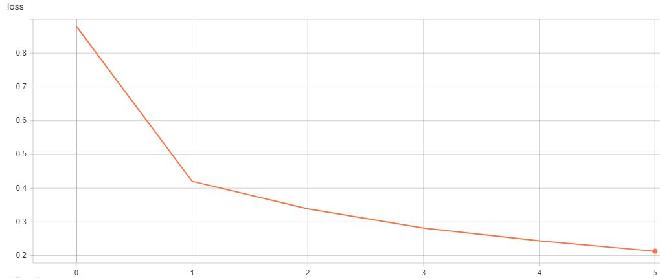
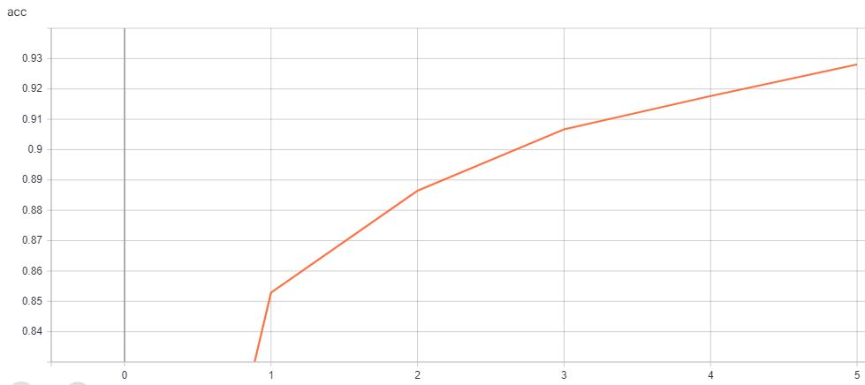
Results
loss
Accuracy on train set: 0.928
Accuracy on validation set: 0.923
Accuracy on test set: 0.914
accuracy

Slide 6
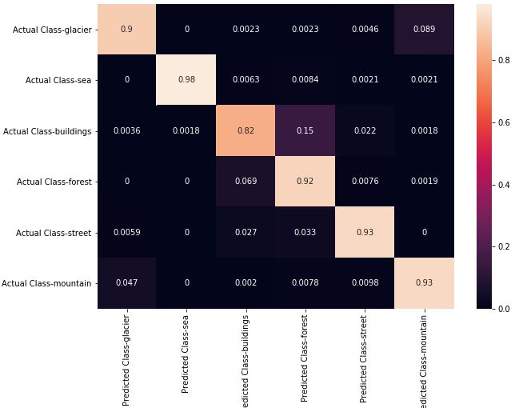
Results

Slide 7
Possible challenges & further steps
Forest and building labels get mixed-up:
→ improve accuracy for these labels
→ increase augmentation for these classes
Keras build-in generator pipeline not suitable for running on google colab, because to many I/O-Operations

