Slide 1


Sales Data Analysis
Leveraging Data for Informed Decision Making
Presented by : Simran Kaur
Git Hub:
https://github.com/Milimia/AfameTechnologies_SalesData

Slide 2
Introduction
Objective:
Analyse Sales Data to gain Insights into performance and Customer Behaviour.
Agenda
Overview of Sales Data
Key Metrics Analysis
Insights and Recommendations

Slide 3
Overview of Sales Data
Dataset Details:
Total Records: 51290
Columns: Row ID, Order ID, Order Date Ship Date, Ship Mode Customer Id, Customer Name, Segment City, State, Country, Postal Code, Market Region, Product Id, Category, Sub-Category, Product Name, Sales Quantity, Discount, Profit Shipping Cost, Order Priority, Order Month

Slide 4
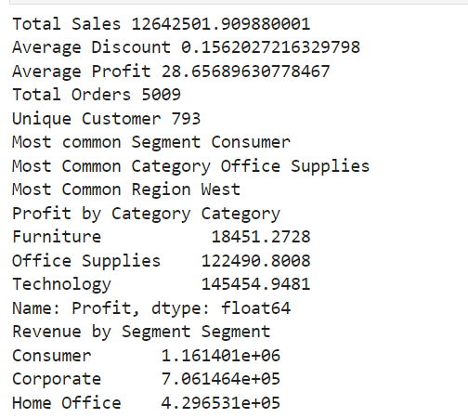
Key Metrics Analysis
Total Sales: 12,642,501.91
Average Discount: 15.62%
Average Profit Per Order: 28.66
Total Orders: 5,009
Unique Customers: 793

Slide 5
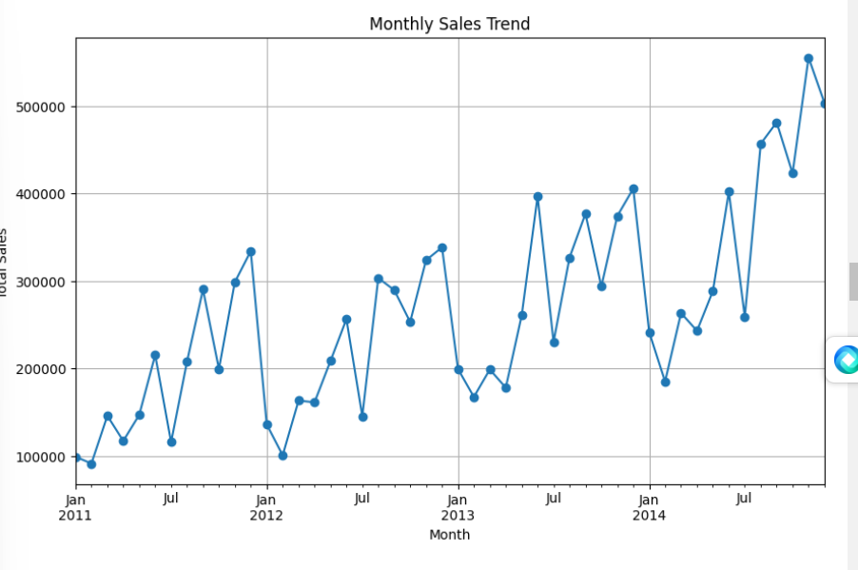
Monthly Sales Trend
This graphs shows the Monthly sales trends over the past four years.
It highlights the seasonal trend.
Sales appear to rise in the second half of each year.

Slide 6
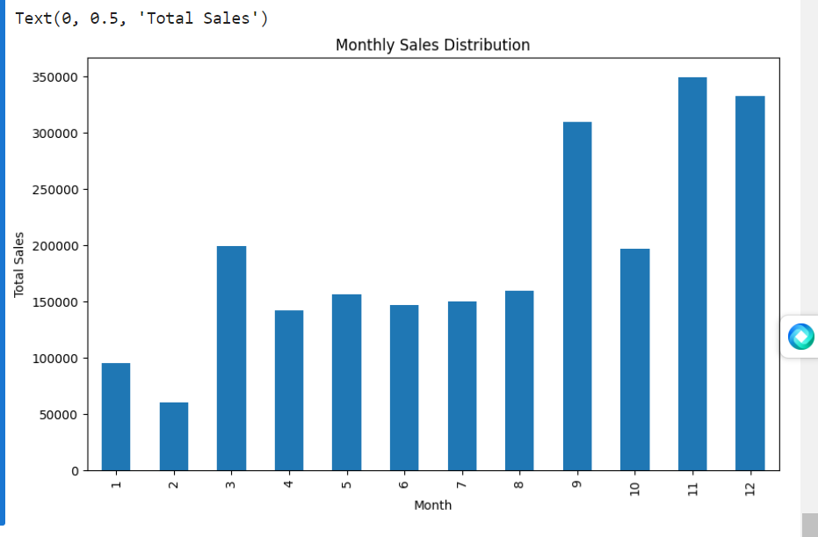
Monthly Sales Distribution
In the Second Month, February, Sales appear to be lower compared to other months throughout the year.
Conversely, the September, November and December month exhibit the highest sales across the entire year.
This pattern suggests that sales tend to rise in the second half of each year.

Slide 7
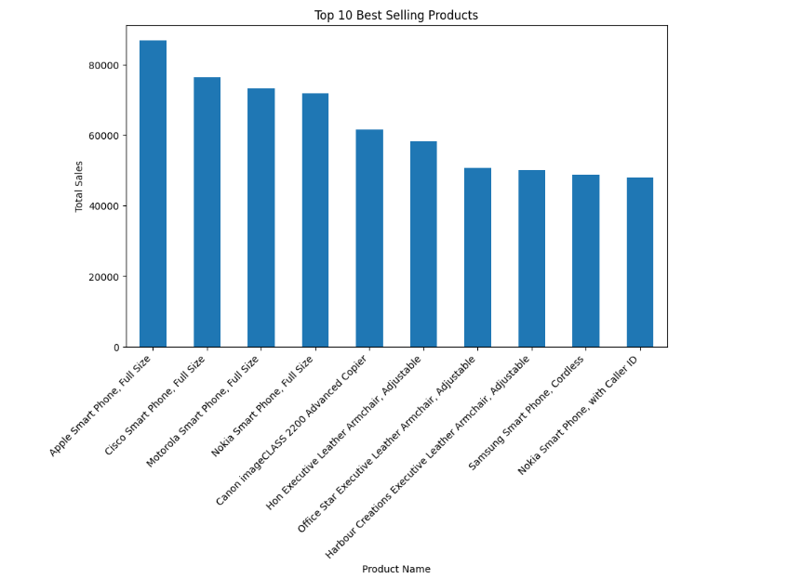
Top 10 Best Selling Product:
Apple iPhones account for the highest total sales among all the products.
Eight out of the ten bestselling products are smartphones, with brands including Apple, Cisco, Motorola, Nokia and Samsung.

Slide 8
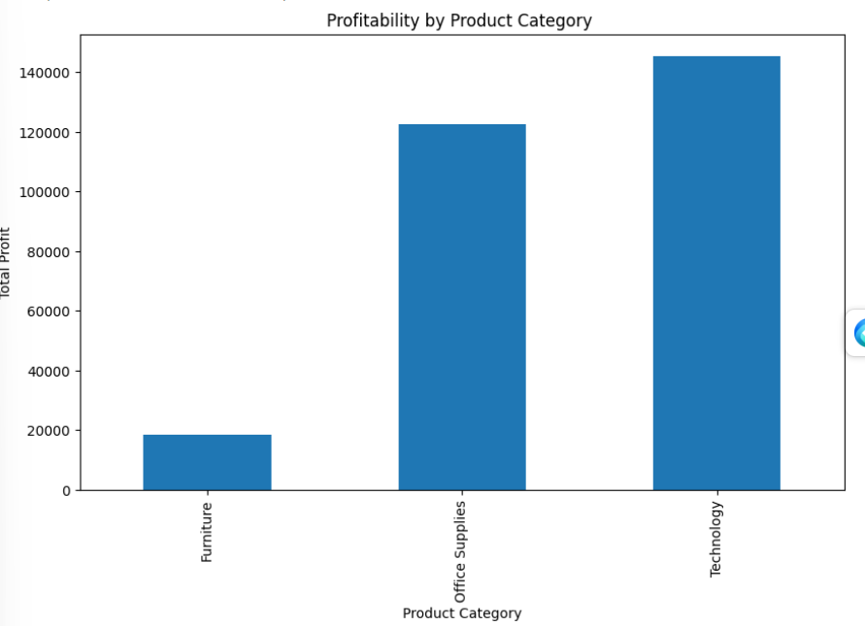
Profitability by Product Category
The profitability of each product category is different.
Furniture is most profitable category, followed by office supplies and technology.

Slide 9
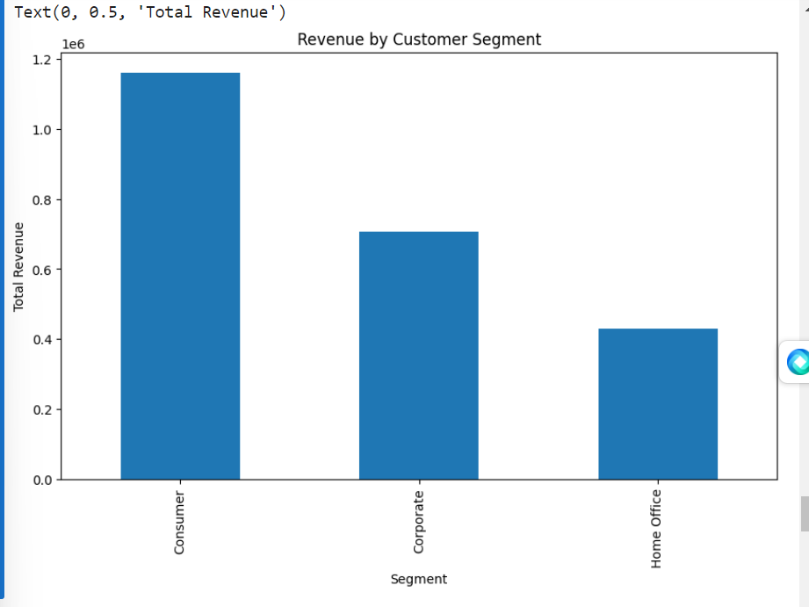
Revenue by Customer Segment
Consumer segment is our largest revenue generator, followed by the Corporate Segment. The Home Office Segment contributes the least amount of revenue.

Slide 10
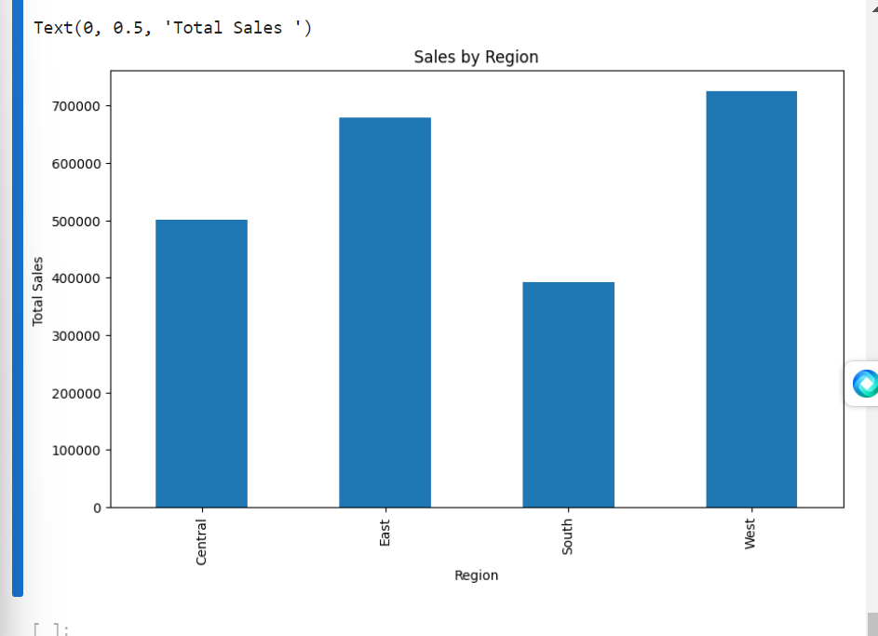
Sales by Region
West is the top selling region, followed by East, Central and South.

Slide 11
Conclusions:
The customer Segment is the biggest revenue generator. This suggests a focus on understanding and catering to the needs of the Consumer Segment may be profitable.
There might be a seasonal trend with sales rising in the second half of the year.
Smartphones dominate the top selling products list, with Apple iPhones being the clear leader. Profitability varies by category, with furniture being the most profitable.
Sales vary by region, with the East region being the Strongest Performer.

