Slide 1
Linear Algebra
线性代数

Slide 2
Linear Algebra
Chapter 1 Linear Equations 线性方程（组）
Chapter 2 Matrix Algebra 矩阵代数
Chapter 3 Determinants 行列式
Chapter 4 Vector Spaces 向量空间
Chapter 5 Eigenvalues and Eigenvectors
Chapter 6 Orthogonality 特征值、特征向量、正交
Chapter 7 Symmetric Matrices and Quadratic Forms 对称矩阵 和 二次型

Slide 3
Linear Equations
1.1 System of linear Equations
1.2 Row Reduction and Echelon Forms
1.3 Vector Equations
1.4 The Matrix Equation Ax = b
1.5 Solution Sets of Linear Systems
1.7 Linear Independence

Slide 4
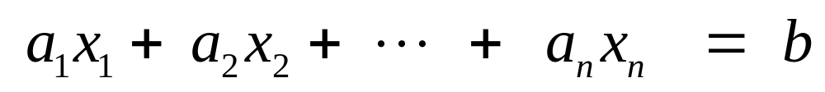
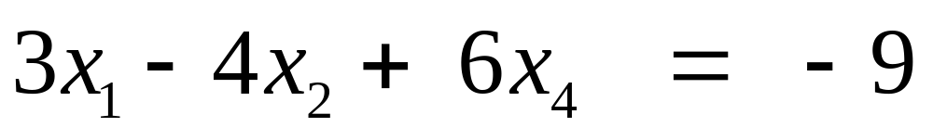
System of linear Equations
What is a linear equation? 线性方程
A:
Coefficients ：a_{1,…,} a_{n}
Exp:

Slide 5
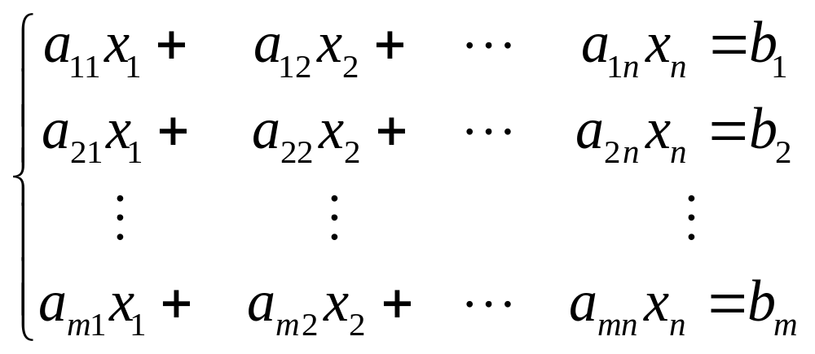
What is a system of linear equations ( linear system ) ? 线性方程组，线性系统

Slide 6
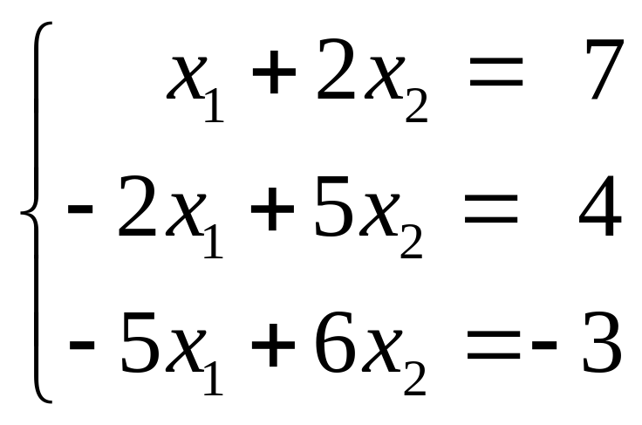
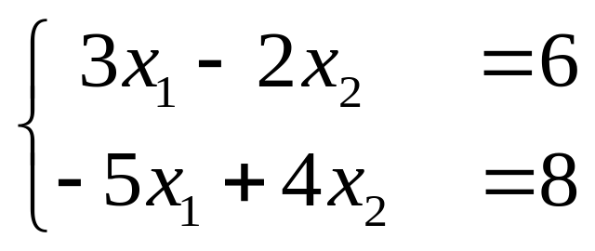
Solution 解
Solution set 解集
Equivalent 等价
Exp:

Slide 7
A system of linear equations has either
  1. no solution, or
  2. exactly one solution, or
  3. infinitely many solutions.
(will be proved later.)

Slide 8
Consistent ( 相容的，有解的 ) inconsistent ( 不相容的，无解的 )
A linear system is consistent if it has at least one solution.

Slide 9
Matrix Notation
A rectangular array --- Matrix 矩阵

Slide 10
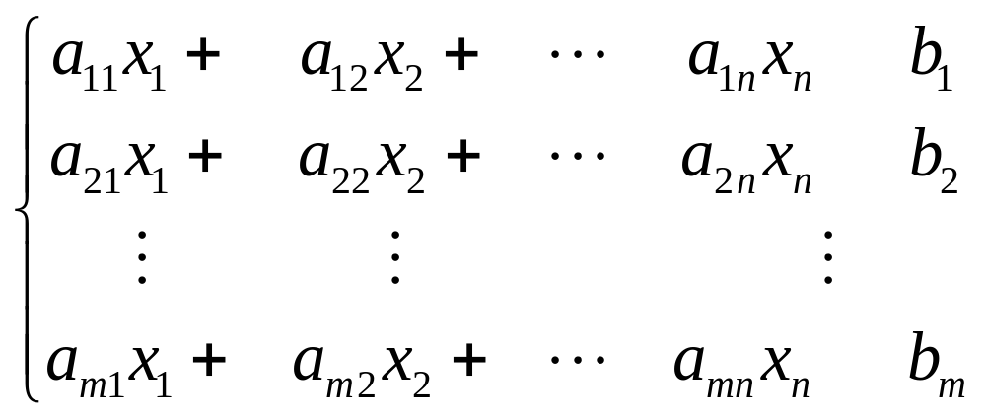
Matrix Notation
A rectangular array --- Matrix 矩阵

Slide 11
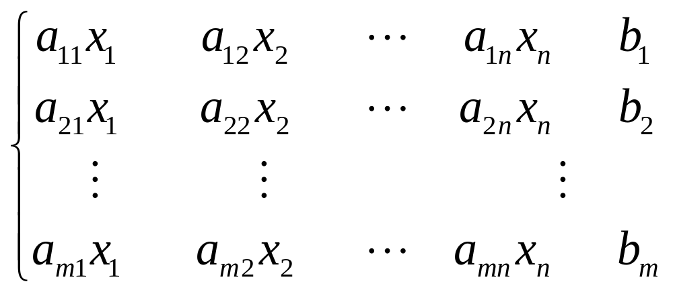
Matrix Notation
A rectangular array --- Matrix 矩阵

Slide 12
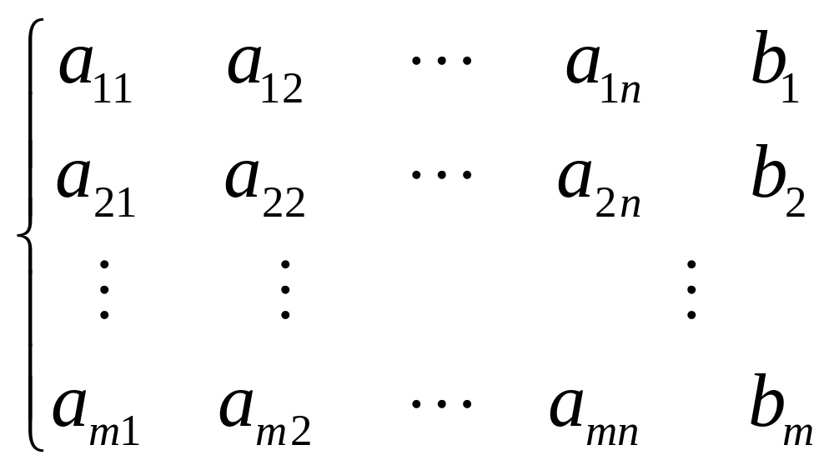
Matrix Notation
A rectangular array --- Matrix 矩阵

Slide 13
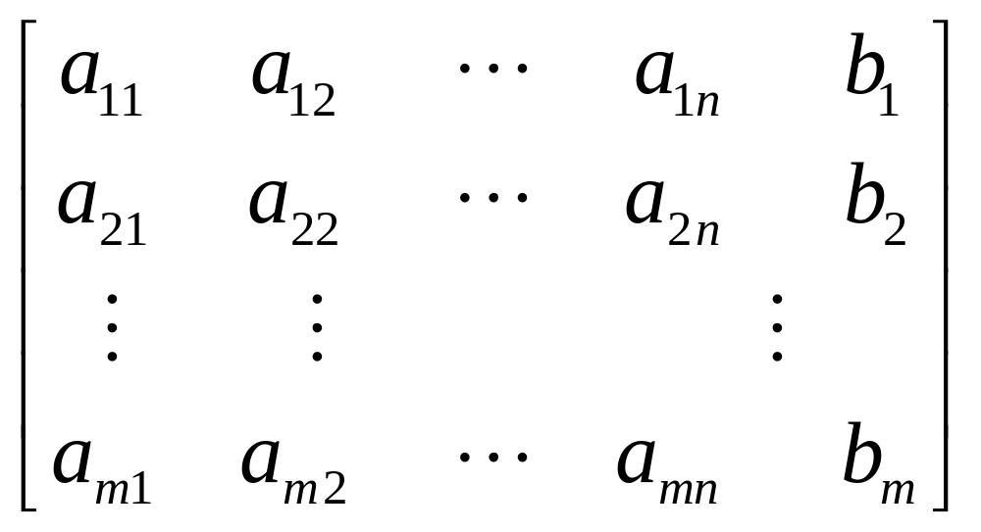
Matrix Notation
A rectangular array --- Matrix 矩阵

Slide 14
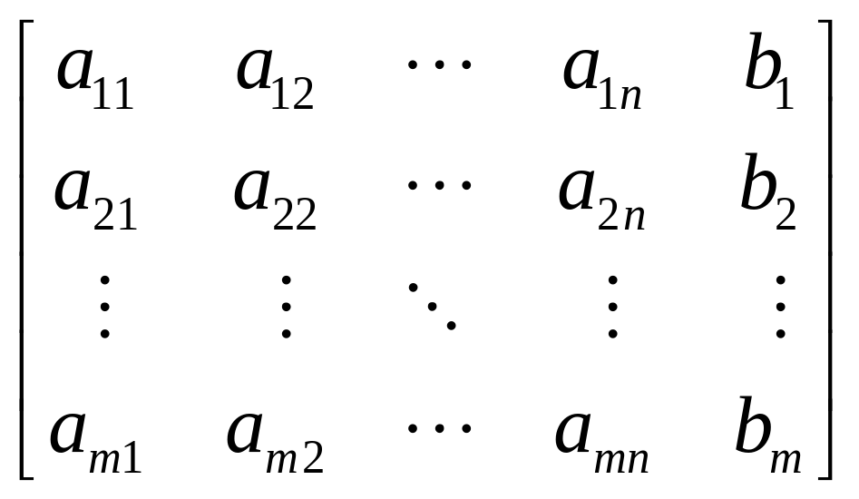
Augmented matrix 增广矩阵

Slide 15
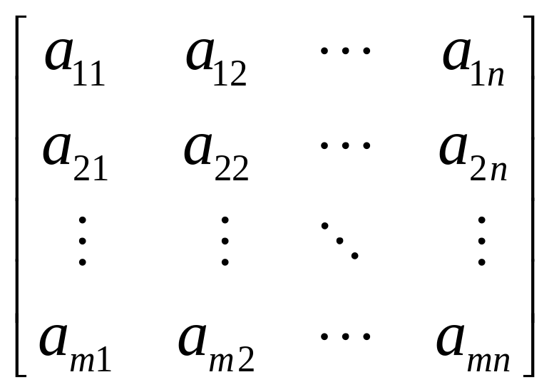
Coefficient matrix ( matrix of coefficients ) 系数矩阵

Slide 16
Size ( of a matrix ) m by n
一个矩阵是m乘n的

Slide 17
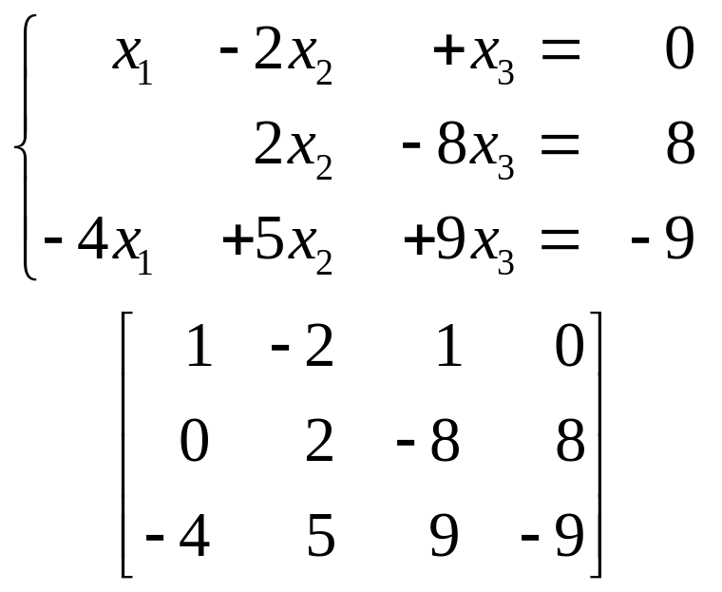
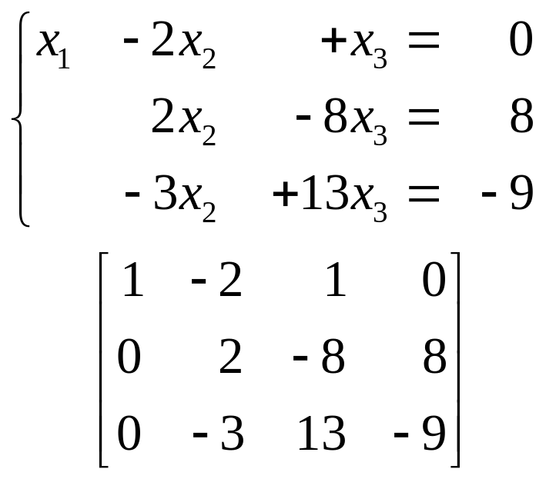
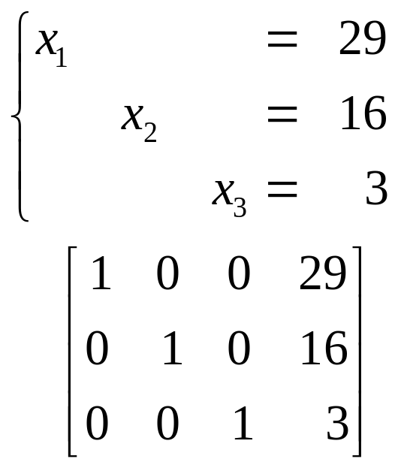
Solving a Linear System
Exp1:
→

Slide 18
Elementary Row Operations
行初等变换
( Replacement ) Replace one row by the sum of itself and a multiple of another row.
( Interchange ) Interchange two rows.
( Scaling ) Multiply all entries in a row by a nonzero constant.
替换 交换 倍乘

Slide 19
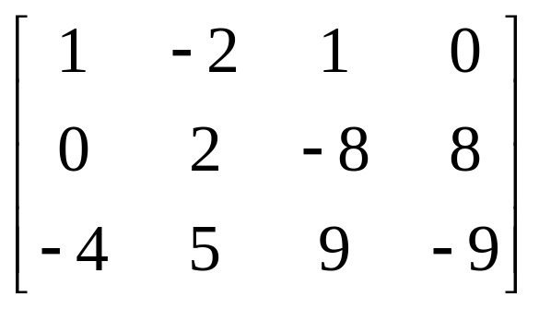
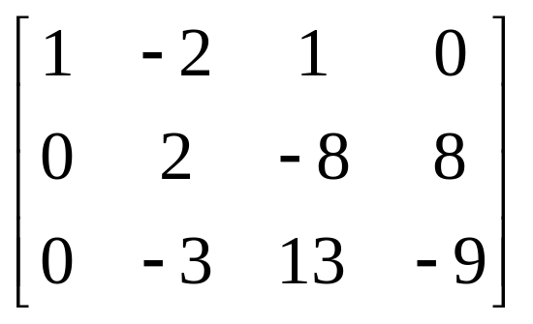
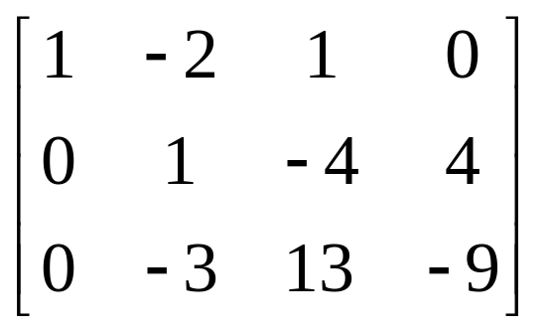
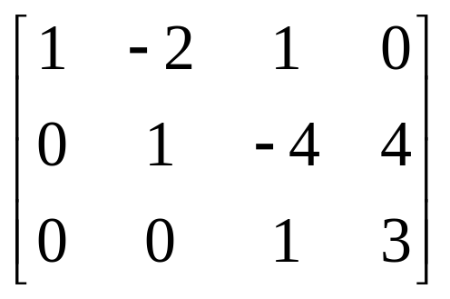
Exp2: Determine if
is consistent.
Solution：
→
→
..….
→
→

Slide 20
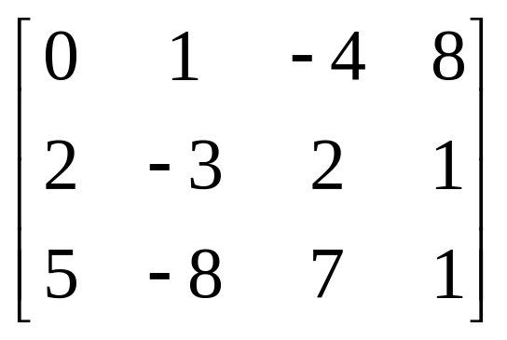
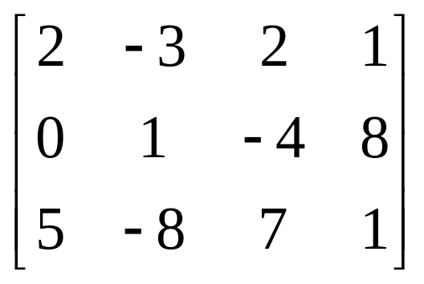
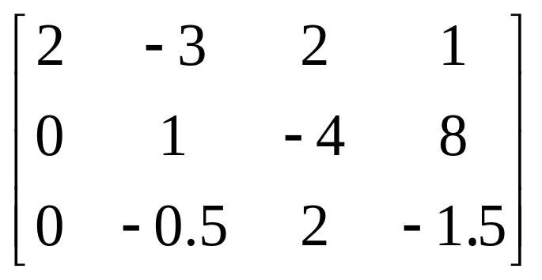
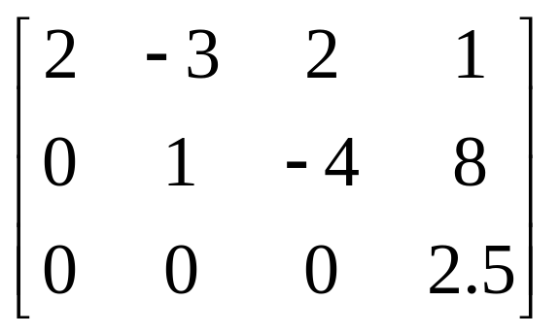
Exp3: Determine if
is consistent.
Solution:
→
→
→
… …

Slide 21
Homework:
Exercise1.1 2, 6, 12, 32

