Slide 1
Linear Equations
1.1 System of linear Equations
1.2 Row Reduction and Echelon Forms
1.3 Vector Equations 向量方程
1.4 The Matrix Equation Ax = b 矩阵方程
1.5 Solution Sets of Linear Systems
1.7 Linear Independence 线性无关

Slide 2
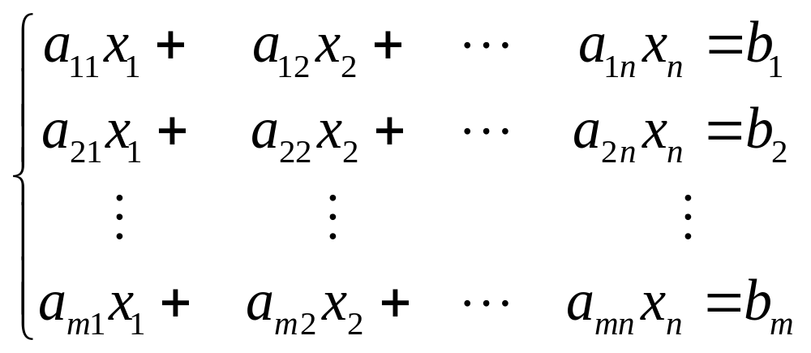
What is a system of linear equations ( linear system ) ? 线性方程组，线性系统

Slide 3
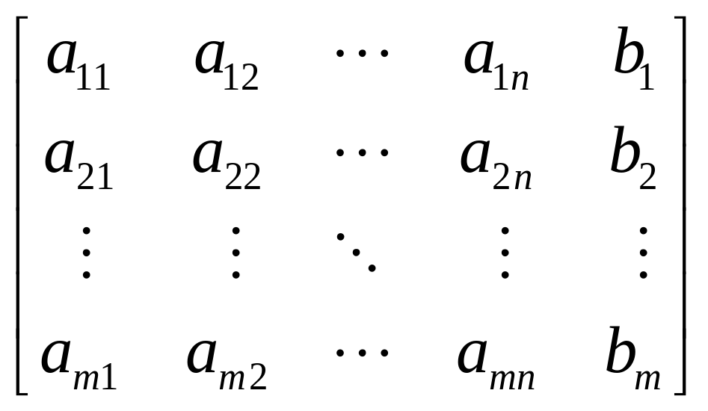
Augmented matrix 增广矩阵

Slide 4
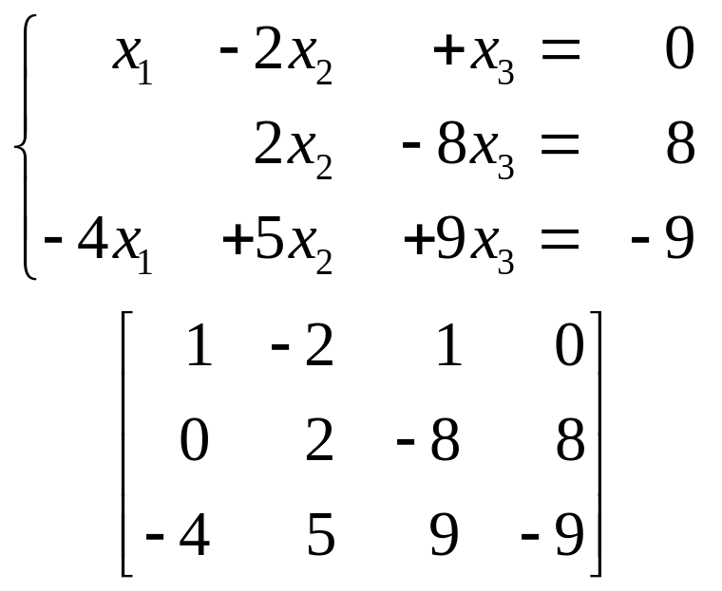
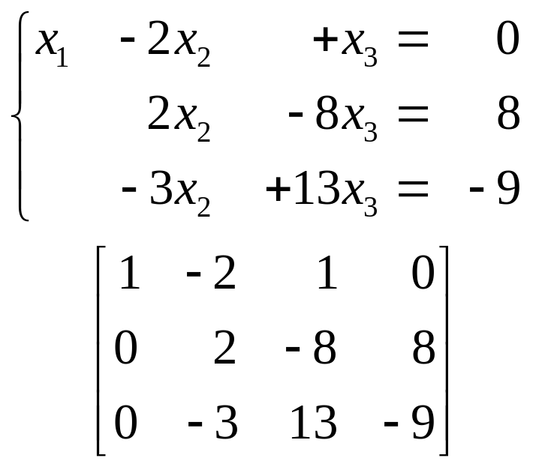
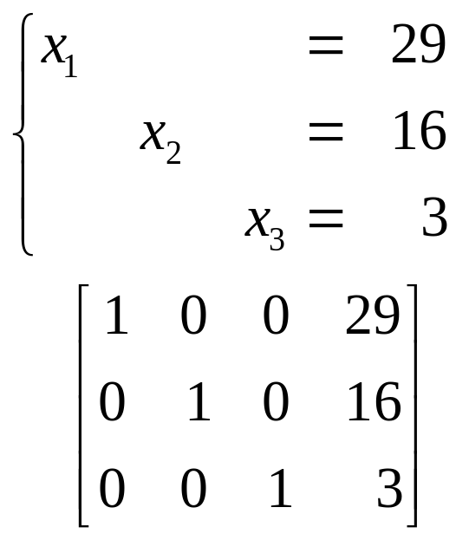
Solving a Linear System
Exp1:
→

Slide 5
Elementary Row Operations
行初等变换
( Replacement ) Replace one row by the sum of itself and a multiple of another row.
( Interchange ) Interchange two rows.
( Scaling ) Multiply all entries in a row by a nonzero constant.
替换 交换 倍乘

Slide 6
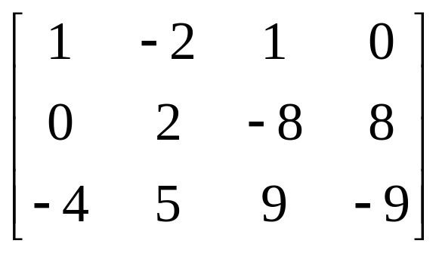
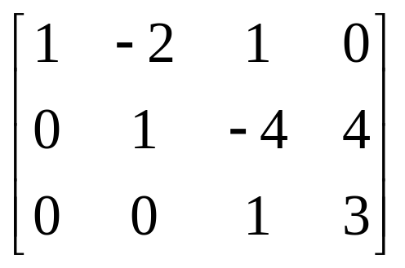
Exp2: Determine if
is consistent.
Solution：
→
..….

Slide 7
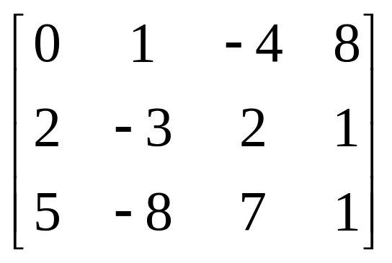
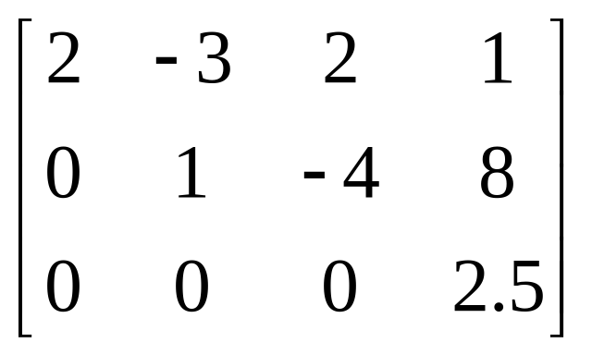
Exp3: Determine if
is consistent.
Solution:
→
… …

Slide 8
1.2 Row Reduction and Echelon Forms
行化简 与 阶梯形
DEFINITION--echelon form ( or row echelon form )
1）All nonzero rows are above any rows of all zeros.
2）Each leading entry of a row is in a column to the right of the leading entry of the row above it. 先导元素
3）All entries in a column below a leading entry are zeros.

Slide 9
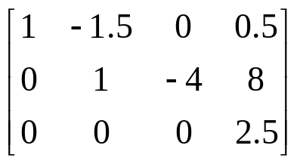
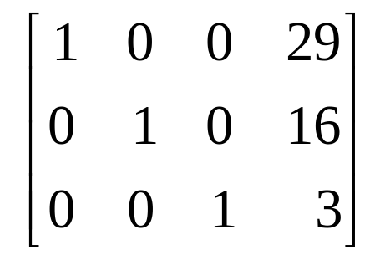
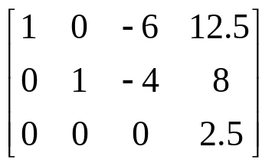
reduced echelon form (or reduced row echelon form) 简化阶梯形
4、The leading entry in each nonzero row is 1
5、Each leading 1 is the only nonzero entry in its column.
Echelon matrix ―― matrix that is in echelon form.

Slide 10
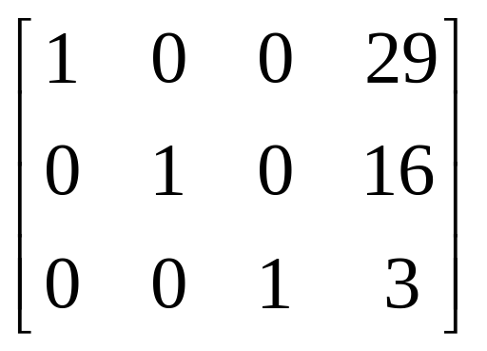
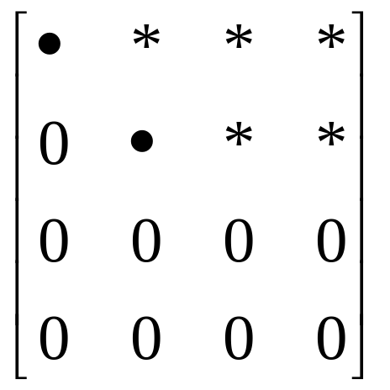
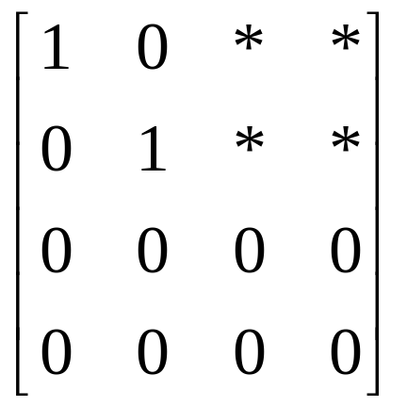
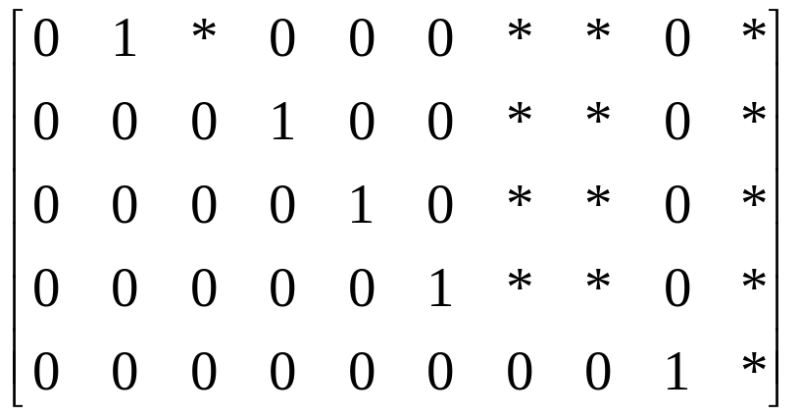

Slide 11
A nonzero matrix →row reduced ( transformed by elementary row oprations) echelon form.
A nonzero matrix →row reduced ( transformed by elementary row oprations) unique reduced echelon form.

Slide 12
THEOREM 1
Each matrix is row equivalent to one and only one reduced echelon form.
an echelon form of matrix A；an reduced echelon form of matrix A.
(RREF)

Slide 13
The leading entries are always in the same positions in any echelon form obtained from a given matrix.
DEFINITION A pivot position (主元位置) in a matrix A is a location in A that corresponds to a leading 1 in the reduced echelon form of A. A pivot column (主元列) is a column of A that contains a pivot position.

Slide 14
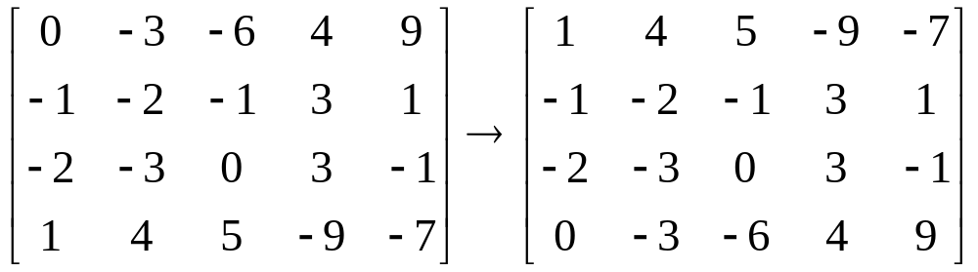
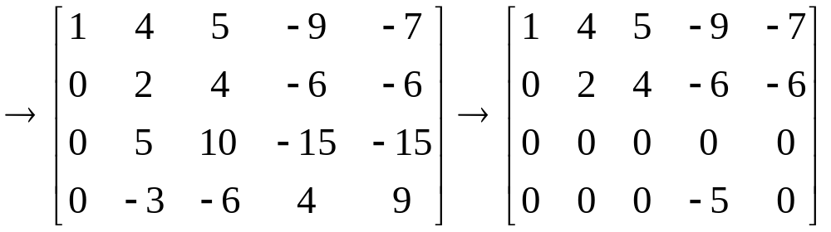
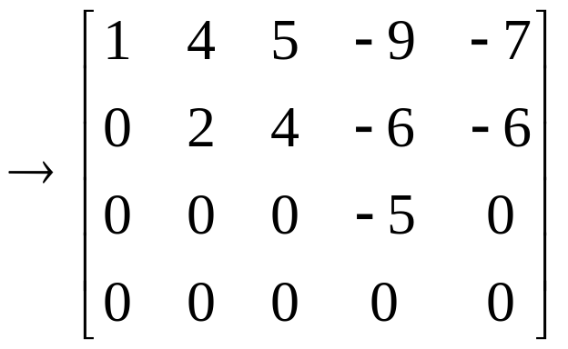
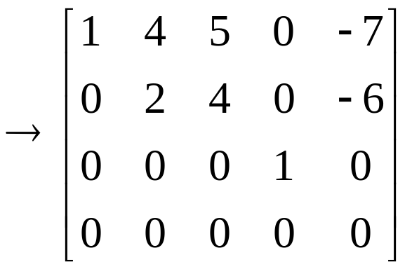
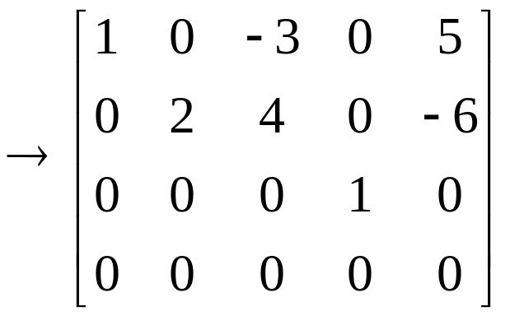

Slide 15
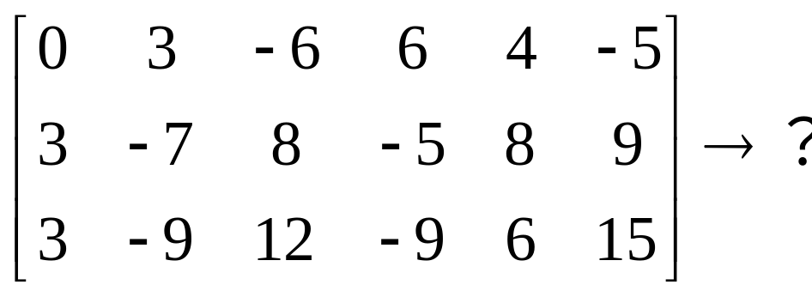
The Row Reduced Algorithm
行简化算法

Slide 16
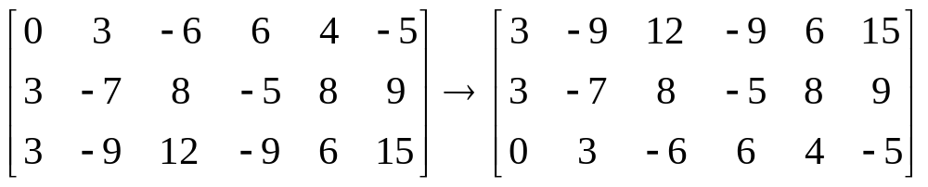
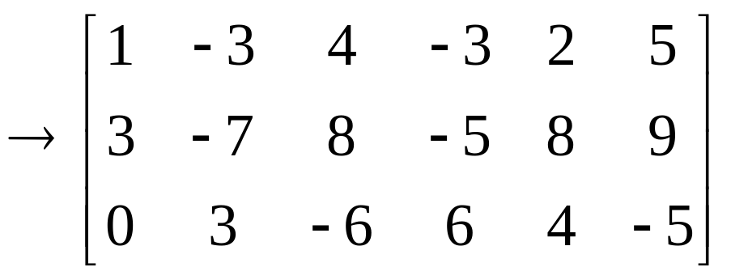
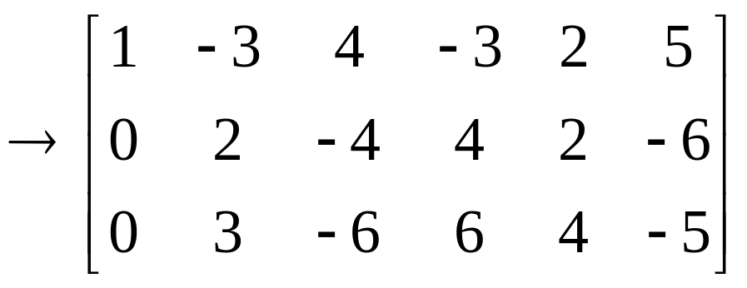
The Row Reduced Algorithm
行简化算法

Slide 17
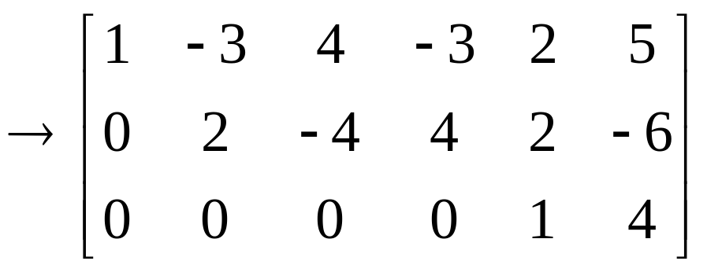
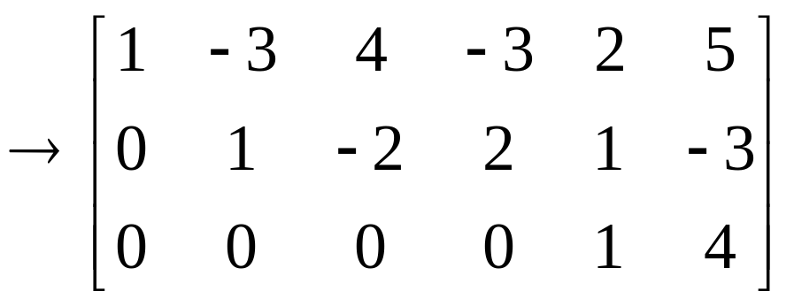
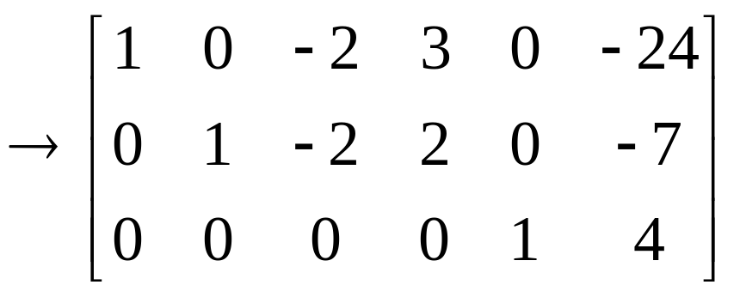
The Row Reduced Algorithm
行简化算法

Slide 18
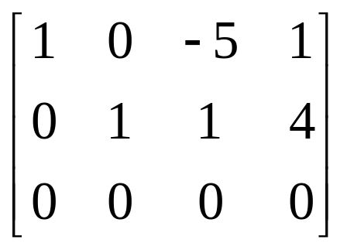
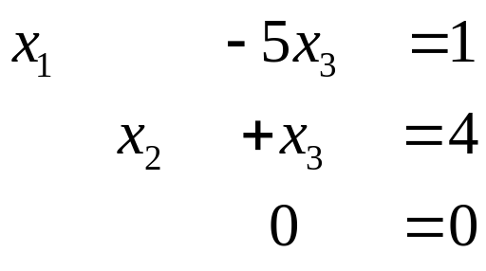
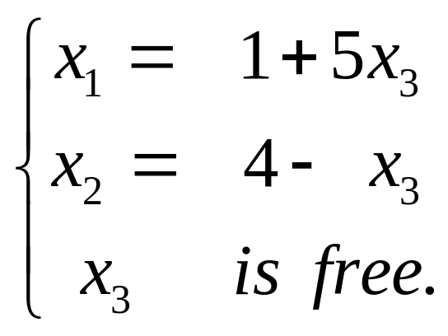
Solution of Linear Systems
⇔
x₁, x₂ → Basic variables, 基本变量
x₃ → free variables ，自由变量
General solution 通解

Slide 19
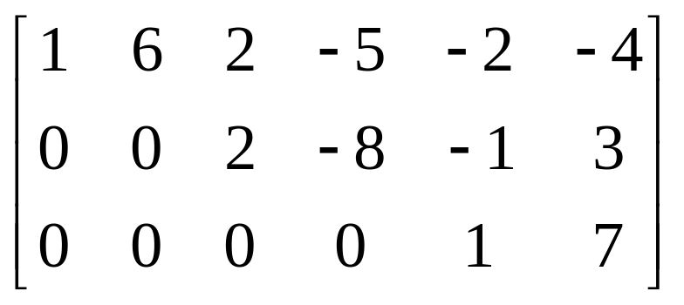
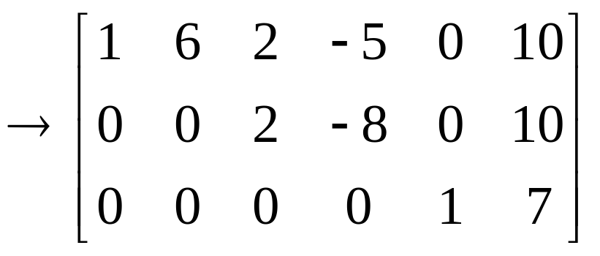
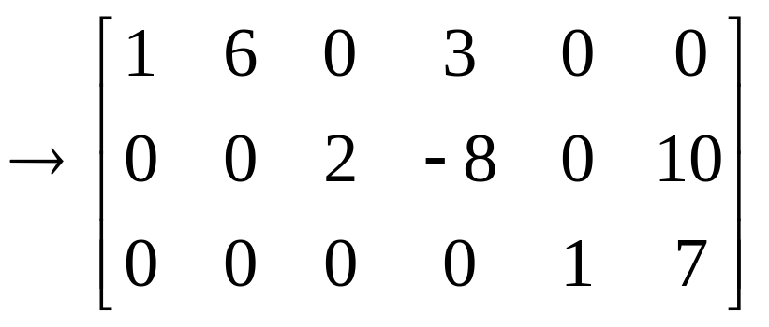
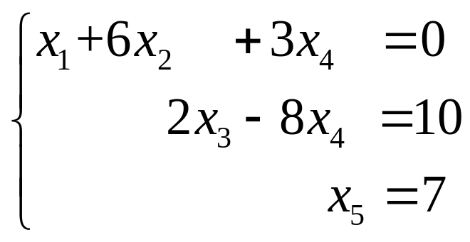
EXAMPLE 4
⇔

Slide 20
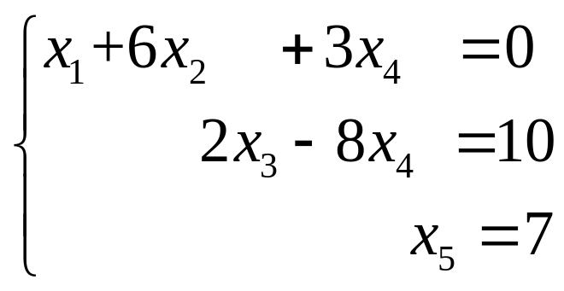
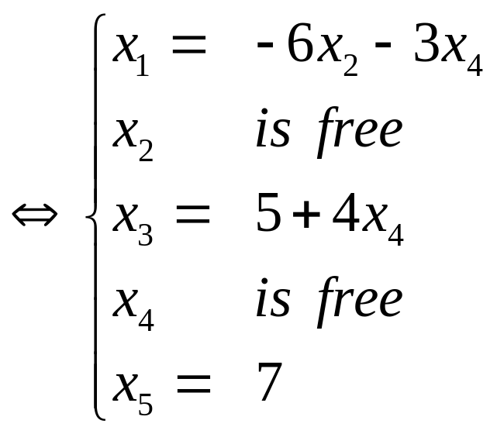
EXAMPLE 4
⇔
Parametric descriptions of solution sets 解集的参数表示

Slide 21
Existence and Uniqueness Questions
存在性和唯一性问题
THEOREM 2
Existence and Uniqueness Theorem
A linear system is consistent if and only if the rightmost column of the augmented matrix is not a pivot column.
If a linear system is consistent, then the solution set contains either (i) a unique solution, when there are no free variables, or (ii) infinity many solutions, when there is at least one free variable.

Slide 22
Using Row Reduction to solve a linear system
Augmented matrix
Echelon form
Reduced echelon form
The system of equations
Rewrite
Homework: 1.2 Exercises 3,4,7,9,15,16

