Slide 1
Linear Equations
1.1 System of linear Equations
1.2 Row Reduction and Echelon Forms
1.3 Vector Equations 向量方程
1.4 The Matrix Equation Ax = b 矩阵方程
1.5 Solution Sets of Linear Systems
1.7 Linear Independence 线性无关

Slide 2
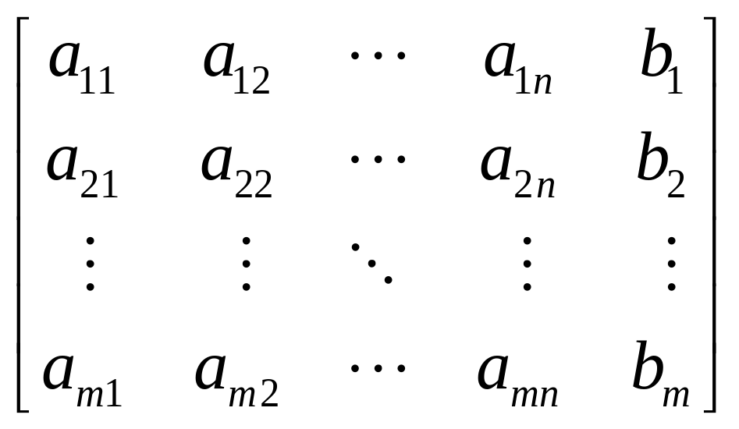
Augmented matrix 增广矩阵

Slide 3
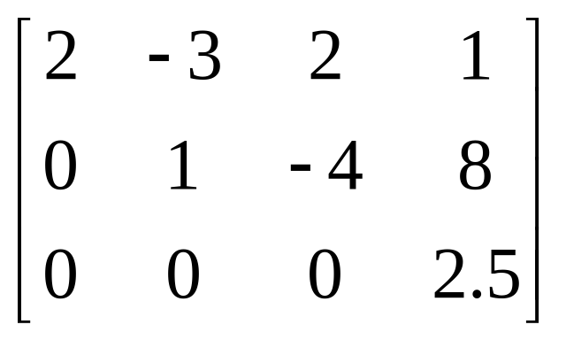
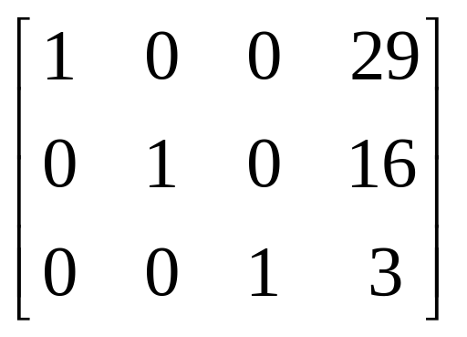
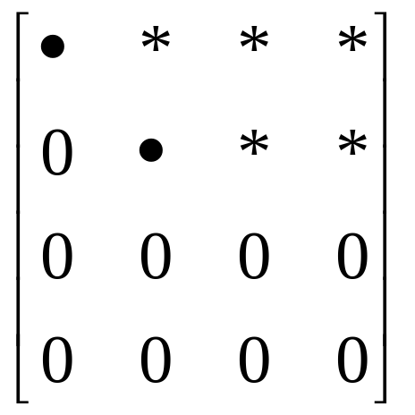
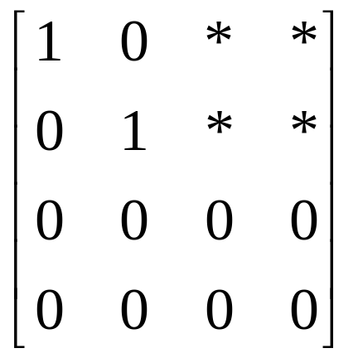
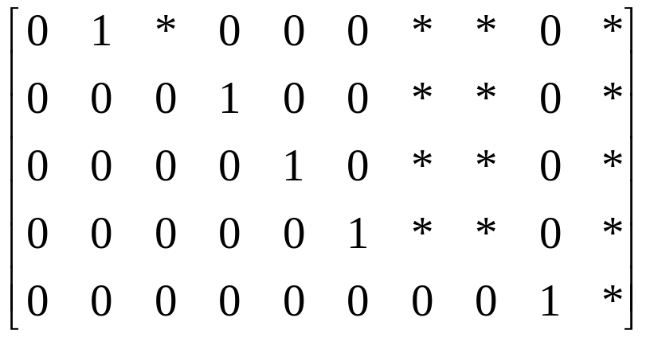

Slide 4
The leading entries are always in the same positions in any echelon form obtained from a given matrix.
DEFINITION A pivot position (主元位置) in a matrix A is a location in A that corresponds to a leading 1 in the reduced echelon form of A. A pivot column (主元列) is a column of A that contains a pivot position.

Slide 5
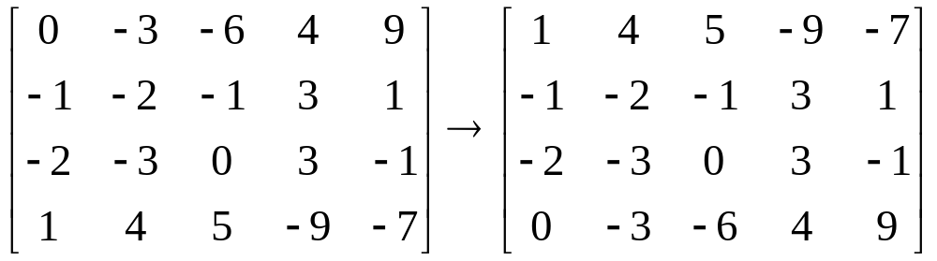
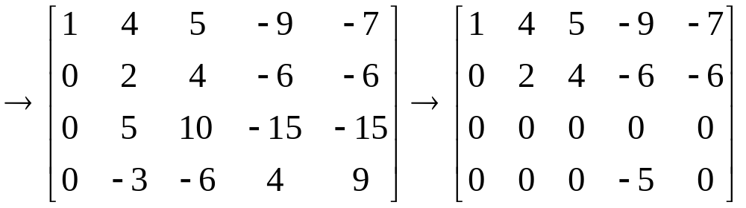
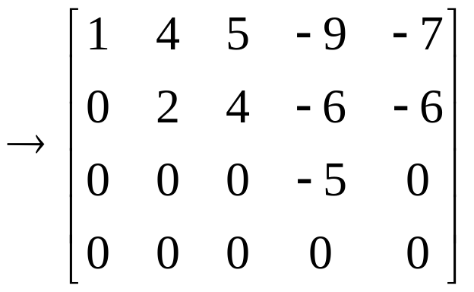
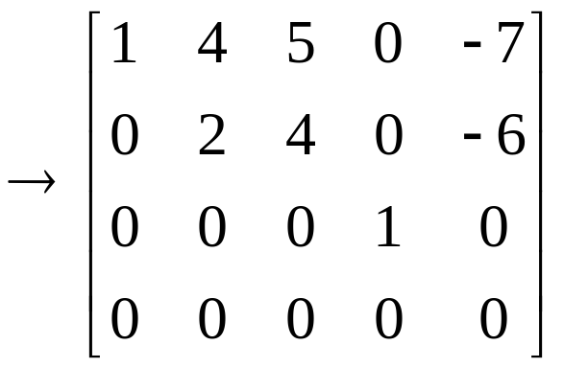
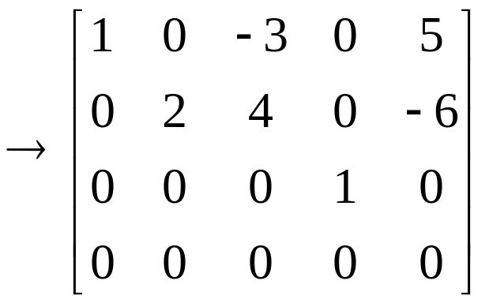

Slide 6
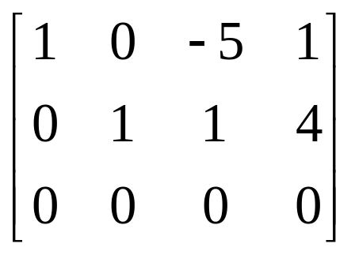
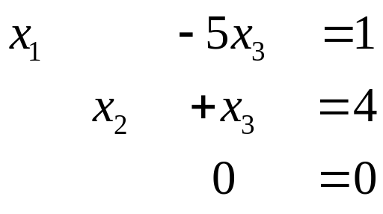
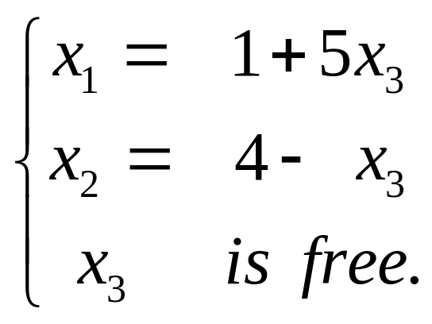
Solution of Linear Systems
⇔
x₁, x₂ → Basic variables, 基本变量
x₃ → free variables ，自由变量
General solution 通解

Slide 7
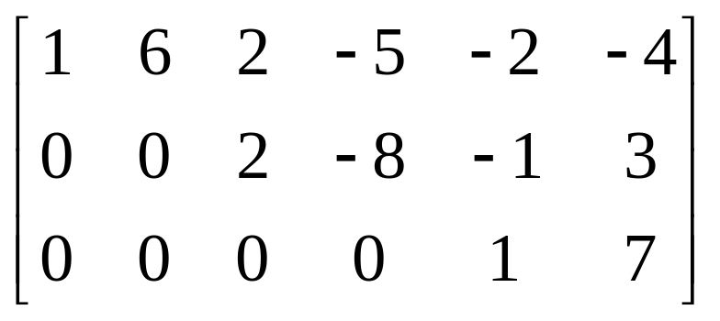
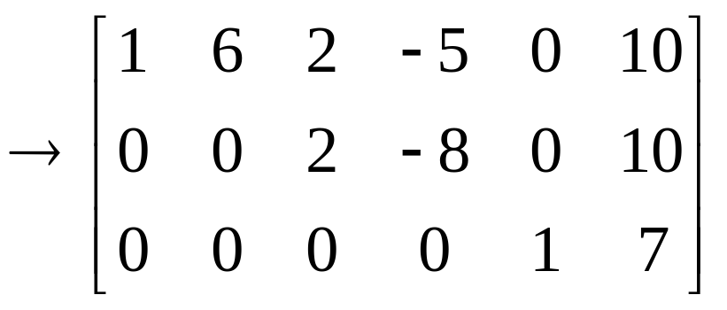
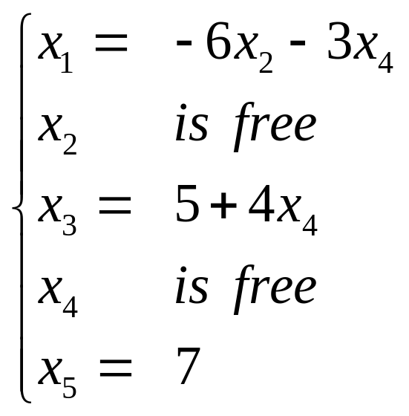
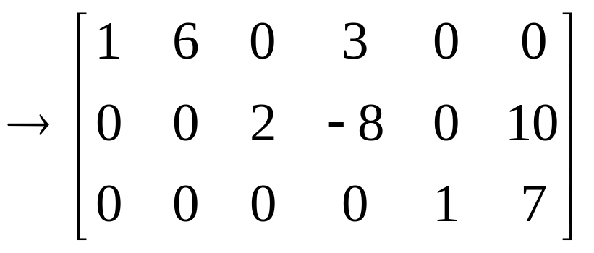
EXAMPLE 4
⇔
Parametric descriptions of solution sets 解集的参数表示

Slide 8
Existence and Uniqueness Questions
存在性和唯一性问题
THEOREM 2
Existence and Uniqueness Theorem
A linear system is consistent if and only if the rightmost column of the augmented matrix is not a pivot column.
If a linear system is consistent, then the solution set contains either (i) a unique solution, when there are no free variables, or (ii) infinity many solutions, when there is at least one free variable.

Slide 9
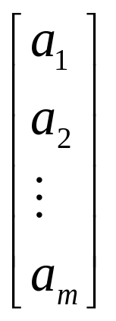
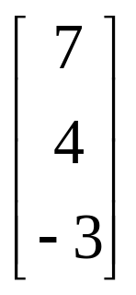
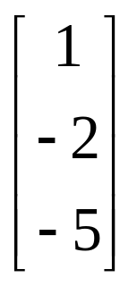
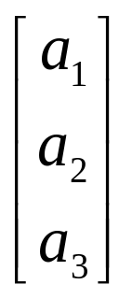
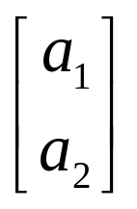
1.3 Vector Equations
A column vector, or, a vector, is a matrix with only one column. 列向量
Row vector (-2, 3.5)， (1, 2，6) ， (a₁, a₂)

Slide 10

Vectors in R²
R² : the set of all vectors with two entries. (ordered pairs, 有序对)
x₂
(1,2)
(0,0)
x₁
(-4,-0.5)
b

Slide 11
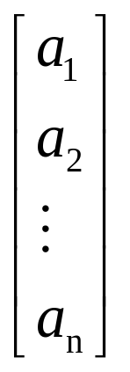
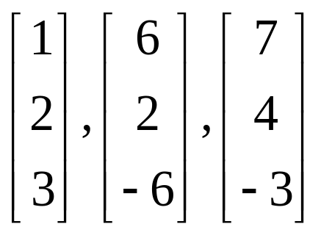
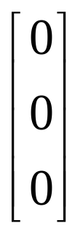
Vectors in R³
Vectors in R^{n} (ordered n-tuples, 有序n元组)
Zero vector

Slide 12
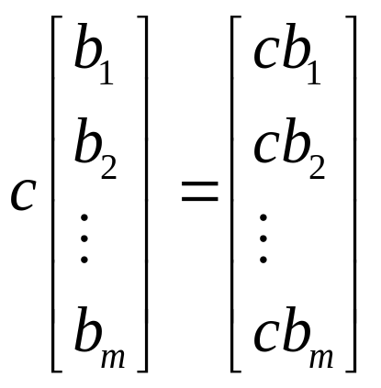
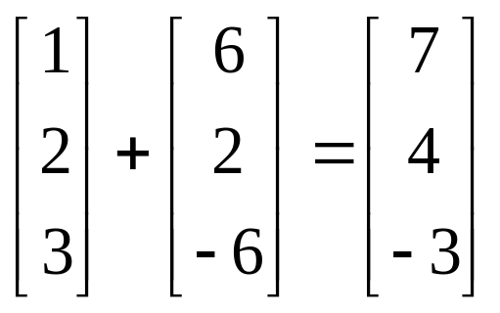
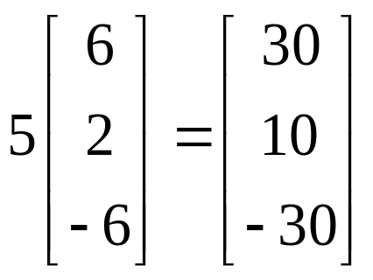
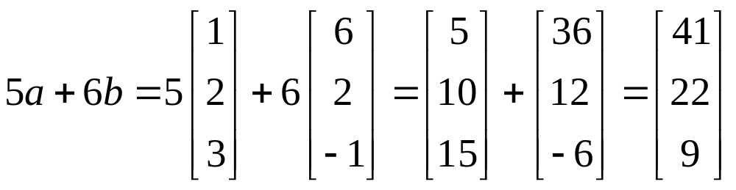


Equal, sum, scalar multiple, scalar multiplication 相等，和，数乘，标量积

Slide 13
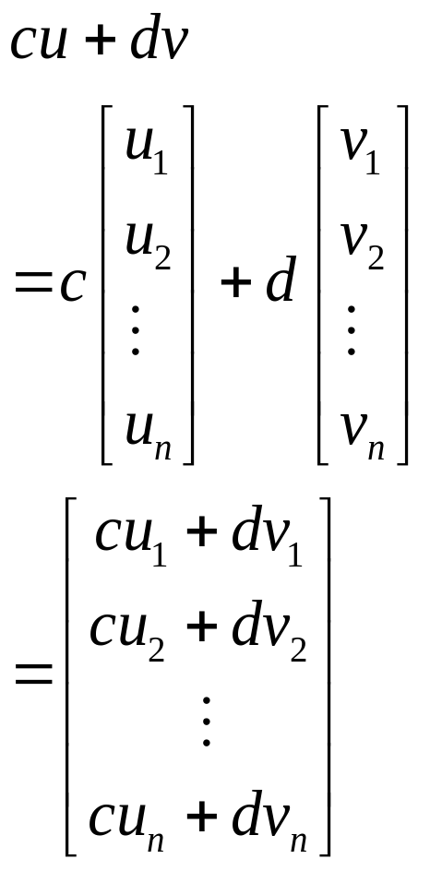
Algebraic properties of R^{n}
For all u, v, w in R^{n} and all scalar c and d:
(i) u + v = v + u
(ii) (u + v) + w = u +( v + w)
(iii) u + 0 = 0 + u = u
(iv) u + ( - u) = - u + u = 0
- u denotes (-1) u
(v) c (u + v) = cu + cv
(vi) (c + d)u = cu + du
(vii) c (du) = (cd)u
(viii) 1u = u
u – v = u + (-v)
u – v = ?

Slide 14
Linear Combinations
线性组合
y = c₁v₁+ c₂v₂+ … + c_{p}v_{p}
is called a linear combination of vectors
v₁, v₂, …, v_{p}
with weights c₁, c₂,…, c_{p}.

Slide 15
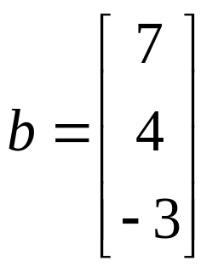
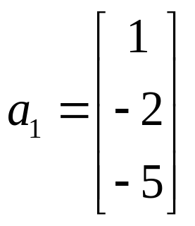
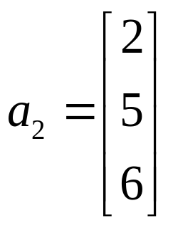
EXAMPLE5
Determine whether
can be generated
as a linear combination of
and
i.e., determine whether weights
x₁ and x₂ exist such that b = x₁a₁+ x₂a₂.

Slide 16
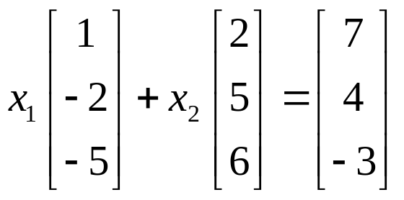
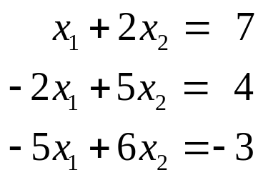
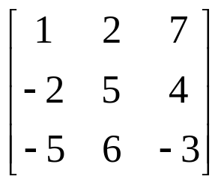
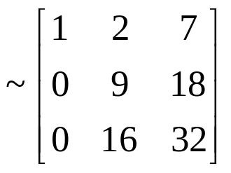
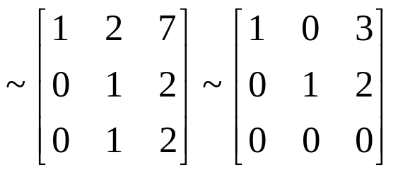
Solution
b = x₁a₁+ x₂a₂
is called a
vector equation.
b = 3a₁+ 2a₂

Slide 17
A vector equation
x₁a₁+ x₂a₂+ … + x_{n}a_{n} = b
has the same solution set as the linear system whose augmented matrix is
[a₁ a₂ … a_{n} b].

Slide 18
b can be generated by a linear combination of
a₁ a₂ … a_{n},
if and only if there exits a solution to the linear system corresponding to
[a₁ a₂ … a_{n} b].

Slide 19
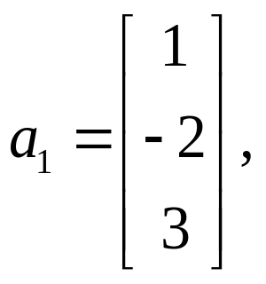
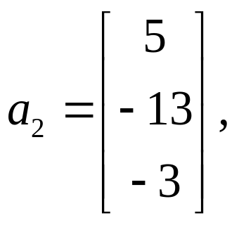
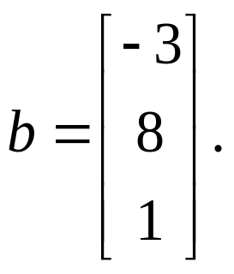
DEFINITION 生成集
Subset of R^{n} spanned by v₁, v₂, …, v_{p} ,
Span{ v₁, v₂, …, v_{p} }
= {b | b = c₁v₁+ c₂v₂+ … + c_{p}v_{p} }
EXAMPLE6
Let
Is b in Span{a₁, a₂}?

Slide 20
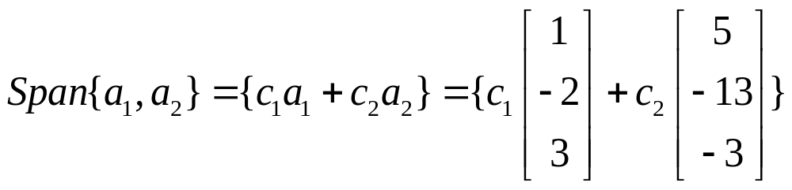
EXAMPLE6
Let
Is b in Span{a₁, a₂}?
Dose the equation b = x₁a₁+ x₂a₂ have a solution?

Slide 21
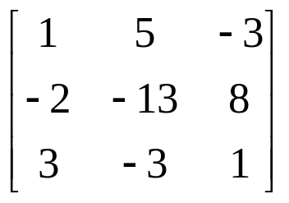
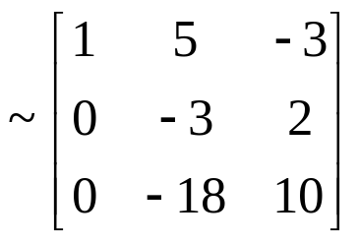
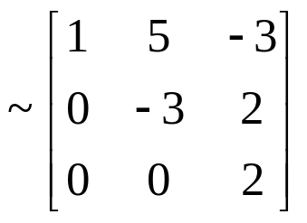
EXAMPLE6
Let
Is b in Span{a₁, a₂}?
Dose the equation b = x₁a₁+ x₂a₂ have a solution?
So b is not in Span{a₁, a₂}.

Slide 22
DEFINITION 生成集
Subset of R^{n} spanned by v₁, v₂, …, v_{p} ,
Span{ v₁, v₂, …, v_{p} }
= {b | b = c₁v₁+ c₂v₂+ … + c_{p}v_{p} }
x₂
(1,2)
(0,0)
x₁
(-4,-0.5)
Homework : 1.3 exercises 2, 5, 10, 12,

