Slide 1
Linear Equations
1.1 System of linear Equations
1.2 Row Reduction and Echelon Forms
1.3 Vector Equations 向量方程
1.4 The Matrix Equation Ax = b 矩阵方程
1.5 Solution Sets of Linear Systems
1.7 Linear Independence 线性无关

Slide 2
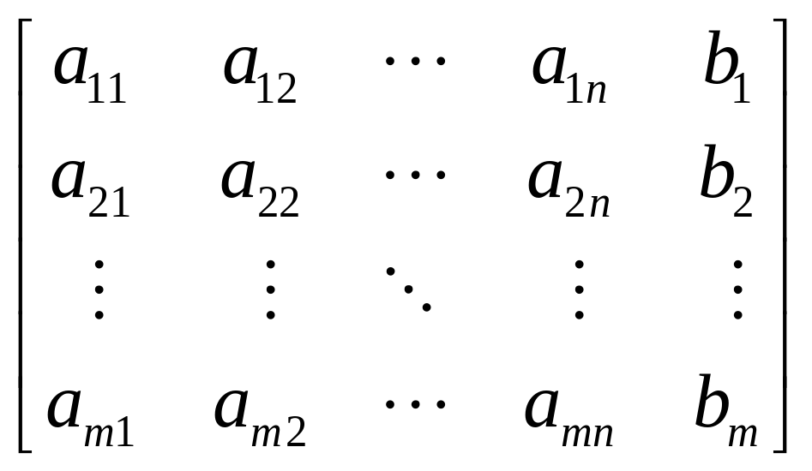
Augmented matrix 增广矩阵

Slide 3
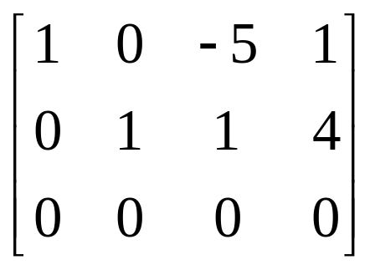
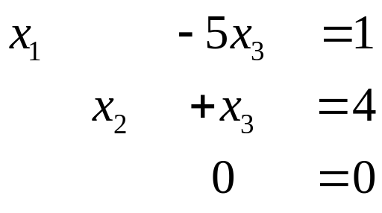
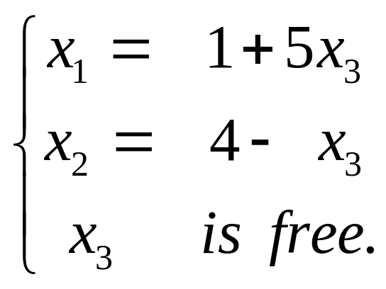
Solution of Linear Systems
⇔
x₁, x₂ → Basic variables, 基本变量
x₃ → free variables ，自由变量
General solution 通解

Slide 4
Algebraic properties of R^{n}
For all u, v, w in R^{n} and all scalar c and d:
(i) u + v = v + u
(ii) (u + v) + w = u +( v + w)
(iii) u + 0 = 0 + u = u
(iv) u + ( - u) = - u + u = 0 - u denotes (-1) u.
(v) c (u + v) = cu + cv
(vi) (c + d)u = cu + du
(vii) c (du) = (cd)u
(viii) 1u = u
u – v = u + (-v)
u – v = ?

Slide 5
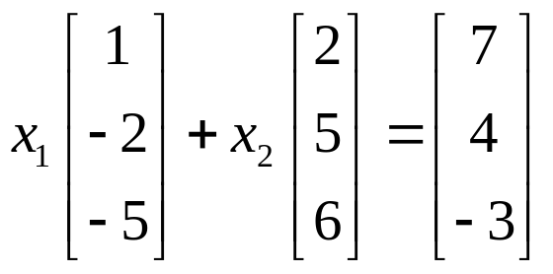
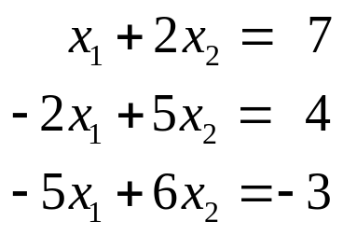
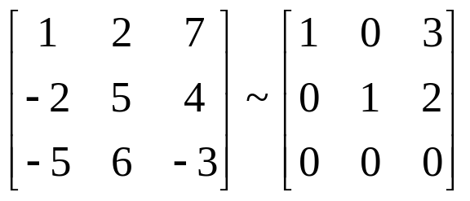
Solution
b = 3a₁+ 2a₂

Slide 6
DEFINITION
Subset of R^{n} spanned by v₁, v₂, …, v_{p} ,
Span{ v₁, v₂, …, v_{p} }
= {b | b = c₁v₁+ c₂v₂+ … + c_{p}v_{p} }
生成集

Slide 7
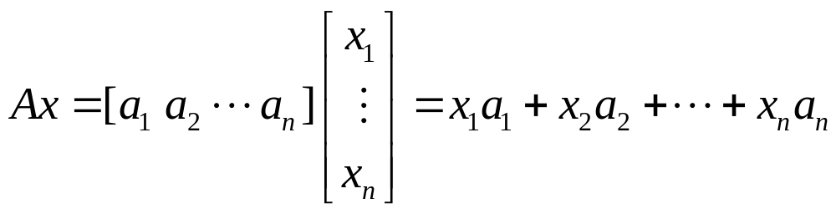
1.4 The Matrix Equation Ax = b
DEFINITION
The product of A and x, is the linear combination of the columns of A using the corresponding entries in x as weights; that is,

Slide 8
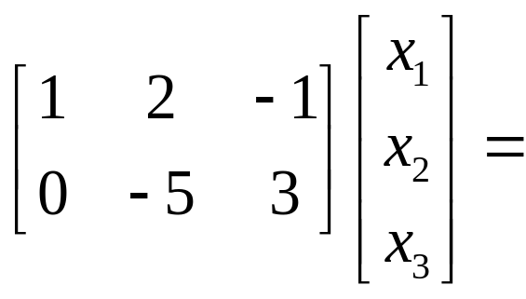
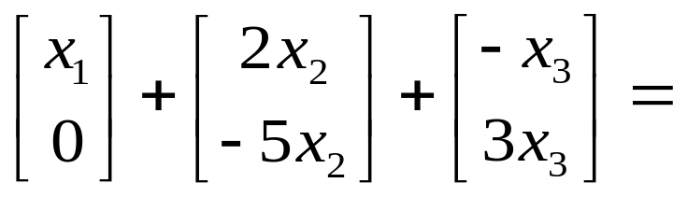
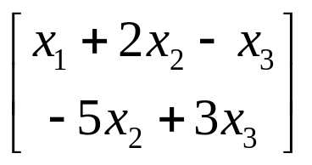
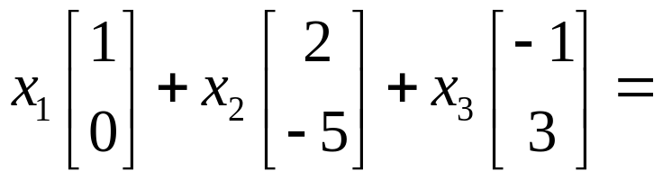
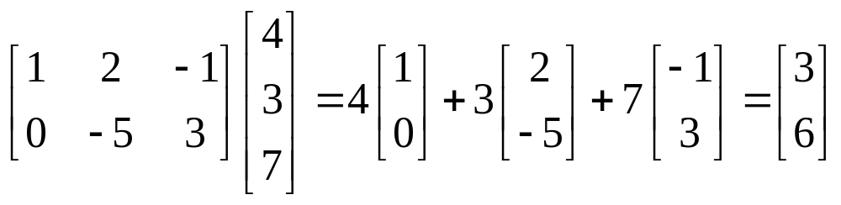
EXAMPLE

Slide 9
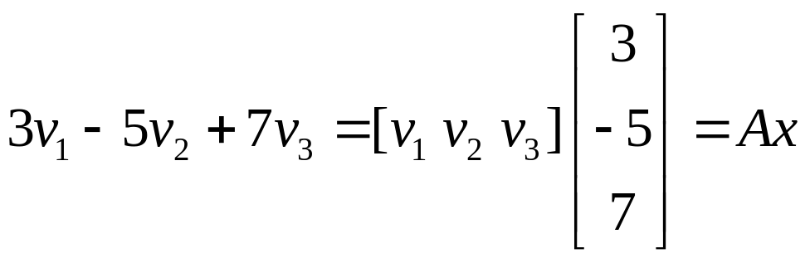
EXAMPLE 2
v₁, v₂, v₃ ∈R^{m} ,

Slide 10
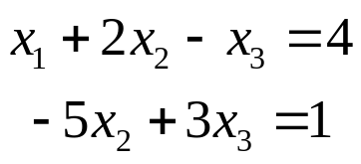
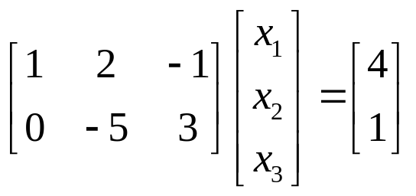
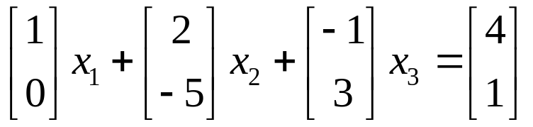
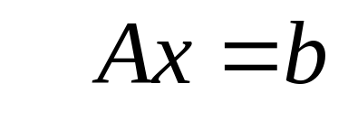
a matrix equation

Slide 11
THEOREM 3
The matrix equation Ax=b has the same solution set as the vector equation
x₁a₁+ x₂a₂+ … + x_{n}a_{n} = b,
which, in turn, has the same solution set as the system of linear equations whose augmented matrix is [a₁ a₂ … a_{n} b].

Slide 12
Existence of Solution
The equation Ax = b has a solution if and only if b is a linear combination of the columns of A.

Slide 13
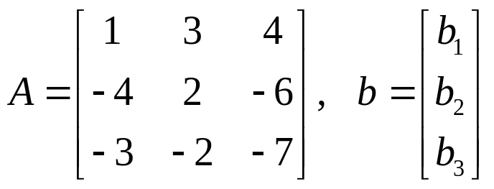
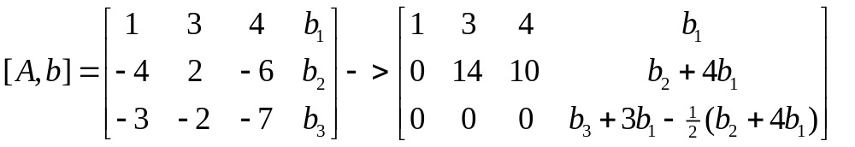
EXAMPLE 3
is the equation Ax=b consistent for all possible b₁, b₂, b₃ ?

Slide 14
THEOREM 4
The following statements are logically equivalent.
a. For each b in R^{m}, the equation Ax = b has a solution.
b. Each b in R^{m} is a linear combination of the column of A.
c. The columns of A span R^{m}.
d. A has a pivot position in every row.

Slide 15
Computation of Ax
(Row-Vector Rule for Computing Ax)
The ith entry in Ax is the sum of the products of corresponding entries from row i of A and from the vector x.

Slide 16
EXAMPLE

Slide 17
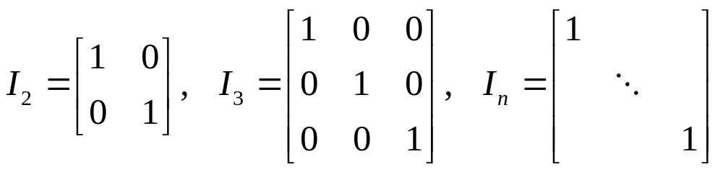
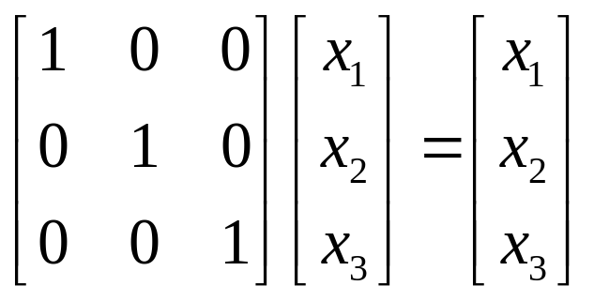
Identity matrix I 单位矩阵
I x = x

Slide 18
Properties of the Matrix-Vector Product Ax
THEROM 5 If A is an m×n matrix, u and v are vectors in R^{n}, then
a. A( u + v ) = Au+Av; b. A(cu)=c(Au).
Homework 1.4 5,6,7,8

