Slide 1
Linear Equations
1.1 System of linear Equations
1.2 Row Reduction and Echelon Forms
1.3 Vector Equations 向量方程
1.4 The Matrix Equation Ax = b 矩阵方程
1.5 Solution Sets of Linear Systems
1.7 Linear Independence 线性无关

Slide 2
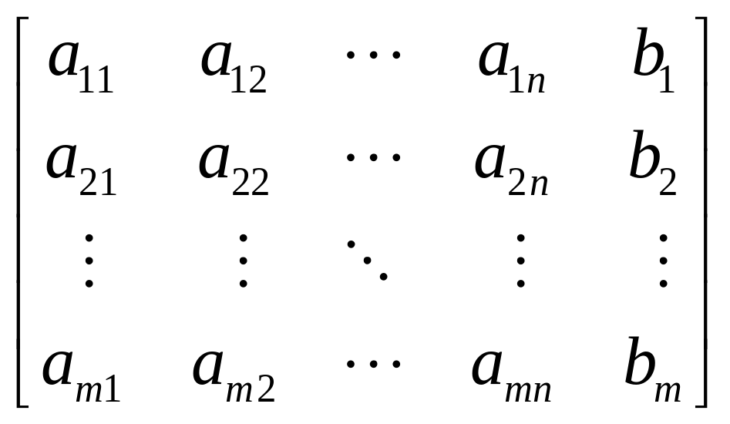
Augmented matrix 增广矩阵

Slide 3
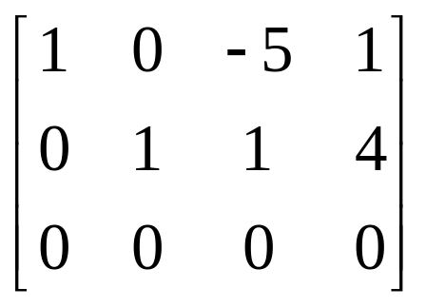
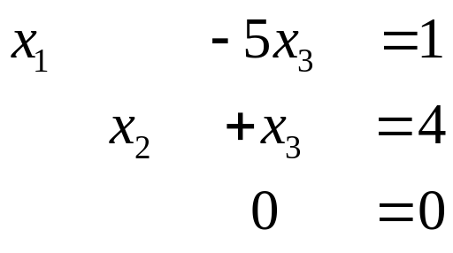
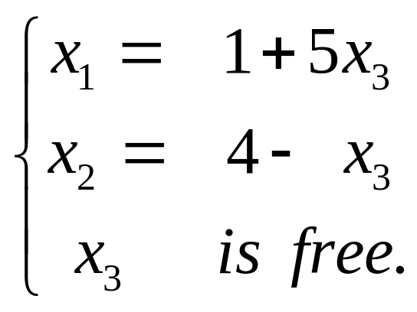
Solution of Linear Systems
⇔
x₁, x₂ → Basic variables, 基本变量
x₃ → free variables ，自由变量
General solution 通解

Slide 4
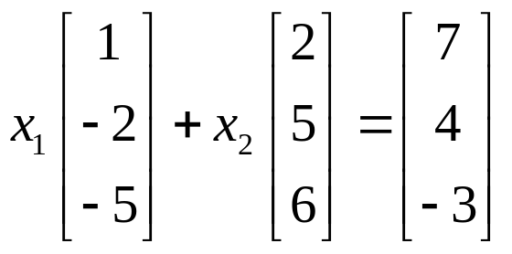
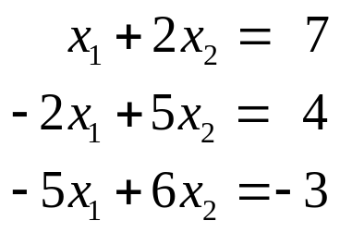
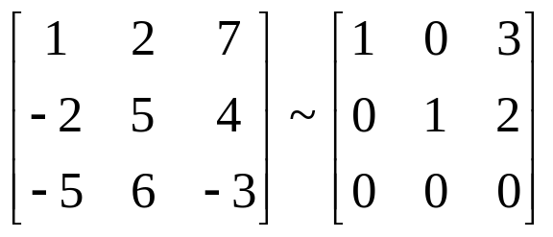
Solution
b = 3a₁+ 2a₂

Slide 5
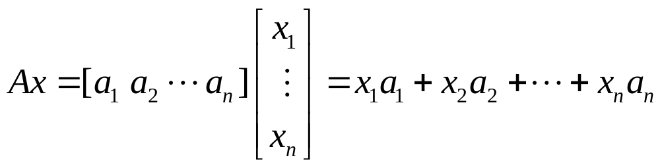
1.4 The Matrix Equation Ax = b
DEFINITION
The product of A and x, is the linear combination of the columns of A using the corresponding entries in x as weights; that is,

Slide 6
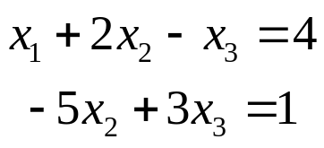
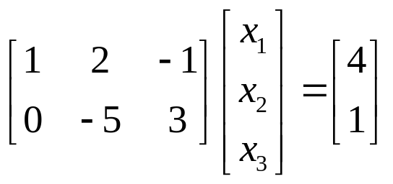
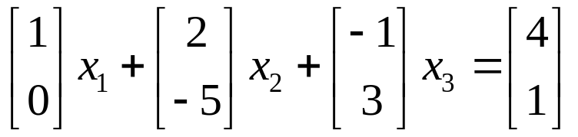
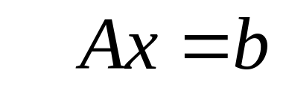
a matrix equation

Slide 7
THEOREM 3
The matrix equation Ax=b has the same solution set as the vector equation
x₁a₁+ x₂a₂+ … + x_{n}a_{n} = b,
which, in turn, has the same solution set as the system of linear equations whose augmented matrix is [a₁ a₂ … a_{n} b].

Slide 8
Existence of Solution
The equation Ax = b has a solution if and only if b is a linear combination of the columns of A.

Slide 9
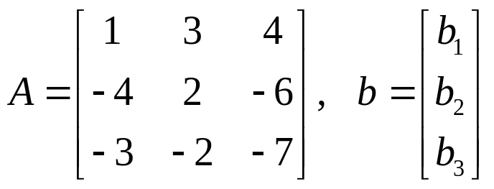
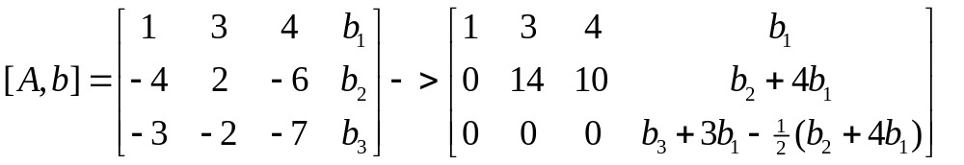
EXAMPLE 3
is the equation Ax=b consistent for all possible b₁, b₂, b₃ ?

Slide 10
THEOREM 4
The following statements are logically equivalent.
a. For each b in R^{m}, the equation Ax = b has a solution.
b. Each b in R^{m} is a linear combination of the column of A.
c. The columns of A span R^{m}.
d. A has a pivot position in every row.

Slide 11
Computation of Ax
(Row-Vector Rule for Computing Ax)
The ith entry in Ax is the sum of the products of corresponding entries from row i of A and from the vector x.

Slide 12
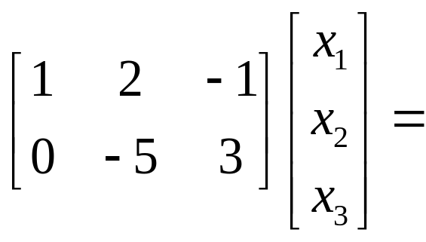
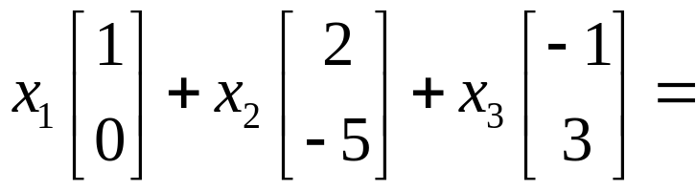
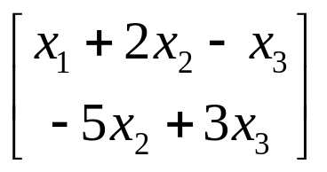
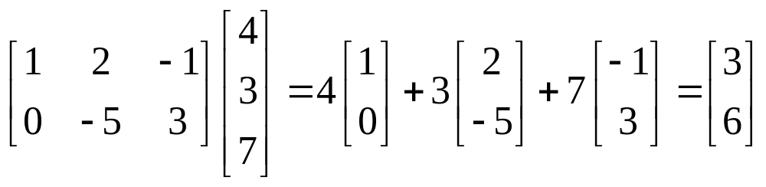
EXAMPLE

Slide 13
Properties of the Matrix-Vector Product Ax
THEROM 5 If A is an m×n matrix, u and v are vectors in R^{n}, then
a. A( u + v ) = Au+Av; b. A(cu)=c(Au).
Homework 1.4 5,6,7,8

Slide 14
1.5 Solution Sets of Linear Systems
Homogeneous Linear System
齐次线性方程
Ax = 0
Ax=0 always has at least one solution x = 0 (trivial solution )
Dose Ax=0 have a nontriviall solution?

Slide 15
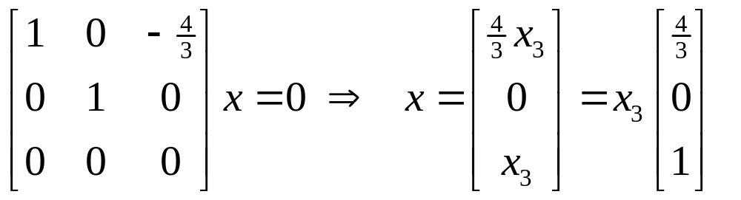
The homogeneous equation Ax=0 has a nontriviall solution if and only if the equation has at least one free variable.

Slide 16

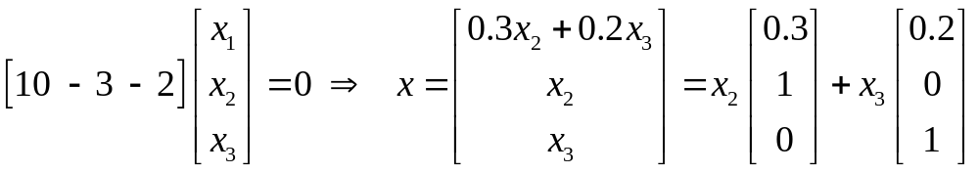
The solution set of Ax=0
can always be expressed explicitly as
Span{v₁, v₂, … , v_{p}} for suitable vectors v₁, v₂, … , v_{p}.

Slide 17
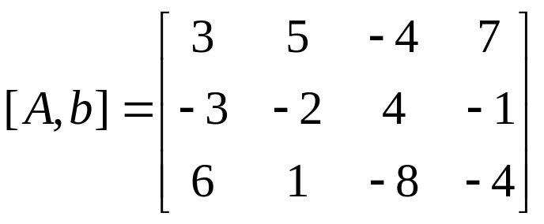
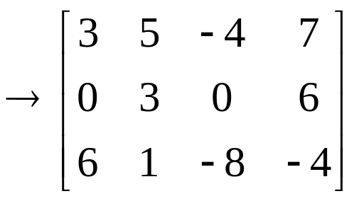
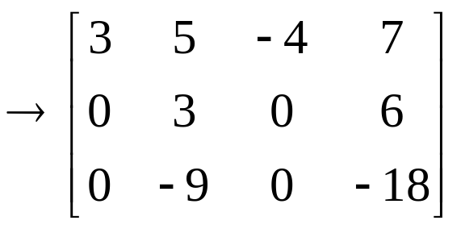
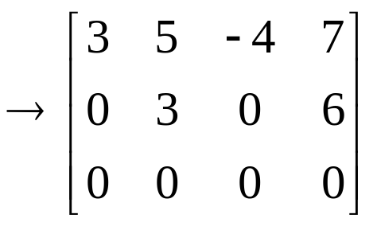
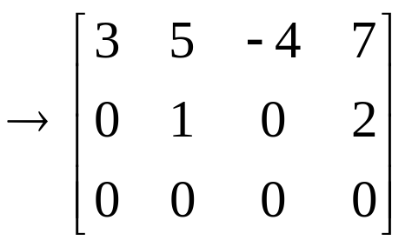
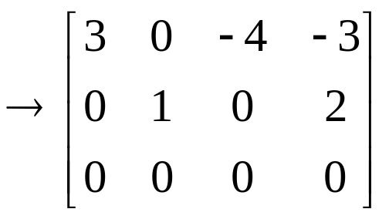
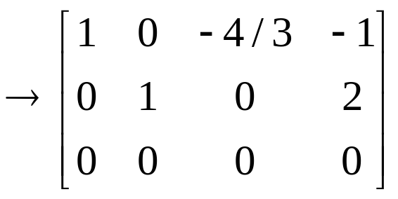
Solution of Nonhomogeneous Systems
What is Nonhomogeneous Systems ?
Ax = b, b ≠ 0

Slide 18
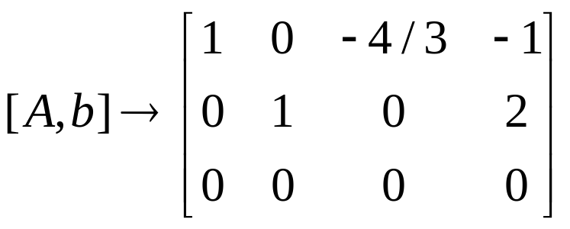
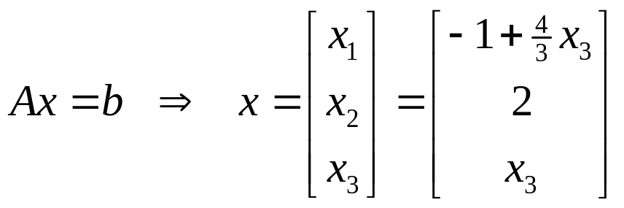
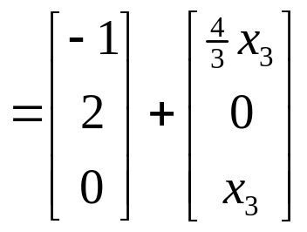
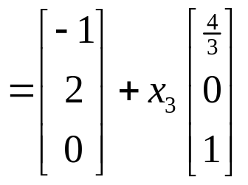

Slide 19
THEOREM 6
Suppose Ax = b is consistent, and let p be a solution. Then the solution set of Ax = b is the set of all vectors of the form
w = p + v_{h} ,
where v_{h} is any solution of the homogeneous equation Ax = 0.

Slide 20
Homework 1.5 2,4,6,17(just give the solution)

