Slide 1
Linear Equations
1.1 System of linear Equations
1.2 Row Reduction and Echelon Forms
1.3 Vector Equations 向量方程
1.4 The Matrix Equation Ax = b 矩阵方程
1.5 Solution Sets of Linear Systems
1.7 Linear Independence 线性无关

Slide 2
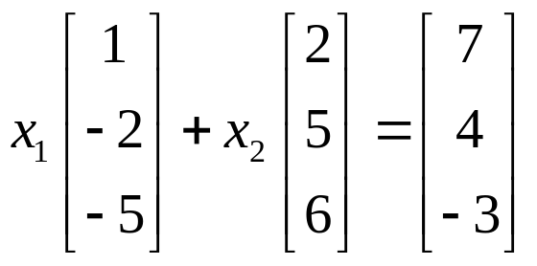
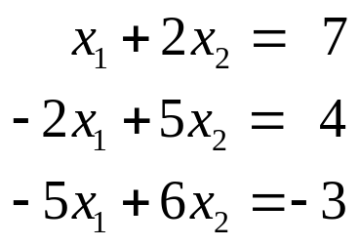
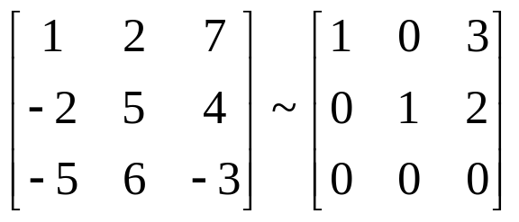
Solution
b = 3a₁+ 2a₂

Slide 3
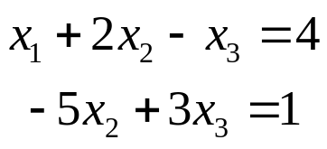
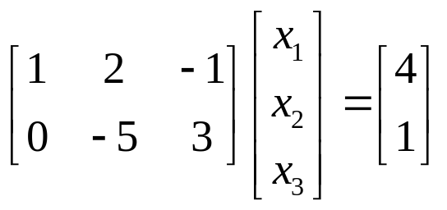
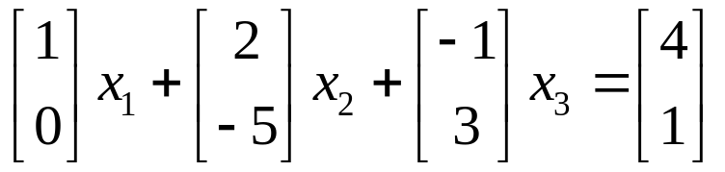
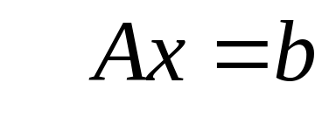
a matrix equation

Slide 4
THEOREM 4
The following statements are logically equivalent.
a. For each b in R^{m}, the equation Ax = b has a solution.
b. Each b in R^{m} is a linear combination of the column of A.
c. The columns of A span R^{m}.
d. A has a pivot position in every row.

Slide 5

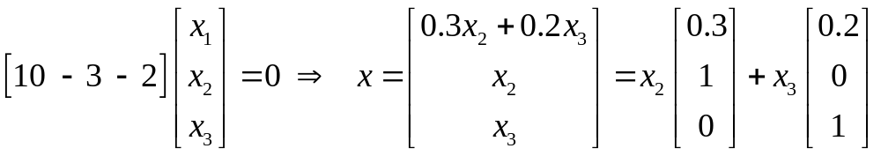
The solution set of Ax=0
can always be expressed explicitly as
Span{v₁, v₂, … , v_{p}} for suitable vectors v₁, v₂, … , v_{p}.

Slide 6
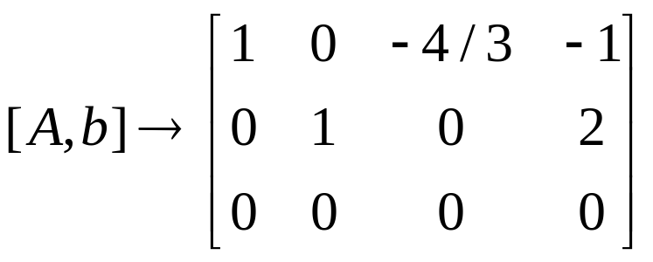
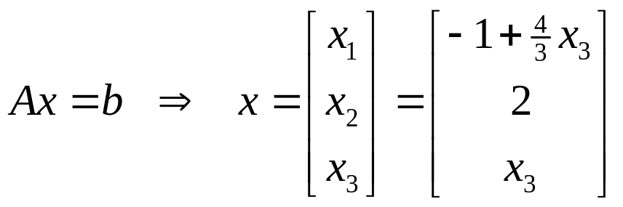
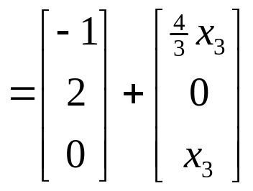
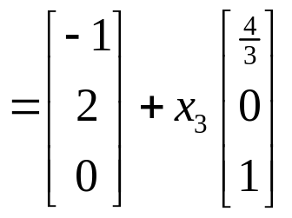

Slide 7
THEOREM 6
Suppose Ax = b is consistent, and let p be a solution. Then the solution set of Ax = b is the set of all vectors of the form
w = p + v_{h} ,
where v_{h} is any solution of the homogeneous equation Ax = 0.

Slide 8
1.7 Linear Independence
线性无关
DEFINITION
A set {v₁, v₂, … , v_{p}} in R^{n} is said to be
linearly independent
if the vector equation
x₁v₁+ x₂v₂+ … + x_{p}v_{p}=0
has only the trivial solution.
The set {v₁, v₂, … , v_{p}} is said to be
linearly dependent
if there exist weights c₁, c₂, …, c_{p}, not all zero,
such that
c₁v₁+ c₂v₂+ … + c_{p}v_{p}=0.

Slide 9
A set is linearly dependent if and only if it is not linearly independent.
不是“线性独立”
没有“线性有关”这个词，应该是“线性相关”

Slide 10
Linear dependence relation, 线性相关关系
c₁v₁+ c₂v₂+ … + c_{p}v_{p}=0
linearly dependent set, 线性相关组
{v₁, v₂, … , v_{p}} is linearly dependent
linearly independent set 线性无关组
{v₁, v₂, … , v_{p}} is linearly independent

Slide 11
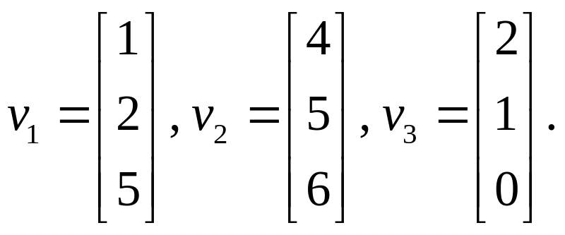
EXAMPLE 1
Let
a. Determine if the set {v₁, v₂, v₃} is linearly independent.
b. If possible, find a linear dependence relation among v₁, v₂, v₃.

Slide 12
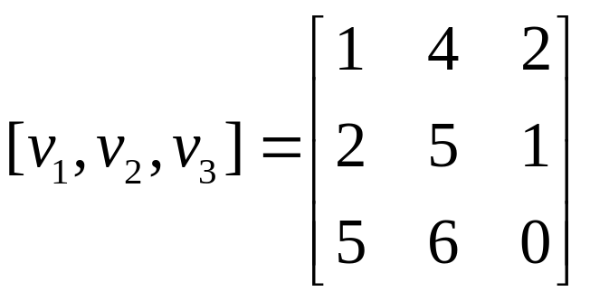
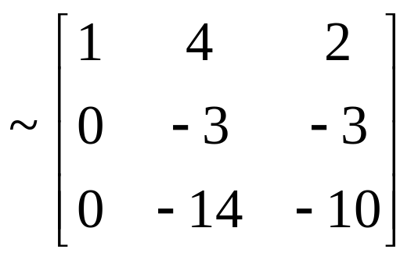

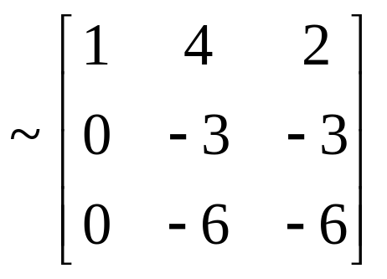
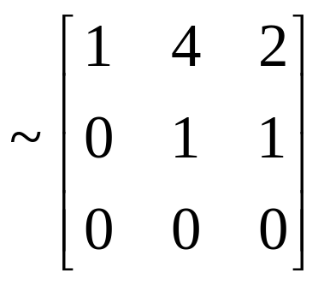
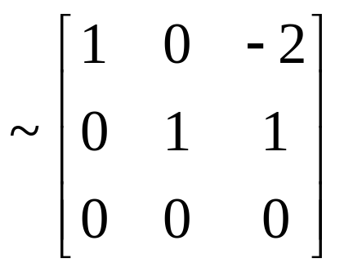
DOES x₁v₁+ x₂v₂+ x₃v₃=0
has only the trivial solution?
2v₁-v₂+v₃=0

Slide 13
Linear Independence of Matrix Columns
The columns of a matrix A are
linearly independent
if and only if
the equation
Ax=0
has only the trivial solution.
Ax=0 ⇔ A₁x₁+ A₂x₂+…+ A_{n}x_{n}+=0

Slide 14
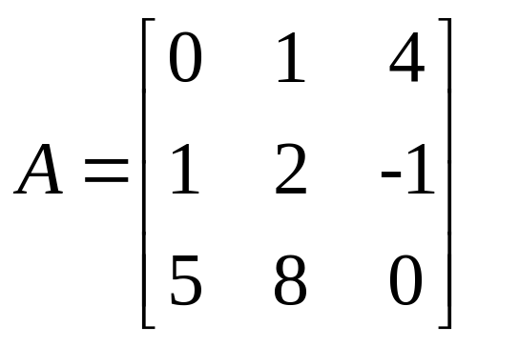
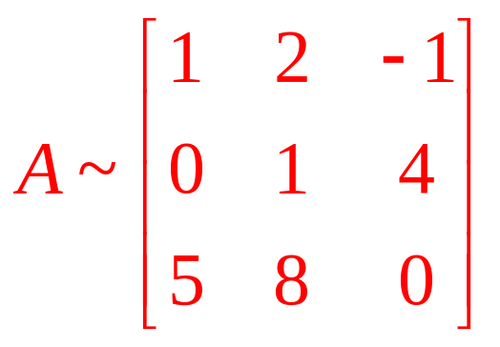
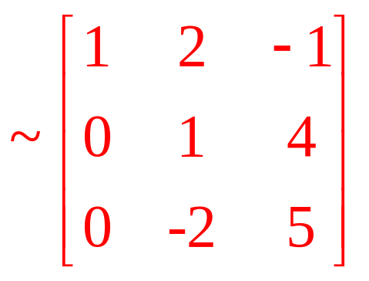
EXAMPLE 2
Determine if the column of the matrix
are linearly independent.

Slide 15
Sets of One or Two Vectors
A set containing only one vector – say, v – is linearly independent if and only if v is not the zero vector.
A set of two vectors {v₁, v₂} is linearly dependent if at least one of the vectors is a multiple of the other. The set is linearly independent if and only if neither of the vectors is a multiple of the other.

Slide 16
Sets of Two or More Vectors
THEOREM 7
Characterization of Linearly Dependent Sets
A set S={v₁, v₂,…, v_{p}} of two or more vectors is linearly dependent if and only if at least one of the vectors in S is a linear combination of the others.

Slide 17
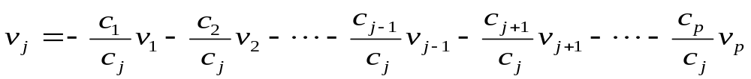
Sets of Two or More Vectors
A set S={v₁, v₂,…, v_{p}} of two or more vectors is linearly dependent if and only if at least one of the vectors in S is a linear combination of the others.
⇒：The set {v₁, v₂, … , v_{p}} is linearly dependent , so there exist weights c₁, c₂, …, c_{p}, not all zero, such that c₁v₁+ c₂v₂+ … + c_{p}v_{p}=0.

Slide 18
Sets of Two or More Vectors
THEOREM 7
Characterization of Linearly Dependent Sets
A set S={v₁, v₂,…, v_{p}} of two or more vectors is linearly dependent if and only if at least one of the vectors in S is a linear combination of the others. If S is linearly dependent and v₁≠0,then some v_{j} is a linear combination of the preceding vectors, v₁, v₂,…, v_{j-1}.

Slide 19
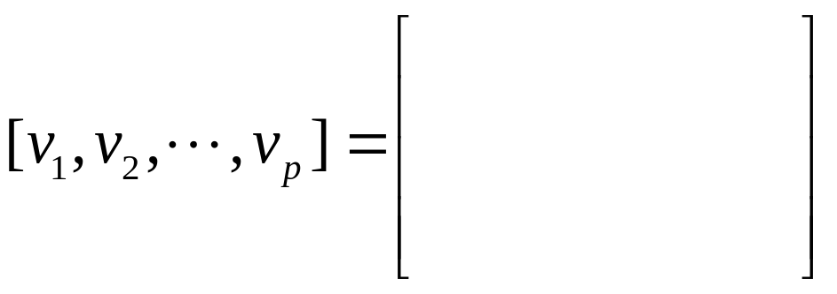
THEOREM 8
If a set contains more vectors than there are entries in each vector, then the set is linearly dependent.
That is, any set {v₁, v₂,…, v_{p}} in R^{n} is linearly dependent if p>n.
x₁v₁+ x₂v₂+ … + x_{p}v_{p}=0

Slide 20
THEOREM 9
If a set S={v₁, v₂,…, v_{p}} in R^{n} contains the zero vector, then the set is linearly dependent.
Homework: Exercise1.7 2, 6, 12, 32
50+ x₁v₁+ x₂v₂+ … + x_{p}v_{p}=0

