Slide 1
Linear Algebra
Chapter 1 Linear Equations 线性方程（组）
Chapter 2 Matrix Algebra 矩阵代数
Chapter 3 Determinants 行列式
Chapter 4 Vector Spaces 向量空间
Chapter 5 Eigenvalues and Eigenvectors
Chapter 6 Orthogonality 特征值、特征向量、正交
Chapter 7 Symmetric Matrices and Quadratic Forms 对称矩阵 和 二次型

Slide 2
Chapter 2 Matrix Algebra
2.1 Matrix operations 矩阵运算
2.2 The inverse of matrix 矩阵的逆
2.3 Characterizations of invertible matrices
2.4 Partitioned Matrices 分块矩阵

Slide 3
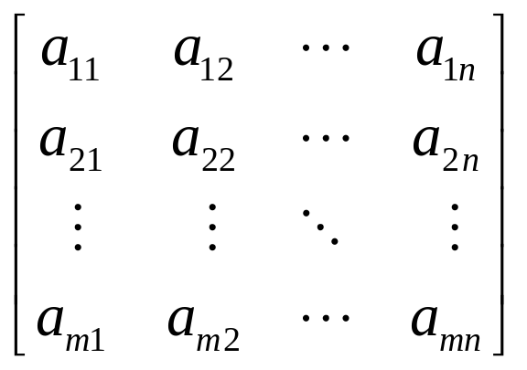
A=[a₁ a₂ … a_{n}] = =( a_{ij} )_{m×n} = [ a_{ij} ] _{m×n}
a_{j}――the jth column vector of A
a_{ij}――the scalar entry in the ith row and jth column of A

Slide 4
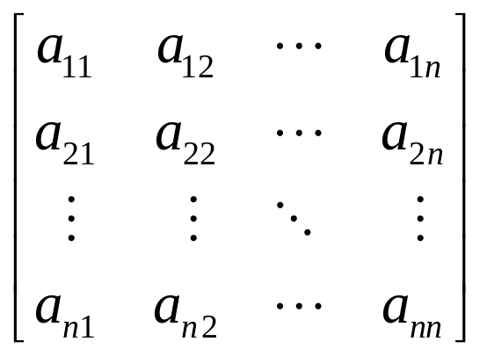
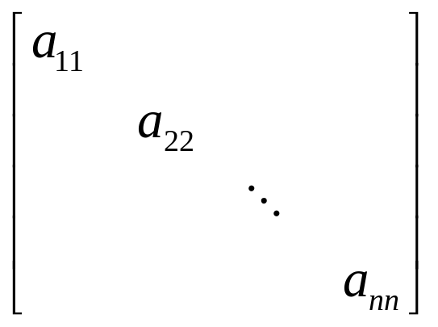
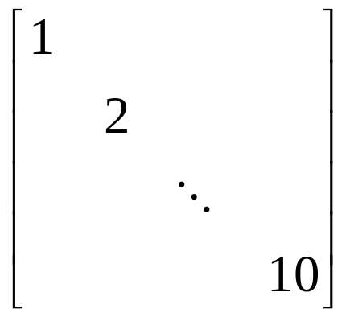
a₁₁, a₂₂, a₃₃,…――diagonal entries, main diagonal of A
A diagonal matrix is a square matrix whose nondiagonal entries are zero

Slide 5
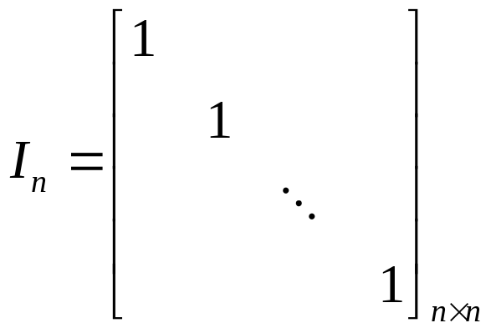
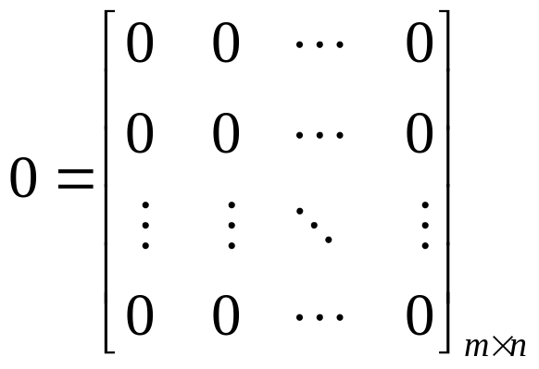
identity matrix, zero matrix

Slide 6
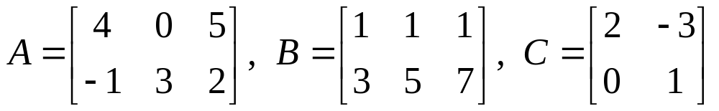
Sums and Scalar Multiples
Equal 相等
sum A+B 相加，和
scalar multiple rA, 数乘，数量积
-A = (-1)A 负矩阵
A-B=A+(-B) 相减，差

Slide 7
THEOREM 1
Let A, B, C be matrices of the same size, and let r and s be scalars.
a. A+B=B+A d. r(A+B) = rA + rB
b. A+(B+C) = (A+B)+C e. (r + s) A = rA + sA
c. A+0 = A f. r ( s A ) = (r s)A

Slide 8
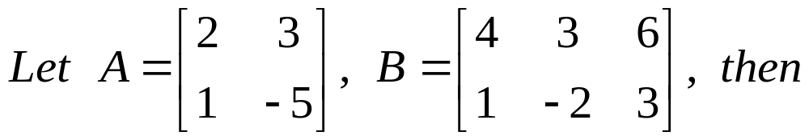
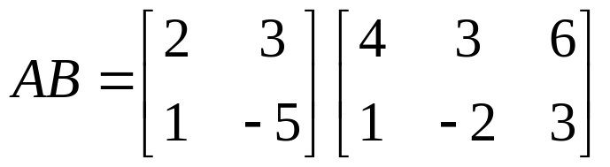
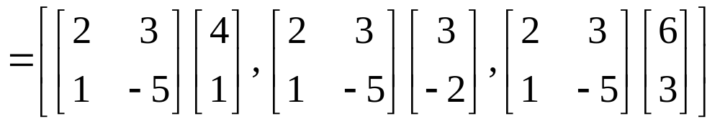
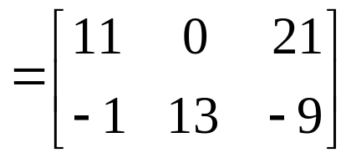
Matrix Multiplication
矩阵乘法
DEFINITION
AB = A [b₁ b₂ … b_{p}] = [Ab₁ Ab₂ … Ab_{p}]

Slide 9
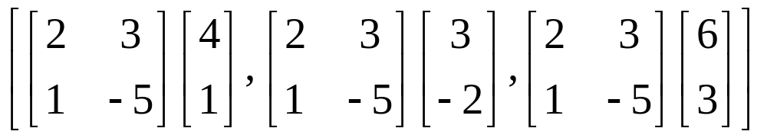
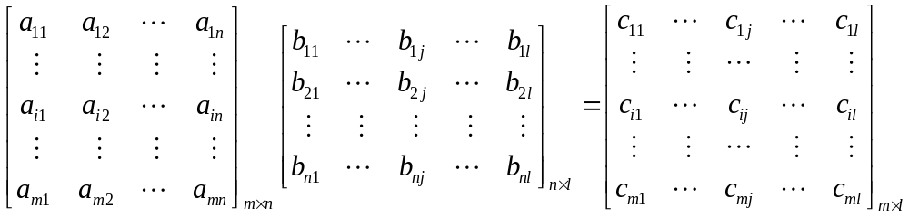
Row-Column Rule For Computing AB
c_{ij}=(AB)_{ij} = a_{i1}b_{1j} + a_{i2}b_{2j} + … + a_{in}b_{nj}

Slide 10
Properties of Matrix Multiplication
THEOREM 2
a. A_{m×n}(B_{n×l}C_{l×k}) = (AB)C
b. A ( B + C ) = AB + AC
c. ( B + C ) A = BA + CA
d. r(AB) = (rA)B = A (rB)
e. I_{m}A = A = AI_{n}
If AB = BA, then we say that A and B commute with one another.

Slide 11
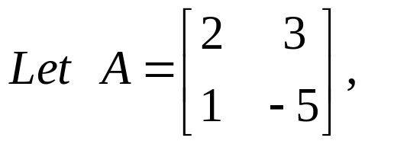
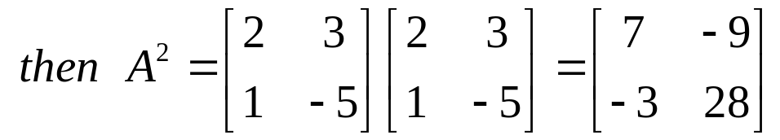
Powers of a Matrix
幂
A_{n×n} , A^{k} = A·A·…·A
I ^{n} = I, 0 ^{n} = 0
Warning: AB=AC → B=C ? AB=0 → A=0 or B=0 ?

Slide 12
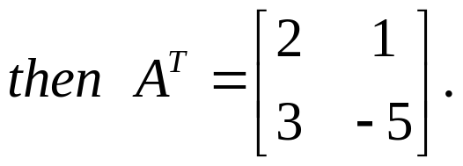
The Transpose of a Matrix
矩阵的转置
Given an m×n matrix A,
the transpose of A is the n×m matrix,
denoted by A^{T},
whose columns are formed from the corresponding rows of A.

Slide 13
THEOREM 3
a. (A^{T} )^{T} = A
b. (A+B)^{T} = A^{T} + B^{T}
c. (rA)^{T} = rA^{T}
d. (AB)^{T} = B^{T}A^{T}
Homework: 5,9,10,27

Slide 14
2.2 The Inverse of a Matrix
矩阵的逆
DEFINITION
An n×n matrix A is said to be invertible if there is an n×n matrix C such that CA=I_{n} and AC=I_{n}. In this case, C is an inverse of A. A matrix that is not invertible is called a singular matrix, and an invertible matrix is called a nonsingular matrix. 奇异矩阵，非奇异矩阵
C = A⁻¹, C is uniquely determined by A. WHY?

Slide 15
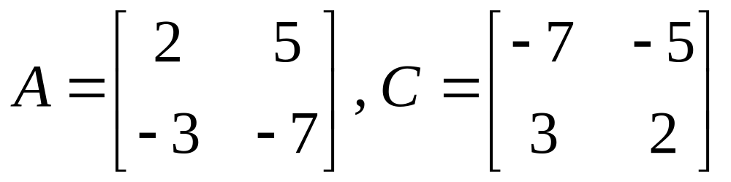
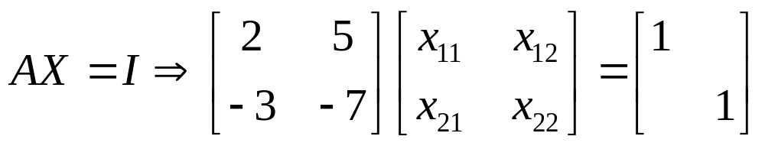
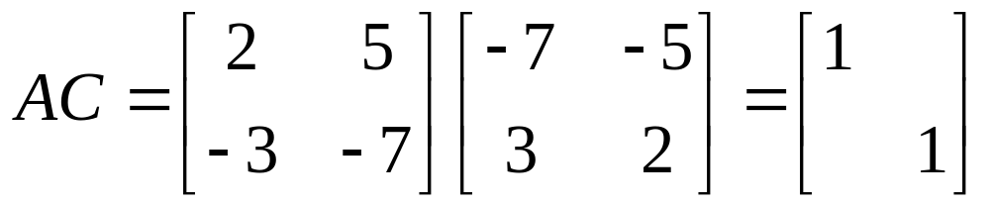
A⁻¹=?

Slide 16
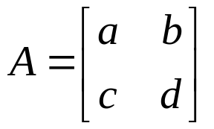
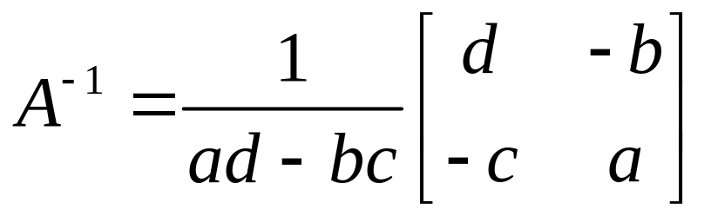
THEOREM 4
Let , if ad – bc ≠ 0, then
A is invertible
and .
If ad – bc = 0, then A is not invertible

Slide 17

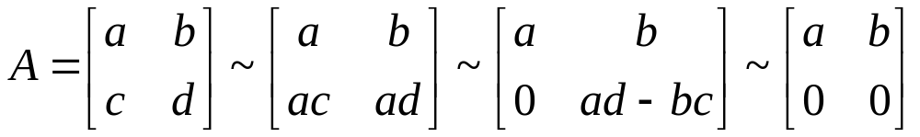
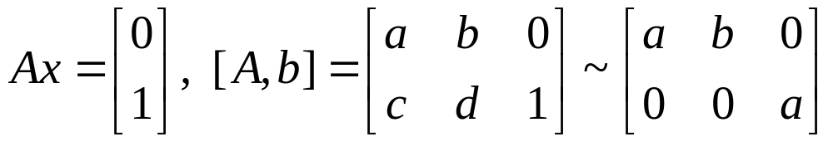



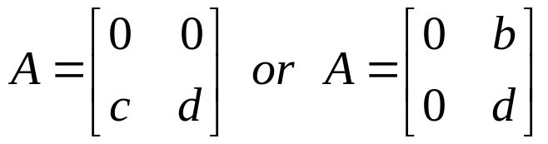
THEOREM 4
Let , If ad – bc = 0, then A is not invertible.
PROOF
1.
2. ,then or

Slide 18
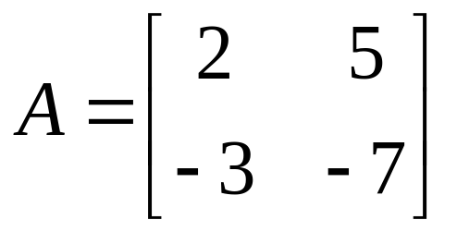
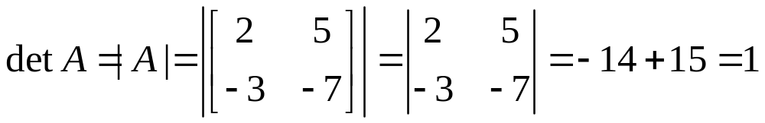
The quantity ad – bc is called the determinant of A, and we write
det A = ad – bc. 行列式

Slide 19
THEOREM 5
If A is an invertible n×n matrix, then for each b in R^{n}, the equation Ax = b has the unique solution x =A⁻¹b.

Slide 20
THEOREM 6
  a. If A is an invertible matrix, then A⁻¹ is invertible, and (A⁻¹)⁻¹ = A
  b. If A an B are invertible n×n matrices ,then so is AB ,and
  (AB)⁻¹ = B⁻¹A ⁻¹
  c. If A is an invertible matrix, then so is A^{T}, and
  ( A^{T} )⁻¹ = ( A⁻¹ )^{T}.

Slide 21
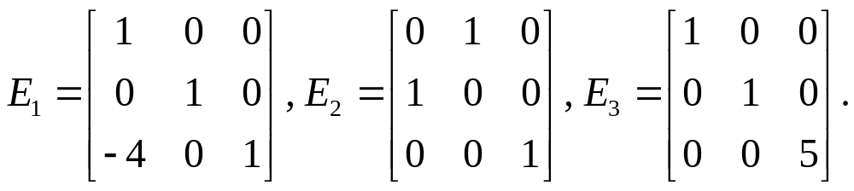
Elementary Matrices
An elementary matrix is one that is obtained by performing a single elementary row operation on an identity matrix.
Each elementary matrix is invertible.

Slide 22
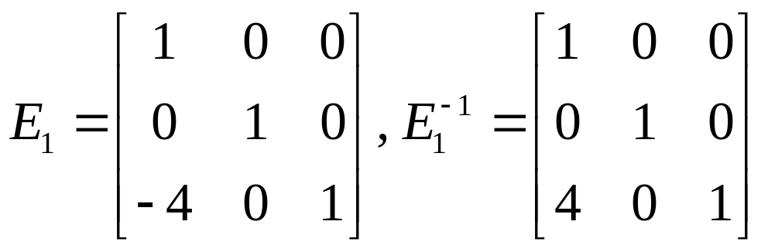
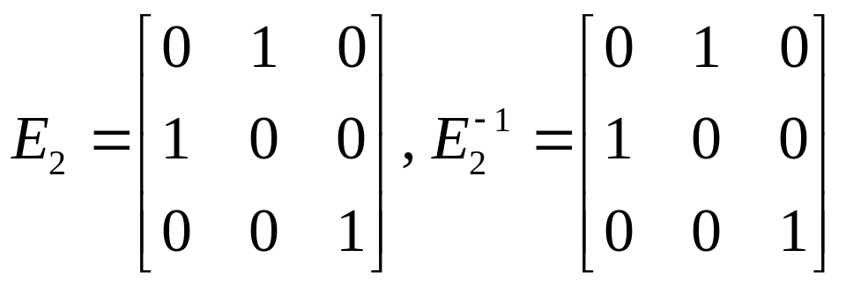
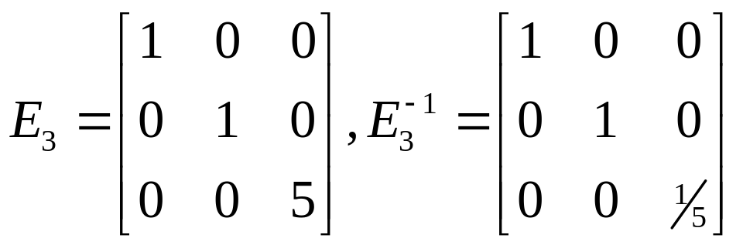
Each elementary matrix is invertible.

Slide 23
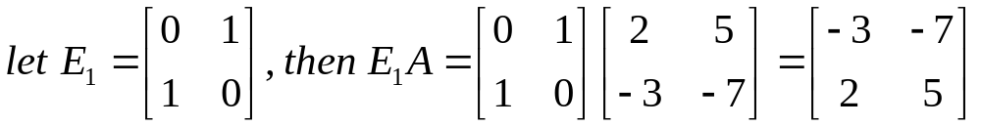
If an elementary row operation is performed on an m×n matrix A, the resulting matrix can be written as EA, where the m×m matrix E is created by performing the same row operation on I_{m}.

Slide 24
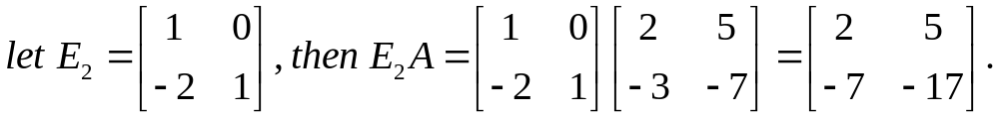
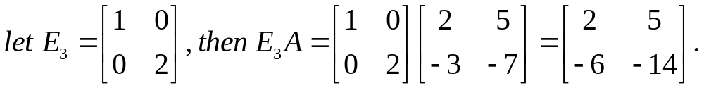

Slide 25
THEOREM 7
An n×n matrix A is invertible if and only if A is row equivalent to I_{n}, and in this case, any sequence of elementary row operations that reduce A to I_{n} also transforms I_{n} into A⁻¹.
PROOF Ax=b, → A~I_{n} →E_{p}…E₁A=I_{n}, → A⁻¹= E_{p}…E₁.

Slide 26
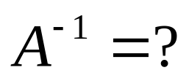
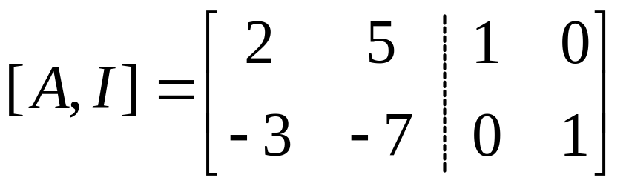
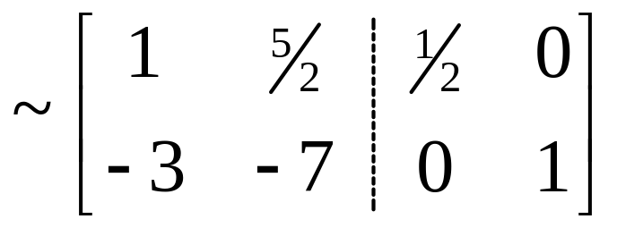
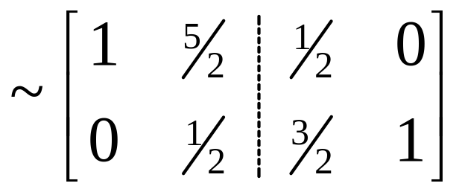
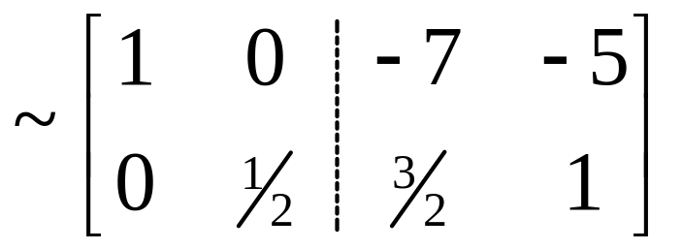
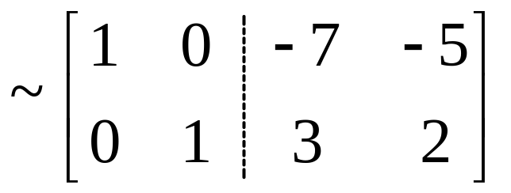
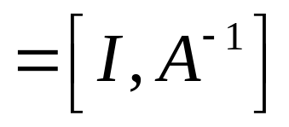

Slide 27
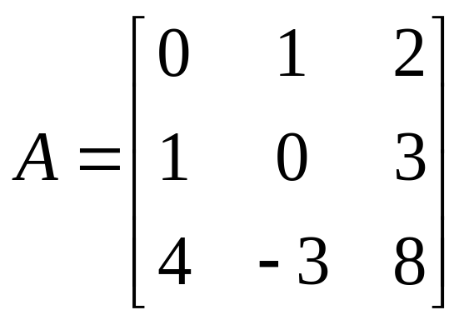
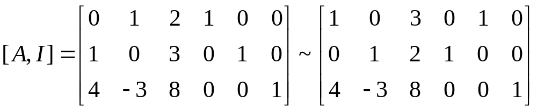
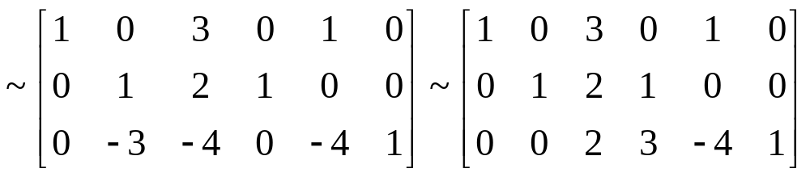

Slide 28
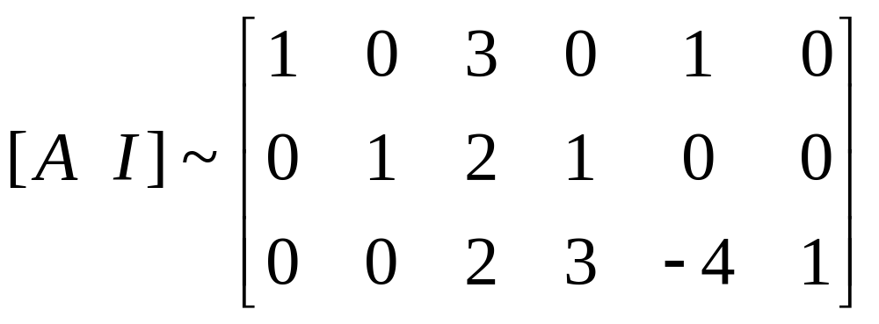
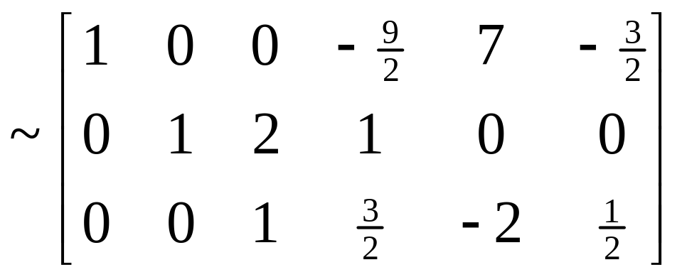
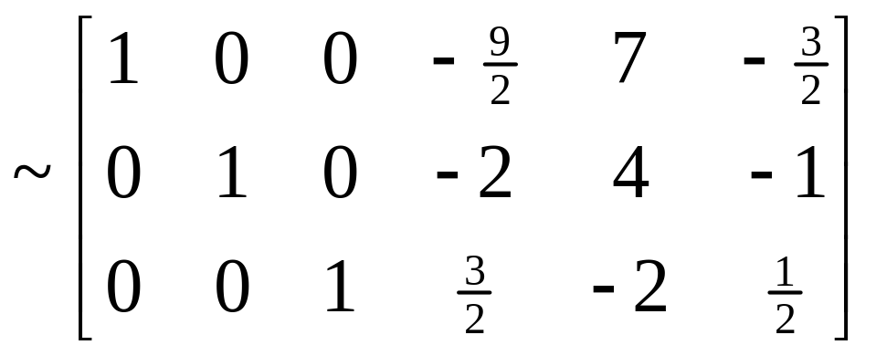

Slide 29
An Algorithm for Finding A⁻¹
Row reduce the augmented matrix [ A I ].
If A is row equivalent to I, then [ A I ] is equivalent to [ I A⁻¹ ].
Otherwise, A does not have an inverse.
Homework: 2.2 exercises 2,5,11,38

