Slide 1
Chapter 2 Matrix Algebra
2.1 Matrix operations 矩阵运算
2.2 The inverse of matrix 矩阵的逆
2.3 Characterizations of invertible matrices
2.4 Partitioned Matrices 分块矩阵

Slide 2
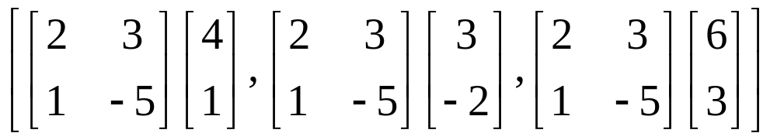
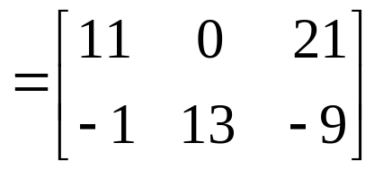
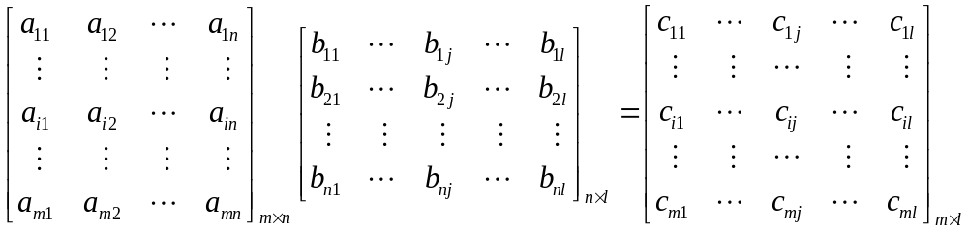
Row-Column Rule For Computing AB
c_{ij}=(AB)_{ij} = a_{i1}b_{1j} + a_{i2}b_{2j} + … + a_{in}b_{nj}

Slide 3
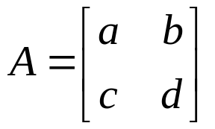
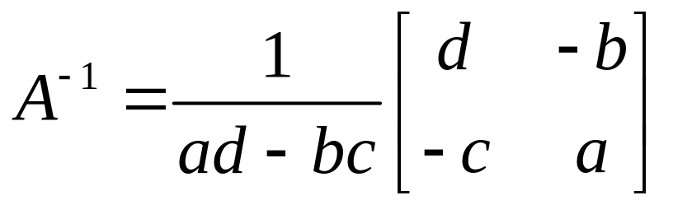
THEOREM 4
Let , if ad – bc ≠ 0, then
A is invertible
and .
If ad – bc = 0, then A is not invertible

Slide 4
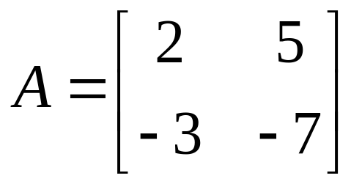
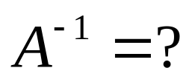
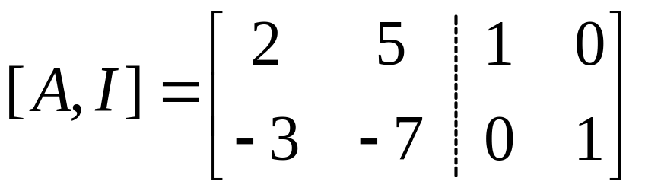
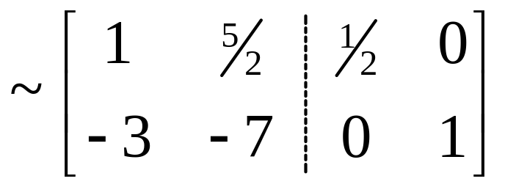
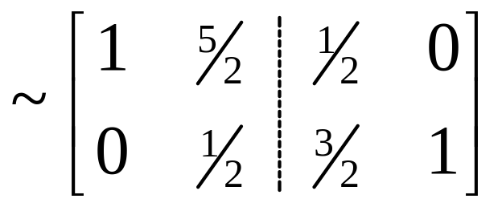
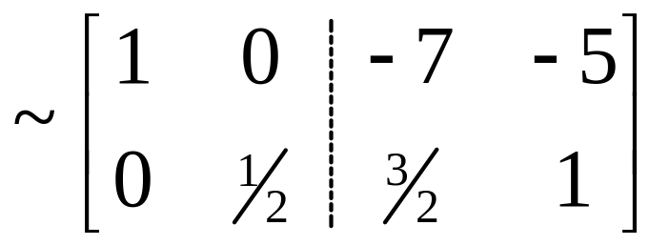
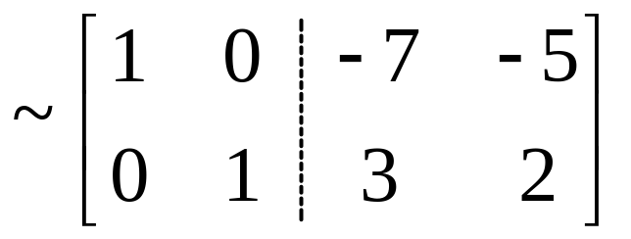
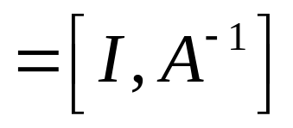

Slide 5
2.3 Characterizations of invertible matrices
THEOREM 8 The Invertible Matrix Theorem
  Let A be a square n×n matrix. Then the following statements are equivalent.
  A is an invertible matrix.
  A is row equivalent to the n×n identity matrix.
  A has n pivot positions.
  The equation Ax = 0 has only the trivial solution.
  The columns of A form a linearly independent set.
  The linear transformation x→ Ax is one to one.

Slide 6
THEOREM 8 The Invertible Matrix Theorem
  Let A be a square n×n matrix. Then the following statements are equivalent.
  The equation Ax = b has at least one solution for each b in R^{n}.
  The columns of A span R^{n}.
  The linear transformation x→ Ax maps R^{n} to R^{n}.
  There is an n×n matrix C such that CA=I.
  There is an n×n matrix D such that AD=I.
  A^{T} is an invertible matrix.

Slide 7
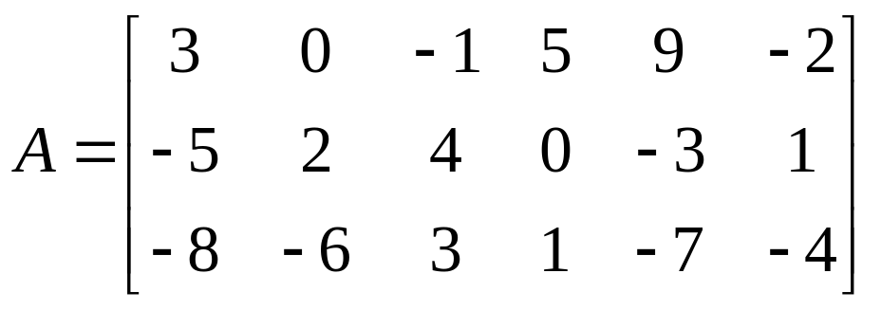
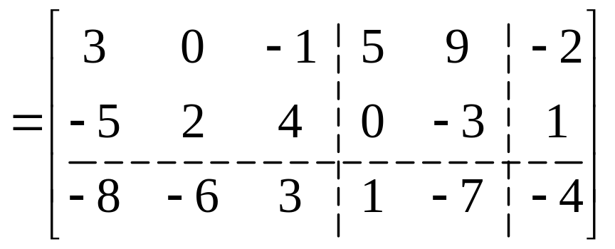
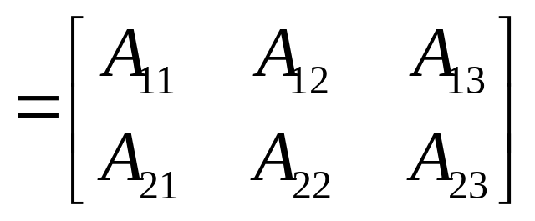
2.4 Partitioned Matrices 分块矩阵
Partitioned (or block) matrix

Slide 8
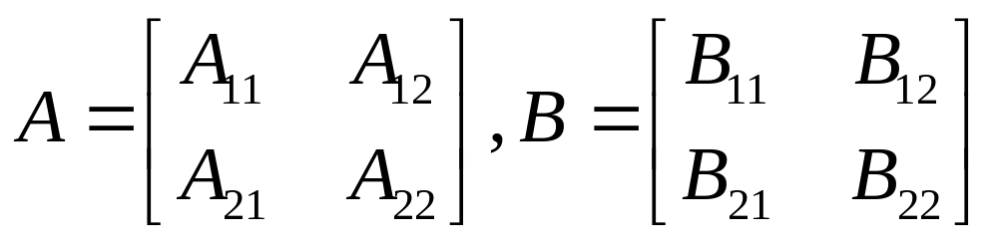
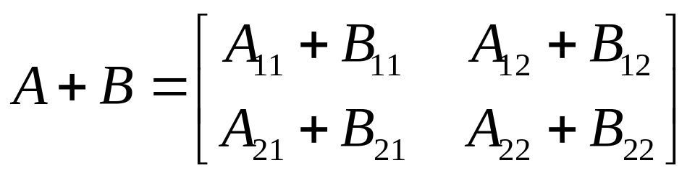
Addition and Scalar Multiplication
Addition
A+B

Slide 9
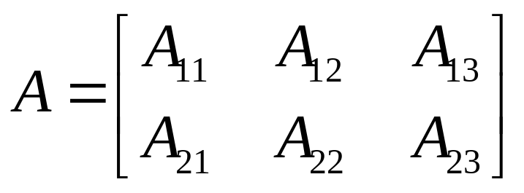
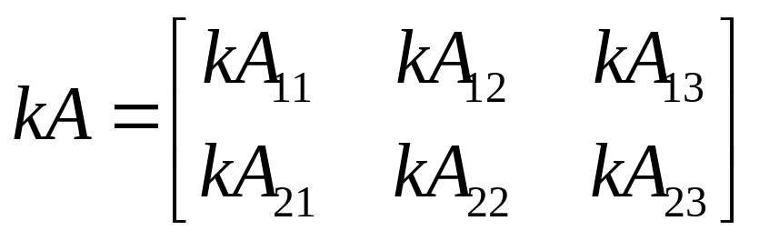
Addition and Scalar Multiplication
Scalar Multiplication
kA

Slide 10
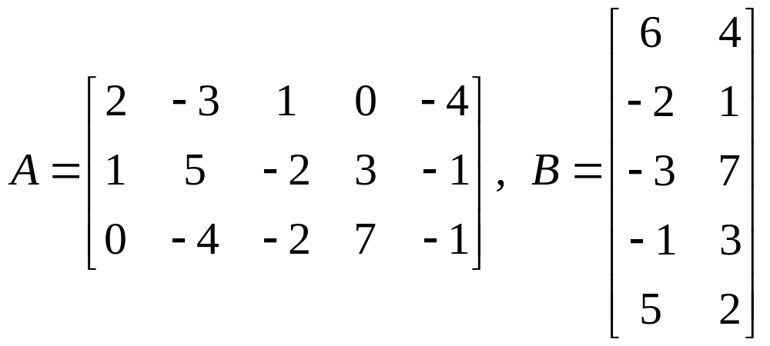
Multiplication of Partitioned Matrices

Slide 11
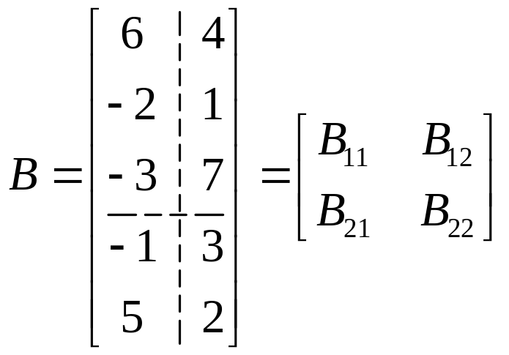
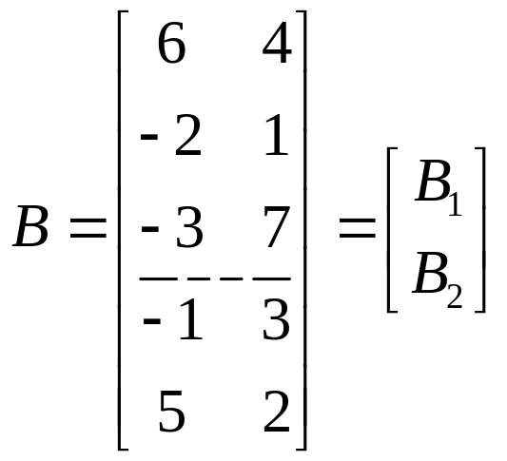
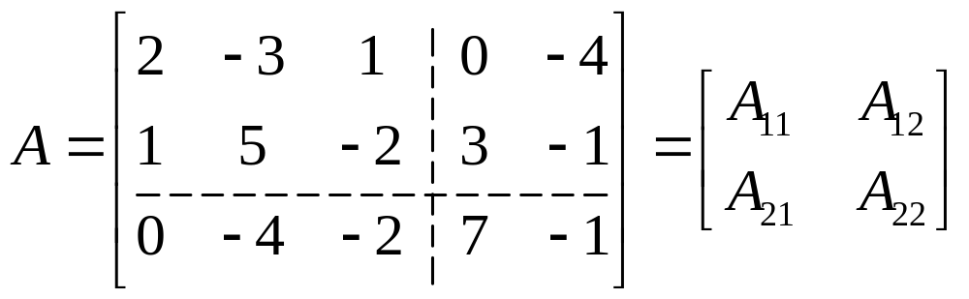
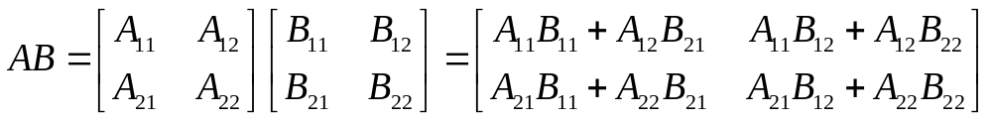
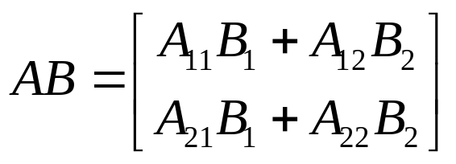
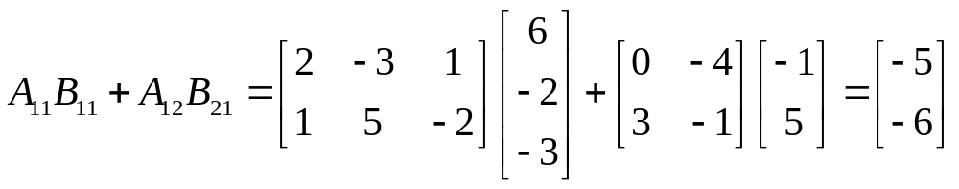
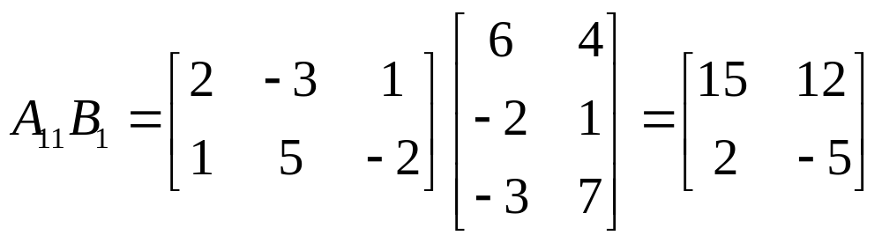

Slide 12
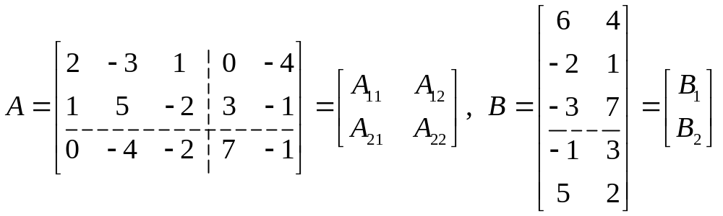
Multiplication of Partitioned Matrices

Slide 13
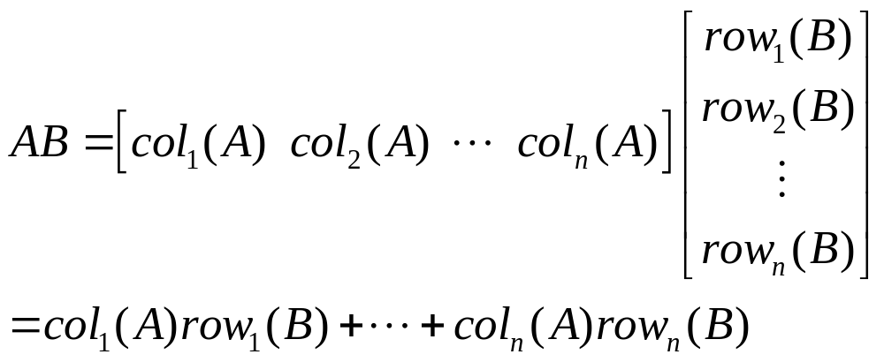
THEOREM 10
Column-Row Expansion of AB

Slide 14
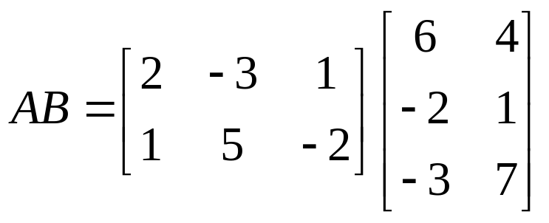
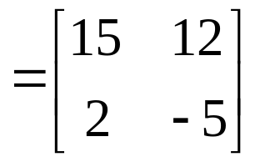
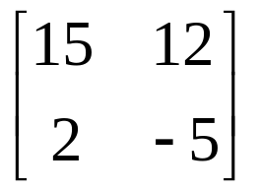
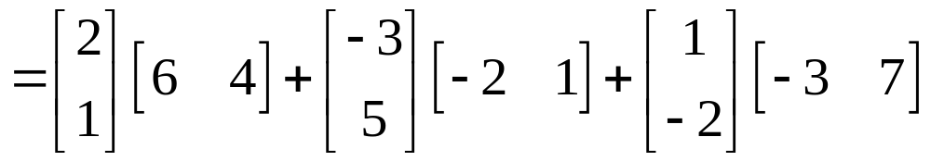
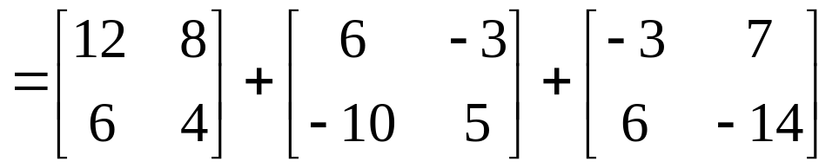

Slide 15
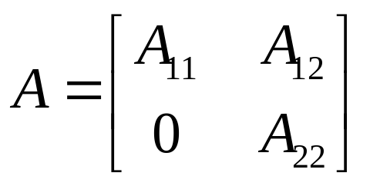
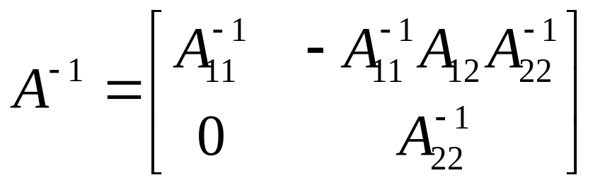
Inverse of Partitioned Matrices
A matrix of the form
is said to be block upper triangular.上三角块
Assume that A₁₁ is p×p, A₂₂ is q×q, and A is invertible, then

Slide 16
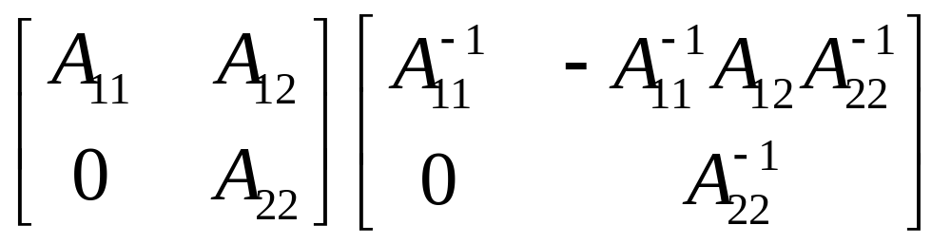
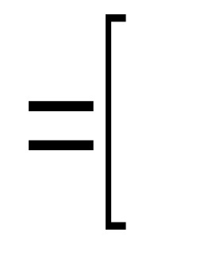

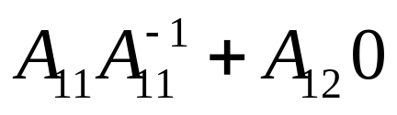
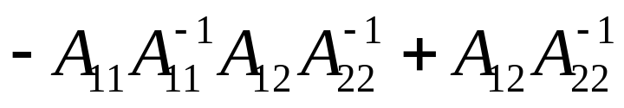
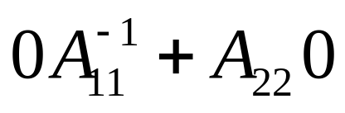
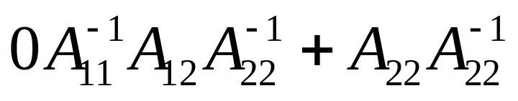
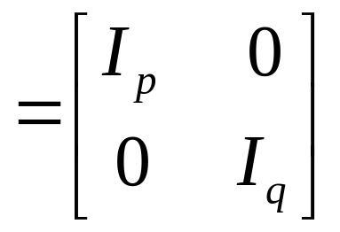

Slide 17
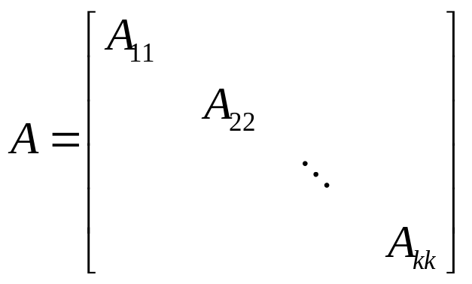
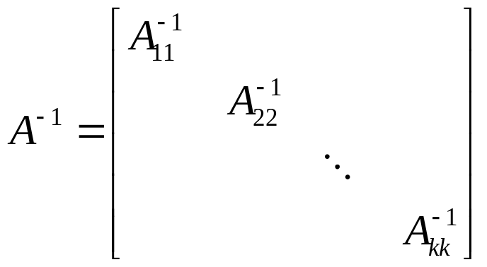
A block diagonal matrix 对角块
is a partitioned matrix with zero blocks off the main diagonal (of blocks).
Such a matrix is invertible if and only if each block on the diagonal is invertible.

Slide 18
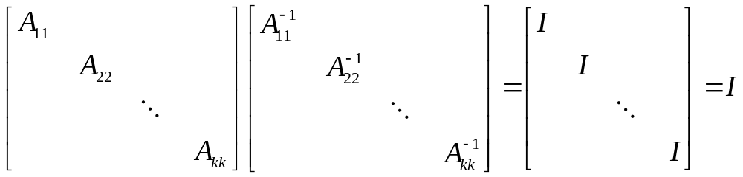
Homework: 2.4 Exercises 13, 24, 25

