Slide 1
Chapter 3 Determinants
3.1 Introduction to Determinants 行列式
3.2 Properties of Determinants
3.3 Cramer’s Rule 克莱姆法则

Slide 2
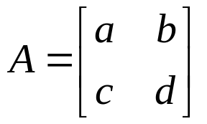
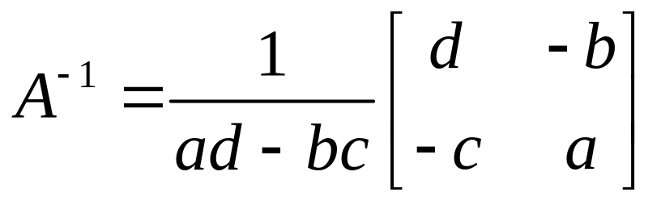
THEOREM 4
Let , if ad – bc ≠ 0, then
A is invertible
and .
If ad – bc = 0, then A is not invertible

Slide 3
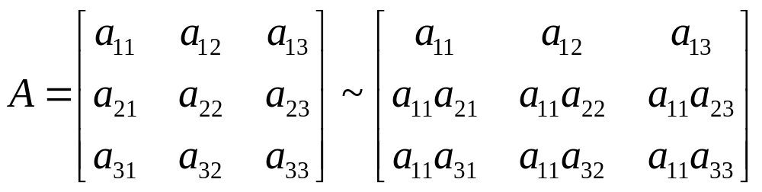
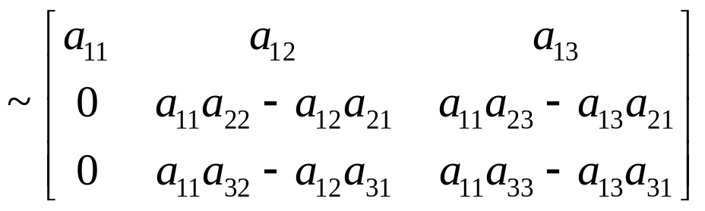
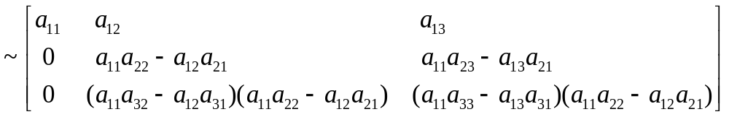
3.1 Introduction to Determinants
A is invertible, a₁₁≠ 0.

Slide 4
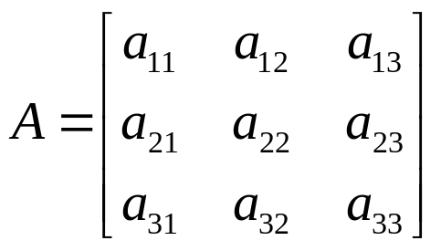
3.1 Introduction to Determinants
A is invertible, a₁₁≠ 0.

Slide 5
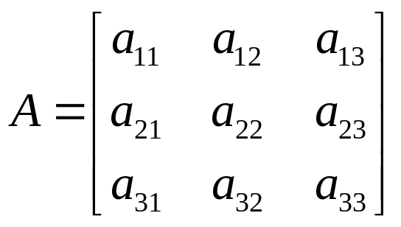
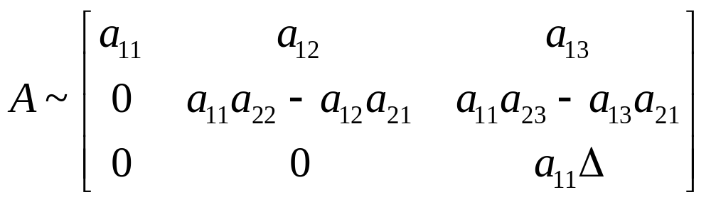
A is invertible, Δ must be nonzero. The converse is true, too.
We call Δ the determinant of the A.

Slide 6
A 可逆, Δ 必不为0. 反之亦然.
称Δ 为 A的行列式.
反之亦然？？？.

Slide 7
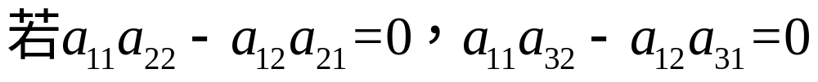
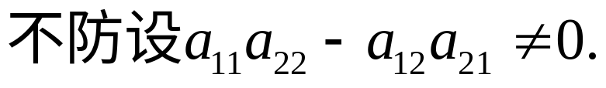
Δ ≠ 0 ⇒ A is invertible .
1）A的第一列不可能全为0，不防设a₁₁≠ 0.
2）
则可以证明Δ =0.

Slide 8


Slide 9
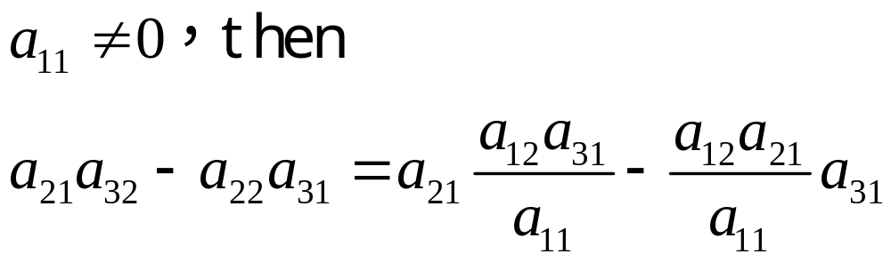
2）
则可以证明Δ =0：

Slide 10
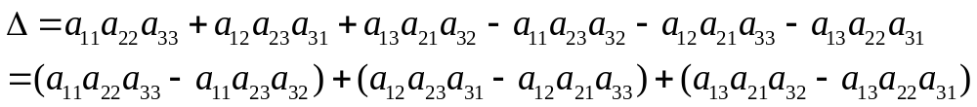
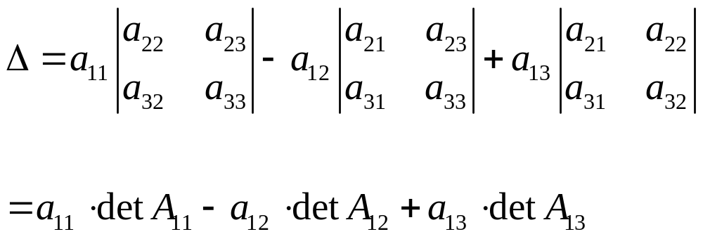


Slide 11
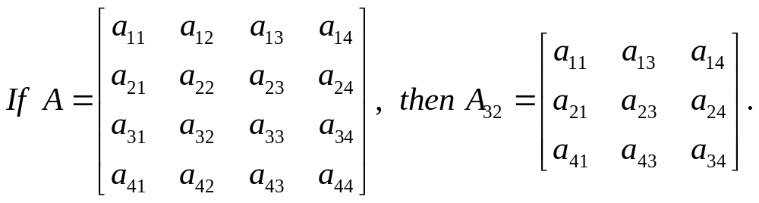
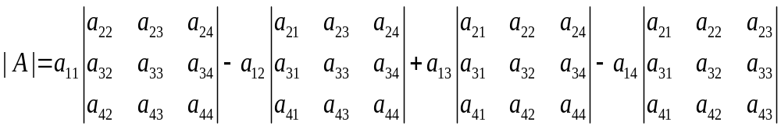

Slide 12
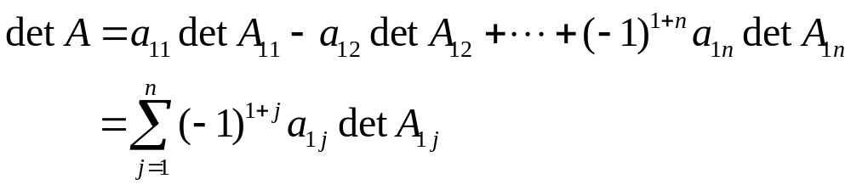
DEFINITION
For n ≥ 2, the determinant of an n×n matrix A is the sum of n terms of the form ±a_{1j}detA_{1j}, with plus and minus signs alternating, where the entries a₁₁, a₁₂, …, a_{1n} are from the first row of A. In symbols,

Slide 13
定义
对 n ≥ 2, n×n 矩阵 A 的行列式是如下 n 项的和： ±a_{1j}detA_{1j}, 其中正负号交错, a₁₁, a₁₂, …, a_{1n} 是A的第一行元素，A_{1j}是A中去掉a_{1j}所在的行列后剩下的矩阵。即,

Slide 14
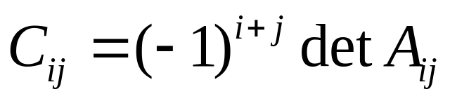
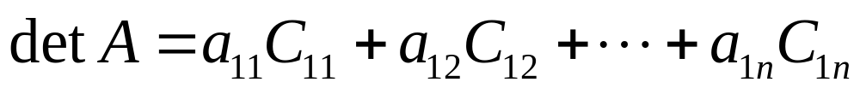
代数余子式
Given A=[a_{ij}], the (i, j)-cofactor of A is the number C_{ij} given by
Then
.
This formula is called a cofactor expansion across the first row of A. 按第一行展开

Slide 15
代数余子式
对矩阵 A=[a_{ij}], 称
为a_{ij}对应的代数余子式.
This formula is called a cofactor expansion across the first row of A. 按第一行展开

Slide 16

THEOREM 1
The determinant of an n×n matrix A can be computed by a cofactor expansion across any row or down any column. The expansion across the ith row using the cofactors is

Slide 17
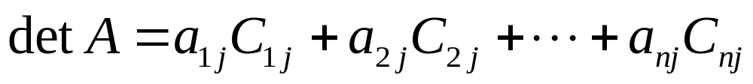
The cofactor expansion down the jth column is

Slide 18
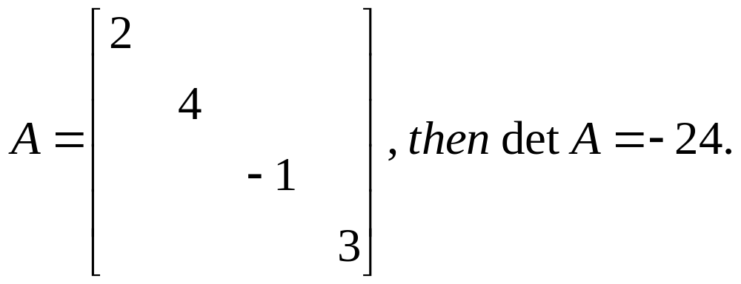
THEOREM 2
If A is a triangular matrix, then detA is the product of the entries on the main diagonal of A.

Slide 19
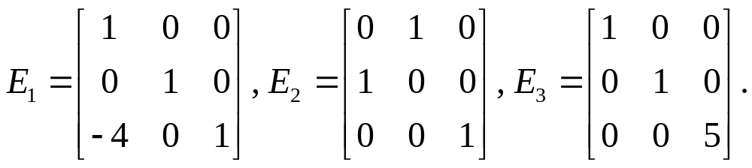
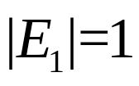
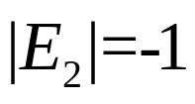
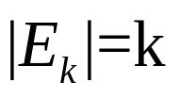
3.2 Properties of Determinants
THEOREM 3 Row Operations
初等矩阵的行列式

Slide 20
3.2 Properties of Determinants
THEOREM 3 Row Operations
Let A be a square matrix.
  a. If a multiple of one row of A is added to another row to produce a matrix B, then det B = det A.
  b. If two rows of A are interchanged to produce B, then det B = - det A.
  c. If one row of A is multiplied by k to produce B, then det B = k ·det A.

Slide 21
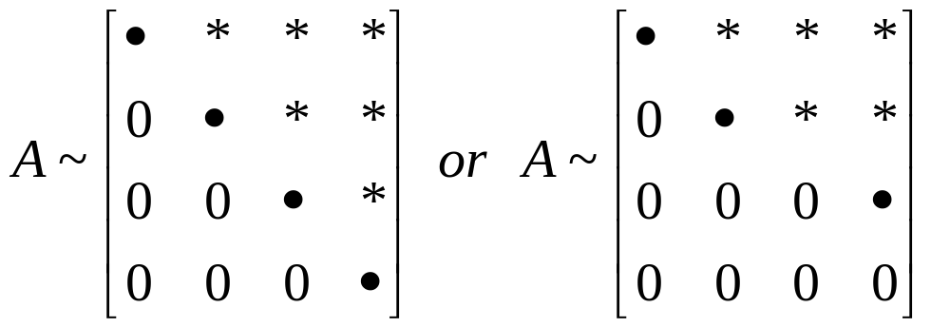
THEOREM 4
A square matrix A is invertible if and only if det A ≠ 0.
Hint:
行初等变换会改变行列式的值，但不改变“行列式是否为0 ”这个结论。

Slide 22
THEOREM 5
If A is an n×n matrix, then det A^{T} = det A.

Slide 23
THEOREM 6
If A and B are n×n matrices, then
det(AB) = (det A)(det B).
Proof:
1) if A is not invertible, then so is not AB, …
2) if A is invertible, then…

Slide 24
THEOREM 6 If A and B are n×n matrices, then
det(AB) = (det A)(det B).
Proof:
2) if A is invertible, then A=E_{p}…E_{1,}
det(AB) = det (E_{p}…E₁)B
=det E_{p}(E_{p-1} …E₁)B = det E_{p}•det(E_{p-1} …E₁) B =…
=det E_{p}•detE_{p-1}• …•detE₁•detB
= det (E_{p}…E₁) •detB = detA•detB
Homework: 3.2 Exercises 8,19,20,31,40

