Slide 1
Chapter 3 Determinants
3.1 Introduction to Determinants 行列式
3.2 Properties of Determinants
3.3 Cramer’s Rule 克莱姆法则

Slide 2
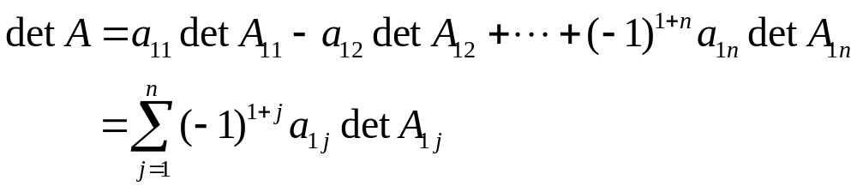
DEFINITION
For n ≥ 2, the determinant of an n×n matrix A is the sum of n terms of the form ±a_{1j}detA_{1j}, with plus and minus signs alternating, where the entries a₁₁, a₁₂, …, a_{1n} are from the first row of A. In symbols,

Slide 3
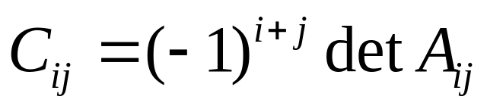
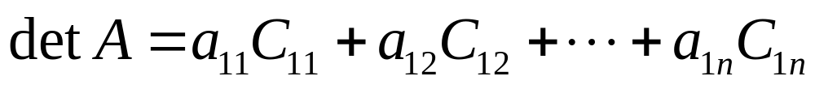
代数余子式
Given A=[a_{ij}], the (i, j)-cofactor of A is the number C_{ij} given by
Then
.
This formula is called a cofactor expansion across the first row of A. 按第一行展开

Slide 4

THEOREM 1
The determinant of an n×n matrix A can be computed by a cofactor expansion across any row or down any column. The expansion across the ith row using the cofactors is

Slide 5
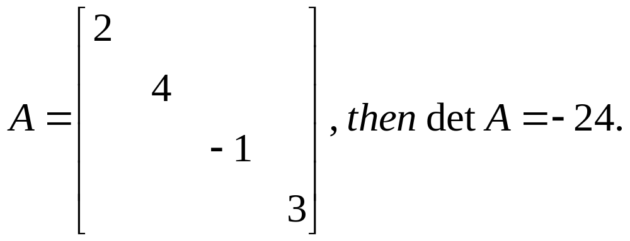
THEOREM 2
If A is a triangular matrix, then detA is the product of the entries on the main diagonal of A.

Slide 6
3.2 Properties of Determinants
THEOREM 3 Row Operations
Let A be a square matrix.
  a. If a multiple of one row of A is added to another row to produce a matrix B, then det B = det A.
  b. If two rows of A are interchanged to produce B, then det B = - det A.
  c. If one row of A is multiplied by k to produce B, then det B = k ·det A.

Slide 7
THEOREM 4
A square matrix A is invertible if and only if det A ≠ 0.

Slide 8
THEOREM 6
If A and B are n×n matrices, then
det(AB) = (det A)(det B). |AB|=|A|•|B|
Proof:
1) if A is not invertible, then so is not AB, …
2) if A is invertible, then A=E_{p}…E_{1,}
det(AB) = det (E_{p}…E₁)B
=det E_{p}(E_{p-1} …E₁)B = det E_{p}•det(E_{p-1} …E₁) B =…
=det E_{p}•detE_{p-1}• …•detE₁•detB
= det (E_{p}…E₁) •detB = detA•detB

Slide 9
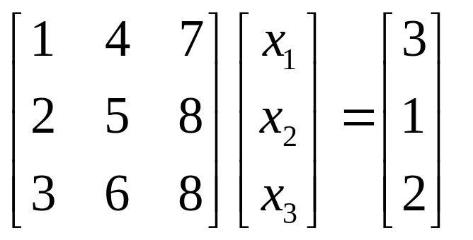
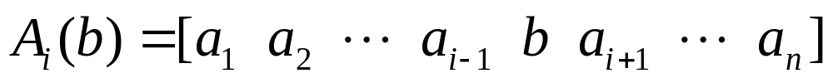
3.3 Cramer’s Rule

Slide 10
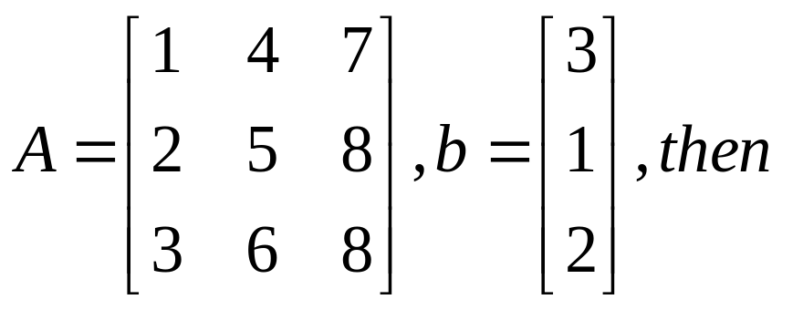
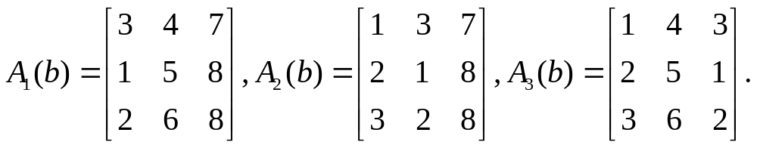
3.3 Cramer’s Rule

Slide 11
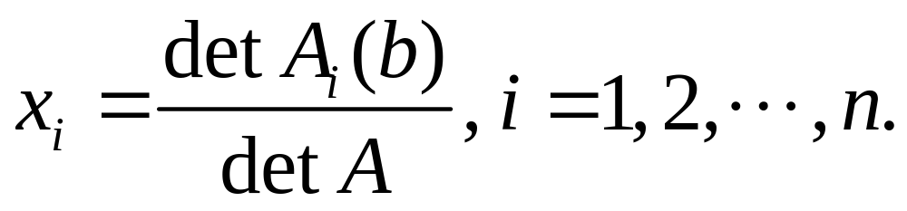
例：
THEOREM 7
Let A be an invertible n×n matrix. The unique solution x of Ax = b has the entries given by

Slide 12
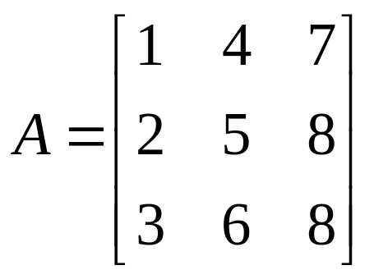
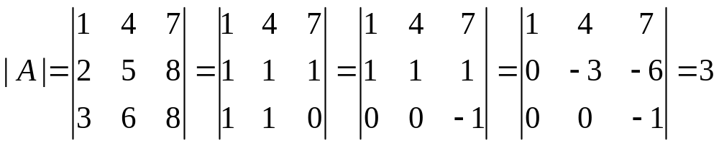
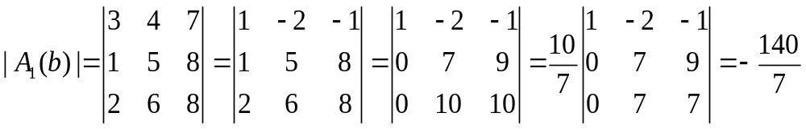
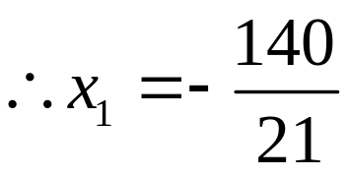

Slide 13
证法一：将x代入方程，Ax第一行算出b1……
THEOREM 7
Let A be an invertible n×n matrix. The unique solution x of Ax = b has the entries given by

Slide 14
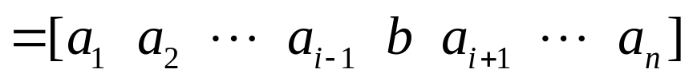
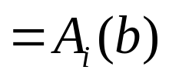
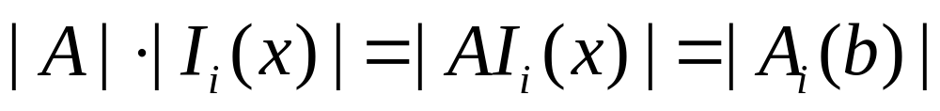
PROOF

Slide 15
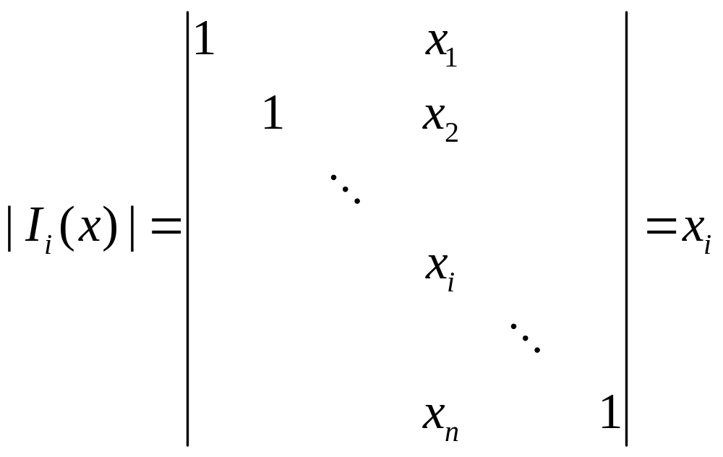

Slide 16
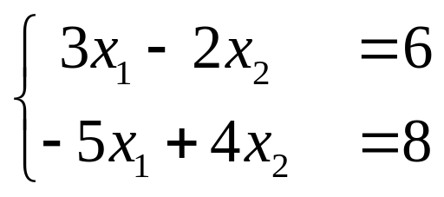
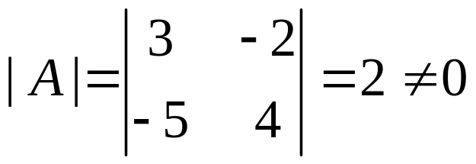
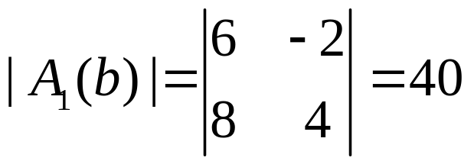
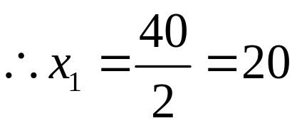
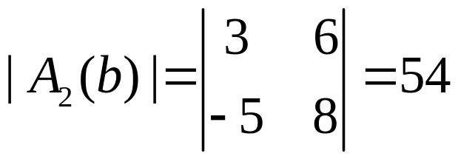
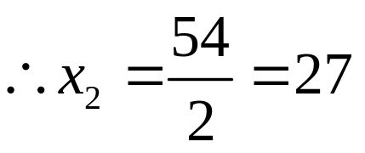
Example

Slide 17
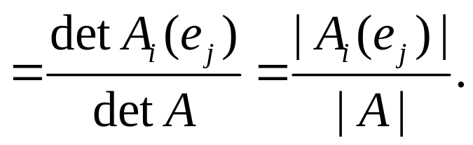
A Formula for A⁻¹
AB = I
Ax = e_{j} , x is the jth column of A⁻¹
x_{i} = (i, j)-entry of A⁻¹

Slide 18
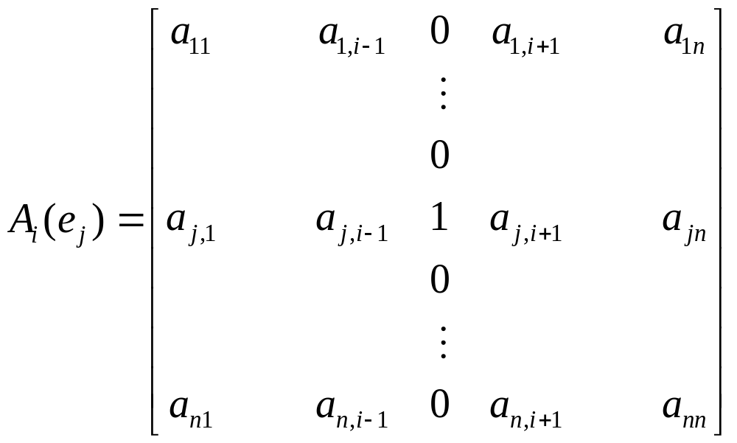
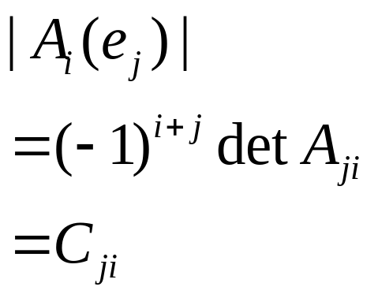
A Formula for A⁻¹
x_{i} = (i, j)-entry of A⁻¹

Slide 19
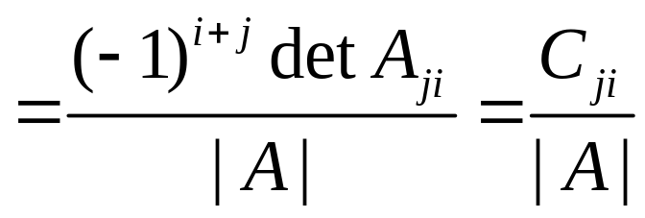
A Formula for A⁻¹
AB = I
Ax = e_{j} , x is the jth column of A⁻¹
x_{i} = (i, j)-entry of A⁻¹

Slide 20
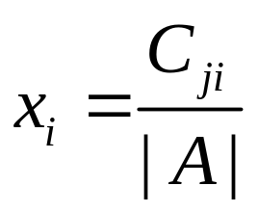
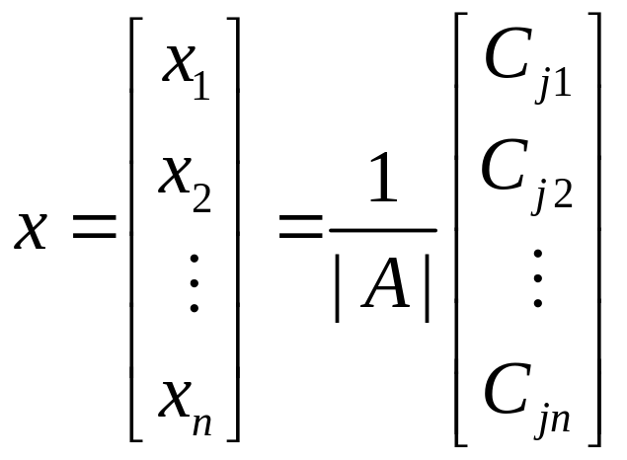
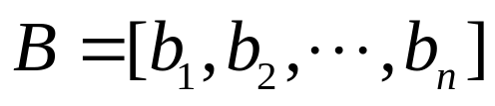
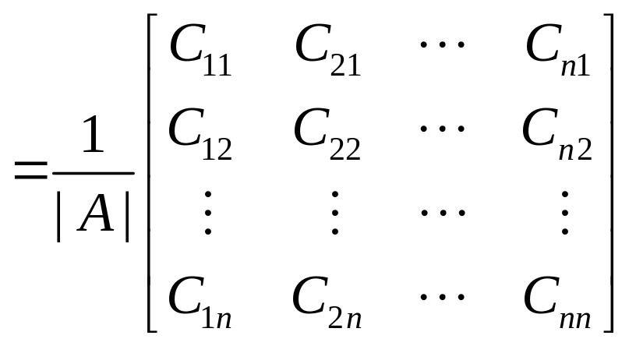
A Formula for A⁻¹
AB = I，Ax = e_{j}，

Slide 21
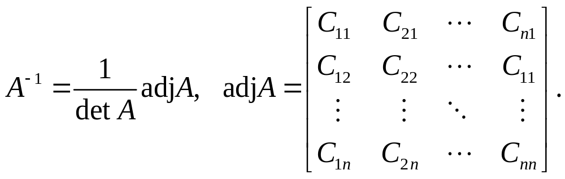
THEOREM 8
( adjugate , adjoint，A*) 伴随矩阵
Homework: 3.3 Exercises 4,12,17,18

