Slide 1
Chapter 4 Vector Spaces
4.1 Vector spaces and Subspaces
    向量空间 和 子空间
4.2 Null Space and Column Space
    零空间 和 列空间
4.3 Linearly independent sets, bases
4.4 Coordinate systems 坐标系
4.5 The dimension of a vector space
    维数
4.6 Rank 秩

Slide 2
4.1 Vector spaces and Subspaces
    向量空间 和 子空间

Slide 3
DEFINITION
A vector space is a nonempty set V of objects, called vectors, on which are defined two operations, called addition and multiplication by scalars (real numbers), subject to the ten axioms (or rules) listed below. The axioms must hold for all vectors u, v and w in V and for all scalars c and d.
1. The sum of u and v, denoted by u + v, is in V
2. u + v = v + u
3. ( u + v ) + w = u + ( v + w )
4. There is a zero vector 0 in V, such that u + 0 = u
5. For each vector u in V, there is a vector –u in V, such that u + (–u) = 0
6. The scalar multiple of u by c, denoted by cu, is in V
7. c ( u + v ) = cu + cv
8. ( c + d ) u = cu + du
9. c ( du ) = ( cd ) u
10. 1u = u

Slide 4
In a vector space,
The zero vector is unique, the vector -u, called the negative of u, is unique for each u in V. And
0u = 0, c0 = 0, -u = (-1)u.

Slide 5
EXAMPLE
For n ≥ 0, the set P_{n} of all polynomials of degree at most n is the set of all polynomials of the form
p(t) = a₀ + a₁t + a₂t² + … + a_{n}t^{n},
where the coefficients a₀ , a₁, a₂, … , a_{n} and the variable t are real numbers.
P_{n} is a vector space. 不超过n次的多项式

Slide 6
EXAMPLE
Let V be the set of all real-valued functions defined on a set D. Functions are added in the usual way: f + g is the function whose value at t in the domain D is f(t)+g(t). For a scalar c and an f in V, the scalar multiple cf is the function whose value at t is cf(t).
V is a vector space. 集合D上的实值函数

Slide 7
Subspace 子空间
DEFINITION
A subspace of a vector space V is a subset H of V that has three properties:
a. The zero vector of V is in H.
b. H is closed under vector addition. That is, for each u and v in H, the sum u + v is in H.
c. H is closed under multiplication by scalars. That is, for each u is in H and each scalar c, the vector cu is in H.

Slide 8
EXAMPLE
The set consisting of only zero vector in a vector space V is a subspace of V, called the zero subspace and written as {0}.

Slide 9
A Subspace Spanned by a Set
EXAMPLE
Given v₁ and v₂ in a vector space V, then
H = Span{v₁, v₂}
is a subspace of V.

Slide 10
THEOREM 1
If v₁, v₂ ,…, v_{p} are in a vector space V, then Span{v₁, v₂ ,…, v_{p} }
is a subspace of V.

Slide 11
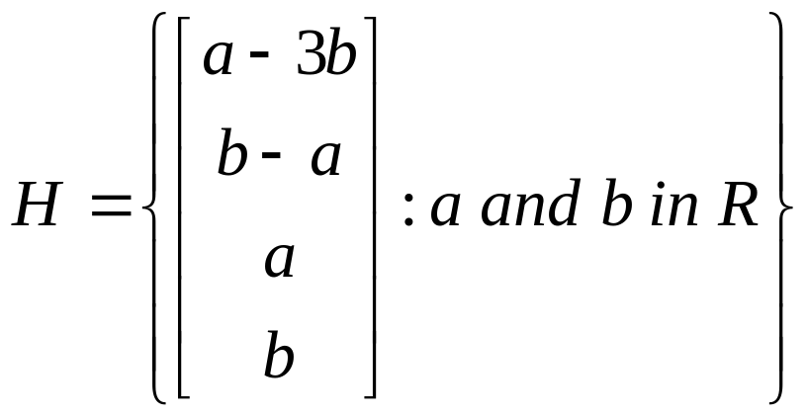
EXAMPLE
is a subspace of R⁴.
Homework: 4.1 exercises 6, 12, 25, 26

Slide 12
4.2 Null Space and Column Space
The Null Space of a Matrix
DEFINITION
The null space of an m×n matrix A, written as Nul A, is the set of all solutions to the homogeneous equation Ax = 0.
In set notation,
Nul A = {x : x∈R^{n} and Ax = 0 }.

Slide 13
THEOREM 2
The null space of an m×n matrix A is a subspace of R^{n}.

Slide 14
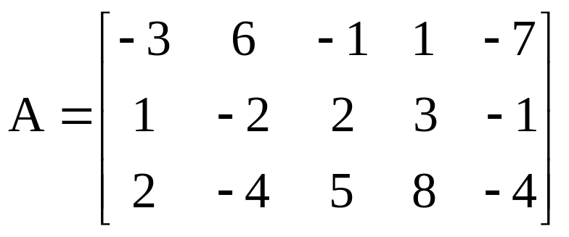
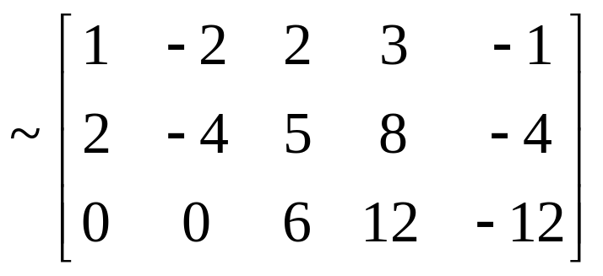
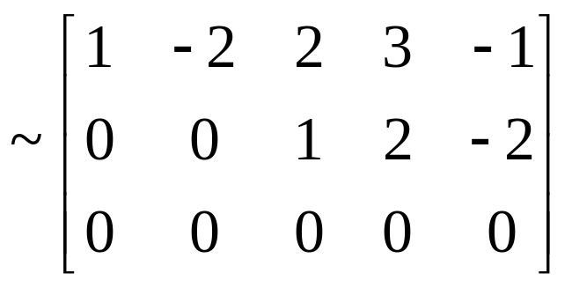
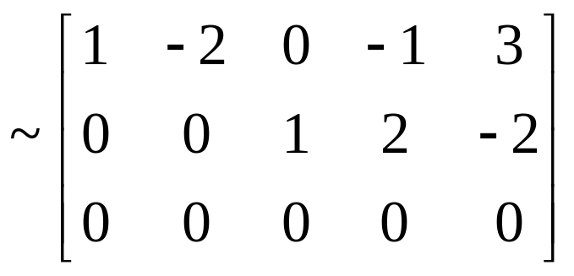
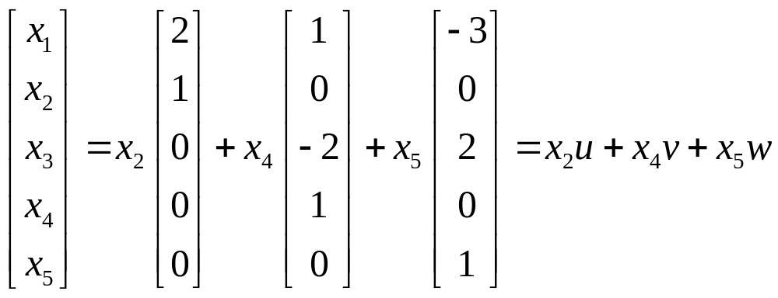
So, Nul A = Span{u,v,w}

Slide 15
The Column Space of a Matrix
DEFINITION
The column space of an m×n matrix A, written as Col A, is the set of all linear combinations of the columns of A.
If A=[a₁,…,a_{n}], then
Col A = Span{ a₁,…,a_{n} }
Col A ={b : b is in R^{m} and b=Ax for some x in R^{n}}

Slide 16
THEOREM 3
The column space of an m×n matrix A is a subspace of R^{m}.

