Slide 1
Chapter 4 Vector Spaces
4.1 Vector spaces and Subspaces
    向量空间 和 子空间
4.2 Null Space and Column Space
    零空间 和 列空间
4.3 Linearly independent sets, bases
4.4 Coordinate systems 坐标系
4.5 The dimension of a vector space
    维数
4.6 Rank 秩

Slide 2
DEFINITION
A vector space is a nonempty set V of objects, called vectors, on which are defined two operations, called addition and multiplication by scalars (real numbers), subject to the ten axioms (or rules) listed below. The axioms must hold for all vectors u, v and w in V and for all scalars c and d.
1. The sum of u and v, denoted by u + v, is in V
2. u + v = v + u
3. ( u + v ) + w = u + ( v + w )
4. There is a zero vector 0 in V, such that u + 0 = u
5. For each vector u in V, there is a vector –u in V, such that u + (–u) = 0
6. The scalar multiple of u by c, denoted by cu, is in V
7. c ( u + v ) = cu + cv
8. ( c + d ) u = cu + du
9. c ( du ) = ( cd ) u
10. 1u = u

Slide 3
EXAMPLE
For n ≥ 0, the set P_{n} of all polynomials of degree at most n is the set of all polynomials of the form
p(t) = a₀ + a₁t + a₂t² + … + a_{n}t^{n},
where the coefficients a₀ , a₁, a₂, … , a_{n} and the variable t are real numbers.
P_{n} is a vector space. 不超过n次的多项式

Slide 4
THEOREM 1
If v₁, v₂ ,…, v_{p} are in a vector space V, then Span{v₁, v₂ ,…, v_{p} }
is a subspace of V.

Slide 5
4.2 Null Space and Column Space
The Null Space of a Matrix
Nul A = {x : x∈R^{n} and Ax = 0 }.
If A=[a₁,…,a_{n}], then
Col A = Span{ a₁,…,a_{n} }

Slide 6
4.3 Linearly independent sets, bases 线性无关组，基
An indexed set of vectors { v₁,…, v_{p} } in V is said to be linearly independent if the vector equation
c₁v₁+ c₂v₂+ … + c_{p}v_{p} = 0
has only the trivial solution
c₁= 0, c₂= 0, … , c_{p} = 0.

Slide 7
The set { v₁,…, v_{p} } is said to be linearly dependent if the vector equation
c₁v₁+ c₂v₂+ … + c_{p}v_{p} = 0
has a nontrivial solution
c₁, c₂, … , c_{p}.

Slide 8
THEOREM 4
An indexed set {v₁,…, v_{p} } of two or more vectors, with v₁≠ 0, is linearly dependent if and only if some v_{j} (with j >1) is a linear combination of the preceding vectors v₁,…, v_{j-1}.
Proof
c₁v₁+ c₂v₂+ … + c_{p}v_{p} = 0,……

Slide 9
EXAMPLE 1
Let p₁(t)=1, p₂(t)=t, and p₃(t)=4-t.
Then { p₁, p₂, p₃} is linearly dependent because p₃=4p₁-p₂.

Slide 10
DEFINITION
Let H be a subspace of a vector space V. An indexed set of vectors B={ b₁,…, b_{p} } in V is a basis for H if
(i) B is a linearly independent set, and
(ii) the subspace spanned by B coincides with H, that is,
H = Span{ b₁,…, b_{p} }.

Slide 11
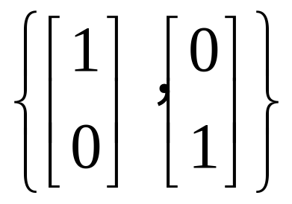
is a basis of R².
The set { e₁, e₂,…, e_{n} } is called the standard basis for R^{n}. 标准基
S={1, t, t², …, t^{n}} is a basis for P_{n}.

Slide 12
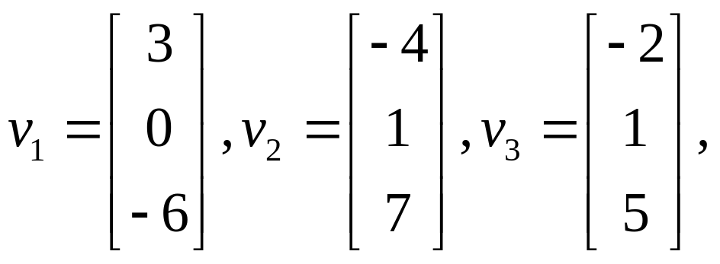
is {v₁, v₂, v₃} a basis for R³?

Slide 13
THEOREM 5
The Spanning Set Theorem
Let S= { v₁,…, v_{p} } be a set in V, and let H = Span{ v₁,…, v_{p} }.
a. If one of the vectors in S –say, v_{k}—is a linear combination of the remaining vectors in S, then the set formed from S by removing v_{k} still spans H.
b. If H≠{0}, some subset of S is a basis for H.

Slide 14
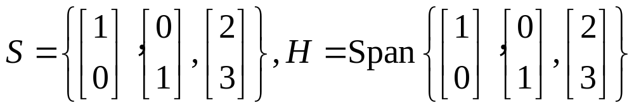
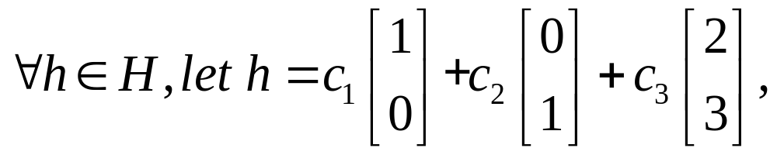
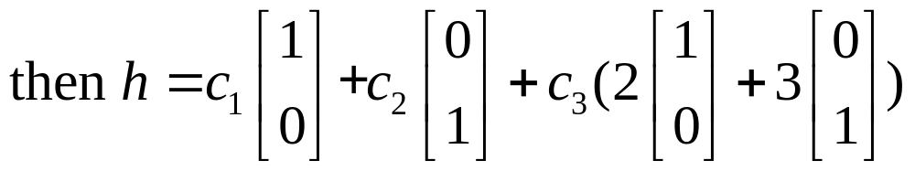
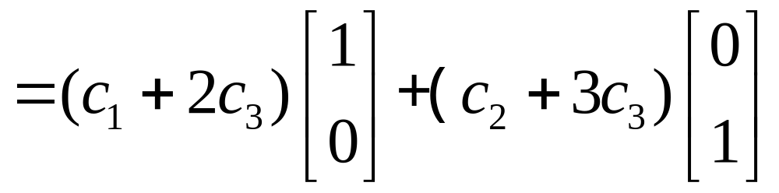

Slide 15
Bases for Nul A and Col A

Slide 16
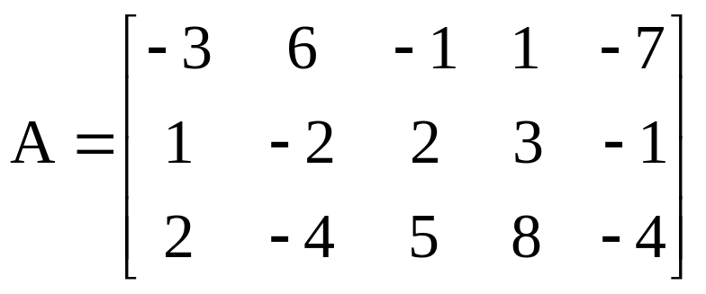
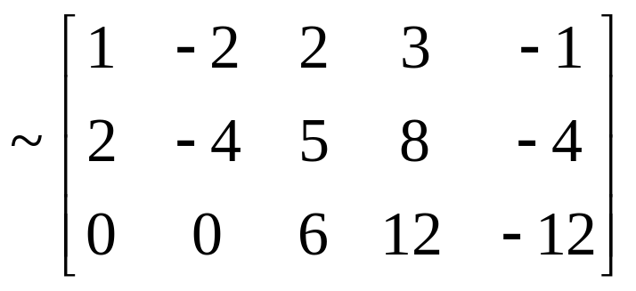
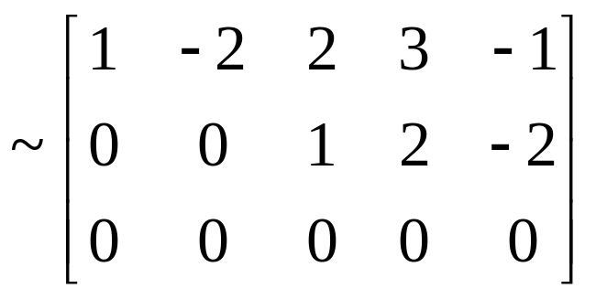
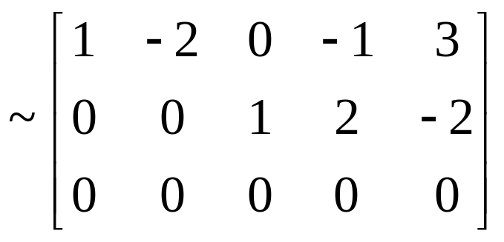
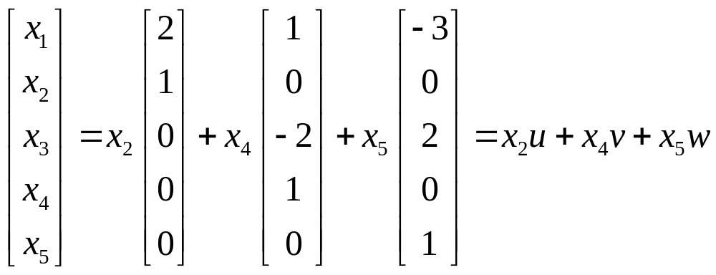
So, Nul A = Span{u,v,w}

Slide 17
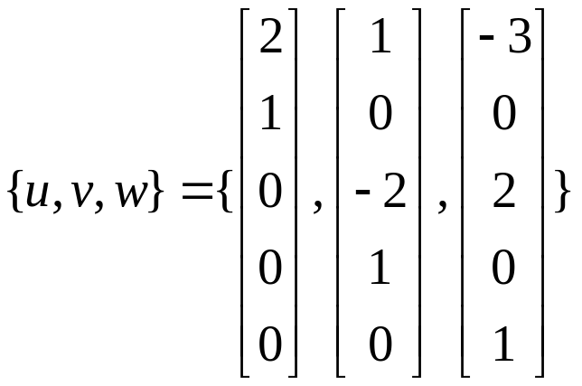
is a basis of Nul A.

Slide 18
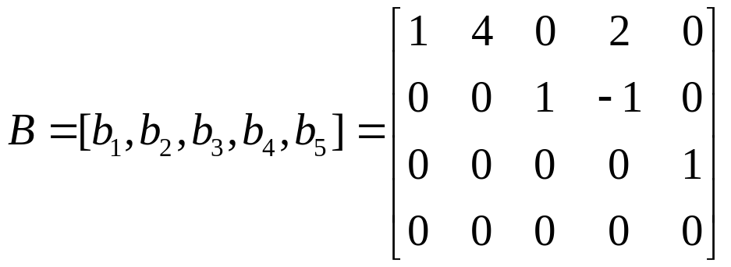

Bases for Col A

Slide 19
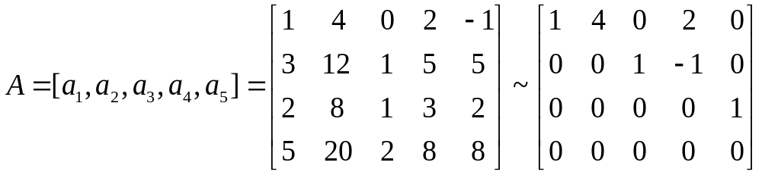


Slide 20
Bases for Col A
THEOREM 6
The pivot columns of a matrix A form a basis for Col A.
Homework: 4.3 Exercises 2,8,15,16

