Slide 1
Chapter 4 Vector Spaces
4.1 Vector spaces and Subspaces
    向量空间 和 子空间
4.2 Null Space and Column Space
    零空间 和 列空间
4.3 Linearly independent sets, bases
4.4 Coordinate systems 坐标系
4.5 The dimension of a vector space
    维数
4.6 Rank 秩

Slide 2
4.4 Coordinate systems 坐标系
THEOREM 7
The Unique Representation Theorem
Let B = { b₁, …, b_{n} } be a basis for a vector space V. Then for each x in V, there exists a unique set of scalars c₁, …, c_{n} such that
x = c₁b₁+ … + c_{n}b_{n}.

Slide 3
THEOREM 7
PROOF Let
x = c₁b₁+ … + c_{n}b_{n}
and
x = d₁b₁+ … + d_{n}b_{n}
then
0= x - x = (c₁-d₁)b₁+ … + (c_{n}-d_{n}) b_{n，……}

Slide 4
DEFINITION
Suppose B = {b₁, …, b_{n} } is a basis for V and x is in V. The coordinates of x relative to the basis B ( or the B-coordinates of x) are weights c₁, …, c_{n} such that
x = c₁b₁+ … + c_{n}b_{n}.

Slide 5
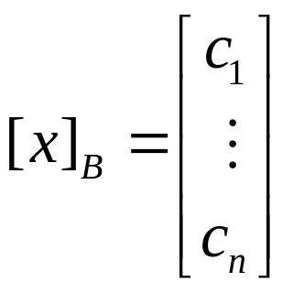
If c₁, …, c_{n} are the B-coordinates of x, then the vector in R^{n}
is the coordinate vector of x ( relative to B), or the B-coordinate vector of x. The mapping x→[x]_{B} is the coordinate mapping (determined by B).
Homework: 4.4 Exercises 2, 4

Slide 6
4.5 The dimension of a vector space
THEOREM 9
If a vector space V has a basis B = {b₁, …, b_{n}}, then any set in V containing more than n vectors must be linearly dependent.

Slide 7
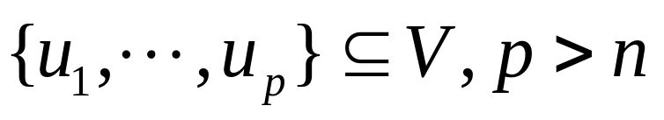
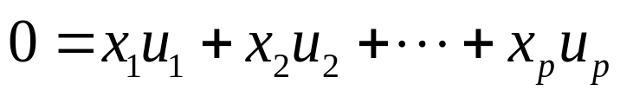
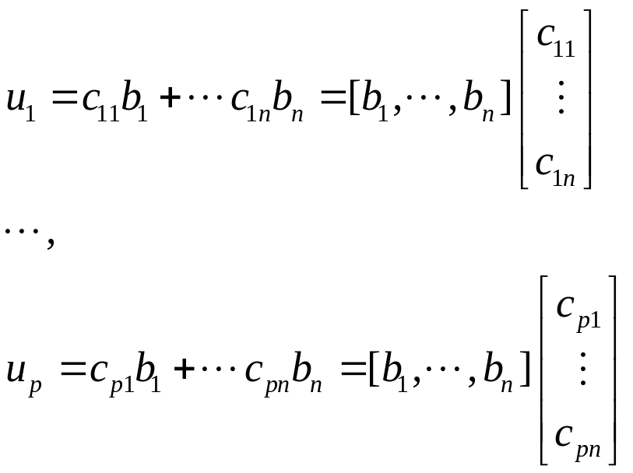
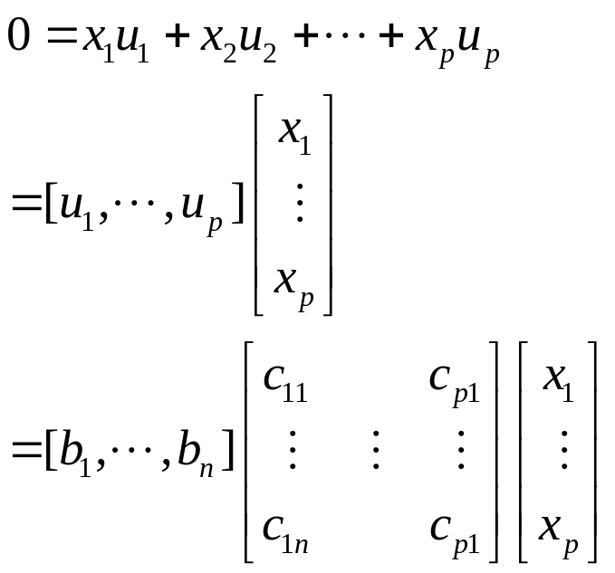
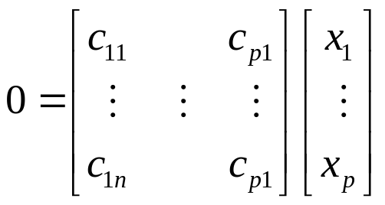
PROOF of THEOREM 9
Let

Slide 8
THEOREM 10
If a vector space V has a basis of n vectors, then every basis of V must consist of exactly n vectors.

Slide 9
DEFINITION
If V is spanned by a finite set, then V is said to be finite-dimensional, and the dimension of V, written as dimV, is the number of vectors in a basis for V. The dimension of the zero vector space {0} is defined to be zero. If V is not spanned by a finite set, then V is said to be infinite-dimensional.

Slide 10
THEOREM 11
Let H be a subspace of a finite-dimensional vector space V. Any linearly independent set in H can be expanded, if necessary, to a basis for H. Also, H is finite-dimensional and
dimH ≤ dimV.

Slide 11
THEOREM 12
The Basis Theorem
Let V be a p-dimensional vector space, p≥ 1. Any linearly independent set of exactly p elements in V is automatically a basis for V. Any set of exactly p elements that spans V is automatically a basis for V.

Slide 12
The Dimensions of Nul A and Col A
The dimension of Nul A is the number of free variables in the eqution Ax = 0, and the dimension of ColA is the number of pivot columns in A.
Homework: 4.5 Exercises 2, 4

Slide 13
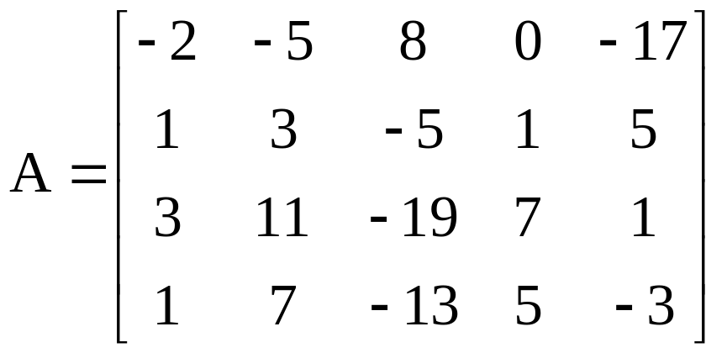
4.6 Rank
The Row Space
Row A =? COL A^{T}

Slide 14
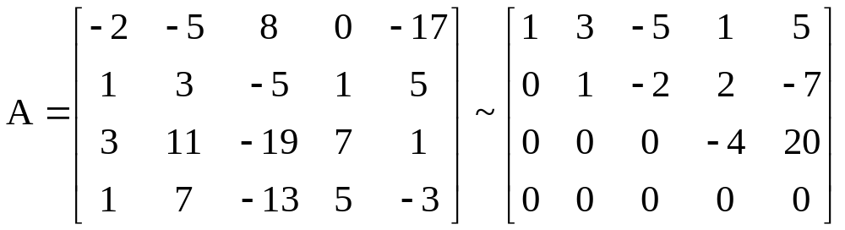
THEOREM 13
If two matrices A and B are row equivalent, then their row spaces are the same.
If B is in echelon form, the nonzero rows of B form a basis for the row space of A as well as for that of B.

Slide 15
DEFINITION
The rank of A is the dimension of the column space of A.

Slide 16
THEOREM 14
The Rank Theorem
The dimensions of the column space and the row space of an m×n matrix A are equal. This common dimension, the rank of A, also equals the number of pivot positions in A and satisfies the equation
rank A + dim Nul A = n .

Slide 17
Rank and the Invertible Matrix Theorem
THEOREM
The Invertible Matrix Theorem
Let A be an n×n matrix. Then the following statements are each equivalent to the statement that A is an invertible matrix.
m. The columns of A form a basis of R^{n}.
n. Col A = R^{n}.
o. dim Col A = n.
p. rank A = n.
q. Nul A = {0}.
Homework:4.6 Exercises 2,4,14,31

Slide 18


