Slide 1
Chapter 5 Eigenvalues and Eigenvectors
5.1 Eigenvectors and Eigenvalues
    特征向量 和 特征值
5.2 The Characteristic equation
    特征方程
5.3 Diagonalization 对角化

Slide 2
5.1 Eigenvectors and Eigenvalues
DEFINITION
An eigenvector of an n×n matrix A is a nonzero vector x such that Ax=λx for some scalar λ. A scalar λ is called an eigenvalue of A if there is a nontrivial solution x of Ax=λx; such an x is called an eigenvector corresponding to λ.

Slide 3
5.1 Eigenvectors and Eigenvalues
定义
若存在非零向量x和标量λ ，使得Ax=λx，则称λ为A的特征值，称x为与λ对应的特征向量。

Slide 4
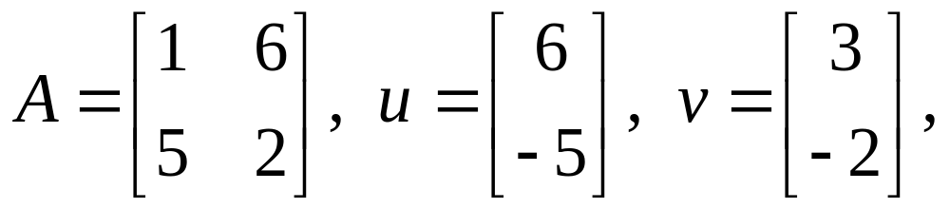
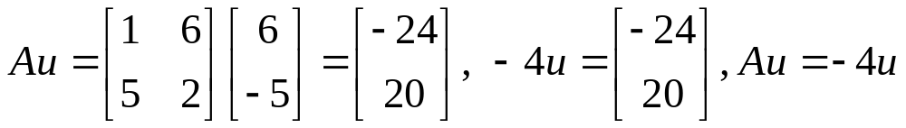
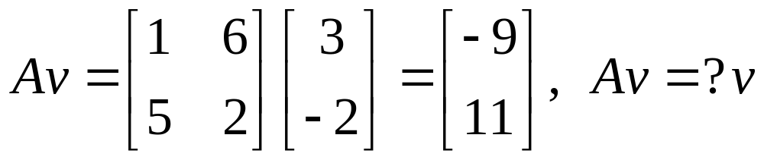
EXAMPLE

Slide 5
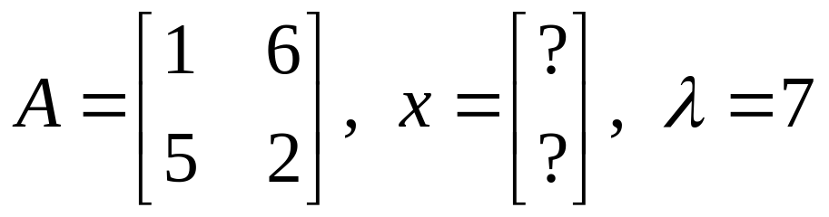

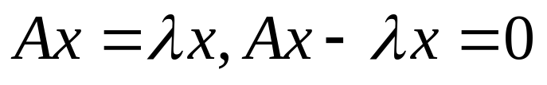
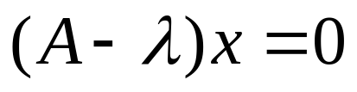
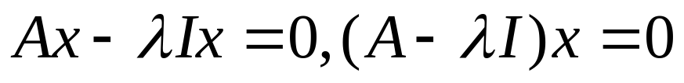
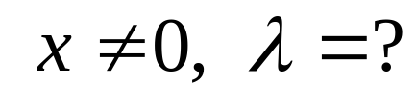
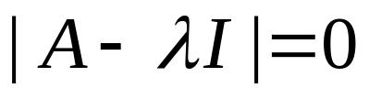
EXAMPLE
λ is an eigenvalue of A if and only if the equation (A-λI)x =0 has a nontrivial solution.

Slide 6
EXAMPLE
λ 是矩阵 A 的特征值 当且仅当 (A-λI)x =0 有非零解；当且仅当A-λI不可逆；当且仅当

Slide 7
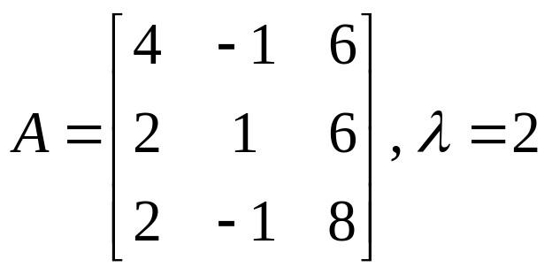
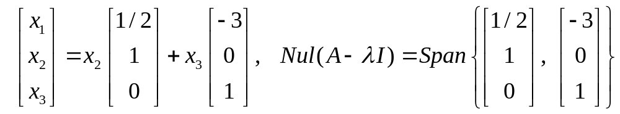
EXAMPLE (eigenspace) 特征空间

Slide 8
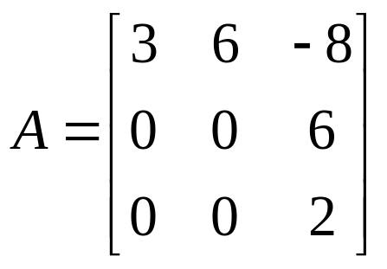
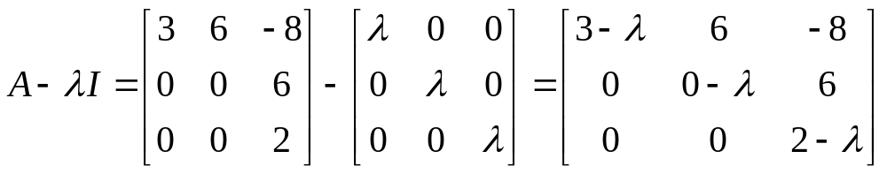
THEOREM 1
The Eigenvalues of a triangular matrix are the entries on its main diagonal.

Slide 9
THEOREM 2
If v₁, v₂,…, v_{r} are eigenvectors that corresponding to distinct Eigenvalues λ₁, λ₂,…,λ_{r} of an n×n matrix A, then the set
{v₁, v₂,…, v_{r} } is linearly independent.
Homework: 5.1 exercises 10, 25, 27, 29

Slide 10
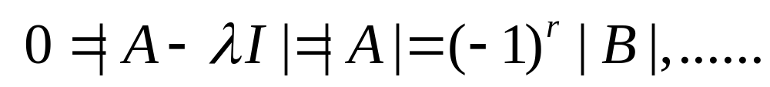
5.2 The Characteristic equation
THEOREM
The Invertible Matrix Theorem (continued)
Let A be an n×n matrix. Then A is invertible if and only if :
s. The number 0 is not an eigenvalue of A.
t. The determinant of A is not zero.
Proof :

Slide 11
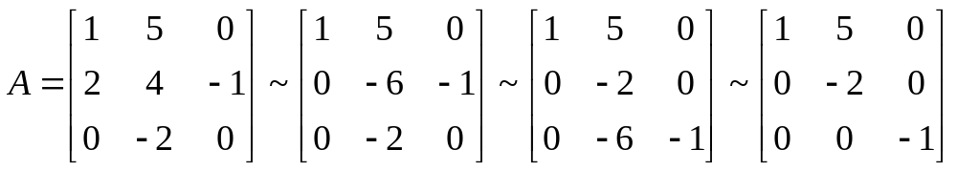

Slide 12
The Characteristic Equation
The scalar equation det (A –λI ) = 0 is called the characteristic equation of A, and
A scalar λ is an eigenvalue of an n×n matrix A if and only if λ satisfies the characteristic equation
det (A – λI ) = 0.
If A is an n×n matrix, then det (A – λI ) is a polynomial of degree n called characteristic polynomial of A.

Slide 13
Multiplicity 重数
Similarity 相似
If A and B are n×n matrices, then A is similar to B if there is an invertible matrix P such that P⁻¹AP = B, or equivalently, A = PBP⁻¹. A and B are similar. Changing A into P⁻¹AP is called a similarity transformation （相似变换）.

Slide 14
THEOREM 4
If n×n matrices A and B are similar, then they have the same characteristic polynomial and hence the same Eigenvalues (with the same multiplicities. )

Slide 15
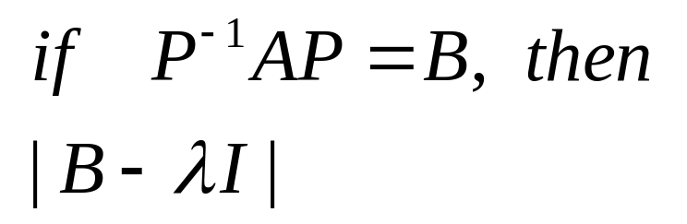
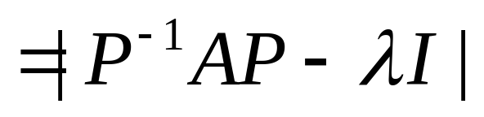
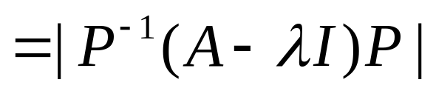


Proof
Homework: 5.2 exercises 2, 19, 20

Slide 16
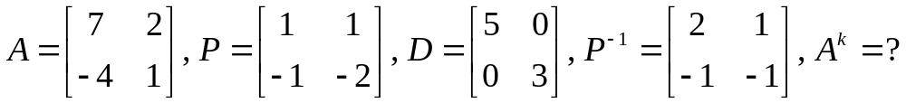
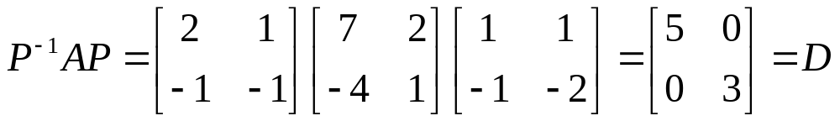
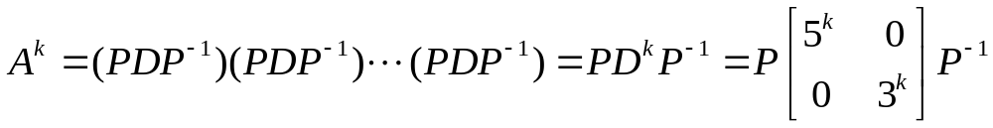
5.3 Diagonalization
EXAMPLE
A square matrix A is said to be diagonalizable
if A is similar to a diagonal matrix.

Slide 17
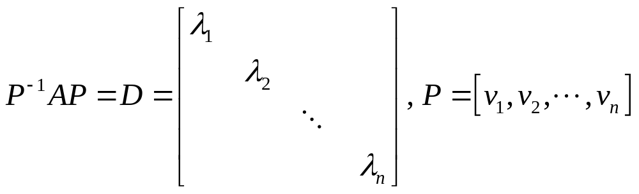
THEOREM 5
The Diagonalization Theorem
An n×n matrix A is diagonalizable if and only if A has n linearly independent eigenvectors.
Proof
⇒:

Slide 18

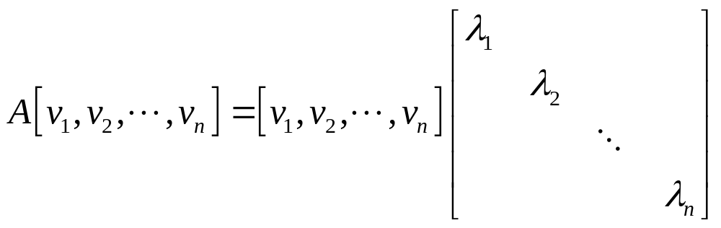
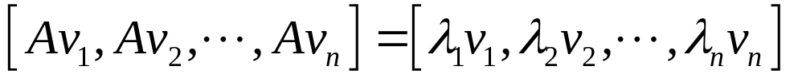

Slide 19
⇐:
v₁, v₂,…, v_{n} are eigenvectors that corresponding to eigenvalues λ₁, λ₂,…,λ_{n} of an n×n matrix A,

Slide 20
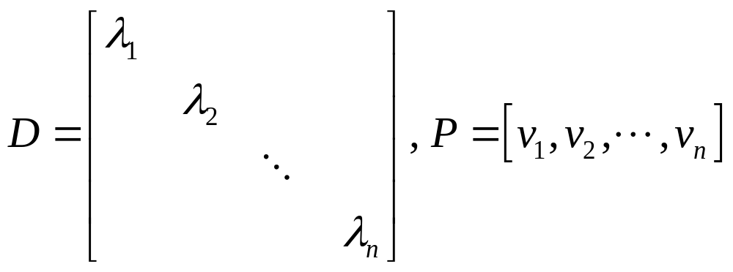
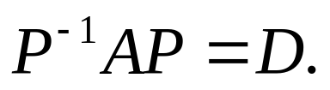
⇐:
v₁, v₂,…, v_{n} are eigenvectors that corresponding to eigenvalues λ₁, λ₂,…,λ_{n} of an n×n matrix A,

Slide 21
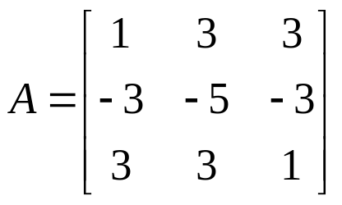
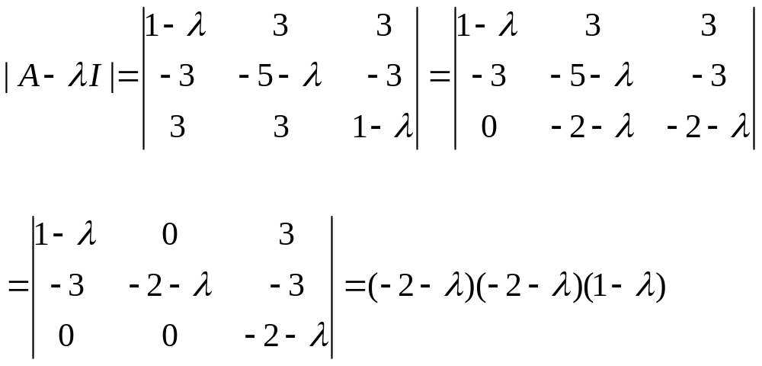
EXAMPLE
Diagonalize the matrix A, if possible.

Slide 22
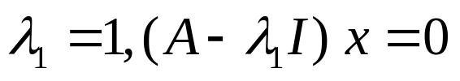
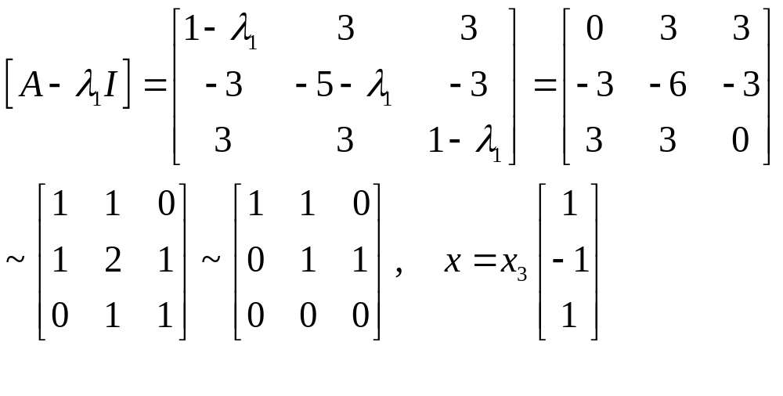
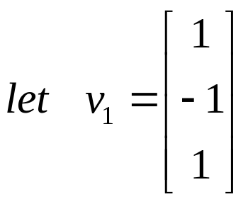

Slide 23
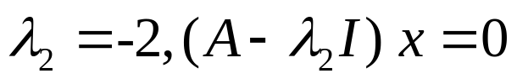
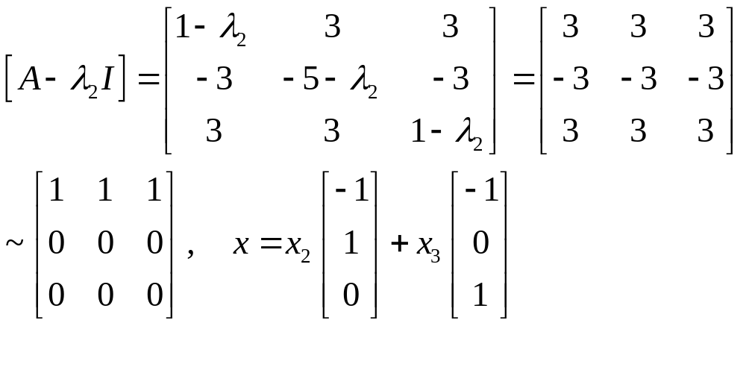
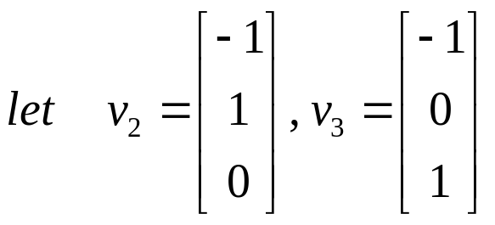

Slide 24
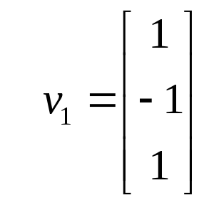
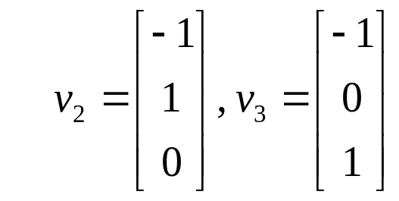
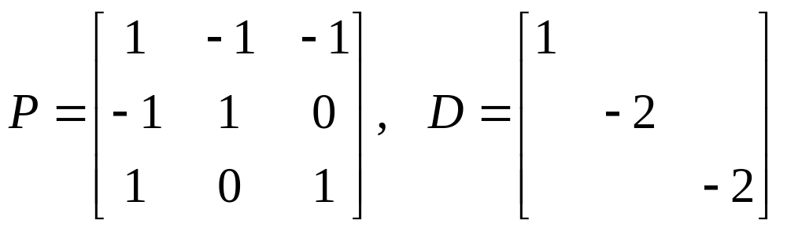
{v₁, v₂, v₃ } is linearly independent.
Let
then P⁻¹AP=D.

Slide 25
THEOREM 6
An n×n matrix with n distinct Eigenvalues is diagonalizable.
Homework: 5.3 exercises 8, 27, 31, 32.

